Slide 1
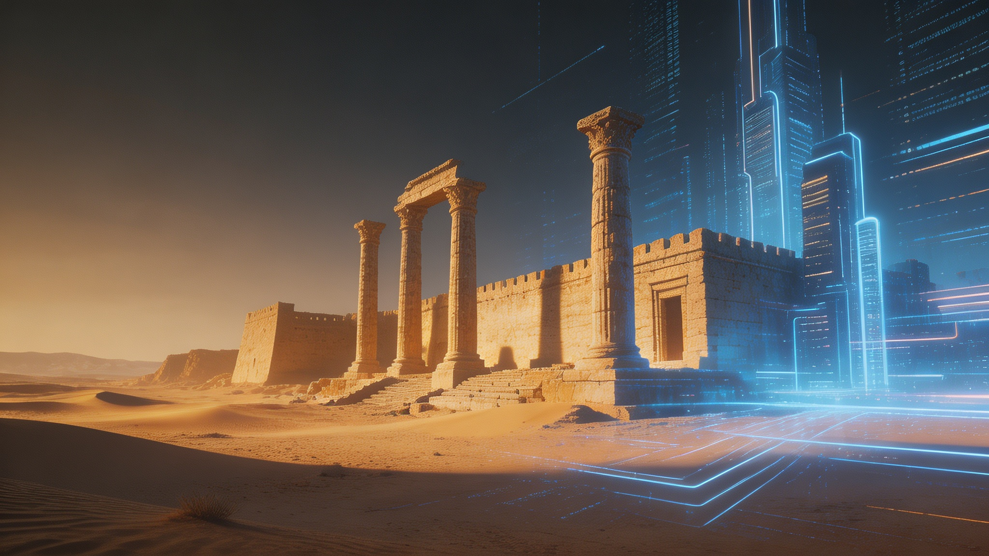
Archaeology and Technological Civilization
How Technology Reconnects Civilizations
Liu Yumeng 2230026108
Notes:
"Archaeology and Technological Civilization

Slide 2

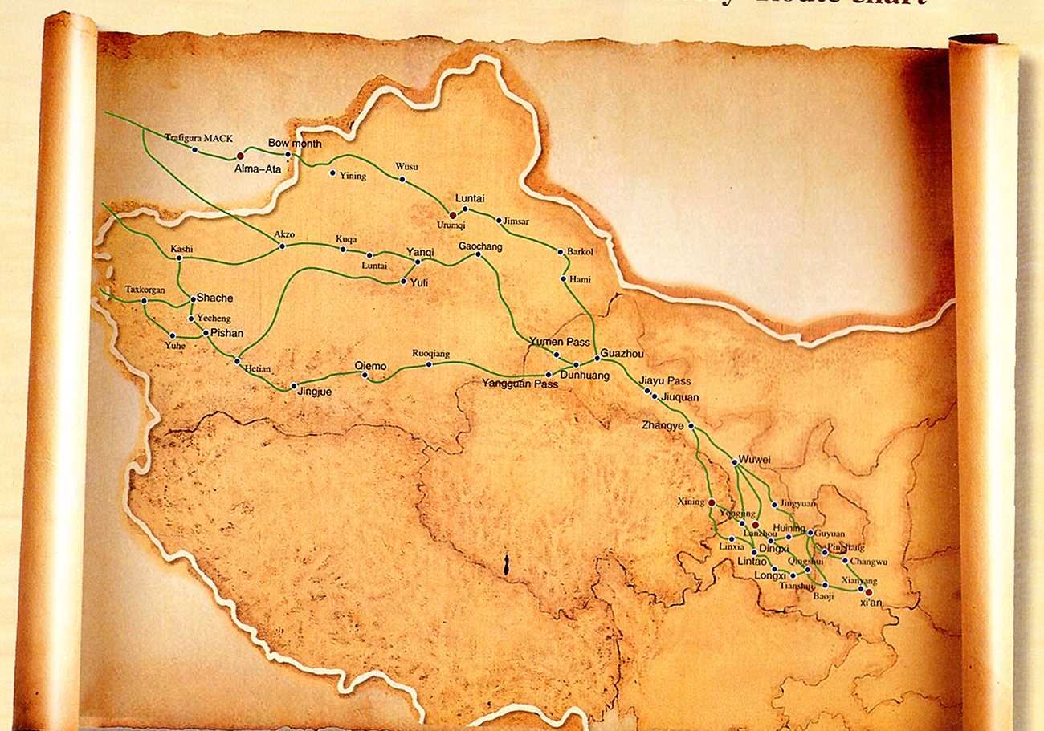
Research Coordinates
ACADEMIC DISCIPLINE
Major: Archaeology
CIVILIZATIONAL THEME
Focus: Technological Civilization
HISTORICAL SCOPE
Timeline: Silk Road Era • Contemporary Globalization
Keywords: Cross-civilizational exchange | Digital Silk Road | Cultural heritage
Notes:
This project combines Archaeology and Technological Civilization.
I chose the Silk Road Era and Contemporary Globalization as my focus.
The Silk Road connected civilizations in the past, while technology is creating new connections today.
This project explores the relationship between these two forms of connection.

Slide 3
Why This AI Tool?
TOOL USED
即梦 AI video generation（Seedence 2.0）
PURPOSE
Cinematic storytelling
FUNCTION
Visualizing impossible historical scenes
RESULT
AI reconstruction and immersive experience
"Technology is not only studying history, but reactivating history."
Notes:
For this project, I used JiMeng AI video generation.
I chose it because it is one of the most popular AI video tools, and the videos it creates are very realistic.
It helped me visualize historical scenes and create a more immersive experience.

Slide 4
Why These Historical Periods?
“The Silk Road was not a single road, but a network of cultural exchange.” (UNESCO, n.d.)
The Ancient Silk Road
The Digital Silk Road
• Connected China, Central Asia, the Middle East, and Europe in a vast network.
• A conduit for the exchange of trade goods, religious beliefs, cultural practices, and scientific knowledge.
• Leveraging modern technology to build a new bridge for global interaction.
Keywords: Trade · Knowledge Transfer · Civilizational Exchange · Global Connection
Notes:
I selected the Ancient Silk Road because it was an important network of cultural exchange.
It connected China, Central Asia, the Middle East, and Europe through trade and knowledge exchange.
According to UNESCO, the Silk Road was not a single road but a network of cultural exchange.
Today, the Digital Silk Road connects people through technology and global communication.

Slide 5
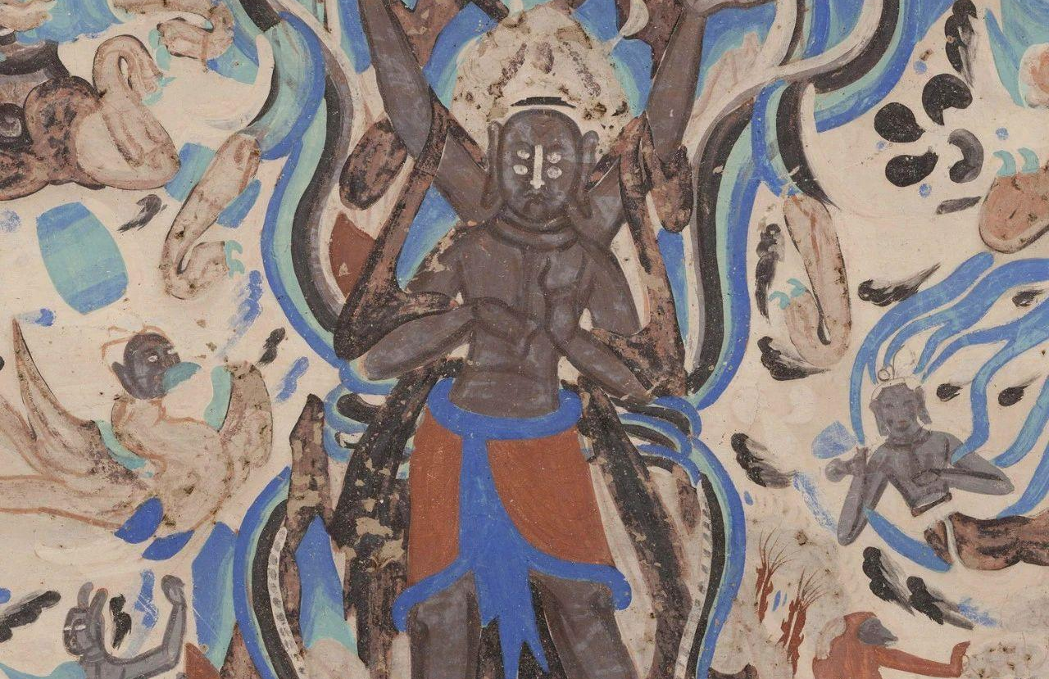
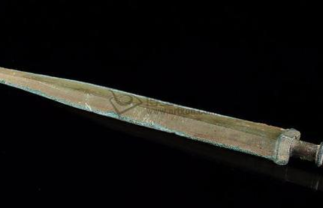

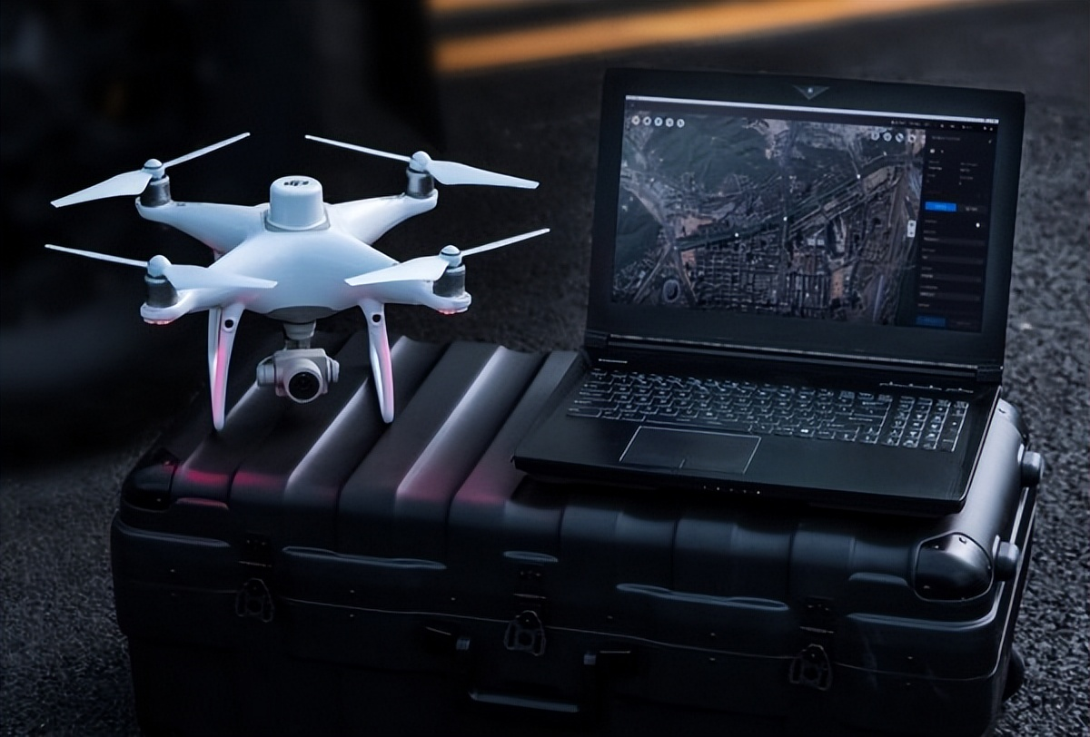
What Happened Historically?
“Archaeology is not the search for treasures, but for knowledge.” (Wheeler, 1954)
Historical Crossroads
Modern Archaeological Lens
•Buddhism spread from India to China, enriching art & philosophy. • Chinese silk and technologies traversed continents to Europe. •Islamic culture deeply interacted with Chinese civilization.
•3D scanning & VR preserve artifacts in virtual reality. •AI analysis uncovers hidden patterns in ancient data. •Drone mapping reveals forgotten landscapes.
"Technology helps civilizations reconnect."
Notes:
Historically, the Silk Road connected different civilizations through trade, religion, and culture.
For example, Buddhism spread to China, Chinese silk reached Europe, and Islamic culture interacted with Chinese civilization.
According to Mortimer Wheeler, "Archaeology is not the search for treasures, but for knowledge."
Today, technologies such as 3D scanning, VR, AI, and drone mapping help archaeologists study and preserve cultural heritage.

Slide 6
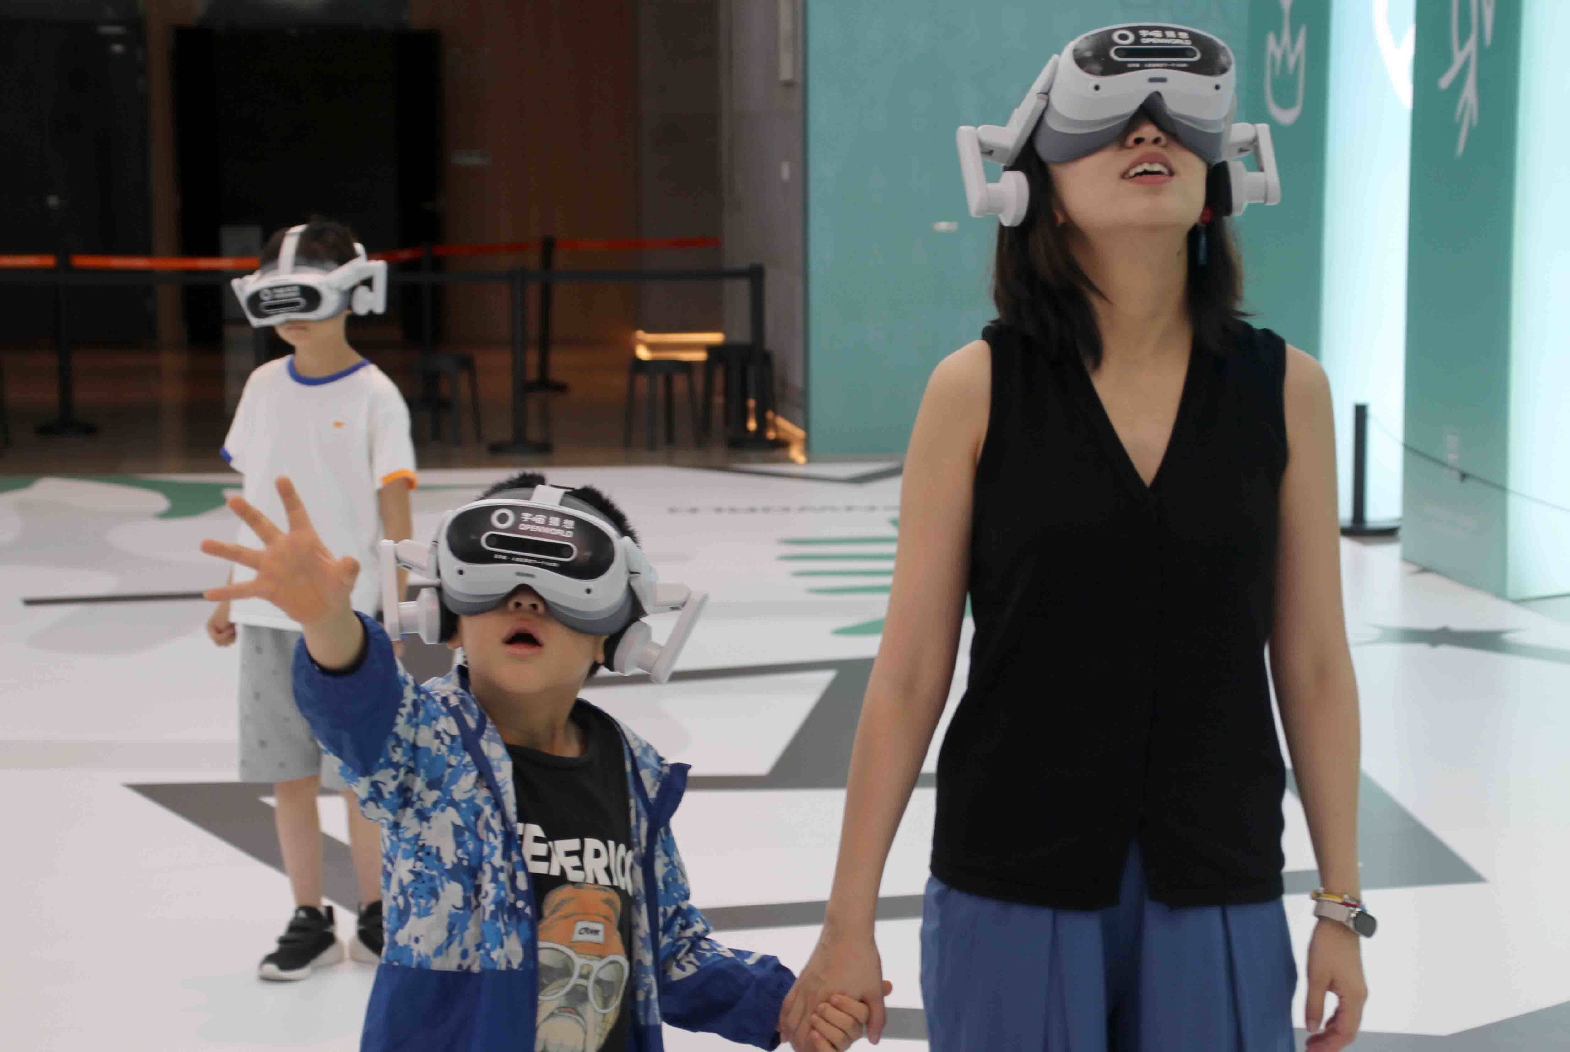
What Does It Mean Today?
Disconnection from History
Young people are becoming increasingly distant from traditional historical narratives and physical artifacts.
Digital technologies have a profound impact on the way we experience and access culture (UNESCO, n.d.).
Immersive Digital Reconnection
VR museums and interactive digital exhibitions create vivid, immersive experiences that bring history to life.
Safeguarding Heritage
Advanced technology provides new methods to protect, restore, and preserve fragile cultural heritage.
Global Accessibility
Digital archives break down geographical barriers, enabling worldwide access to humanity’s shared past.
"Technological civilization reconnects humanity with the past."
Notes:
This topic is important today because technology is changing the way people connect with history.
Virtual museums and digital exhibitions make cultural heritage more accessible.
According to UNESCO, digital technologies have changed the way people experience and access culture.
Technology is helping us reconnect with the past.

Slide 7
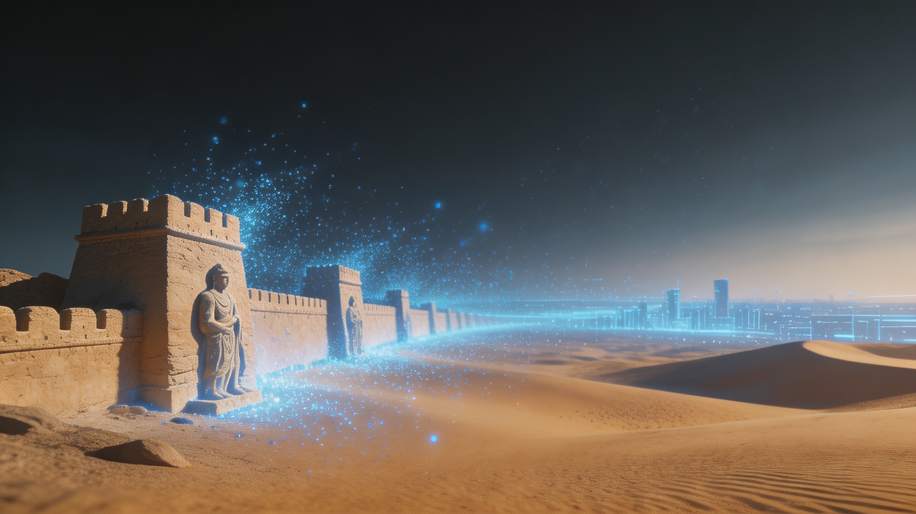
Link to the visual work：https://2230026108.github.io/spuseum/
Conclusion
Ancient civilizations once connected the world through the Silk Road. Today, technology is becoming a new bridge between civilizations.
"Technology is not replacing archaeology. Technology is giving archaeology a new life.
Technology is becoming a new bridge between civilizations."
Notes:
In conclusion, the Silk Road once connected civilizations through trade and cultural exchange.
Today, technology is becoming a new bridge between civilizations.
Technology is not replacing archaeology.
Instead, it is helping us preserve, understand, and share human history.
Thank you.

Slide 8
Reference
UNESCO. (n.d.). About the Silk Roads. UNESCO. https://www.unesco.org/en/silk-roads/about-silk-roads
UNESCO. (n.d.). Culture and digital technologies. UNESCO. https://www.unesco.org/en/culture-and-digital-technologies
Wheeler, M. (1954). Archaeology from the earth. Oxford University Press.
UNESCO. (n.d.). Culture and digital technologies. UNESCO. https://www.unesco.org/en/culture-and-digital-technologies

Slide 9
Thank you

