Slide 1
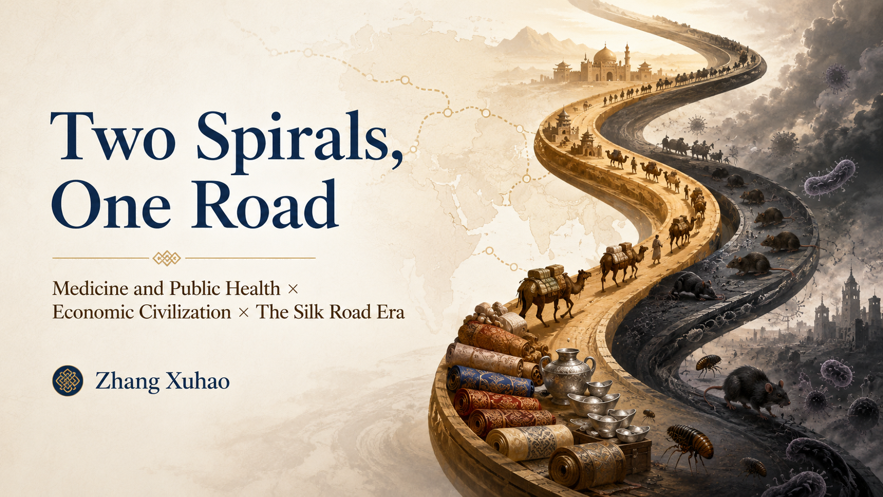

Slide 2
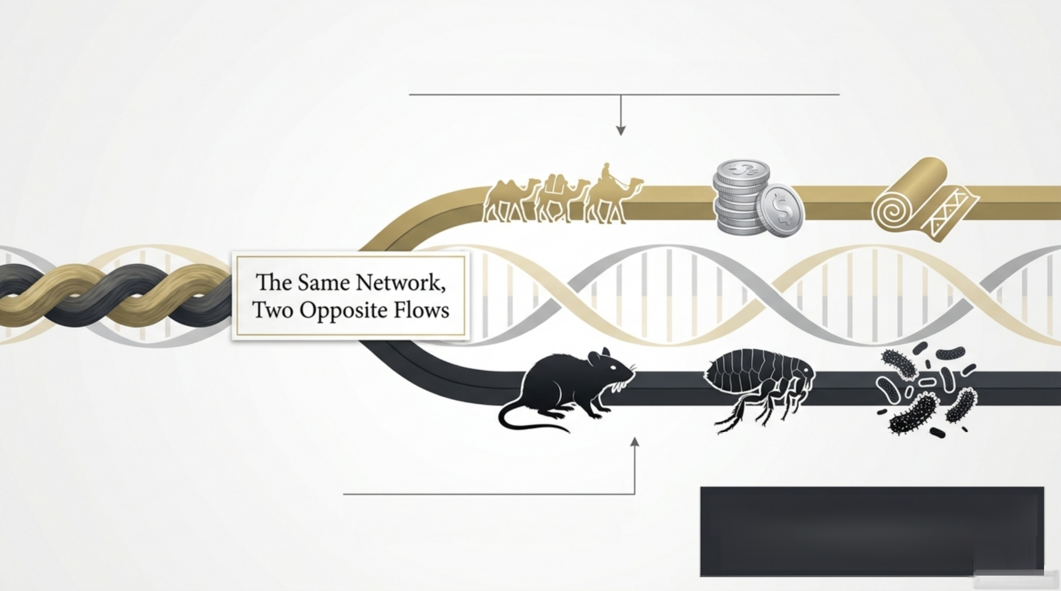

Networks that connect civilizations through trade...
_{n} _{it} The trade route was also
the transmission route.
…are the exact same networks that transmit disease between them.
dise
s
e

Slide 3
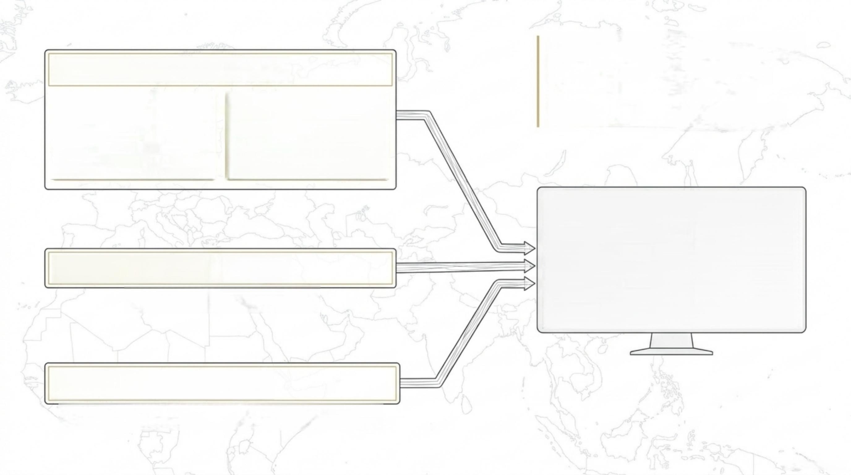
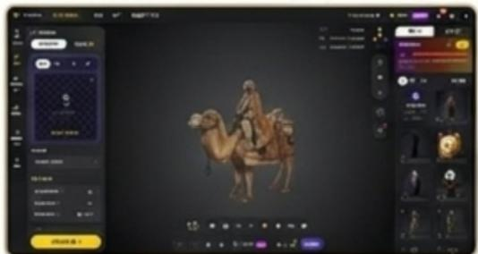
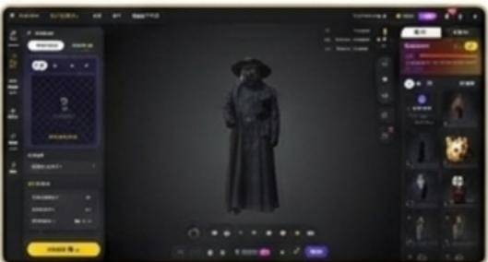
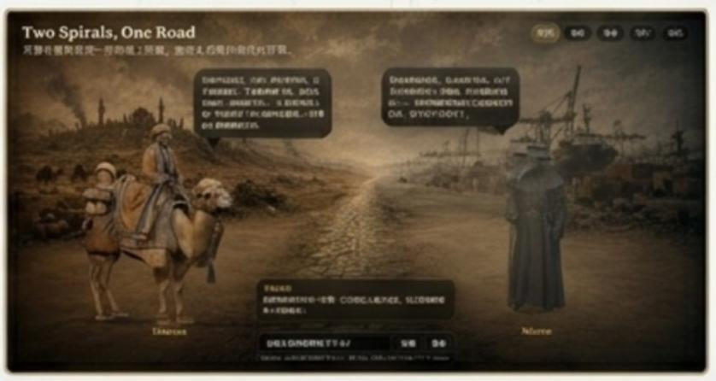
“A multi-tool pipeline, woven by hand,shares the same
shape as the argument:
Many flows, one network.”
Visual Generation: Tripo AI
Environment: GPT Image 2
Historical Landscape Generation
Logic &Assembly: Codex
Character System Prompts,Knowledge Base &React Code

Slide 4
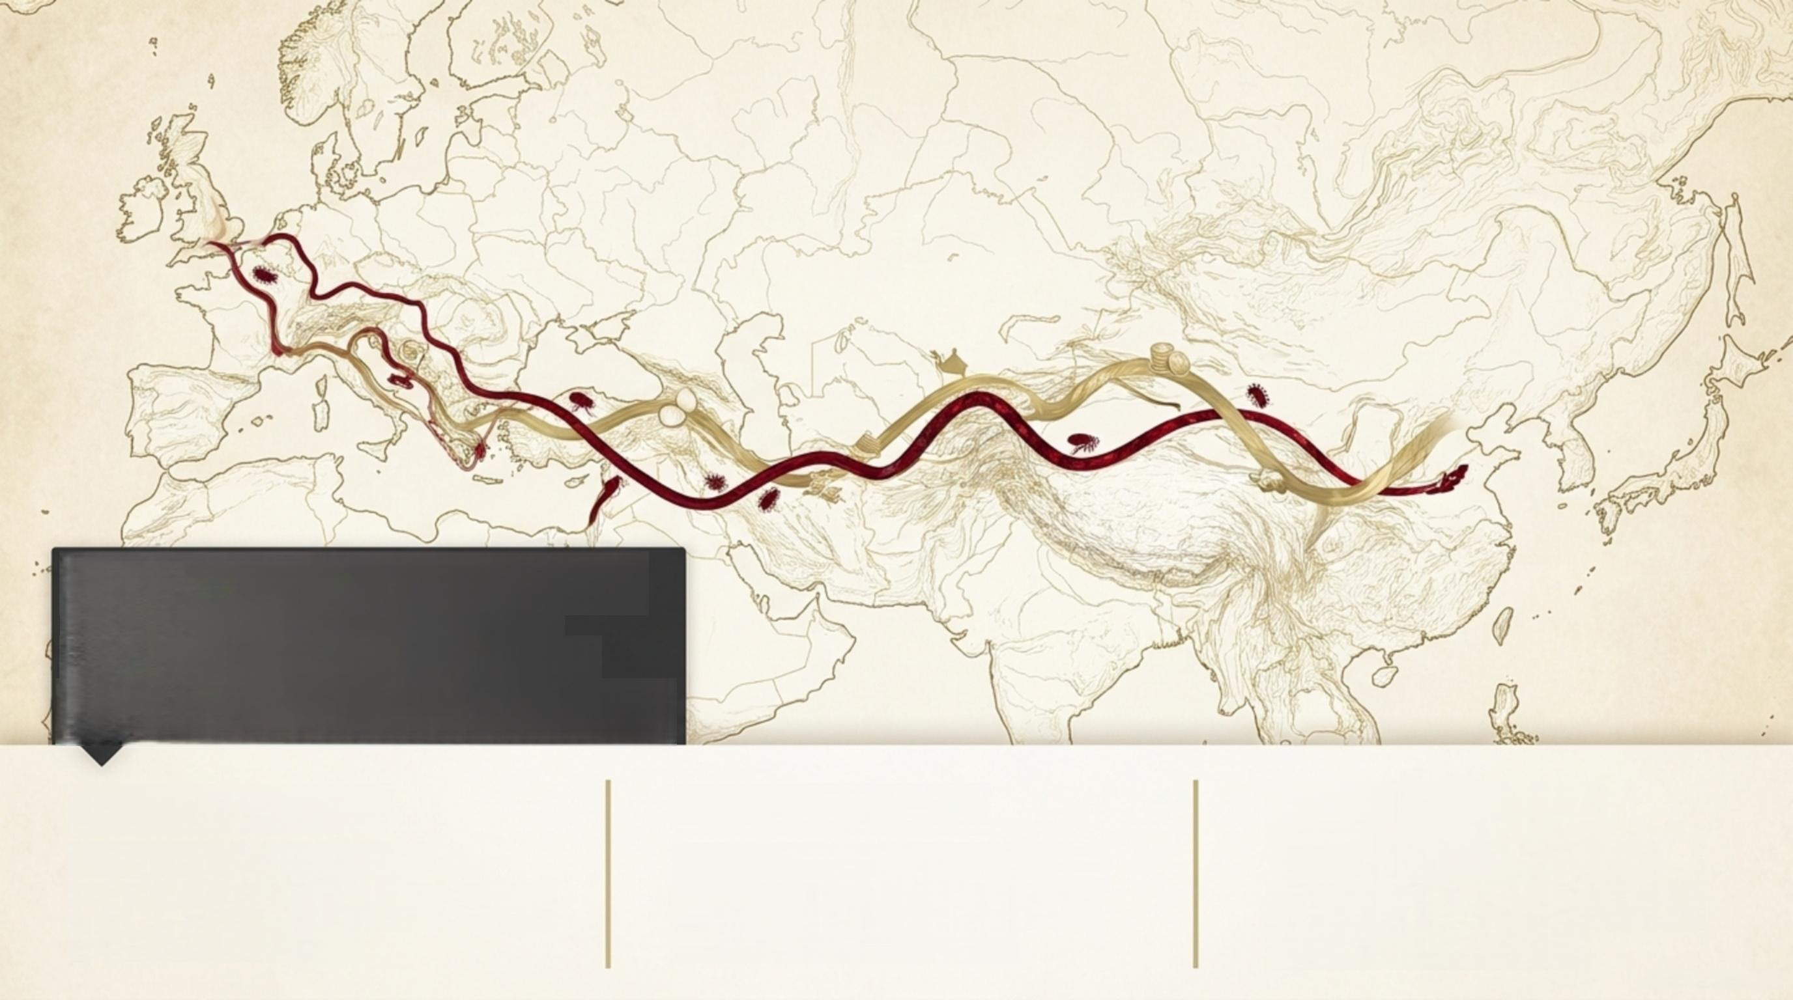
Why this period? This is the precise historical moment when trade,
disease,and formal public health
responses became inextricably linked.
1.The Network
Humanity's first massive,
cross-civilizational, long-distance
trade infrastructure.
2.The Disaster
A regional microbe scales into a cross-continental pandemic via commercial arteries.
3.The Response
1377-The Adriatic port of
Ragusa passes a formal 40-day quarantine ordinance.

Slide 5
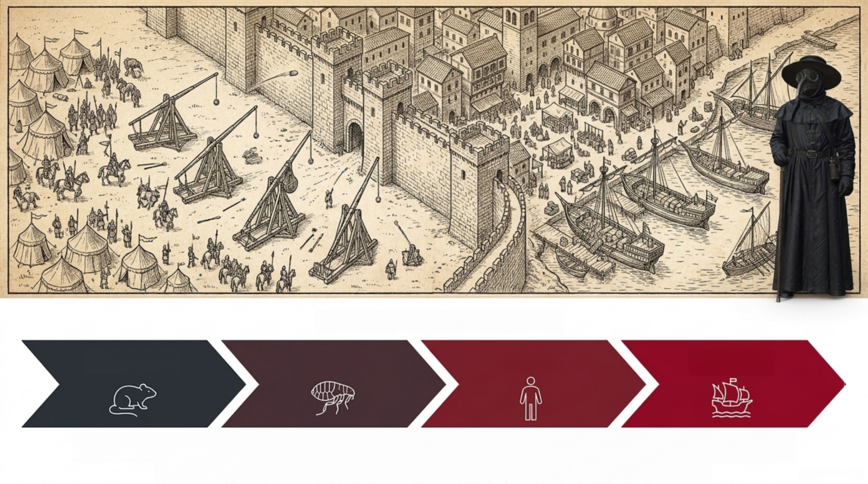
The Chain of Transmission
Reservoir Vector Host Mobility
War brought the reservoir. The port provided the mobility. A local siege became long-distance
transmission as merchants carried the infection into the Mediterranean.

Slide 6

1346 vs. Today
The Network
Caravans &Galleys→Airlines &Global Supply Chains
SDG 1
(No Poverty)
Millions pushed back into extreme poverty.
SDG 8
(Decent Work/Growth)
Global supply chain interruptions.
The Threat
Yersinia pestis → SARS-CoV-2
Public Health Power
Ragusa City-State→National Sovereignty (Local Control) VS.WHO(Fragmented
Global Control)
SDG 10
(Reduced Inequalities)
Asymmetric vaccine access favoring
wealthy nations.
SDG 17
(Partnerships)
The WHO can warn
and coordinate, but cannot command
sovereign states.
The microbe changed. The structural failure did not.

Slide 7
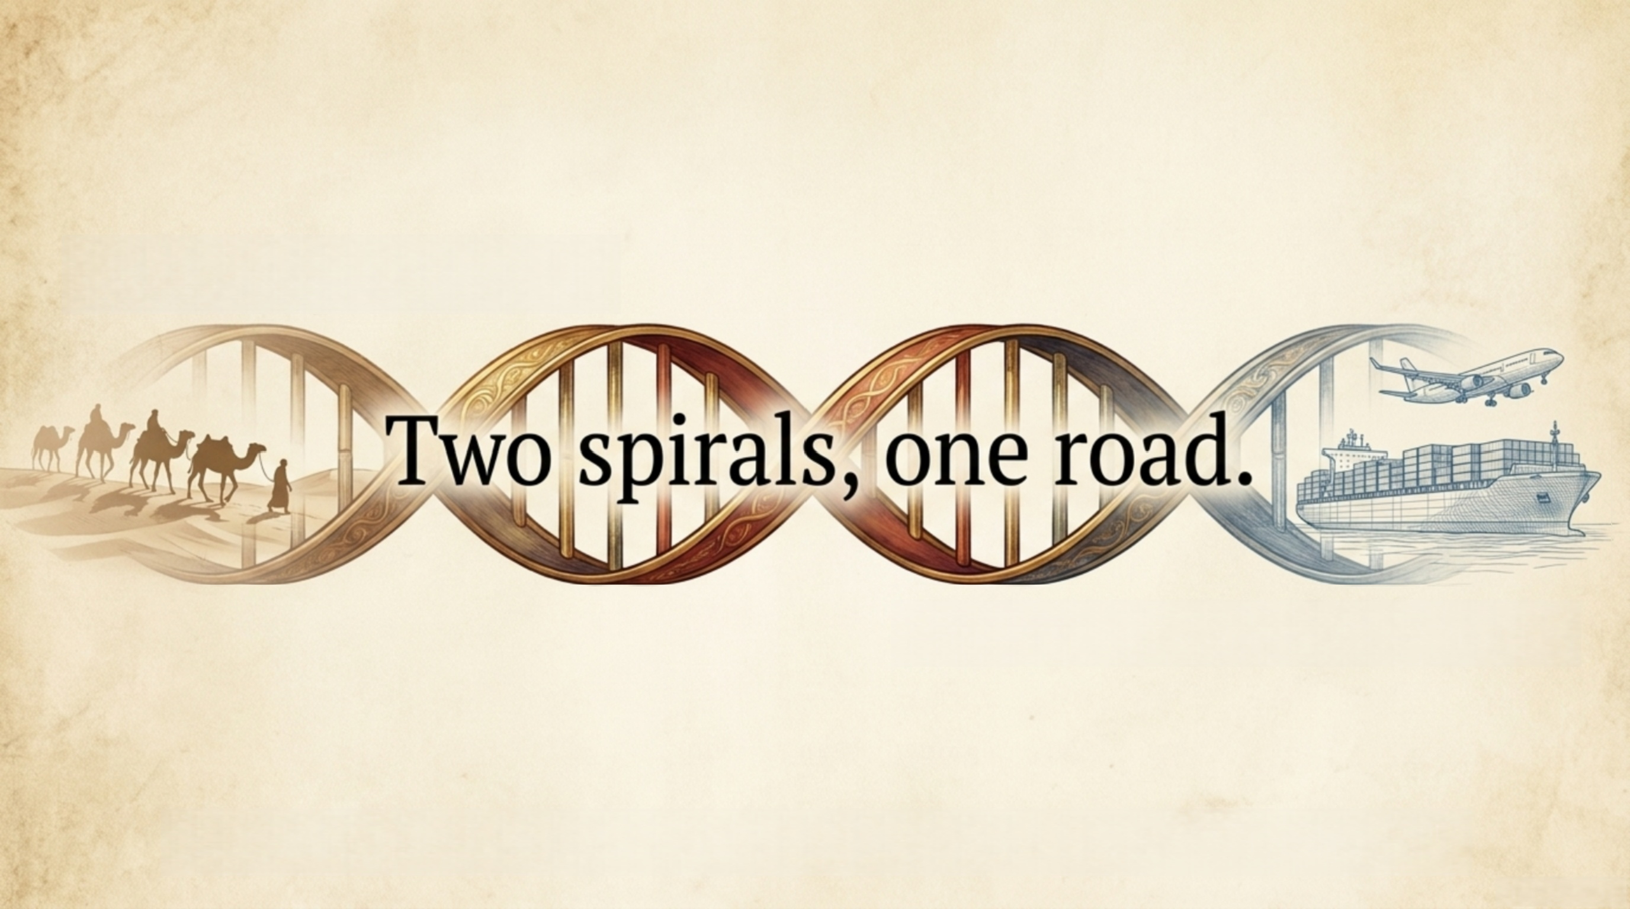
Build a global trade network...
…and you build a highway for disease.
The question of which way the next strand twists is no longer history’s question. It is ours.

