Slide 1
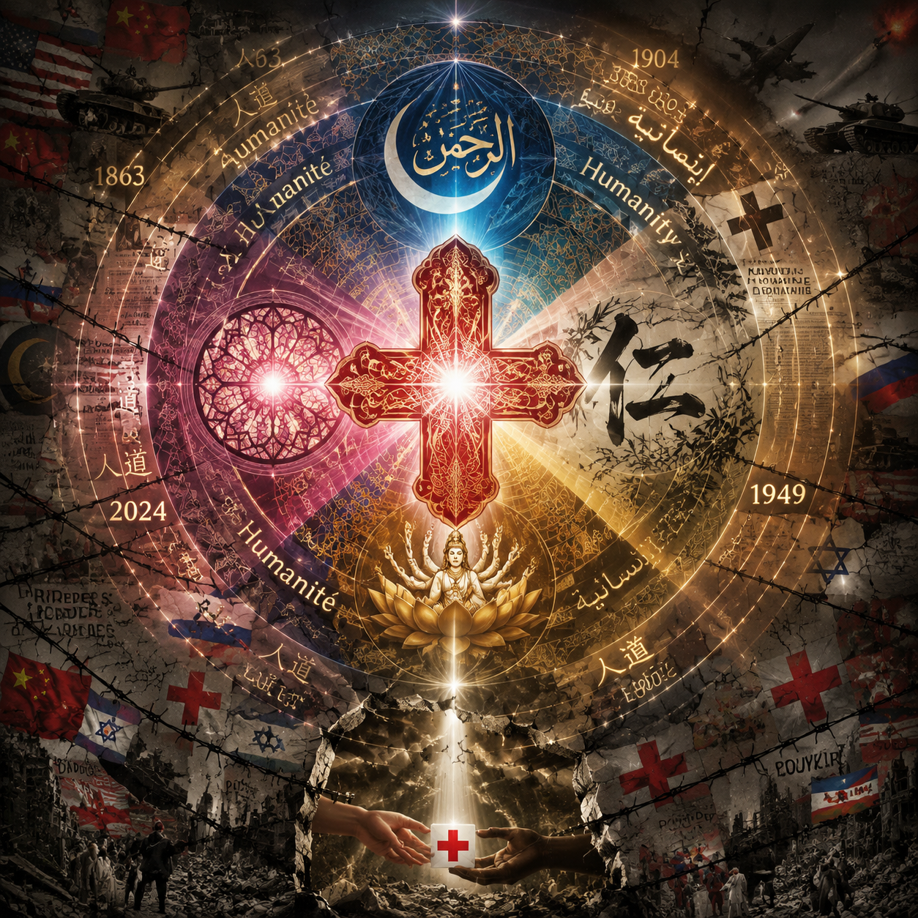
THE FUTURE PROSPECTS OF CIVILIZATION
Translating Humanity
The Cross-Civilizational Journey of a Concept
Medicine / Public Health × Humanistic Civilization
Assignment Two — AI Visual Work

Slide 2
AI Visual Work: "The Fractured Halo"
A mandala of convergence and fracture.
This AI-generated artwork visualizes the cross-civilizational journey of "humanity" — from its sacred origins to its contemporary political instrumentalization.
The Sacred Core
At the center, a Red Cross woven from four civilizational line languages — Chinese ink wash, Islamic geometry, Gothic tracery, and Buddhist scrollwork.
The Fractured Halo
The outer ring reveals barbed wire, tanks, and political borders — the sacred light torn apart by geopolitics.
The Enduring Beam
Yet at the bottom edge, a single ray of light pierces through — symbolizing the resilience of cross-cultural compassion.
02

Slide 3
Why This AI Tool?
THE MANDALA CHOICE
AI CAPABILITIES
A Universal Visual Language
Synthesizing Civilizations
The mandala form is shared across civilizations:
● Buddhist tradition — sacred diagrams representing cosmic order
● Islamic art — geometric arabesques as meditation on the infinite
● Hindu cosmology — yantras as spiritual focal points
By choosing the mandala structure, the AI tool became not just a renderer, but a cultural translator — embodying the very argument of the work.
1. Cross-Cultural Synthesis
The AI merged four distinct visual vocabularies — Chinese ink wash, Islamic geometry, Gothic stained glass, Buddhist iconography — into a single coherent composition.
2. Radial Gradient Narrative
The tool rendered the "sacred-to-fractured" gradient — divine light at center, war-torn fragmentation at edges — impossible to achieve with traditional design software.
3. Argument-as-Image
The concentric ring structure mirrors the historical thesis: convergence → diffusion → crisis → hope.
03

Slide 4
Why These Periods? (1863–2024)
1863
1904
1949
2024
Birth of Humanitarianism
Henri Dunant witnesses the Battle of Solferino and founds the Red Cross in Geneva. The concept of neutral, unconditional aid to the wounded is born.
Period V — Modern China
Translation to the East
China joins the Red Cross movement. "Humanity" is translated as "人道" (Rendao) — resonating deeply with Confucian ethics.
Period V — Modern China
Codification & Politicization
The Geneva Conventions codify humanitarian law, but Cold War dynamics begin turning aid into a geopolitical tool.
Period VI — Cold War Era
Instrumentalization Crisis
"Humanitarian aid" is weaponized — Gaza, Ukraine, Yemen. The sacred halo fractures.
Period VII — Contemporary
Pattern revealed: Every great leap in humanitarianism is followed by a crisis of instrumentalization.
04

Slide 5
What Happened? — The Sacred Core
The Red Cross was not merely a Western invention — it was a convergence point for four civilizational traditions of compassion.
WEST
EAST
SOUTH
NORTH
Christianity
Confucianism
Buddhism
Islam
Caritas
仁 Ren
慈悲 Cibei
الرحمن Al-Rahman
Love of neighbor as divine duty. Charity as an expression of God's grace flowing through human hands.
Benevolence as the foundation of moral society. The capacity to feel with and care for others.
Compassion for all sentient beings. The bodhisattva ideal of delaying enlightenment to relieve suffering.
The Most Merciful. Mercy as a divine attribute, and the obligation of humans to embody mercy.
At the center of the artwork, these four symbols coexist in harmony — this was the original vision.
05

Slide 6
What Happened? — The Fracture
As "humanity" traveled across cultures, it was translated — and mistranslated:
1863
1904
1949
2024
GENEVA
SHANGHAI
DIPLOMACY
GEOPOLITICS
"Humanité"
Universal, apolitical, unconditional. Aid as a moral imperative transcending national borders.
"人道" Rendao
Resonated with Confucian ethics, but reframed as a marker of "modern civilization" — a tool of cultural diplomacy.
International Law
Codified into the Geneva Conventions, but subject to state sovereignty and political veto.
Weaponized Aid
"Humanitarian intervention" as pretext for conflict. Selective aid as leverage.
The outer ring of the artwork shows this fracture:
barbed wire, tanks, political borders — the sacred halo torn apart.
06

Slide 7
What Does It Mean Today?
The artwork's bottom-right corner — a single beam of light piercing through the cracks — holds the answer.
THE CORE ARGUMENT
COURSE CONNECTION
We are not witnessing the death of humanitarianism, but a test of its resilience.
The four civilizational traditions of compassion remain alive — in grassroots aid workers, in cross-border medical volunteers, in refugee camps where caregivers serve "the Other" regardless of politics.
The future of Chinese and world civilization depends not on erasing differences, but on returning to the translation table where 仁, caritas, cibei, and al-Rahman once sat together.
MEDICINE / PUBLIC HEALTH LENS
Public health knows no borders — COVID-19, H5N1, climate health crises force us to remember: compassion must be practical, not ideological.
07

Slide 8
Thank You
"To heal is to translate — across languages, borders, and civilizations."
OPEN FOR DISCUSSION
Medicine / Public Health × Humanistic Civilization
08

