Slide 1
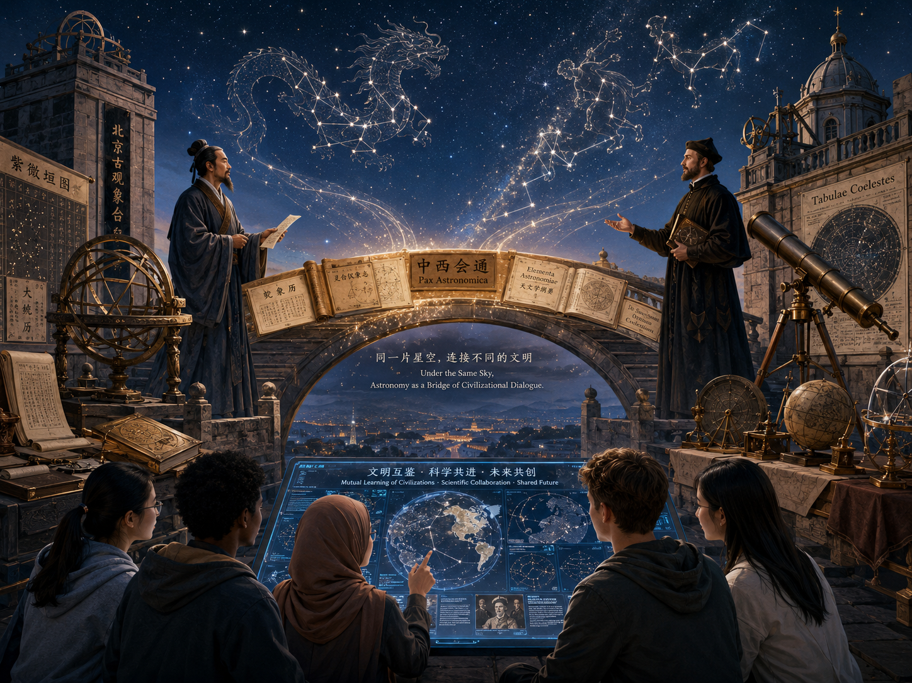
Under the Same Sky
Astronomy as a Bridge of Civilizational Dialogue
Astronomy × Humanistic Civilization | Oral Presentation
Notes:
Good morning everyone. Today, I would like to present my AI visual work titled “Under the Same Sky: Astronomy as a Bridge of Civilizational Dialogue.” My drawn major is Astronomy, and my civilizational theme is Humanistic Civilization. My main argument is that astronomy was not only a scientific discipline, but also a humanistic bridge. Through calendar reform, translation, and astronomical observation, different civilizations learned how to communicate, build trust, and understand one another under the same sky.

Slide 2
Research Coordinates
From a historical encounter to a contemporary humanistic question
Drawn Major
Civilizational Theme
Historical Period
Astronomy
Observation · calendars · star maps · instruments
Humanistic Civilization
Dialogue · education · cultural understanding
Late Ming – Early Qing
Across the Age of Exploration and early Modern China
Core Argument
Astronomy was not only a science of stars and planets. In this historical encounter, it became a bridge for translation, trust, and cross-cultural understanding.
2
Notes:
My research coordinates are Astronomy, Humanistic Civilization, and the late Ming to early Qing period. I chose this period because it shows a clear encounter between Chinese and European astronomical knowledge. The key point is not just that European science entered China. More importantly, astronomy became a language through which different cultures discussed time, order, authority, and knowledge. So my visual work tries to turn a scientific history into a humanistic argument.

Slide 3
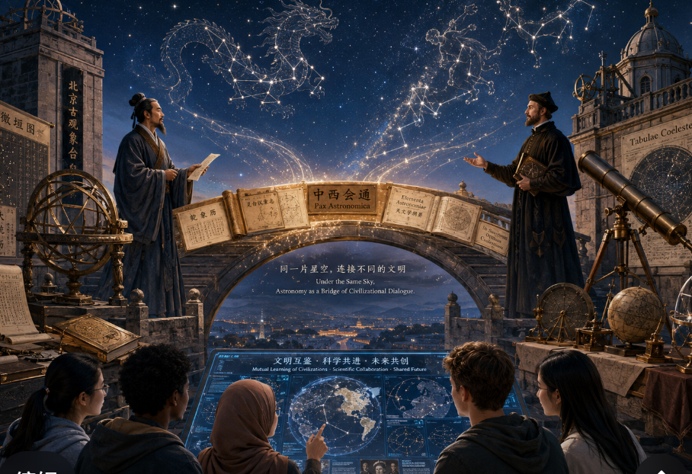
1. Why These AI Tools?
ChatGPT + Pika: from concept to moving visual
ChatGPT
Concept design, prompt refinement, and main symbolic image generation.
Pika
Image-to-video animation: subtle star movement, flowing light, and screen glow.
Simple workflow
Prompt → generate image → upload image to Pika → choose low-motion animation.
ChatGPT helps design the visual argument; Pika turns the still image into a calm cinematic visual.
3
Notes:
First, I used ChatGPT and Pika because they helped me express both the scientific and humanistic parts of my topic. ChatGPT was useful for developing the concept, refining the English prompt, and generating the main symbolic image. Pika was useful for turning the still image into a short moving visual. My process was simple: I wrote and adjusted the prompt in ChatGPT, generated the image, uploaded it to Pika, and used a low-motion animation setting. I wanted only subtle motion, such as twinkling stars, flowing light on the bridge, and a softly glowing AI screen. This keeps the focus on the argument rather than making the image too dramatic.

Slide 4
2. Why This Period?
Late Ming and early Qing China: a strong case of astronomical exchange
Late Ming
Jesuit Contact
Chinese Scholars
Early Qing
Need for calendar reform
and more accurate calculations
European astronomy, mathematics
and instruments entered China
Translation, comparison,
selection and adaptation
Astronomical work became part
of official institutions
Why it fits the assignment
This period shows a real cross-civilizational encounter: astronomy was translated, tested, debated, and connected to society.
4
Notes:
Second, I chose the late Ming and early Qing period because it clearly shows the intersection between astronomy and Humanistic Civilization. During this time, China and Europe had meaningful contact through Jesuit missionaries and Chinese scholars. European astronomy and mathematics were introduced into China, but Chinese scholars did not simply receive them passively. They compared, translated, selected, and adapted this knowledge according to Chinese needs. This period is useful for my topic because the encounter was scientific, but it also involved culture, language, institutions, and trust.

Slide 5
3. What Happened?
Two traditions reading the same sky through different systems
Chinese examples
European examples
The encounter
• Twenty-Eight Lunar Mansions 二十八宿
• Three Enclosures 三垣 and star officials 星官
• Calendar reform: seasons, rituals, eclipse prediction
• Zodiac and classical constellations
• Celestial maps and mathematical tables
• Telescope, geometry and calculation
• Translation of star systems
• Comparing calendar accuracy
• Cooperation and tension
Not “one civilization replacing another,” but two star-reading systems being translated, compared, and adjusted.
5
Notes:
Third, what happened in this historical case? Chinese and European astronomy both studied the sky, but they organized it in different ways. In Ming China, astronomers used systems such as the Twenty-Eight Lunar Mansions, or Ershiba Xiu, and the Three Enclosures, or Sanyuan. These were connected with star officials, calendars, rituals, agriculture, and the authority to define time. European astronomy used ideas such as the zodiac, classical constellations, celestial maps, mathematical tables, and later telescope-based observation. When Jesuit scholars and Chinese scholars worked on calendar reform, they were not only comparing instruments. They were also translating different ways of reading the same sky. So this was not a simple story of Western science replacing Chinese knowledge. It was a process of translation, testing, negotiation, and mutual adjustment.

Slide 6
Reading the Visual Work
Left side
Right side
Chinese astronomy: armillary sphere, calendar scrolls, star charts, 二十八宿 / 星官.
European astronomy: telescope, zodiac / classical constellations, celestial maps, diagrams.
The shared sky
Different star systems look at one universe, so the sky becomes a space of dialogue.
Foreground students
Modern learners connect historical exchange with AI-supported cultural learning.
6
Notes:
In the image, the left side represents Chinese astronomy. The armillary sphere, calendar scrolls, and star charts point to the Chinese tradition of observing and organizing the sky, including the Twenty-Eight Lunar Mansions and star officials. The right side represents European astronomy. The telescope, celestial maps, zodiac and classical constellations, and mathematical diagrams show another way of mapping the heavens. Above them, there is one shared night sky. I wanted to show that different civilizations may use different names, instruments, and systems, but they are still looking at the same universe. The bridge of books and star maps shows exchange rather than separation, and the modern students in the foreground connect this historical exchange with today’s AI-supported cultural learning.

Slide 7
Reading the Visual Work
6
Notes:
In the image, the left side represents Chinese astronomy. The armillary sphere, calendar scrolls, and star charts point to the Chinese tradition of observing and organizing the sky, including the Twenty-Eight Lunar Mansions and star officials. The right side represents European astronomy. The telescope, celestial maps, zodiac and classical constellations, and mathematical diagrams show another way of mapping the heavens. Above them, there is one shared night sky. I wanted to show that different civilizations may use different names, instruments, and systems, but they are still looking at the same universe. The bridge of books and star maps shows exchange rather than separation, and the modern students in the foreground connect this historical exchange with today’s AI-supported cultural learning.

Slide 8
4. What Does It Mean Today?
Humanistic Civilization: knowledge needs cultural respect
“Science is universal, but scientific communication is always cultural.”
Global learning
Main risk
Humanistic lesson
AI and digital platforms allow knowledge to travel faster than ever.
Speed can create simplification, misunderstanding, or one-way communication.
Real exchange requires context, respect, and dialogue between cultures.
Historical astronomy reminds us how to share knowledge without erasing cultural meaning.
7
Notes:
Finally, this case still matters today. In the theme of Humanistic Civilization, the key question is not only how knowledge spreads, but how knowledge is understood across cultures. Today, AI, global education, and digital platforms allow scientific knowledge to travel very quickly. However, speed does not always mean understanding. If knowledge is shared without cultural respect, it may become one-way communication or may simplify local traditions. This historical case reminds us that science is universal, but scientific communication is always cultural. Astronomy teaches people about the universe, but it can also teach civilizations how to listen to one another.

Slide 9
Conclusion
Astronomy is not only about stars and planets.
It is also about how human civilizations learn to understand one another under the same sky.
Notes:
To conclude, my visual work argues that astronomy is not only about stars and planets. It is also about human beings, cultural dialogue, and the shared search for meaning under the same sky. The historical exchange between Chinese and European astronomy shows that knowledge becomes more powerful when it is translated with respect and understood through dialogue. Thank you.

Slide 10
Thank you！
Notes:
To conclude, my visual work argues that astronomy is not only about stars and planets. It is also about human beings, cultural dialogue, and the shared search for meaning under the same sky. The historical exchange between Chinese and European astronomy shows that knowledge becomes more powerful when it is translated with respect and understood through dialogue. Thank you.

