Slide 1
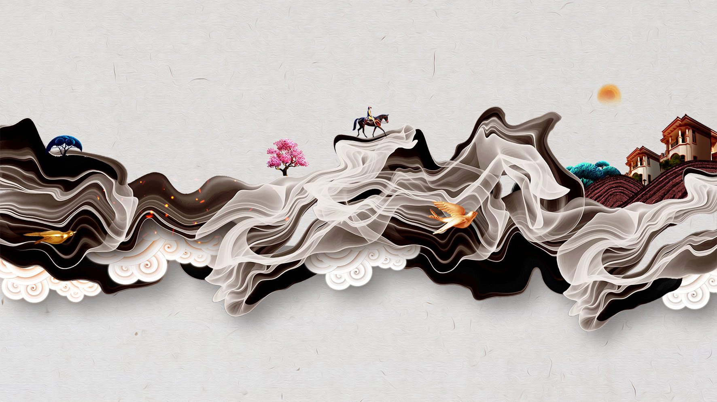
The Green Transformation of “Black Gold” :
Cultural Exchanges and Ecological Awakening in the Rubber Civilization
陆思辰 2530031201
Notes:
1

Slide 2
The Green Transformation of “Black Gold” :
Cultural Exchanges and Ecological Awakening in the Rubber Civilization
Major：
Historical Periods：
Civilizational Theme：
History
Modern China、Contemporary Globalization
Ecological Civilization
Notes:
1

Slide 3
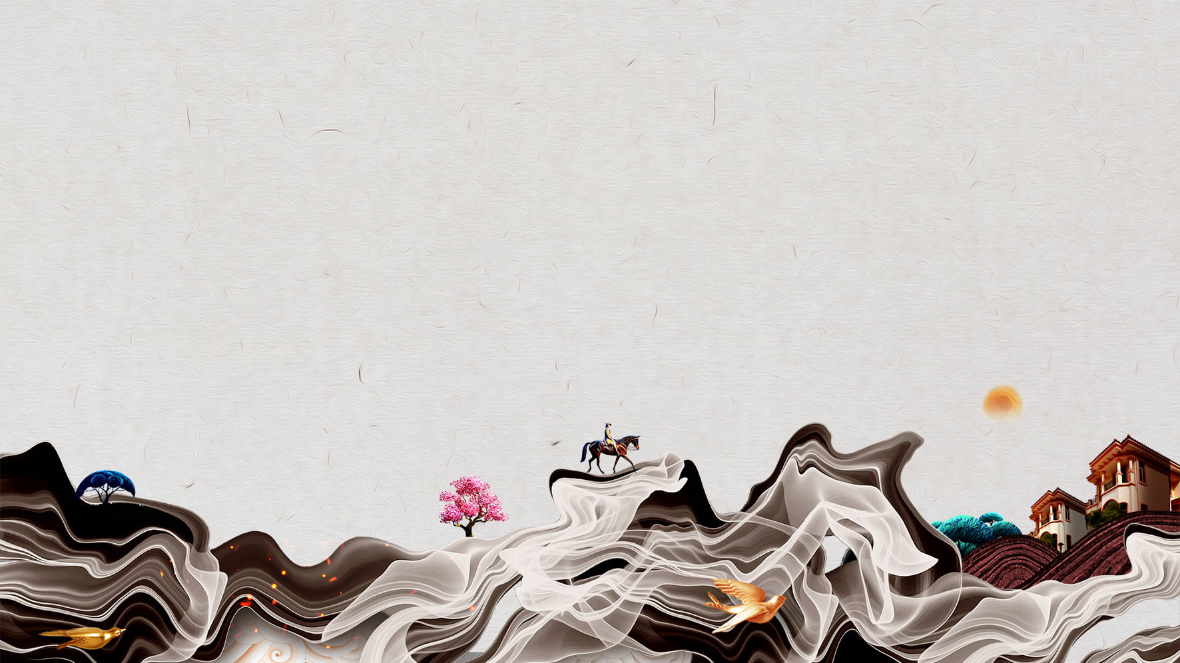

Core Rationale for Tool Selection——Seedance
Temporal-spatial visualization capability:
The AI video generator's ability to model long-term historical dependencies through Diffusion Transformer (DiT) architecture allowed me to visualize the 500-year evolution of rubber civilization as a cohesive narrative, rather than isolated historical fragments. This was critical for illustrating the “cycle of civilization” theme.
Emotional engagement through visual aesthetics:
By generating cinematic-quality visuals (4K resolution, realistic environmental textures), the tool helped convey the emotional weight of historical events like the Putumayo massacre, making the human cost of colonial exploitation more impactful than text alone could achieve.
Notes:
2

Slide 4


Why Modern China
——It was the best of times; it was the worst of times.
The collision of global civilizations gave rise to a macro - perspective of “the history of civilization”
During the Industrial Revolution, Western powers collided with civilizations around the world through colonial expansion and global trade. This cross-civilization interaction forced scholars at that time to think outside the framework of a single nation or country and think about grander issues.
The exchange of ideas and materials promoted the innovation of historical research methods
The Industrial Revolution not only brought about the interaction of commodities and colonies but also the flow of ideas and technologies. Through the comparison of objects and documents across civilizations, we can more realistically restore and understand the moral world and life picture of human beings in the past.
Notes:
11

Slide 5

The Formation of the Ecological Historical View
The Second Industrial Revolution
Global perspective
Scientific History
Raw materials are needed
Wild rubber tree species、
Primitive genetic resources
Distribute rubber saplings and exploit the land
Brazil
Britain
Southeast Asia
Massacre the indigenous people
Economic bankruptcy
Output rubber
Rapid industrial development and the establishment of industrial hegemony
Promote the academic community to summarize the experiences and lessons of human - nature interaction from history
Ecological History
The unequal interaction between industrial civilization and non - industrial civilization has given rise to the ecological historical view.
air environmental pollution Resource depletion Ecological imbalance
Notes:
12

Slide 6
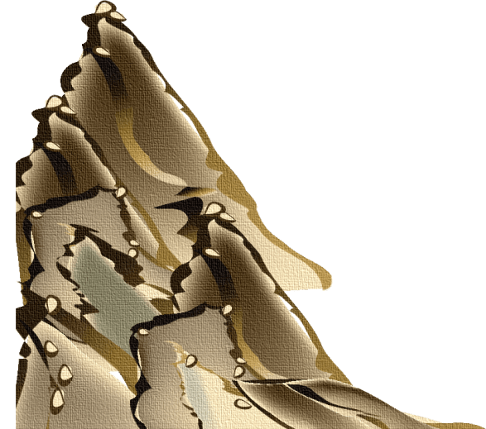
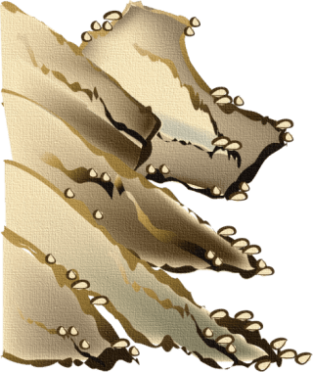

Ecological Historical View
Core viewpoints
Interaction between nature and civilization: The ecological historical view emphasizes the interactive relationship between human civilization and the natural environment, believing that the development of civilization cannot do without respect for and protection of the natural environment.
Sustainability: This theory holds that the sustainability of environmental resources is the foundation for the survival of civilization, and changes in the ecological environment will directly affect the rise and fall of civilization.
Historiography
politics, economy, and culture
politics, economy, culture and nature
one of the seven basic historical views in history
Notes:
17

Slide 7
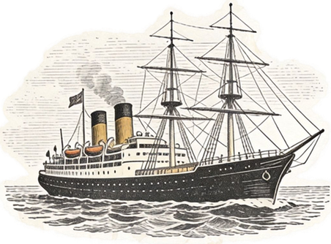
The global flow of “black gold”
1876：
1910：
Henry Wickham smuggled 70,000 rubber seeds from Brazil to the Royal Botanic Gardens in the UK, marking the beginning of 'scientific colonization' and breaking the Amazon's rubber monopoly.
Extreme manifestation of colonial violence
Indigenous people were treated as free labor, and the price of rubber soared to £640 per ton, triggering frenzied plundering. More than 40,000 indigenous people in the Amazon region died due to the rubber boom.
1888：
1913：
In 1888, Dunlop invented the pneumatic tire, and combined with the birth of the internal combustion engine car in 1886, this drove the exponential growth of rubber demand.
Southeast Asian plantations were established. Under the colonial system's redistribution of resources, Southeast Asia became the global center of rubber production.
Notes:
14

Slide 8
The global flow of “black gold”
The Starting Point of Civilizational Interaction:
Driven by the Ecological Needs of Industrial Civilization, Breaking the Regional Ecological Balance
The Process of Civilizational Interaction:
Asymmetric Ecological Power Interaction, The Alienation of the Relationship between Civilization and Nature
The Result of Civilizational Interaction:
The Breakage of the Global Ecological Chain and the Imbalance of Civilization, Incurring Double Costs
Notes:
16

Slide 9


The Profound Lessons of history
Core Essence
Industrial civilization takes ecological plunder as its core and forcibly incorporates natural ecosystems, colonial regional civilizations, and the global market system into the “asymmetric, unbalanced, and unsustainable” interaction process of capital expansion.
Development Trap
Behind the short-term economic benefits lies the disruption of the ecological and cultural system in the colonial areas, as well as the breakdown of the global ecological chain. Eventually, this will have a negative impact on the sustainable development of industrial civillization itselt.
Notes:
7

Slide 10

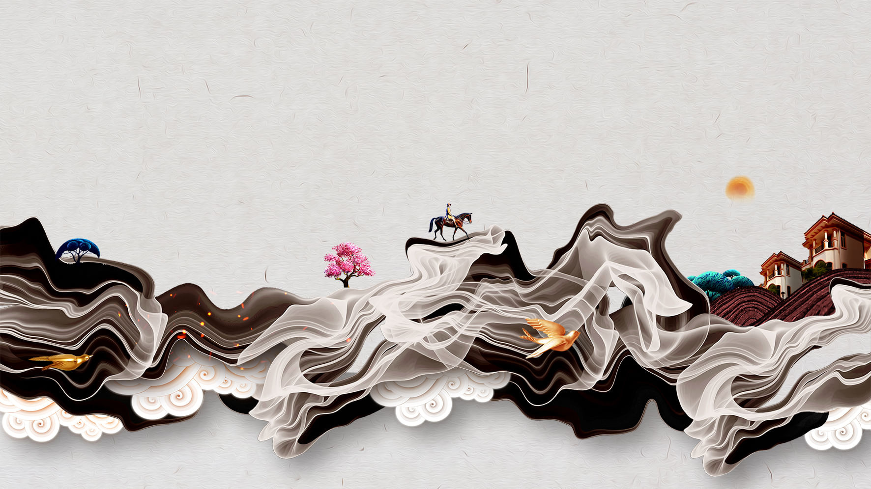

Why Contemporary Globalization
The cognitive upgrade from authropocentrism to ecological community consciousness
Global Consciousness Awakening
In the contemporary era of globalization, the global environmental movement has emerged. Taking history as a mirror, humanity has begun to develop an overall ecological awareness and recognize that humans and nature form a community with a shared future.
Sustainable Development Concept
As the ecological crisis has become a common challenge for humanity, the international community has started to advocate the concept of sustainable development, which emphasizes the harmonious coexistence of humans and nature. This social demand has propelled the ecological historical view from the academic periphery to the center, making it an important theoretical tool to address contemporary issues.
Notes:
3

Slide 11

the Xingu indigenous peoples: the “Forest Health Index”
(the indigenous people's keen perception of nature)
Yale University: satellite and acoustic monitoring (modern technology).
Cases
①
Laos: “agroforestry system.”
China: “dwarfing technology”
②
human society and civilization are shaped by the environment, and humans are also remaking and protecting the environment by integrating old and new knowledge.
Knowledge system
technology crushing
ecological wisdom complementarity
Notes:
6

Slide 12
indigenous peoples: the “circular rubber tapping method”, sustainable raw materials
Michelin: market rules, development funds
Cases
③
Economic system
exploitative economy
bio-economy symbiosis
Economic development does not have to come at the cost of ecological destruction. The economic systems of different civilizations can find a balanced point of mutual benefit and symbiosis within the “web of life” rather than engaging in a zero - sum game.
Thai Rubber Authority : Elders' Council
Modern Industrial Civilization : modern enterprise management
④
colonial rule
diverse co-governance
“transnational evolution of environmental governance ideas”: the environmental anxieties and management policies of different civilizations can inspire each other to jointly address the global ecological crisis.
Governance system
Notes:
6

Slide 13
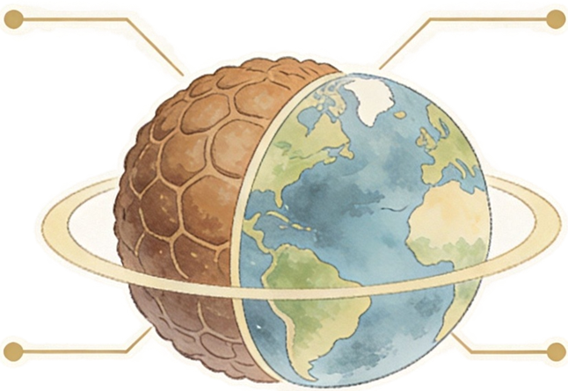
Contemporary Revelation
Reshape Cognition: “Ecological Holism”
Correct the Economy: “Internalizing Costs”
Targeted Challenges: Global plastic pollution and loss of biodiversity.
Specific Measures : When dealing with plastic pollution, we must incorporate the "health of the marine ecosystem" into the core considerations.
Targeted Challenges: Ecological damage in the development of transition minerals (such as lithium and cobalt mines).
Specific Measures : Establish a global unified "real - cost accounting system"
Clarify History: “Repaying Ecological Debts”
Transform Governance: “Diverse Ecological Co – governance”
Targeted Challenges: International climate justice and the financial gap.
Specific Measures : Developed countries must provide free, non - debt - based financial and technological transfers to countries in the Global South to help them adapt to climate change.
Targeted Challenges: Stalemates in international negotiations and the neglect of indigenous rights.
Specific Measures : Establish an inclusive "Earth Parliament," respects and integrates diverse ecological wisdom
Notes:
16

Slide 14
Thanks for Listening
陆思辰 2530031201
Notes:
25

