Slide 1
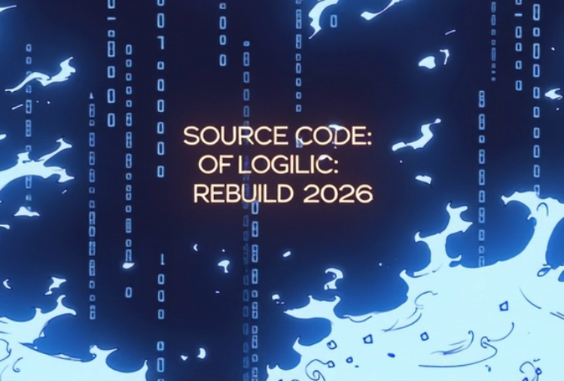
Source Code of Logic:
Rebuild 2026
Major: Philosophy
Theme: Technological Civilization
Period: V (Modern China, 1920)
刘咏昭 2430031157
Notes:
Hello everyone. Today, I will explore with you a theme that spans a century: the cross-temporal dialogue between technology and philosophy. We will examine the trajectory of technological civilization through a specific historical snapshot—Bertrand Russell's trip to China in 1920—and reflect on its profound implications for the present.

Slide 2




Step 1: Why this AI tool?
Visualizing Abstraction:Transcending realism to express complex philosophical metaphors.
Humanistic Warmth: Balancing cold digital data with artistic light and shadow.
Makoto Shinkai style
Notes:
Our research is structured around three core pillars: a philosophical perspective, the theme of technological civilization, and the specific historical context of 1920. This framework allows us to conduct a focused thought experiment across a century.

Slide 3



Step 1: Why this AI tool?
JingYing
(Narrative Engine)
Midjourney
（Visual Engine）
MiniMax
（Audio Engine）
What：Audio Synthesis AI
Advantage：Realistic breathing & high emotional nuance
Role： Revive the emotional voice and soul of historical figures
What：Video Editing Software
Advantage：Precision keyframes, extensions & audio syncing
Role：Chrono-stitcher, transforming static assets into a flowing film
What：AI Image Generator
Advantage：Master cinematic lighting & stylization
Role：Unify 1920 & 2026 into a seamless style
Notes:
The first question is, why did we choose AI as our medium? The answer lies in a powerful metaphor. By using the ultimate efficiency of AI to recreate a historical debate on technology and philosophy, we are not just telling a story; we are performing the theme itself—a dialogue between the cutting-edge technology of today and the profound thoughts of the past.

Slide 4
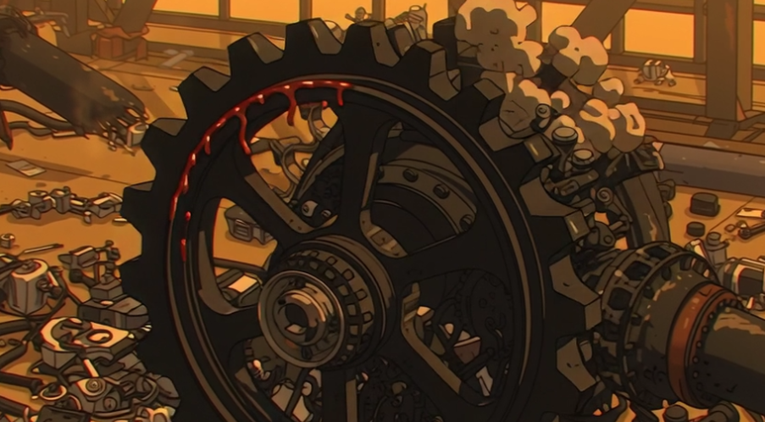

Step 2: Why this period?
Period V: 1920, The Crossroads of Civilizational Collision
WEST: Disillusionment:
Post-WWI traum
Unchecked technology as bloody iron
EAST: Thirst for Logic
May Fourth era
Urgently seeking "Mr. Science" for national survival
The Core Significance:
No single civilization can govern modern technology alone, it requires a cross-civilizational ethical framework
Notes:
Next, why focus on 1920? This year was a pivotal moment. In the West, the trauma of World War I led to a profound disillusionment with unbridled technology. In the East, China, reeling from the May Fourth Movement, was desperately seeking the "scientific method" to modernize. This collision of disillusionment and aspiration created a unique historical tension.

Slide 5

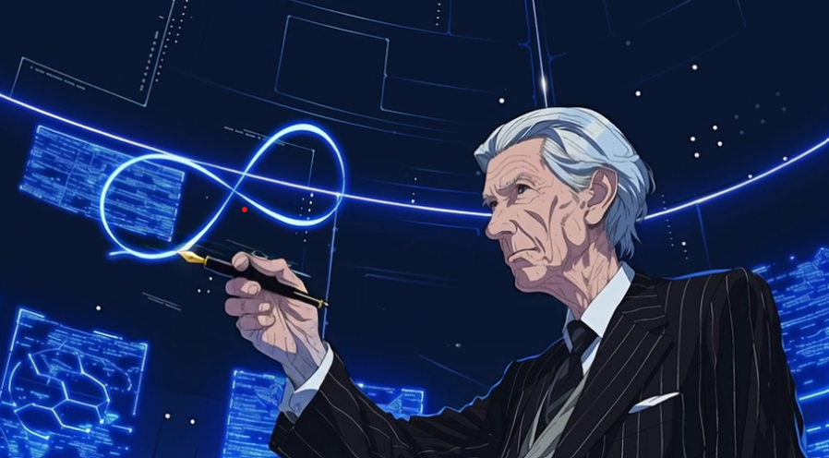
Step 3: What happened?- Mutual Learning
—— A TWO-WAY ENLIGHTENMENT
EAST WEST | Finding the "Antidote"
WEST EAST :Importing the “Engine"
The Encounter: Russell brought mathematical logic & scientific positivism.
The Input: Mathematical Logic & Scientific Positivism.
The Influence: Shattered traditional intuitive paradigms, providing the cognitive infrastructure for China's industrialization.
The Encounter: Russell witnessed China's "reverence for life" clashing with the West's post-WWI "means-over-ends" materialism
The Input: The Eastern philosophy of "reverence for life" and natural harmony.
The Influence: Cured the Western blind spot where "means override ends," providing the ethical anchor against alienation.
Notes:
Next, why focus on 1920? This year was a pivotal moment. In the West, the trauma of World War I led to a profound disillusionment with unbridled technology. In the East, China, reeling from the May Fourth Movement, was desperately seeking the "scientific method" to modernize. This collision of disillusionment and aspiration created a unique historical tension.

Slide 6

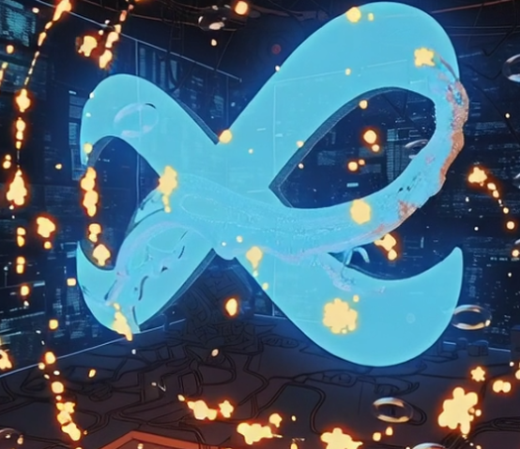



Step 3: What happened?—The Disciplinary Depth
WESTERN LOGIC
The Engine :Mathematical logic & positivism.
The Focus: Maximize efficiency and liberate material productivity.
EASTERN LIFE
The Direction : Reverence for life & natural harmony.
The Focus: Human essence as the ultimate end, not a tool.
OLD PARADIGM | Epistemology
"What the world is" Defining empirical facts and logical frameworks.
NEW PARADIGM | Technological Ethics
"Where technology takes us" Questioning boundaries, control, and human essence.
Notes:
But the enlightenment was not one-sided. Russell himself was deeply influenced by China. Witnessing the horrors of WWI, he found in Chinese philosophy, with its emphasis on life and harmony, a much-needed antidote to the West's tech-driven spiritual crisis. This led him to a crucial insight: technology needs ethical guidance.

Slide 7
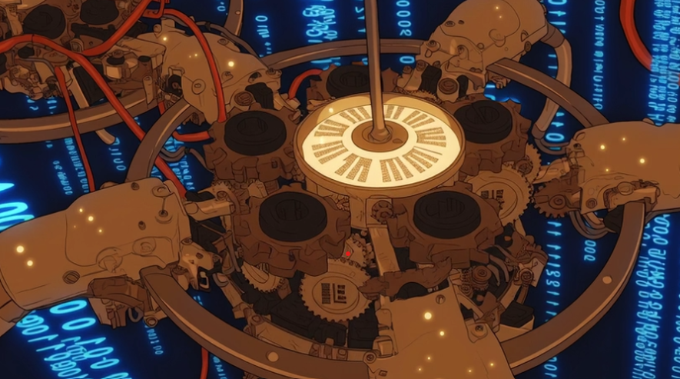
Step 3: What happened?—The Ultimate Synthesis
THE ETHICAL MATRIX: THE FATE OF CIVILIZATION
Instrumental Logic (How) + Ethical Philosophy (Why) = Sustainable Flow
⚠ Speed without Direction Algorithmic Alienation
💡 Direction without Speed Empty Talk
Notes:
So, what is our conclusion? It is a return to Russell's core insight: a symbiosis between technology and philosophy. Technology gives us speed, but philosophy provides the ethical foundation. Without philosophy, technology becomes a tool of oppression. Without technology, philosophy remains empty idealism. We must strive for this balance.

Slide 8

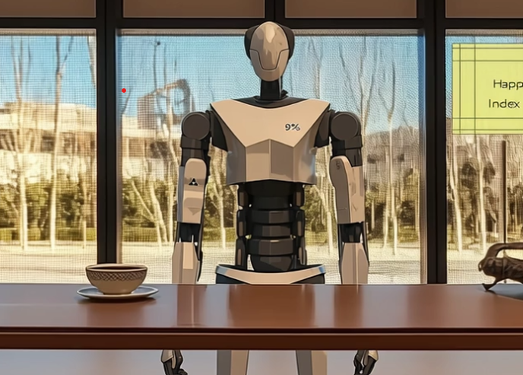
Step 4: What It Means Today?
THE NEW CRISIS: ALGORITHM ALIENATION
SDG 9 CRITIQUE ：
System Alert: "Human emotions classified as redundant parameters."
Pure efficiency-driven infrastructure lacks an ethical evaluation framework.
SDG 10 WARNING ：
System Alert: "Stripping workers of their right to rest."
Technology multiplies social stratification when serving unconstrained capital.
Notes:
So, what happened in 1920? Bertrand Russell arrived in China. His visit was a pivotal event, a true mutual enlightenment.
He came as both a teacher of Western science and a student of Eastern wisdom, making his journey a perfect embodiment of a civilizational dialogue.

Slide 9

Step 4: What It Means Today?
SDG 9 SDG 10
Responsible Infrastructure (SDG 9) naturally eliminates Algorithmic Inequality (SDG 10)
THE CIVILIZATIONAL PROMISE
Technology is the tool for human liberation, not a mechanism for human subjugation.
Notes:
From West to East, Russell brought instrumental rationality. His lectures on mathematical logic and scientific positivism were a revelation for Chinese intellectuals, providing them with a powerful new tool to understand and transform the world, effectively clearing the path for China's modernization.

Slide 10
Thank You
Notes:
Therefore, revisiting Russell's cross-temporal dialogue with China today is precisely to rediscover that precious sense of balance in an era of breakneck technological advancement. Thank you.

