Slide 1

季玥彤 Ji Yuetong 2430031083

Slide 2
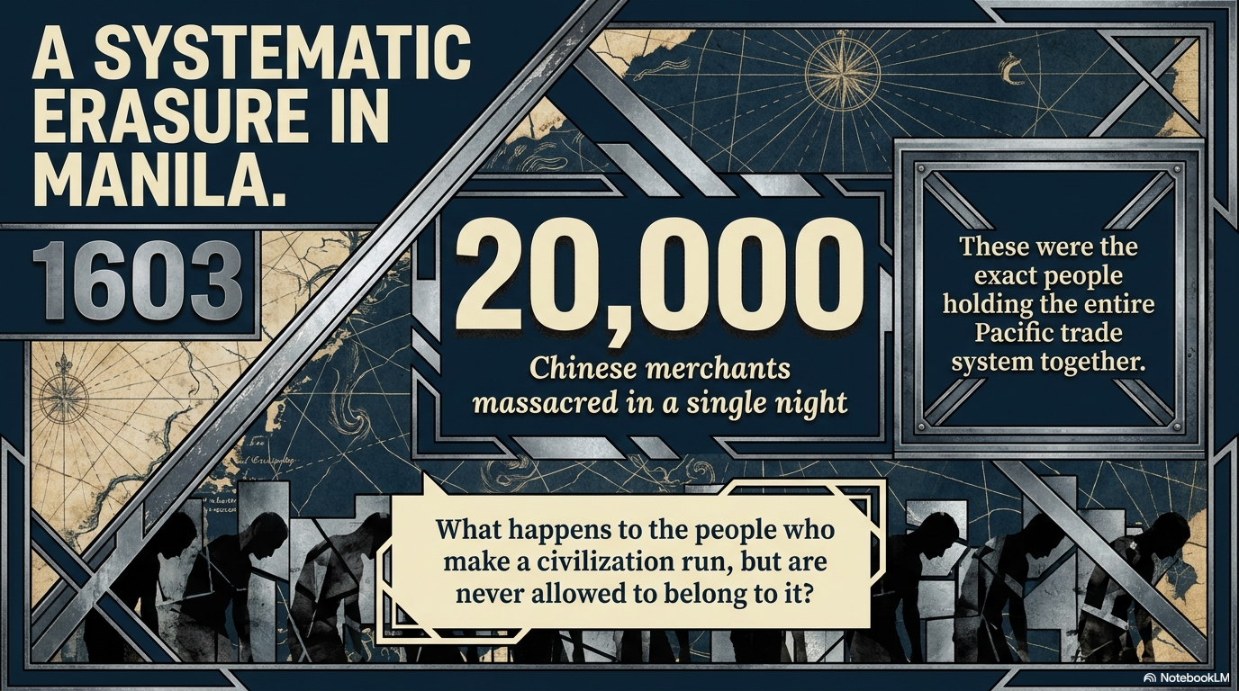

Slide 3
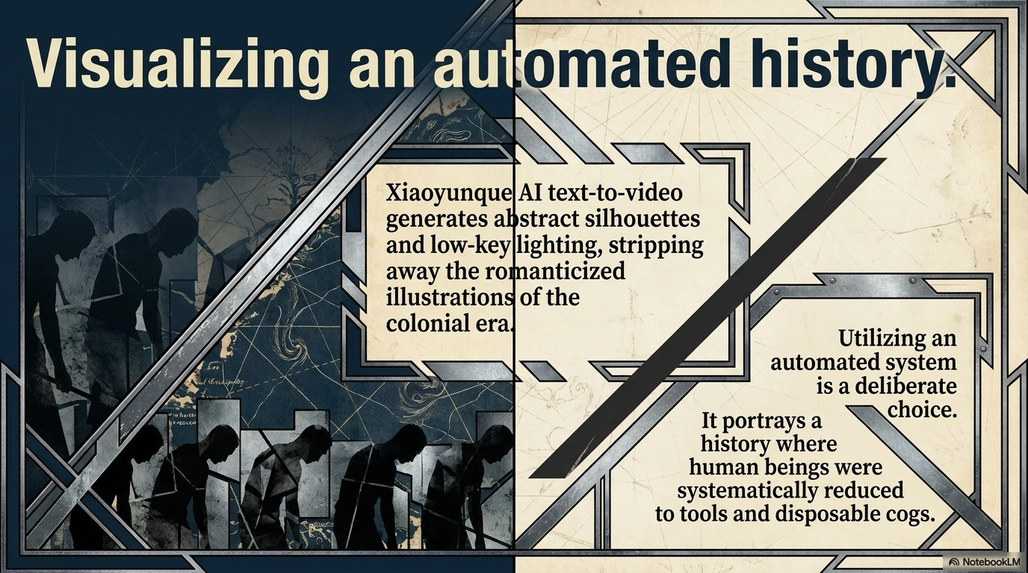
Seedance 2.0 Al text-to-video
generates abstract silhouettes
and low-key lighting, stripping
away the romanticized
illustrations of the
colonial era.

Slide 4
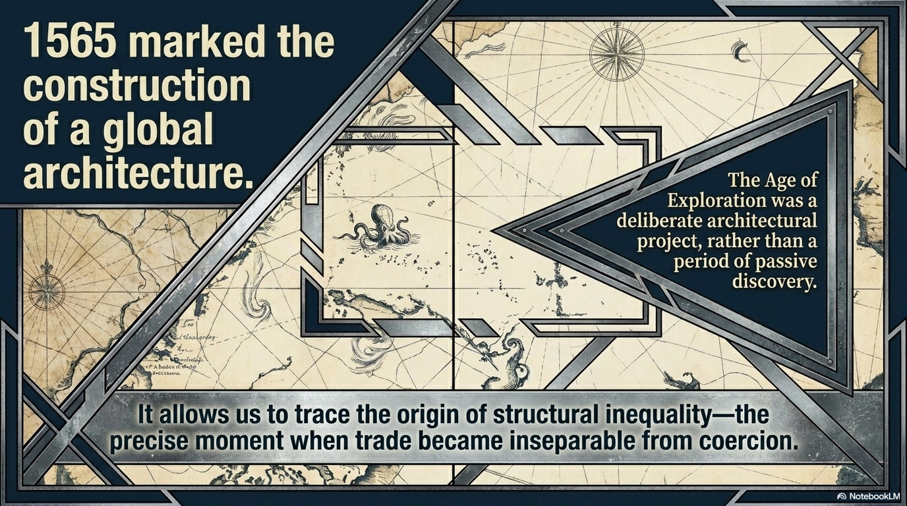

Slide 5
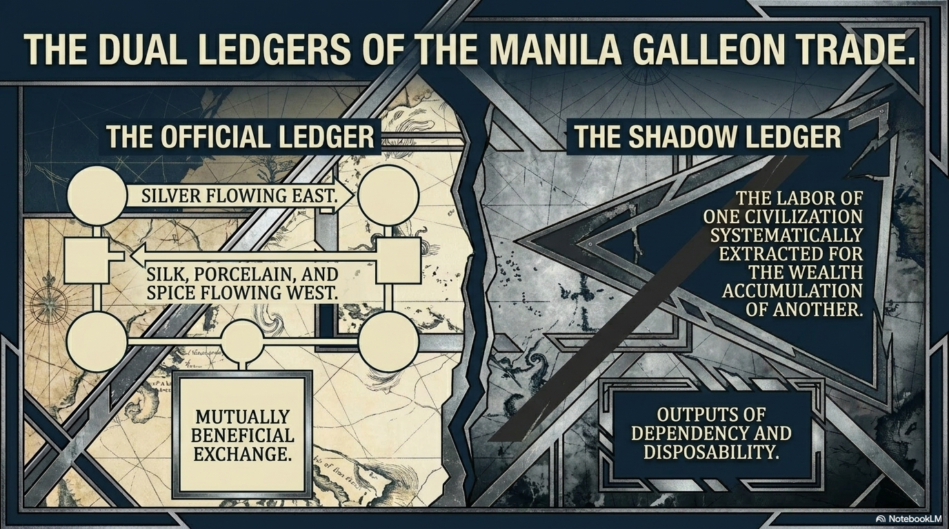

Slide 6
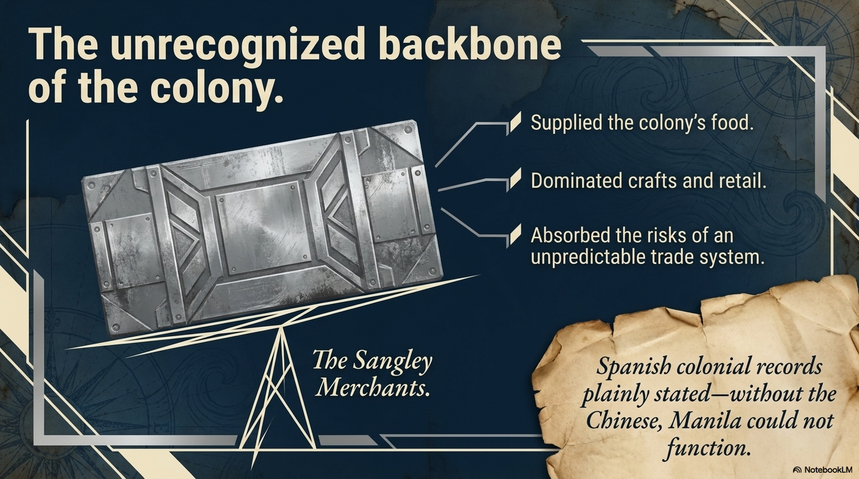

Slide 7
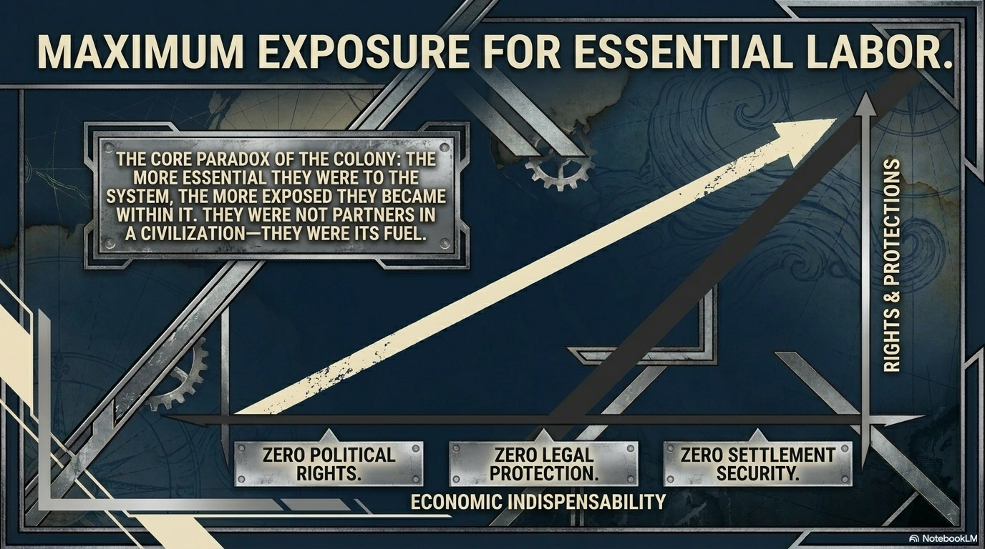

Slide 8
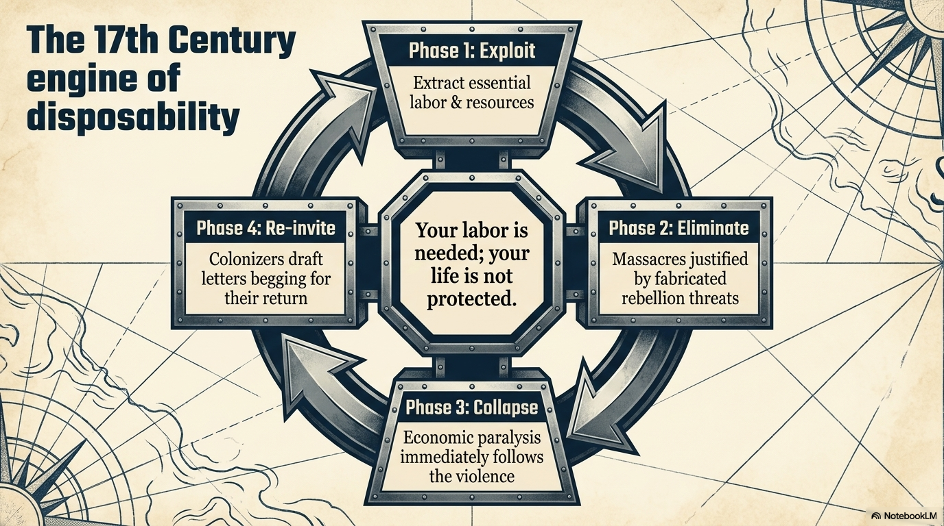

Slide 9
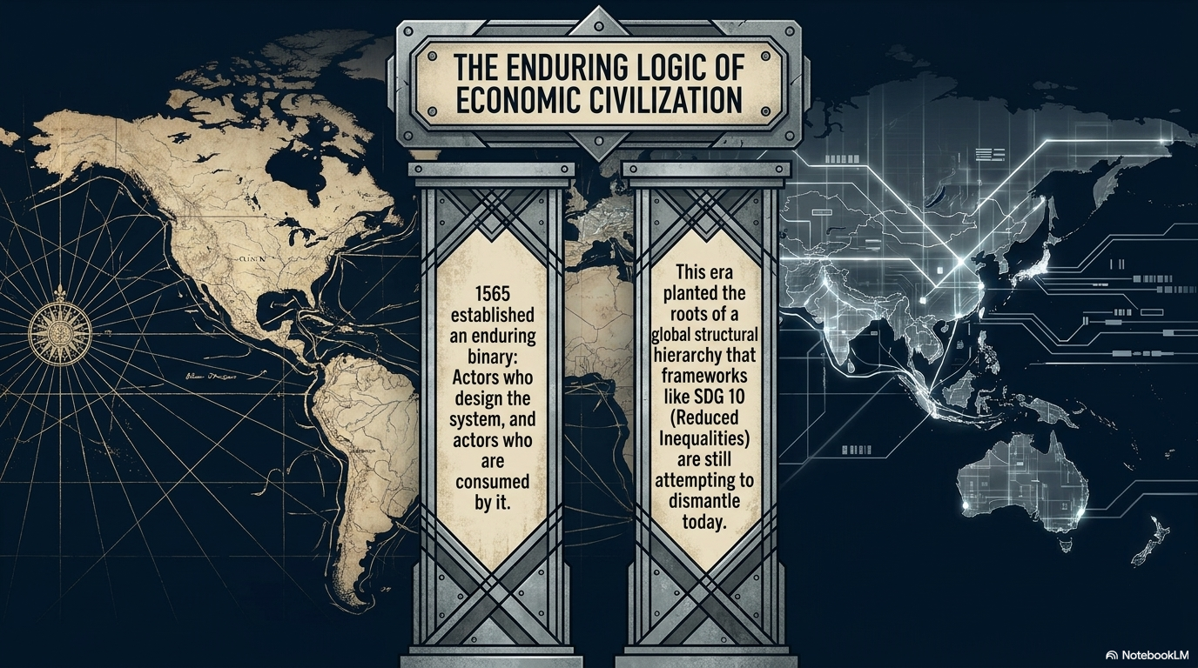

Slide 10
