Slide 1
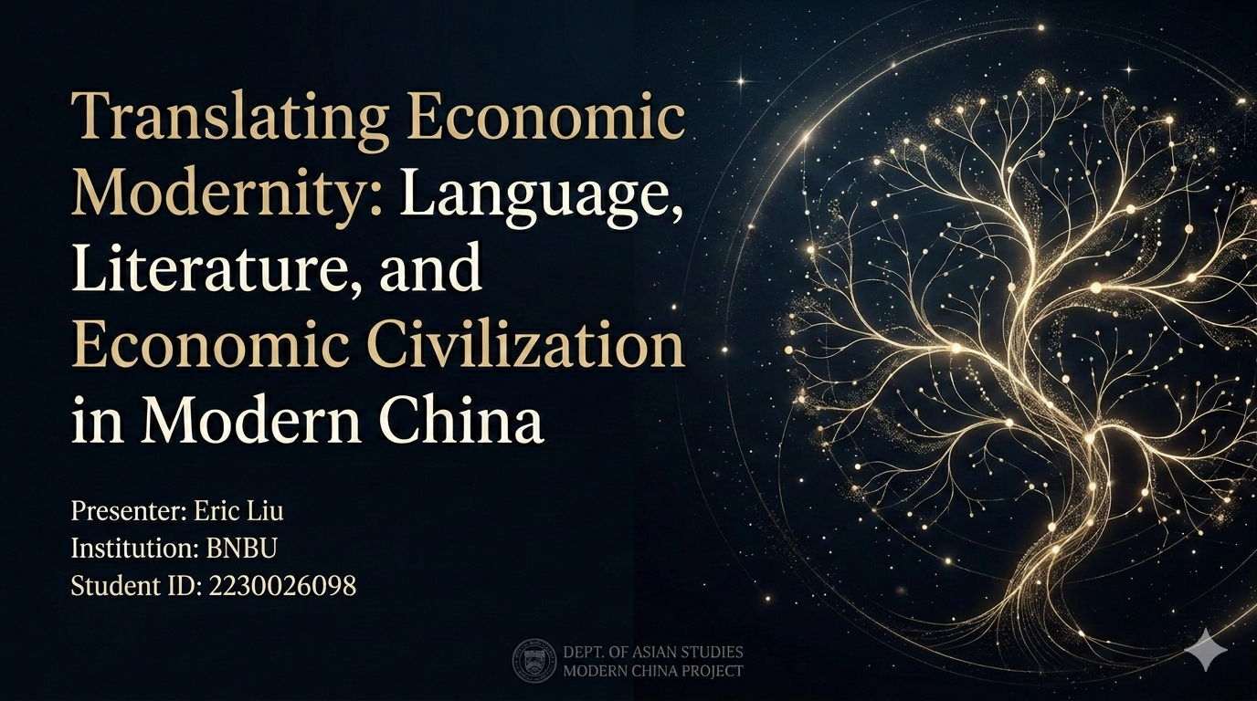
Notes:
Good afternoon everyone.
My project focuses on Chinese Language and Literature, Economic Civilization, and Modern China, especially the late Qing and Republican period. My main argument is that Western economic ideas did not enter China only through trade or institutions. They were also translated into Chinese, spread through newspapers, print culture, and literary discourse, and gradually changed how people understood commerce, wealth, and civilization.

Slide 2
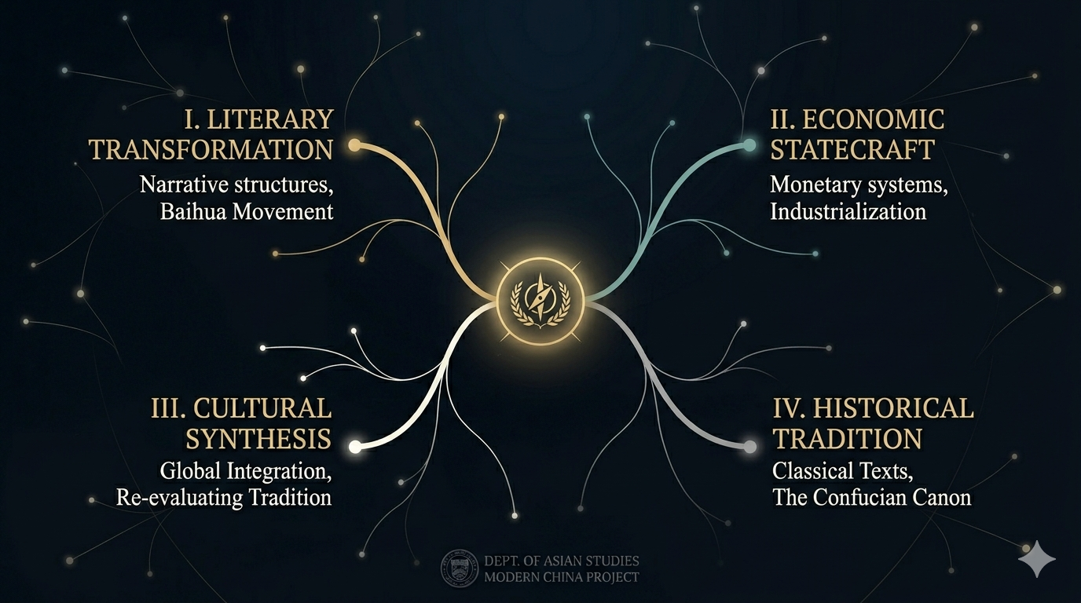
Notes:
My main argument is that Western economic ideas did not enter China only through trade or institutions. They were also translated into Chinese, spread through newspapers, print culture, and literary discourse, and gradually changed how people understood commerce, wealth, and civilization.

Slide 3
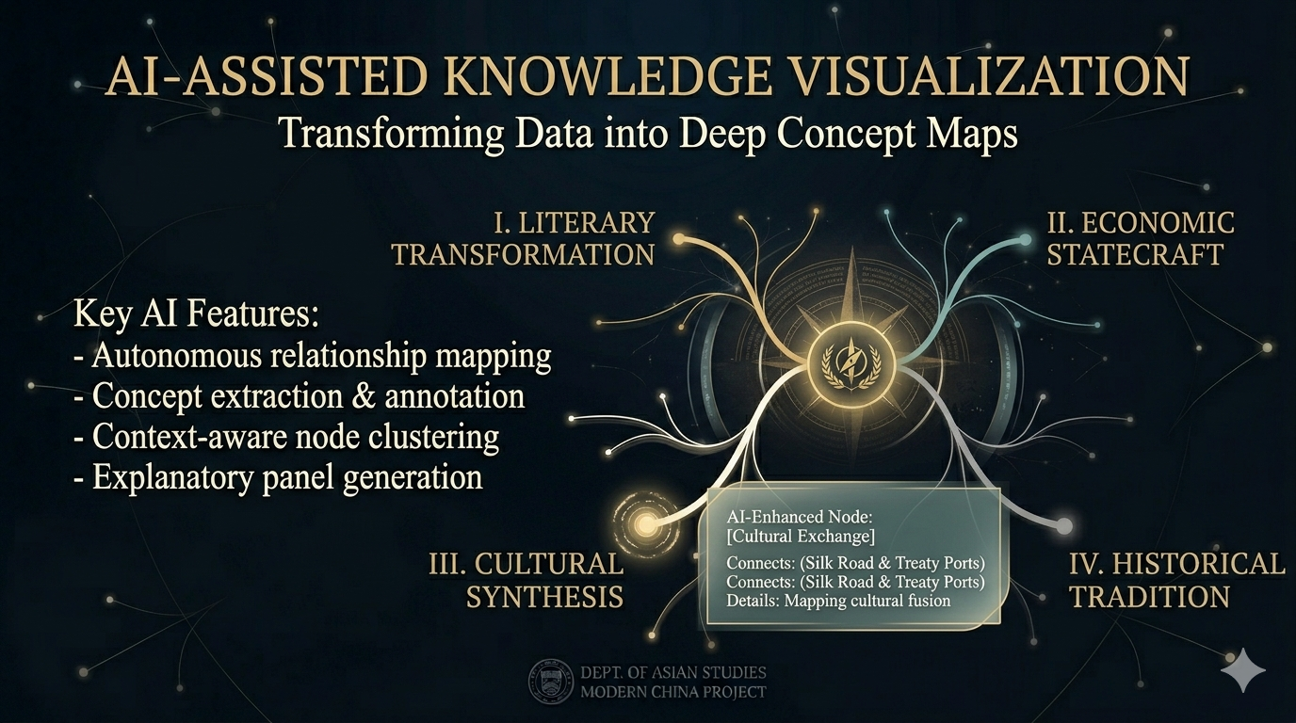
Notes:
I chose Codex as my AI tool because my argument is about connections, not just facts. I used it to build a three-dimensional branching visualization, with glowing points connected like tree branches. Each point opens into a key idea and explanation. This structure helps me show that economic civilization in modern China was not a single event, but a growing network of translation, interpretation, and cultural change. Instead of making a flat image, Codex allowed me to visualize relationships between concepts, texts, and historical developments. That is why it was the right tool for expressing my argument.

Slide 4
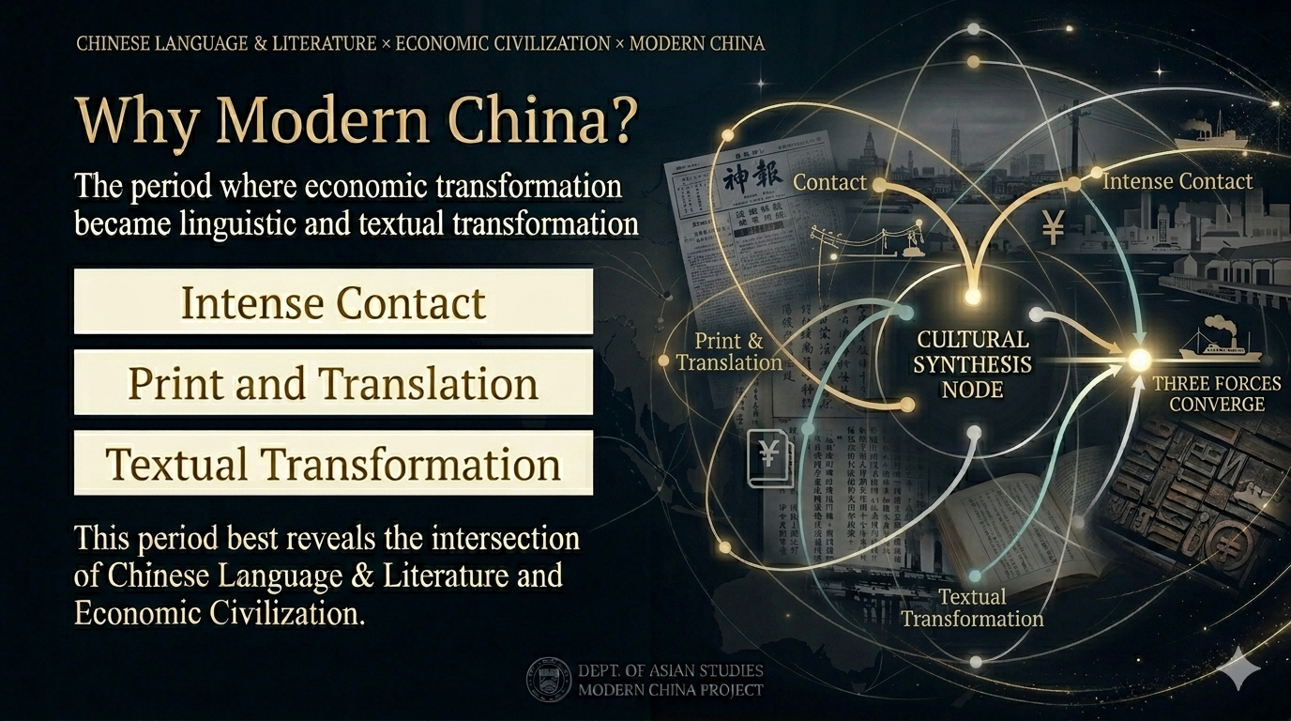
Notes:
I chose the Modern China period because it best shows the intersection of my major and theme. This was a time of intense contact between Chinese and Western civilizations. Trade expanded, treaty ports opened, and foreign ideas entered China rapidly. At the same time, translation, newspapers, publishing, and new literary writing also developed quickly. So this period shows that economic transformation was also a transformation in language and texts.

Slide 5
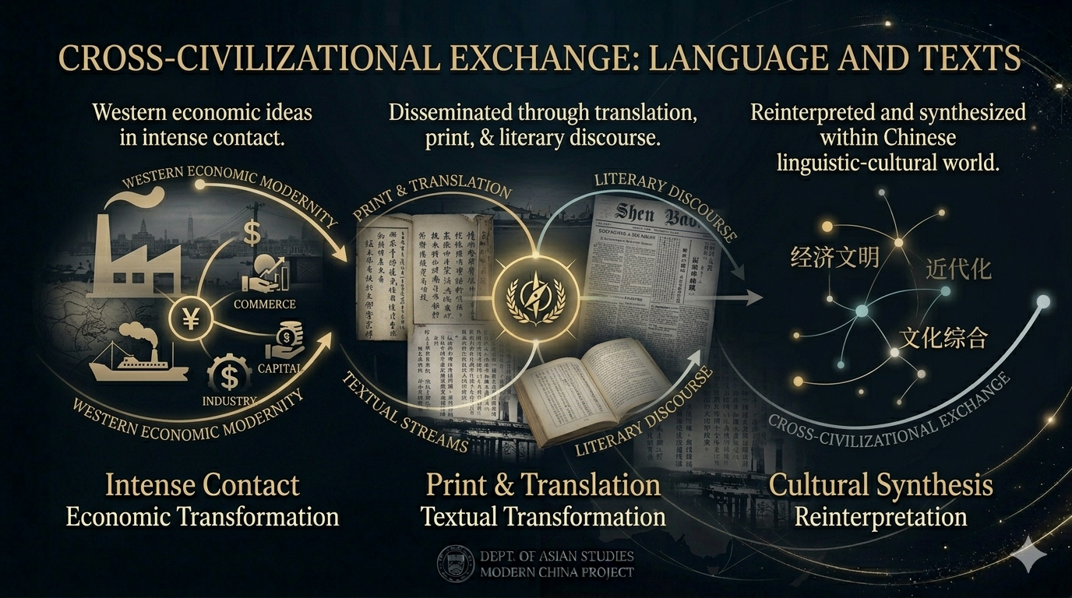
Notes:
What happened was a genuine cross-civilizational exchange. Western ideas about commerce, capital, industry, and modern civilization entered China through translated works, reform essays, journalism, and literary discourse. But these ideas were not simply copied. Once they entered the Chinese language world, they were reinterpreted through local concepts and cultural values. Seen through the lens of Chinese Language and Literature, this was not only an economic encounter. It was also a linguistic and textual encounter. Language gave these ideas names, translation made them discussable, and print culture spread them to the public. In this way, texts helped reshape how China imagined commerce, modernity, and national progress.

Slide 6
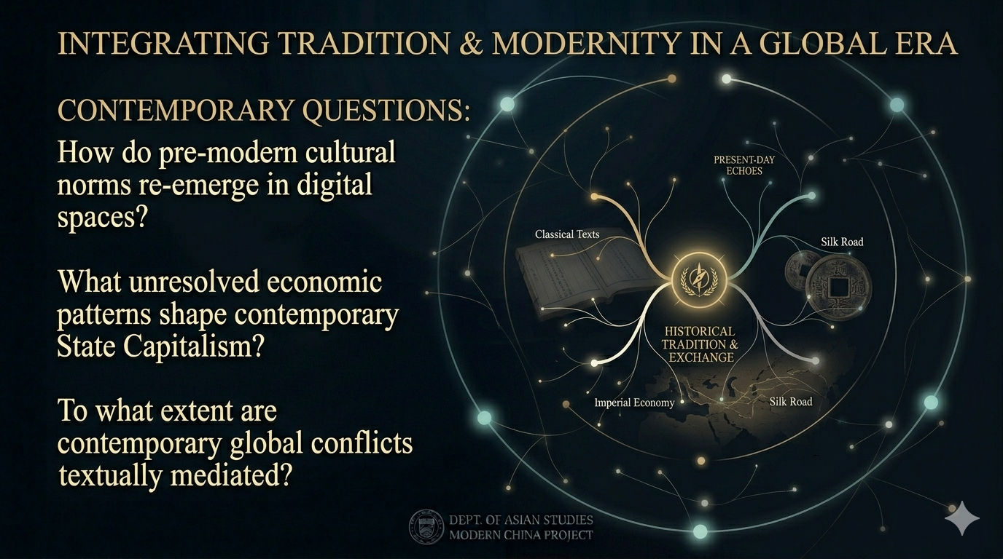
Notes:
This history still matters today. My theme is Economic Civilization, and this case helps us understand that globalization is not only about markets, money, or technology. It is also about language, discourse, and cultural power. Who gets to define development? Who gets to name modernity? Which ideas become global, and which cultures have to translate themselves into someone else’s framework? These questions are still important today.
So my visual work argues that economic civilization is not only built through trade. It is also built through language, translation, and literary mediation. That is what my branching 3D structure is meant to show.
Thank you.

