Slide 1
COMMUNICATION × TECHNOLOGICAL CIVILIZATION
THE JOURNEY
OF PAPER
Medium, Message & Power across Five Civilisations
A Cross-Civilisational Study in Communication & Media Theory
II–III
IV
VII
Silk Road Era
Age of Exploration
Digital Age

Slide 2
RESEARCH COORDINATES
How Three Elements Work Together
HISTORICAL PERIODS
DRAWN MAJOR
CIVILIZATIONAL THEME
Communication
Technological
Civilization
II–III Silk Road Era
First documented cross-civilisational media transfer — papermaking knowledge moves from Han China to the Abbasid world, creating new communication networks.
The disciplinary lens — Communication studies how messages, media, and power shape societies. Paper and its successors are the central objects of this field: every medium restructures who can speak, who is heard, and who is silenced.
The contemporary anchor — in the digital age, communication infrastructure is civilisational infrastructure. Who controls the platform controls the public sphere.
IV Age of Exploration
Print revolution: paper + movable type industrialises mass communication for the first time, reshaping European public discourse (Habermas's early public sphere).
VII Digital Age
The WWW is the fifth medium in this lineage. Today's platform capitalism, algorithmic gatekeeping, and digital divides are the same story at network scale.

Slide 3
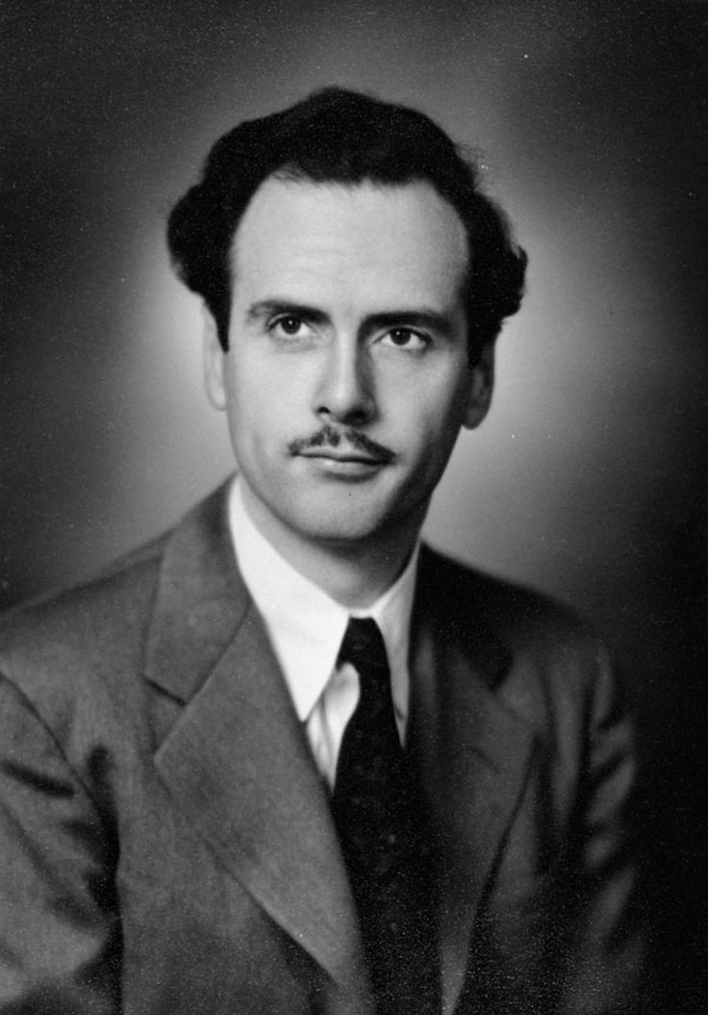
THEORETICAL FRAMEWORK
Marshall McLuhan — Medium Theory
"The medium is the message."
— Understanding Media, 1964
What it means
A medium is not just a container for content. Every medium — paper, print, the web — actively restructures how people think, organise society, and hold power. The medium itself is the real message.
How it applies to this project
Marshall McLuhan
1911 – 1980
Each of the five stages is not simply 'paper spreads to a new place.' It is a new medium transforming an entire civilisation's communication ecology. Baghdad's House of Wisdom only exists because paper changed what knowledge could be. Gutenberg's press didn't just print books — it created mass public discourse.
Canadian communication theorist
Why it connects to today
The WWW is the fifth medium in this lineage. Platform algorithms, content moderation, and digital divides are not technical problems — they are McLuhan problems. And crucially: choosing a 3D interactive globe to tell this story is itself a McLuhanite argument. The medium we chose IS part of the message.

Slide 4
WHY THIS AI TOOL?
The Medium Expresses the Message
Three.js / WebGL — 3D Interactive Globe
COMM. THEORY INSIGHT
McLuhan: the globe as spatial medium
Choosing a digital web tool to tell this story is itself a McLuhanite argument.
Paper's journey was a geographic story across Eurasia. A 3D globe embeds the argument spatially — viewers experience the scale of transmission rather than read about it. The medium literally enacts the thesis.
Animated Arc Routes — Visual Transmission
We are now inside Stage 5 of the same transmission lineage. The interactive globe is not just a visualisation — it is a new medium carrying forward the same civilisational question:
Who controls the infrastructure of communication?
And what does that mean for everyone else?
McLuhan: motion as message
The animated arcs make transmission visible. Each arc is not a product moving along a trade route but a civilisation's communication capacity being transferred. The movement IS the argument — motion equals transmission.
Stage-by-Stage Narrative — Sequential Structure
McLuhan: each medium displaces the last
McLuhan argued each new medium absorbs and transforms its predecessor. The stage structure enacts this: each node is a civilisational communication shift. Choosing a digital web tool to tell this story is itself a McLuhanite argument — we are inside Stage 5.

Slide 5
THE FIVE STAGES
A Cross-Civilisational Diffusion of Communication Infrastructure
01
02
03
04
05
China
Islamic World
Baghdad
Europe
Digital Age
1st C CE
751 CE
c.988 CE
c.1450 CE
1989 CE
Medium Invention
Forced Diffusion
Public Sphere
Mass Communication
Network Medium
Key Figure
Key Figure
Key Figure
Key Figure
Key Figure
Cai Lun
Du Huan
Ibn al-Nadim
Gutenberg
Berners-Lee
Paper as new medium; state-controlled diffusion through Han bureaucratic communication networks
Battle of Talas — Innis's 'monopoly of knowledge' forcibly transferred; Abbasid adoption restructures Islamic communication ecology
House of Wisdom as proto-public sphere; paper enables translation movement — cross-civilisational knowledge exchange at scale
Print revolution = first mass medium; Rogers' full adoption curve complete; Habermas's bourgeois public sphere emerges
WWW as fifth medium in this lineage — McLuhan's global village; but new gatekeepers (platforms) reproduce old monopolies of knowledge

Slide 6
WHAT DOES IT MEAN TODAY?
Communication Theory & Unresolved Civilisational Tensions
Communication's lesson: every new medium reproduces the same question — who controls the channel controls the civilisation (SDG 10).
Platform Gatekeeping
Digital Divide
Media Monopoly
Habermas — Public Sphere
Rogers — Diffusion Inequity
Innis — Monopoly of Knowledge
Historical case:
Historical case:
Historical case:
Baghdad's House of Wisdom (c.830 CE)
Paper's uneven spread (751–1400 CE)
Han → Abbasid technology transfer
Scholars controlled which Greek texts were translated and circulated
Islamic world had paper 500 years before Europe — decisive knowledge advantage
Controlling papermaking = controlling information infrastructure
Today →
Today →
Today →
Algorithmic feeds, content moderation & shadow-banning replicate the same gatekeeping logic at planetary scale
3.5 billion offline today. The digital divide IS the new paper divide — same structural inequality, new medium
5 platforms control 80% of global digital traffic. McLuhan's global village is owned by a handful of corporations

Slide 7
CONCLUSION
Every medium is a
new civilisation.
Communication theory reveals what a purely historical account cannot: the journey of paper is not about paper. It is about the recurring logic by which societies organise who speaks, who is heard, and who is excluded (SDG 10).
McLuhan's insight cuts through five civilisational moments: the medium is never just a tool — it is a new social order. The tensions of today's technological civilisation — platform monopoly, digital divide, algorithmic gatekeeping — are not new problems. They are old problems wearing new interfaces.
McLuhan's Framework
McLuhan
The Medium
Medium Theory
is the Message
Hot & Cool
Global Village
Media & Participation
Civilisational Reach

Slide 8
AI VISUAL WORK
The Journey
of Paper — Interactive
An interactive 3D globe tracing paper’s journey across five civilisational moments. Built with Three.js / WebGL.
https://muahhh-afk.github.io/journey-of-paper/
Built With
Three.js
WebGL
3D Globe
Rendering
AI-assisted
GitHub Pages
Research & Design
Live Deploy

Slide 9
REFERENCES
Primary Theoretical Source
McLuhan, M. (1964). Understanding Media: The Extensions of Man. McGraw-Hill.
McLuhan, M., & Fiore, Q. (1967). The Medium is the Massage. Random House.
Historical Sources
Bloom, J. M. (2001). Paper Before Print: The History and Impact of Paper in the Islamic World. Yale University Press.
Tsien, T. H. (1985). Science and Civilisation in China, Vol. 5, Part 1: Paper and Printing. Cambridge University Press.
Man, J. (2002). The Gutenberg Revolution. Headline Book Publishing.
Digital Age / Contemporary
Berners-Lee, T. (1999). Weaving the Web. HarperCollins.
Castells, M. (1996). The Rise of the Network Society. Blackwell.

