Slide 1
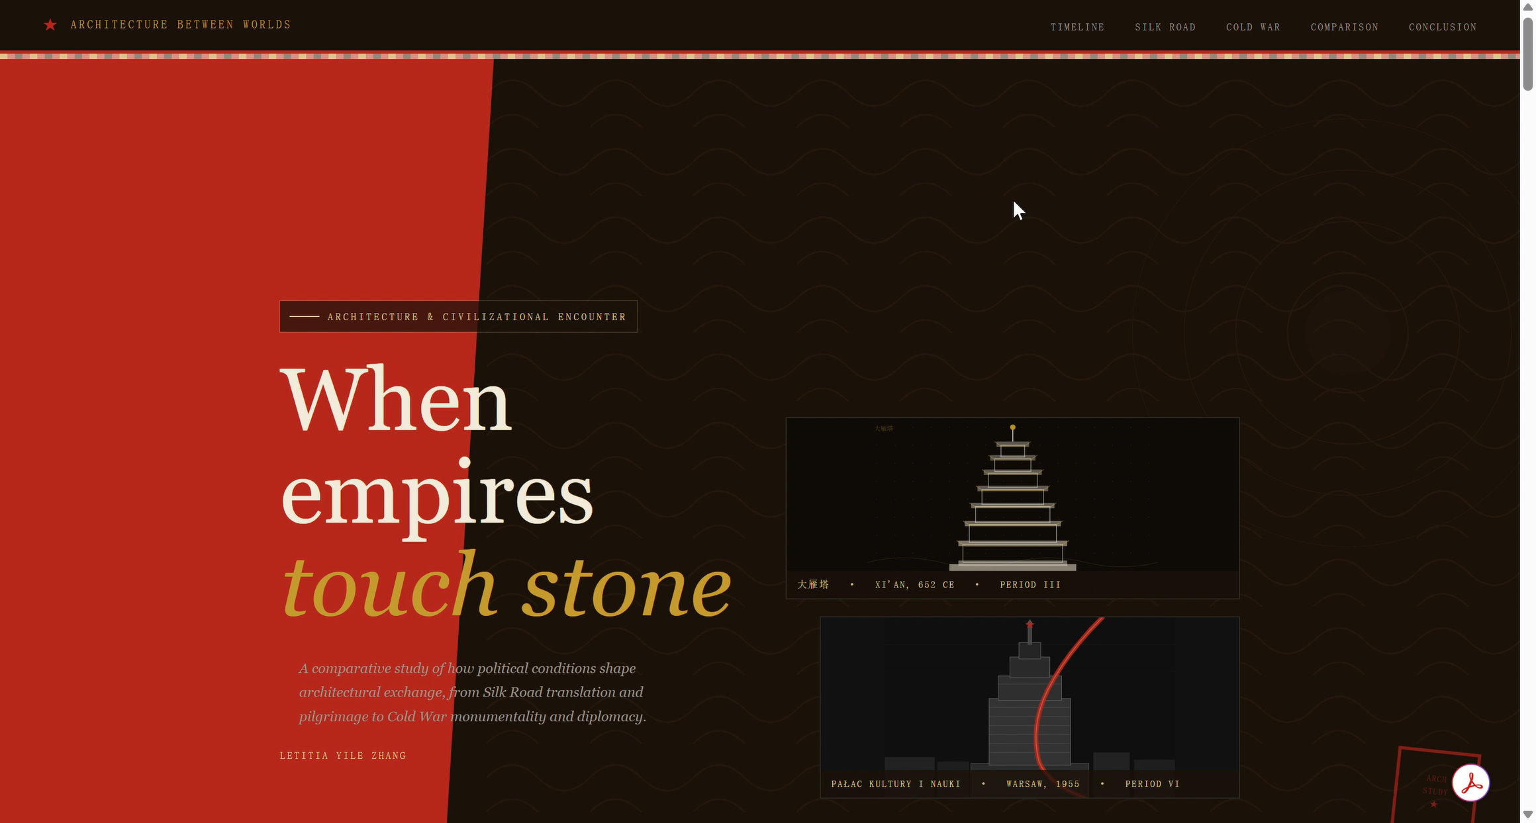
Architectures of Power: Political Civilizations along the Silk Road and Cold War A Website Design Project Letitia 2230025104

Slide 2
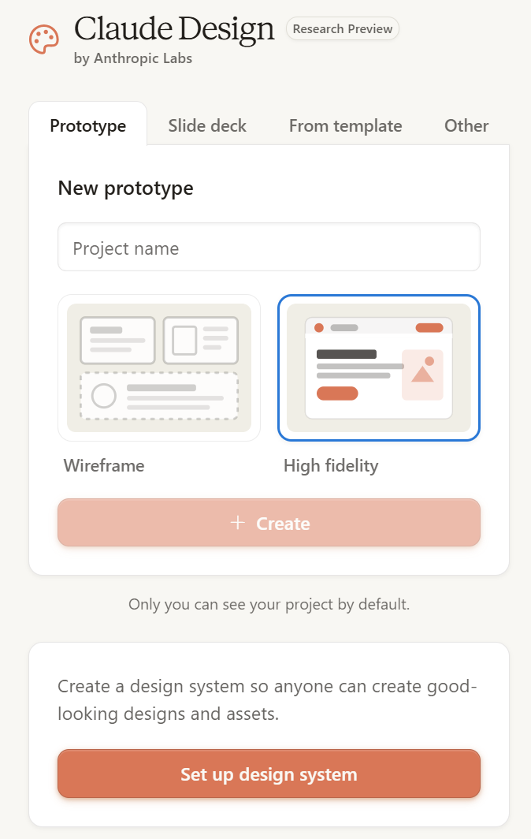
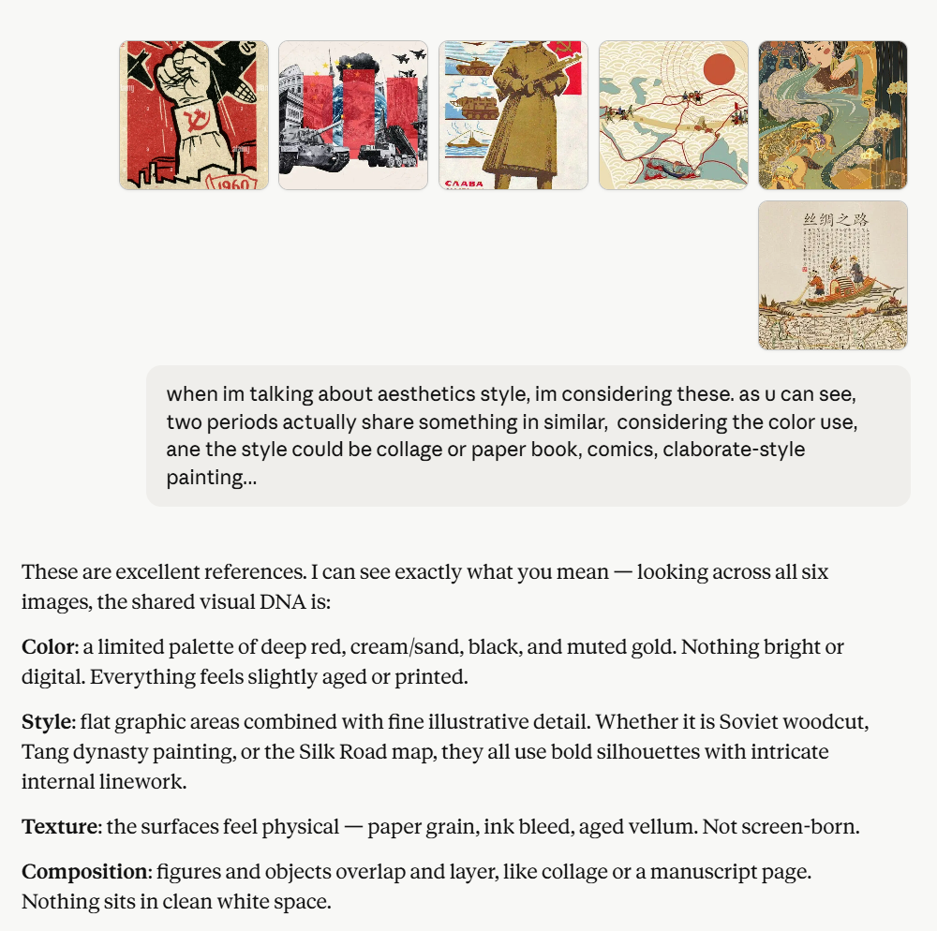
AI Tools: Claude (Design) & Codex
Claude Design - Starting from zero
Launched by Anthropic Labs on April
Defines the initial visual direction Color palette, typography, image style, and overall atmosphere
Translates references into a coherent design language Strong ability to analyse and mimic reference styles
Builds the website structure Sections, page hierarchy, layout logic, and content flow
Official Introduction: https://www.anthropic.com/news/claude-design-anthropic-labs

Slide 3
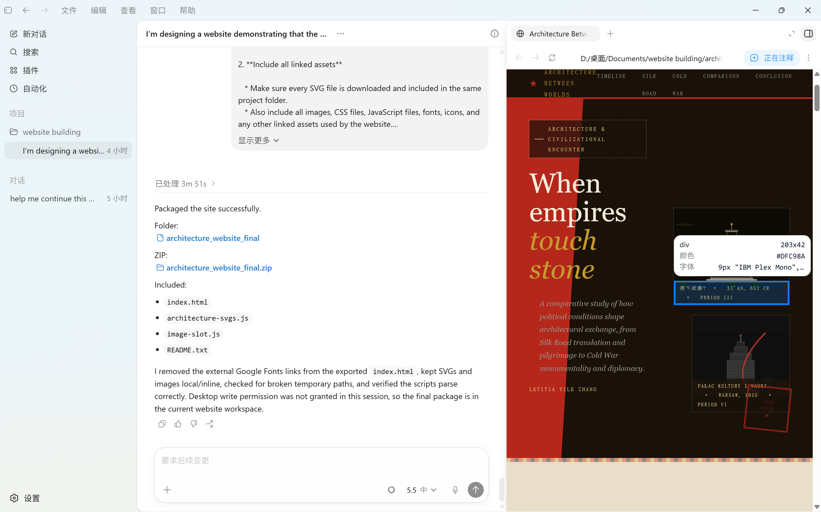
AI Tools: Claude (Design) & Codex
Codex – Vibe-coding
Tackle Claude Design’s limitations in scarce (and expensive!) tokens
Clearer preview window for point-to-point comments and revisions
Better file-level editing for final technical polish

Slide 4
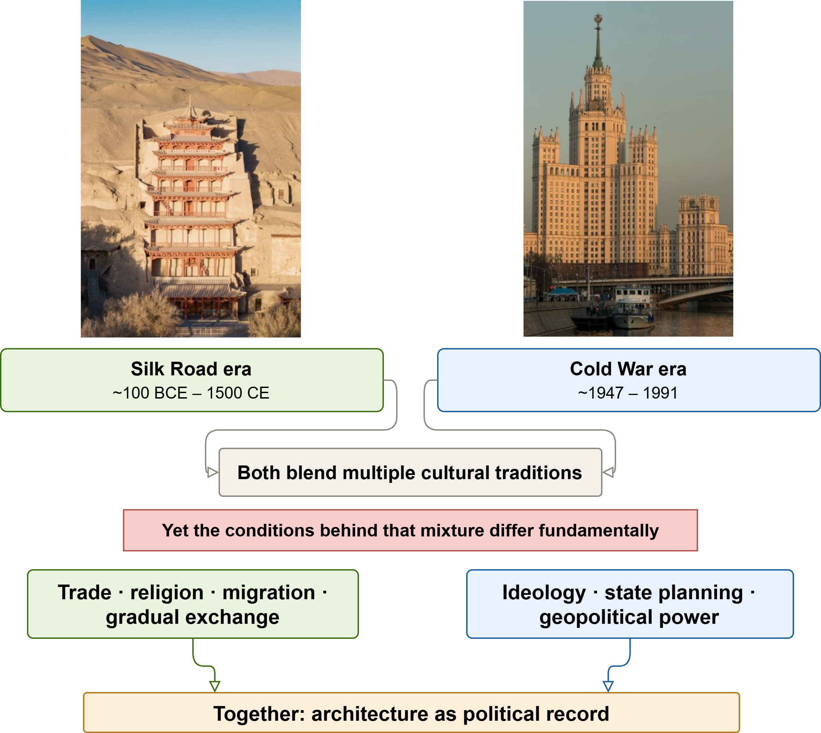
Why Silk Road and Cold War?

Slide 5
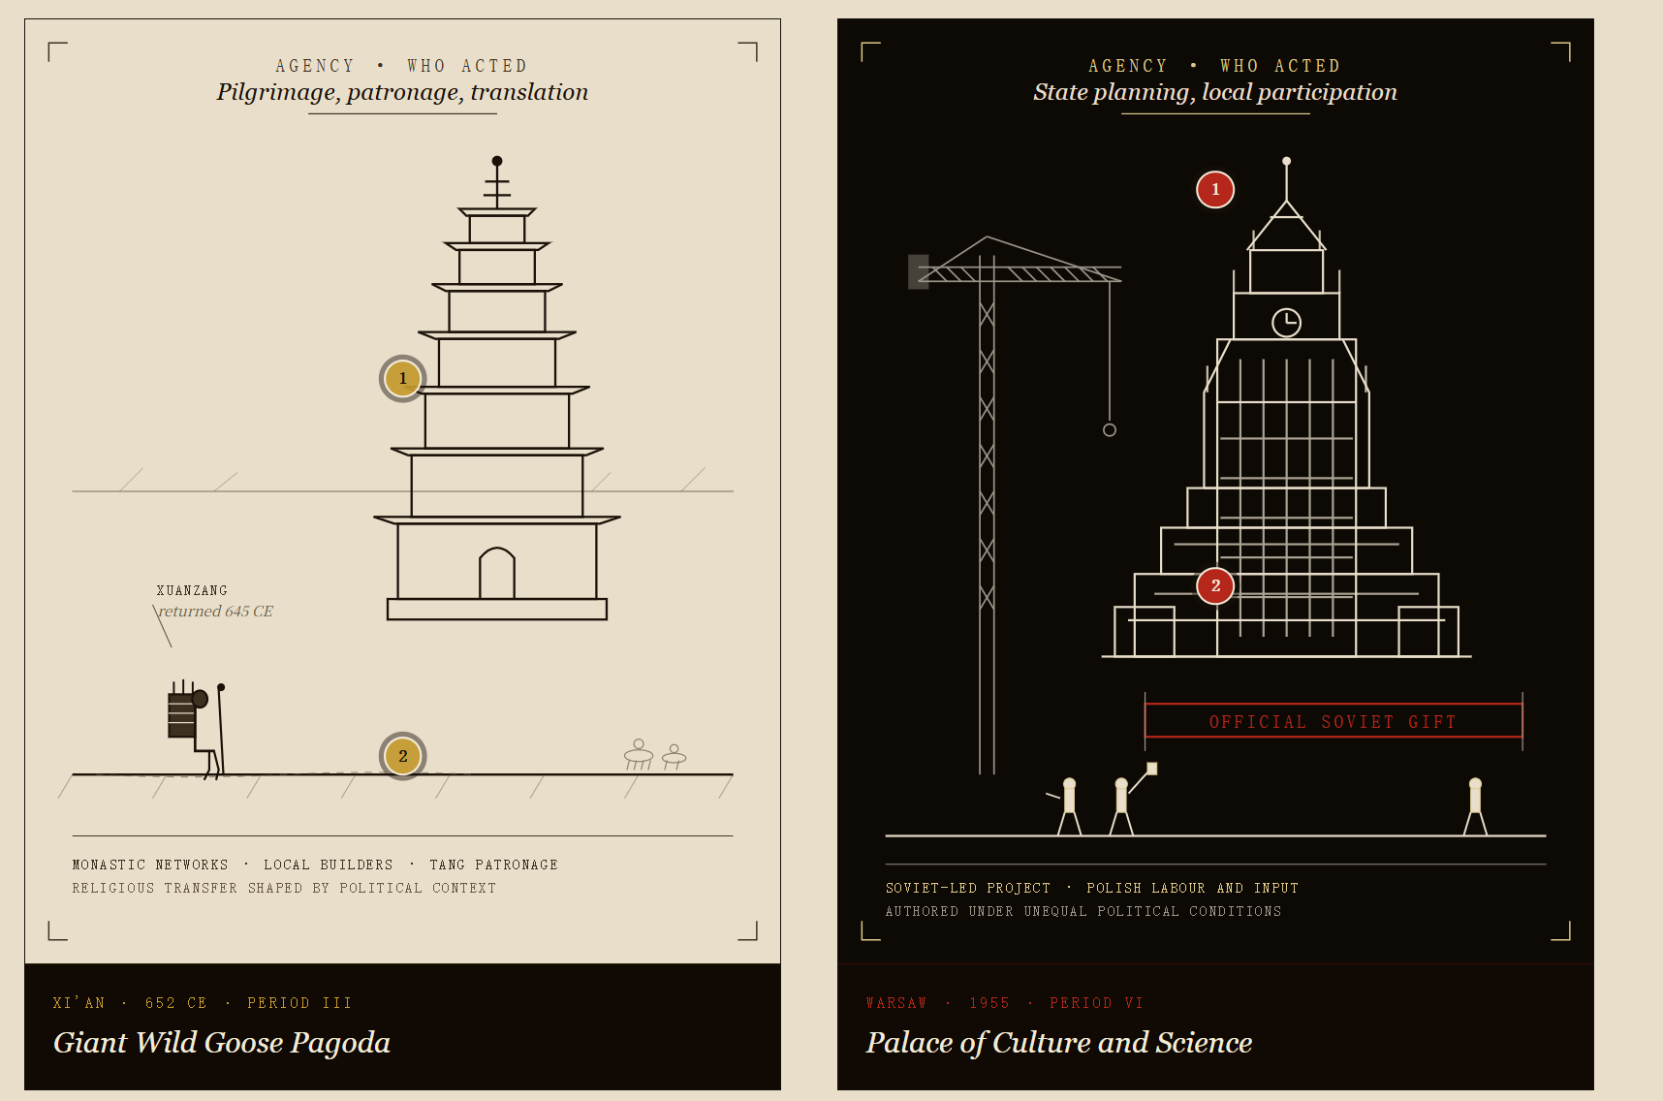
Comparison of Agency: Giant Wild Goose Pagoda vs Palace of Culture and Science

Slide 6
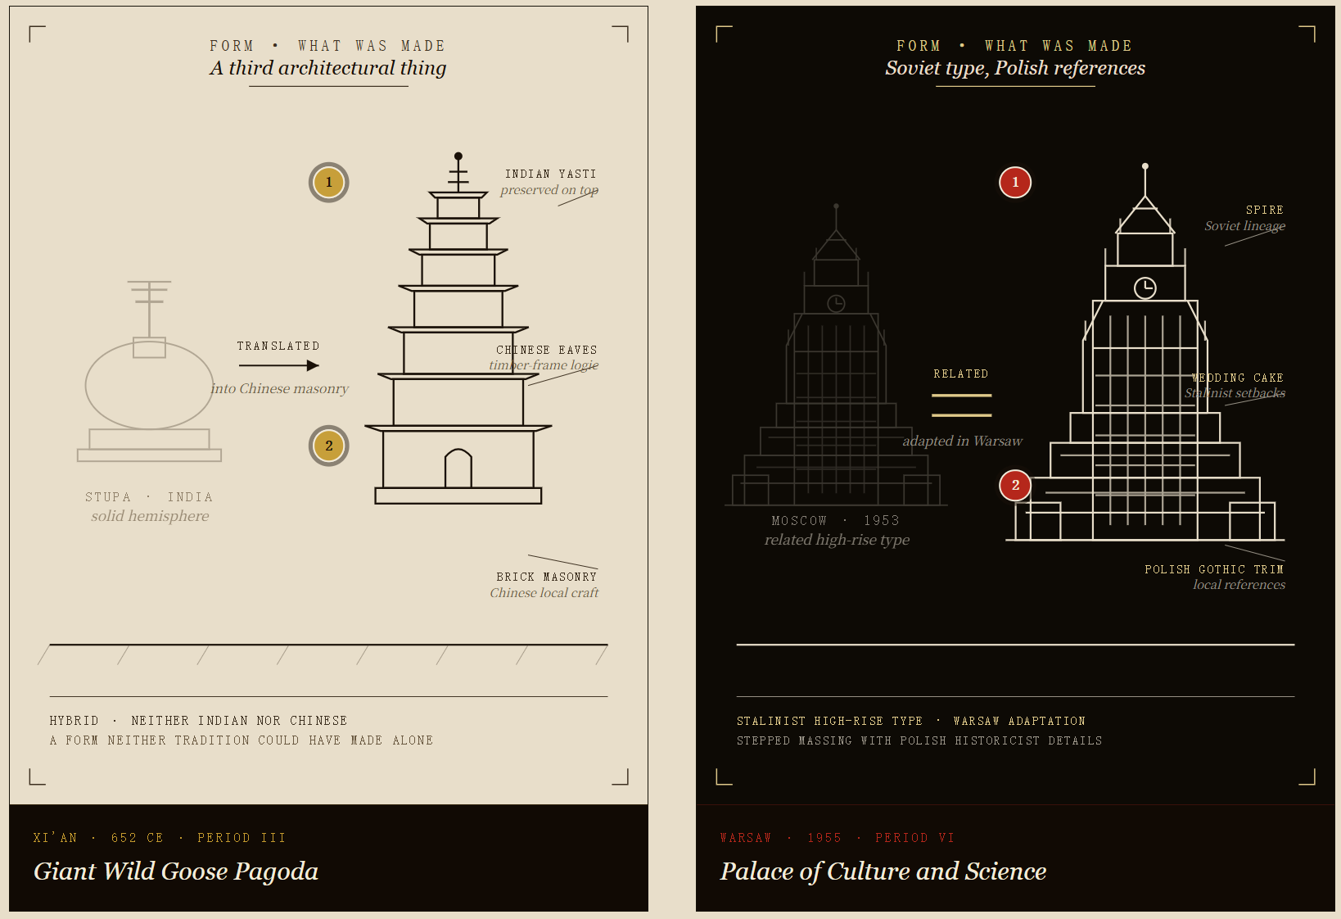
Comparison of Form: Giant Wild Goose Pagoda vs Palace of Culture and Science

Slide 7
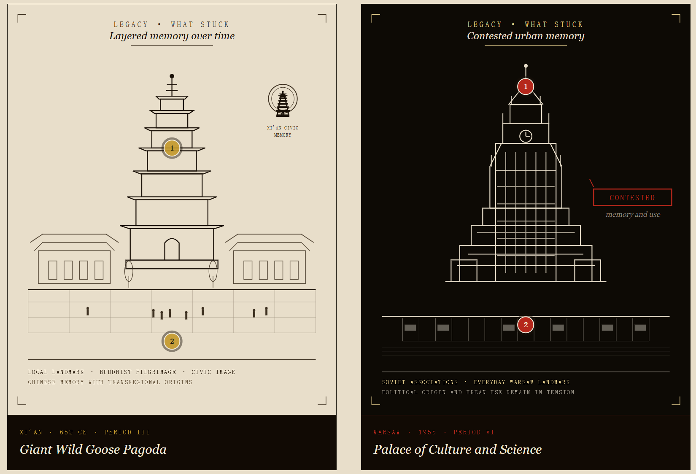
Comparison of Legacy: Giant Wild Goose Pagoda vs Palace of Culture and Science

Slide 8
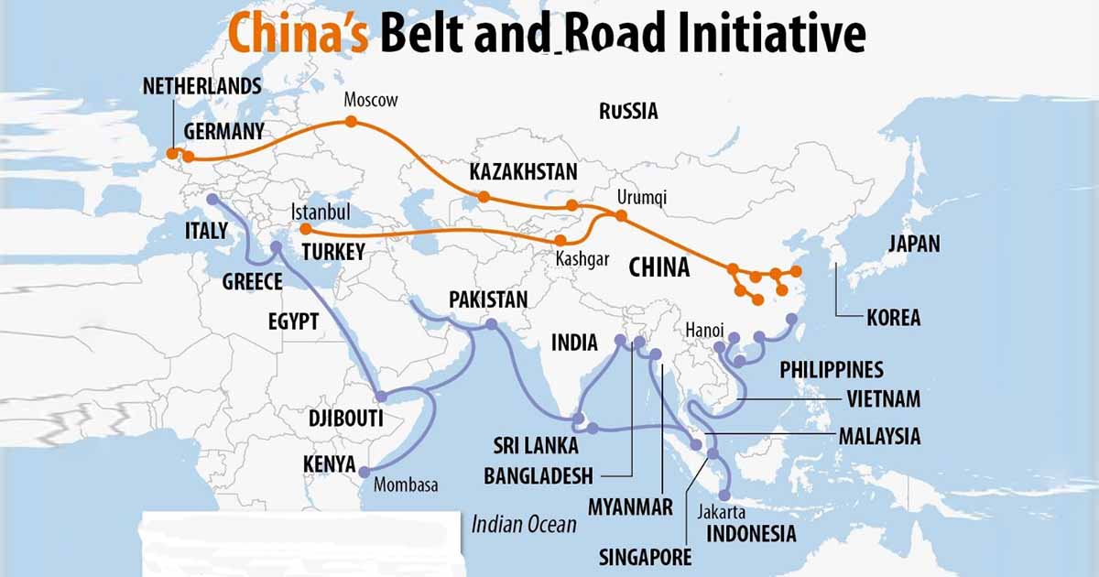
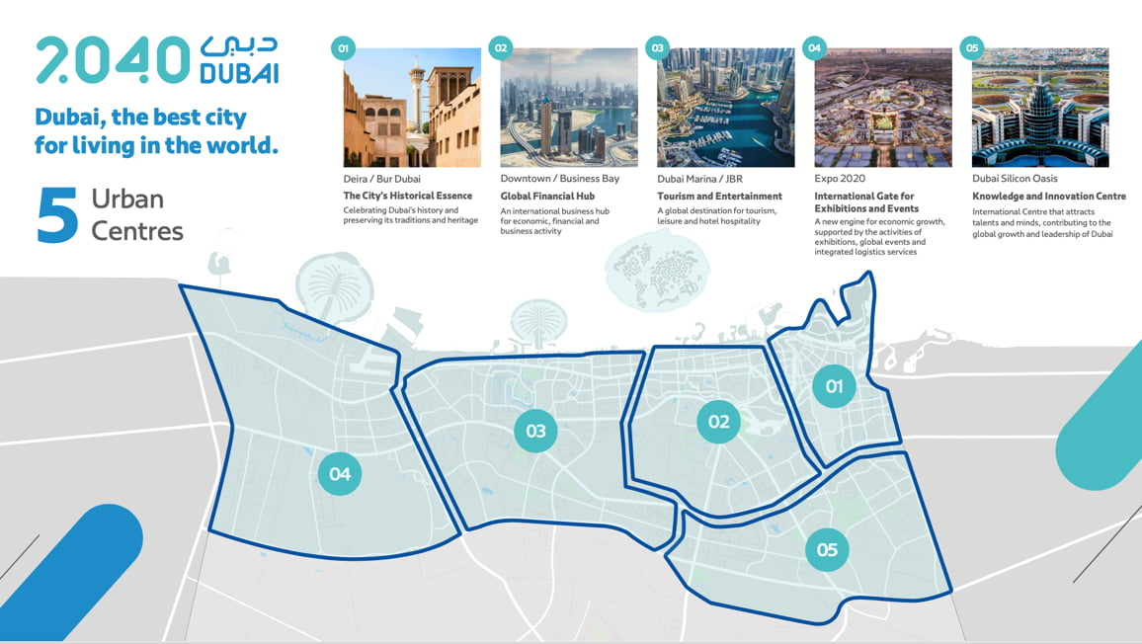
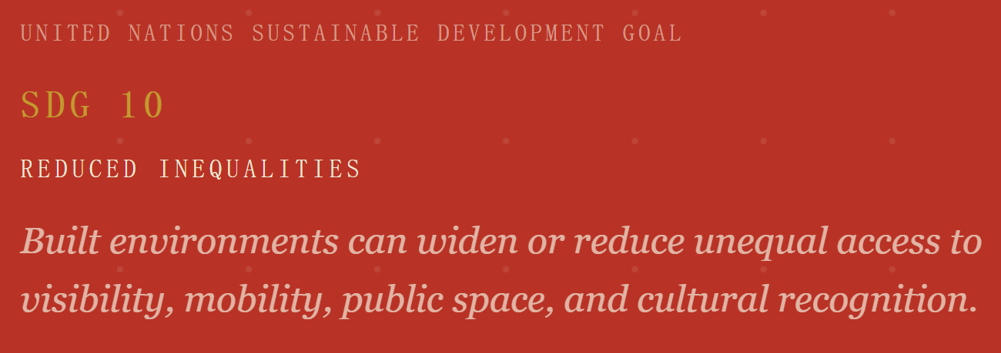
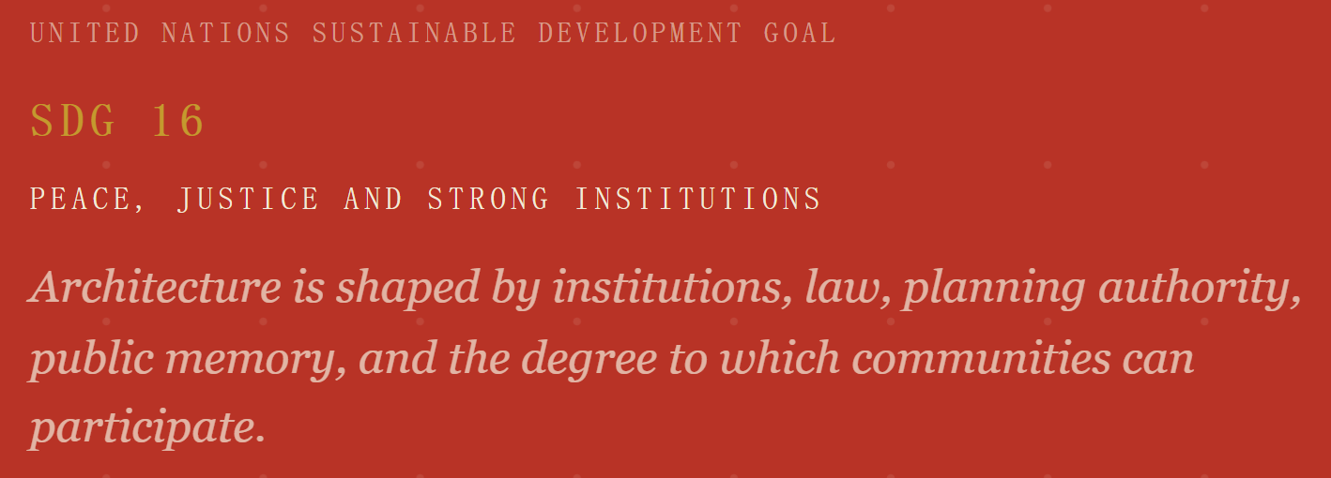
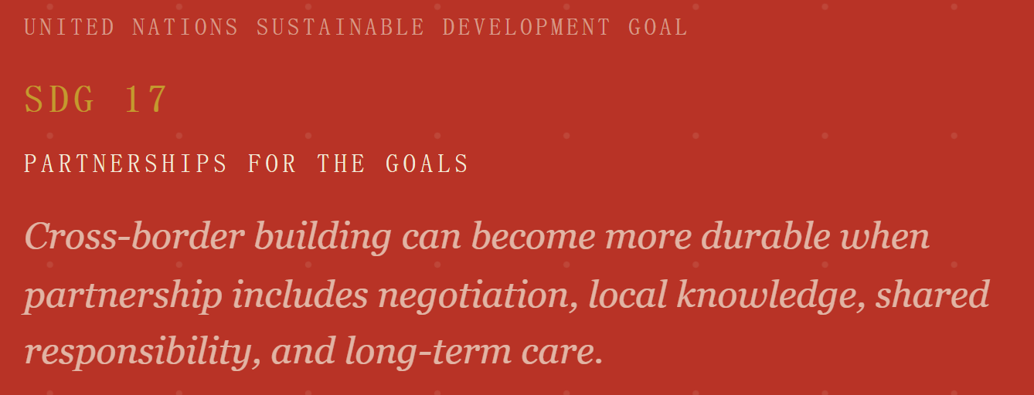
How will today's encounters be reinterpreted?
Contemporary projects may support inclusion, identity, cooperation, and shared infrastructure. They may also expose unequal access, institutional leverage, environmental costs, or unresolved histories. Their future meaning will depend not only on design intent but on governance, maintenance, public use, adaptation, and the communities that inherit them.

