Slide 1
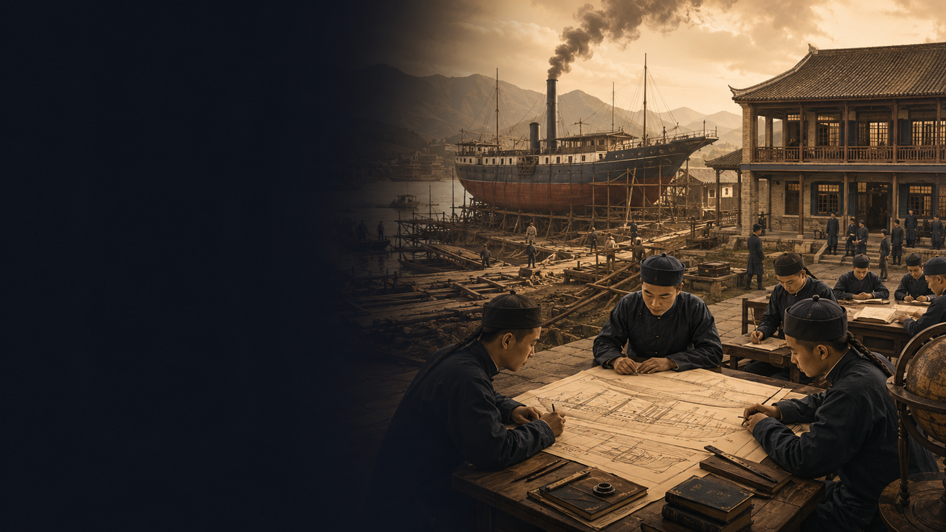
Education & Economy in Modern China
The Fuzhou Shipbuilding Academy, 1866–1895
Wang Zhenyu

Slide 2

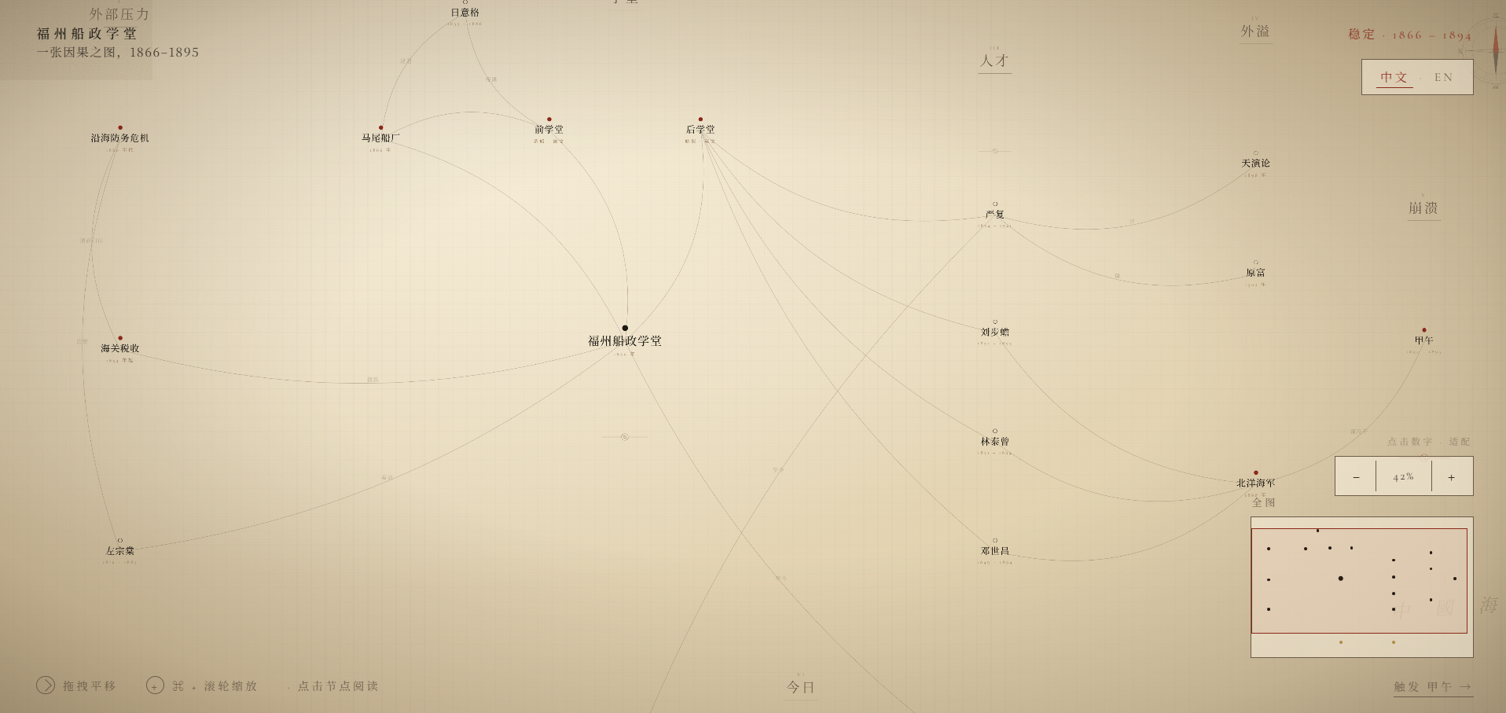
Why I Used Claude Code to Build an Interactive Webpage
CORE INSIGHT
A webpage lets the audience move through this relationship step by step.
The page can include a timeline from 1866 to 1895, with clickable sections.
Helps turn an idea into a working webpage quickly.
My goal is to make the webpage work like a guided explanation. The interaction is not for decoration

Slide 3
Why I Choose 1866 to 1895
Education becomes a foundation for economic development,
but the level of economic development also shapes the size, quality, and direction of education.
Economic Demand Shapes Education
The Fuzhou Shipbuilding Academy's curriculum was shaped by economic and military needs: shipbuilding required engineering, marine engines required mechanics, navigation required mathematics and English.
CORE INSIGHT
External Pressure
Late Qing China lacked modern warships, shipyards, engineers, translators, and naval officers. Without modern technical education, building modern industrial capacity was impossible.
Fiscal Capacity Limits Growth
The academy relied on customs revenue. It was not a national education system but one of a small number of technical schools created by concentrating limited resources.

Slide 4
01 WHY I CHOOSE
02 WHAT HAPPENED
03 WHAT THIS MEANS TODAY
What Happened
Foundation
Zuo Zongtang proposed the Fuzhou Arsenal and Academy at Mawei,
with a front school (French, shipbuilding) and a rear school (English, navigation).
Results
Graduates like Liu Buchan and Deng Shichang became Beiyang Navy leaders.
Yan Fu translated Western works including Evolution and Ethics and The Wealth of Nations.
Decline
After defeat in the First Sino-Japanese War, the Beiyang Fleet was destroyed.
Orders for the Fuzhou Arsenal declined, and the academy's development was interrupted.
1866
1870s
1895
Key Insight
This was a recombination of technology, institutions, and talent through cross-civilizational contact. French shipbuilding tech entered China, was reshaped by Qing needs, and students created new effects across industrial and intellectual fields.
When the external environment collapsed, even an existing system could be interrupted, the mutual support between education and economy does not continue automatically.

Slide 5

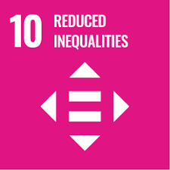
01 WHY I CHOOSE
02 WHAT HAPPENED
03 WHAT THIS MEANS TODAY
What This Means Today
Reduced Inequalities
Decent Work and Economic Growth
The same is true today for artificial intelligence, green energy, semiconductors, and advanced manufacturing.
Industrial upgrading cannot rely only on equipment and capital. It also requires long-term investment in education.
Today, if high-quality technical education is concentrated only in a few regions or among a few groups, economic opportunities will also become concentrated.
Expanding access to vocational education and technical training can help more people enter new industries.

Slide 6
THANK YOU

