Slide 1
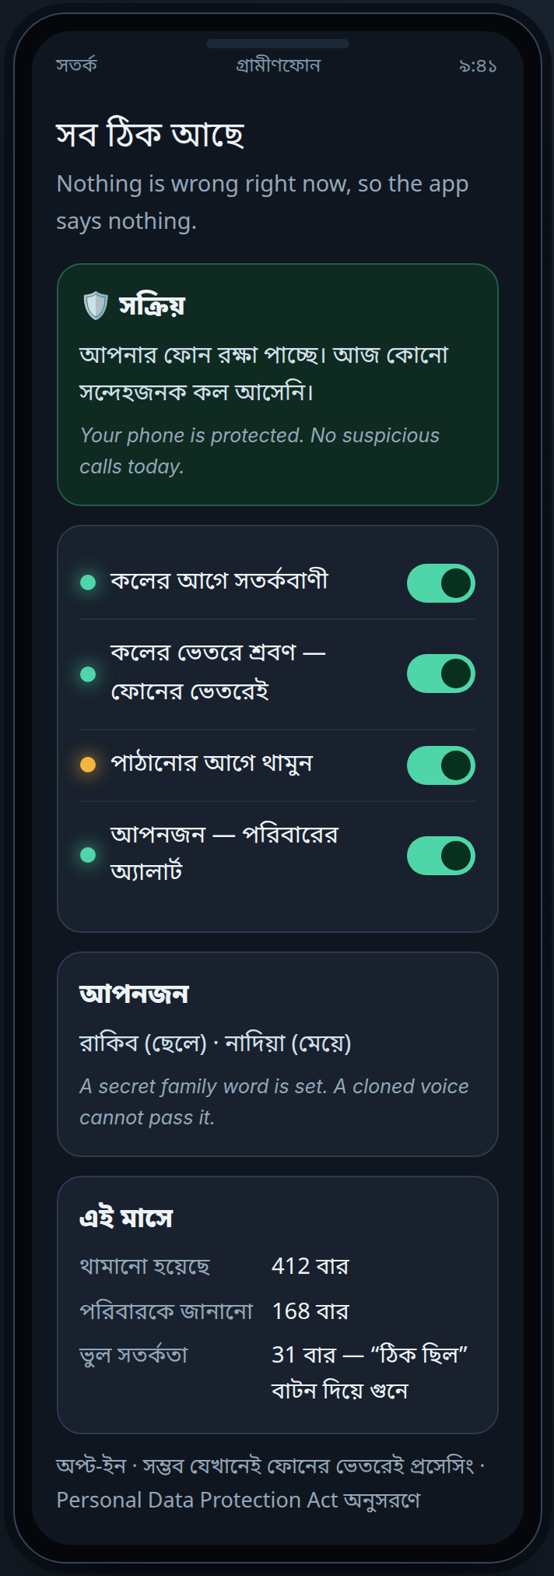
সতর্ক
Shotorko
Stop the scam.
Not the call.
Bangla-first voice safety · any phone · no app store
GP FutureMakers 2026 · Concept Pitch Round
Live prototype · abukawser.xyz
Notes:
Shotorko means *be alert*. One sentence: a phone scam only works for about ninety seconds, and this is built to win those ninety seconds on the cheapest phone in the room. Everything you will see screenshotted in this deck is a real capture of a working prototype, and you can open it yourself at the end.
— Scoring: Clarity — the whole promise in three words, and the prototype named on the first screen
— If asked: Q&A 11 — isn't this a feature? The loop is the product, not the screen.

Slide 2
THE PROBLEM
ভয় · তাড়া · একা
Fear. Urgency. Secrecy.
ONE CALL
আমি থানার ওসি। আপনার ছেলেকে ধরা হয়েছে। এখনই ৩০,০০০ টাকা পাঠান। কাউকে বলবেন না।
Fake police. Son arrested. Send the money now. Tell no one.
0:00
ভয় fear
0:20
তাড়া rush
1:10
একা alone
3:00
টাকা পাঠানো money leaves
Who absorbs it:
older parents in district towns, on the phone they already own
+2 দিন
নাম্বার বন্ধ number dead
The gap: nobody defends those three minutes
Shotorko · সতর্ক · GP FutureMakers 2026
2 / 10
Notes:
Not ignorance — timing. The scam is not a knowledge problem; the victim is not stupid. Fear, urgency and a demand for secrecy arrive together, and that combination shuts down the part of the brain that checks. Look at the clock on the right: three minutes from the first sentence to the money leaving, and two days until the number is dead. Nobody — not the bank, not the family, not the network — is in that three minutes. That window is the product.
— Scoring: Depth of problem understanding — the mechanism of the scam — fear, urgency and silence arriving together — not the fact that scams exist
— If asked: Q&A 13 — Google and Samsung already do this: they need the right handset and a supported language.

Slide 3
PROBLEM DEPTH · COMPETITION
Every defence answers a different crime.
Carrier spam filters
built for volume, not for one persuasive voice
×
Number blocklists
a fresh SIM costs Tk 200
×
Bank and MFS rules
they see the transfer, never the call
×
Awareness campaigns
the script rewords faster than the poster prints
×
Smartphone security apps
the target phone is a Tk 800 button phone
×
Missing: a defender inside the call, in Bangla
Shotorko · সতর্ক · GP FutureMakers 2026
3 / 10
Notes:
Each of these is a real control, and each has a specific reason it misses this case. The important asymmetry: the bank sees a transaction and the operator sees a call, and nobody sees the moment a person is being frightened into pressing buttons. And note the last row — the handset most exposed is the one no app can protect, which is why an app company cannot solve this and an operator can.
— Scoring: Depth of problem understanding & differentiation — knowing exactly why each existing control misses this case
— If asked: Q&A 6 — can you really inject before the ring? An operator capability, with an honest weaker fallback.

Slide 4
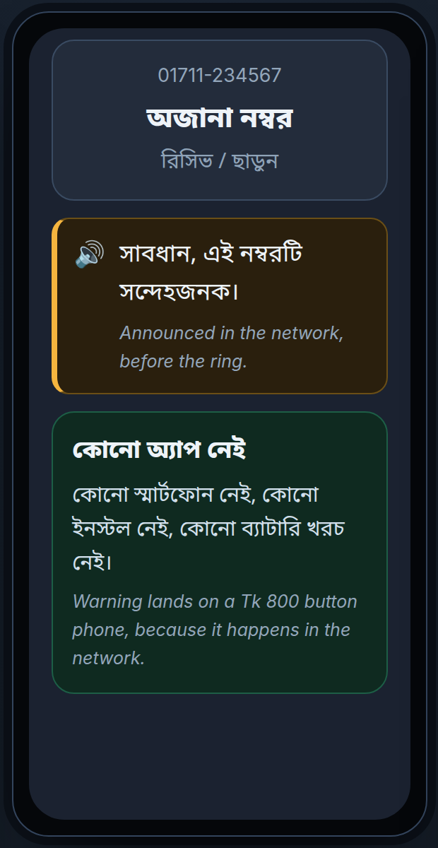
THE MARKET THE MONEY IS IN
The money is already digital.
MOBILE FINANCIAL SERVICES — BANGLADESH BANK, JULY 2026 · SUBSCRIBERS — BTRC, AUGUST 2026
Tk 2.17T
MFS volume
Tk 182.7B
e-money float
258.7M
MFS accounts
191.09M
mobile SIMs
87.20M
Grameenphone
45.6% share
WHY THAT MATTERS FOR GP
— 1.03 billion MFS transactions in one month
— 130.2M MFS accounts are rural
— 68M subscribers are still outside 4G — so the defence cannot live in the cloud
this phone too
Bangladesh Bank MFS statistics (July 2026) · BTRC mobile subscribers (August 2026) · links and what is calculated: Appendix A1
The buyer is not the victim: a parent loses the money, Grameenphone loses the trust
Shotorko · সতর্ক · GP FutureMakers 2026
4 / 10
Notes:
This is the surface we are selling into, and it is published, not estimated. Bangladesh Bank recorded 1.03 billion mobile-financial-services transactions worth 2.17 trillion taka in July alone, on 258.7 million accounts — and more than half of those accounts are rural. BTRC counts 191 million mobile subscribers, 87.2 million of them Grameenphone. The business line at the bottom is the one to remember: the person who loses the money is not the person who buys the protection. Grameenphone buys it because 182.7 billion taka of e-money float is trust, and trust is the product.
— Scoring: Impact & market understanding — the measured size of the money that moves digitally, from primary sources
— If asked: Q&A 14 — how big is this really: Appendix A1 for the denominators, A2 for the attach-rate ladder.

Slide 5
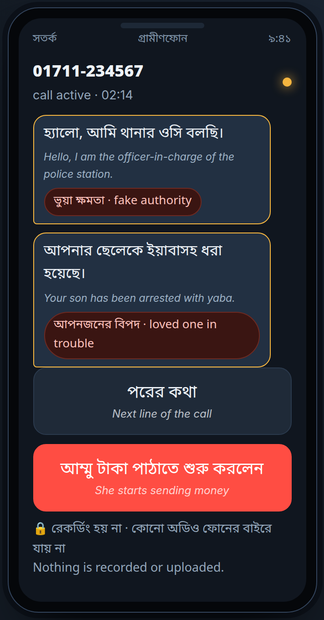
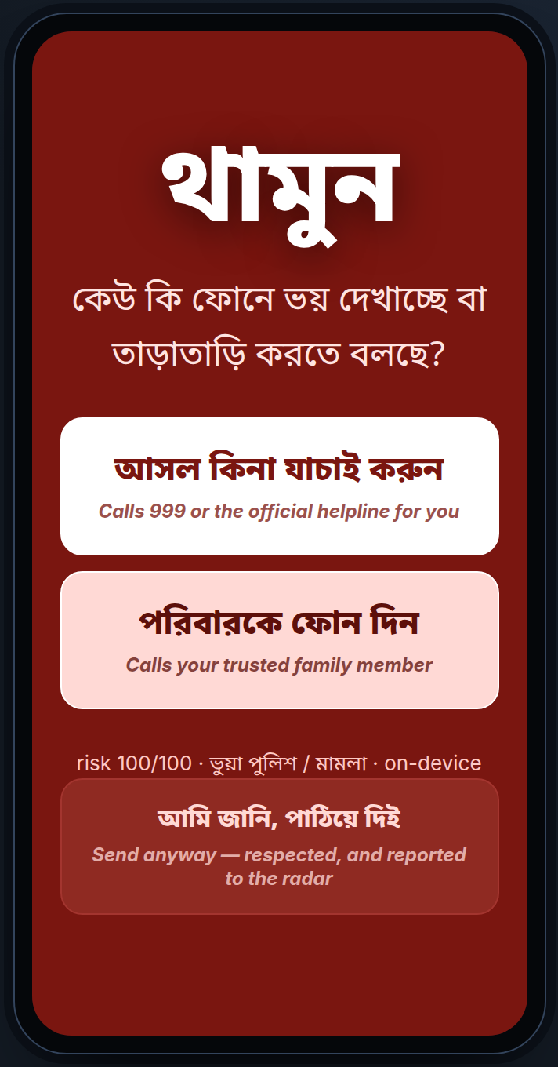
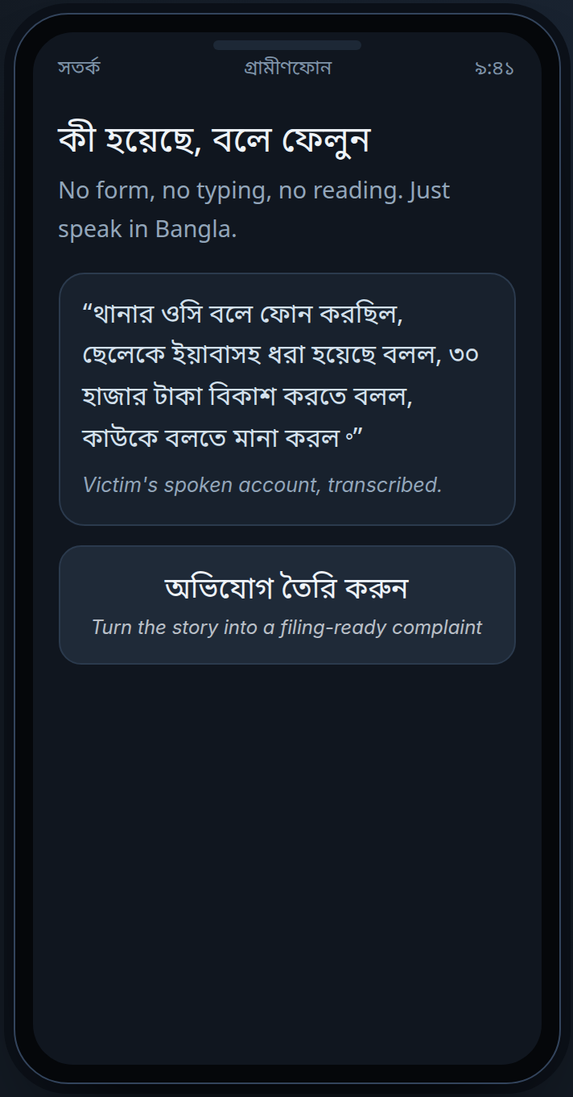
THE SOLUTION
Four moments. One defence.
captured from the live prototype
১ কলের আগে
before the call
২ কলের ভেতরে
during the call
৩ থামুন
the pause
৪ রিপোর্ট
after
Two of the four need no smartphone at all. They happen in the network.
Shotorko · সতর্ক · GP FutureMakers 2026
5 / 10
Notes:
One continuous defence, four moments. Before the call, one Bangla sentence plays in the network before the phone rings — no app, no install, no smartphone. During the call, the handset understands intent and nothing is recorded. At the moment money or a code is about to move, the pause. And after, a spoken Bangla story becomes a complaint that can actually be filed, which feeds a radar that clusters numbers into the networks behind them. Two of those four need no software on the handset at all — that is the reach argument, and it is the reason the pilot can protect a button phone on day one.
— Scoring: Solution strength — four moments of one continuous defence, two of which need no handset at all
— If asked: Q&A 5 — what does the model see? Nothing is stored; opt out of call listening and two layers still work.

Slide 6
THE INTERVENTION
থামুন
One question. Three buttons.
যাচাই করুন
we dial the verification number for you
পরিবারকে ফোন
the family you already saved, one tap
আমি জানি
the user decides — and it is still reported
Warn. Never block.
Wrong: one screen. Right: Tk 30,000.
live capture · risk 100/100
Shotorko · সতর্ক · GP FutureMakers 2026
6 / 10
Notes:
This is the screen, and it is a live capture — that call scored risk 100 out of 100 on the on-device engine and was labelled fake police. Notice what it does not do. It does not block the call. It does not claim you are being scammed, because we may be wrong. It asks one question a frightened person can answer honestly, and offers three exits: verify, call family, or send it anyway — and *anyway* is honoured, and it still teaches the model. On a feature phone the same pause is a voice prompt with two keys. Warn, never block, because a wrong warning costs one screen and a right one keeps 30,000 taka. On the on-device engine this call scored risk 100/100 and was labelled ভুয়া পুলিশ / মামলা.
— Scoring: Solution strength & clarity — the intervention itself, and the restraint inside it
— If asked: Q&A 2 — false positives: three gates, and warn-never-block means a wrong answer costs one screen.

Slide 7
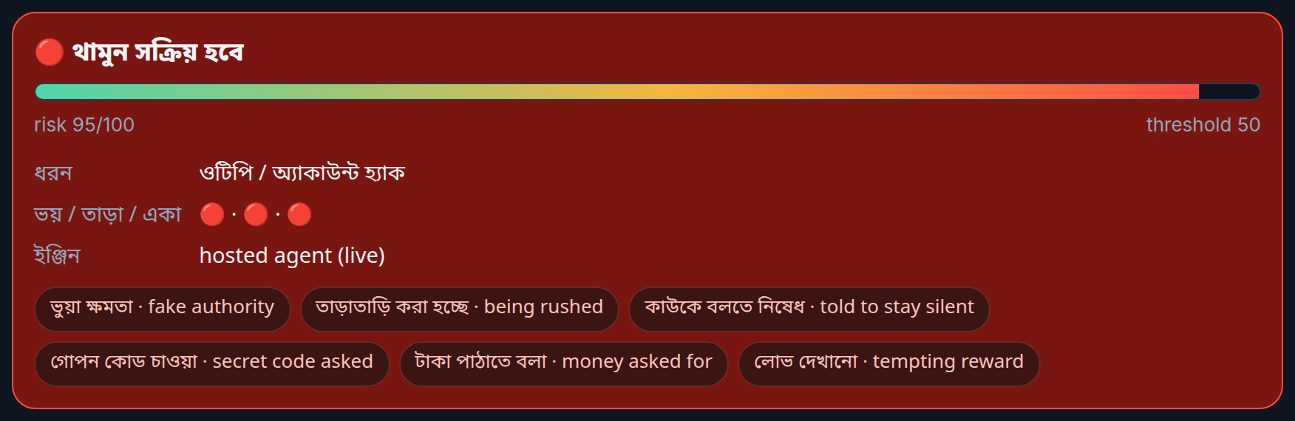
AI APPLICATION & TECHNICAL RATIONALE
Intent, not a word list.
EIGHT SIGNALS
THE SAME SENTENCE, JUDGED LIVE
authority
leverage
urgency
secrecy
credential
payment
reward
install
× THE SITUATION AROUND THEM
unknown caller
call in progress
first receiver
unusual amount
late night
A hosted model call from the free-play console: risk 95/100, five signals named in Bangla.
risk ≥ 50 + an actual ask = থামুন
0 of 10
ordinary sentences paused
4 of 5
reworded scam scripts paused
One signal is normal conversation.
A mother asking for money is not a scam. The combination is.
69
backend checks pass offline
On the handset. No cloud call, no per-call bill.
Shotorko · সতর্ক · GP FutureMakers 2026
7 / 10
Notes:
The claim you should test: the classifier does not look for the word OTP. It looks for pressure — authority claimed, a child in trouble, urgency, a demand for silence — and then an ask. Any one of those is normal conversation; the combination is the signature, and rewording does not escape it because the signals are semantic. Two gates sit on top: the situation multiplies the score, and nothing fires without an actual ask. I measured rather than hoped — ten ordinary sentences in friendly context produce zero pauses; five reworded scam scripts produce four. The reason it must run on the handset is not only privacy: 68 million subscribers are not on 4G, and a rural handset cannot round-trip to a cloud model inside a three-minute window. Any one of those eight signals is normal conversation; the combination is the signature. The hosted model carries only the generative part — a spoken story into a filed complaint — and never decides the interruption alone.
— Scoring: AI application & technical rationale — semantic signals over a word list, and why they must run on the handset
— If asked: Q&A 3 — a scoring function, not a neural net: the contract is the design work, the corpus is the ask.

Slide 8
BUSINESS MODEL
Who pays, and why they keep paying.
WHO PAYS
Subscriber
Tk 20 a month · opt-in
WHO BILLS
Grameenphone
on the phone bill, as a pack
WHO BUILDS
Shotorko
model · engine · report standard
→
→
Revenue
Tk 20 × 1% of GP's 87.20M base = Tk 209M in year one
Cost avoided
fraud refunds · hotline minutes · churn after a publicised loss
Later
scam-network intelligence, licensed to MFS operators, 999 and BTRC
PROOF THAT PEOPLE PAY FOR THIS
— Truecaller: 4M+ paying subscribers, 0.75% of free users convert (Mar 2026)
— Verizon Call Filter Plus: USD 3.99 a month — and it only blocks numbers
Margin: the classifier runs on the handset, so a warning is not a cloud bill
Shotorko · সতর্ক · GP FutureMakers 2026
8 / 10
Notes:
The subscriber pays 20 taka a month, Grameenphone bills it as an ordinary value-added pack, and we supply the model, the engine and the report standard. Year one at one percent attach on GP's base is 209 million taka — small money for an operator, which is honest, and the bigger line is cost avoided: fraud refunds, contact-centre minutes, and the churn that follows a publicised loss in a wallet holding 182.7 billion taka of float. One percent is not a hope: Truecaller converts 0.75 percent of its free base into paid subscribers, and Verizon sells the weaker version of this product — caller blocking — at four dollars a month. Our margin is structural: inference runs on the handset, so serving a warning costs no cloud call.
— Scoring: Feasibility, scalability & business sense — who pays, what they pay for, and evidence that people pay for this
— If asked: Q&A 15 — will anyone pay for safety: Truecaller's measured 0.75% conversion, and Verizon's price point.

Slide 9
MARKET SIZE · GO-TO-MARKET
TAM · SAM · SOM
Tk 45.9B
TAM · every mobile subscriber
191.09M × Tk 20 × 12 · calculated
Tk 20.9B
SAM · Grameenphone's base
87.20M × Tk 20 × 12 · calculated
Tk 209M
SOM · year one
1% attach · Truecaller converts 0.75%
GO-TO-MARKET
Phase 1 · 0–6 months
one district · 5,000 opt-in · GP fraud-cell audio · the network warning first
Phase 2 · 6–18 months
nationwide add-on pack · MFS agent shops · 999 and fraud-cell handoff
Phase 3 · 18 months +
a shared report standard · other operators · licensed to MFS and BTRC
Denominators: BTRC subscribers (Aug 2026), Bangladesh Bank MFS (Jul 2026). The Tk 20 price and the 1% attach rate are our assumptions, not a surveyed willingness to pay.
Entry wedge: the pre-call network warning reaches every handset GP already serves — no install, no upgrade
Shotorko · সতর্ক · GP FutureMakers 2026
9 / 10
Notes:
The sizing is arithmetic you can redo on a napkin: 191 million subscribers at 20 taka a month is 45.9 billion taka, GP's own base is 20.9 billion, and a one percent attach is 209 million in year one. I want to be explicit that the price and the attach rate are our assumptions — no Bangladeshi willingness-to-pay survey covers this category, and I will not pretend one does. The sequencing matters more than the number: phase one is the pre-call network warning, because it needs no handset software, no upgrade and no app store, so it reaches all 87 million subscribers on the day it switches on.
— Scoring: Market analysis & scalability — sizing a judge can redo on a napkin, and a go-to-market that is sequenced
— If asked: Q&A 18 and 19 — the growth path past Grameenphone, and the national fraud-loss figure we refuse to invent.

Slide 10
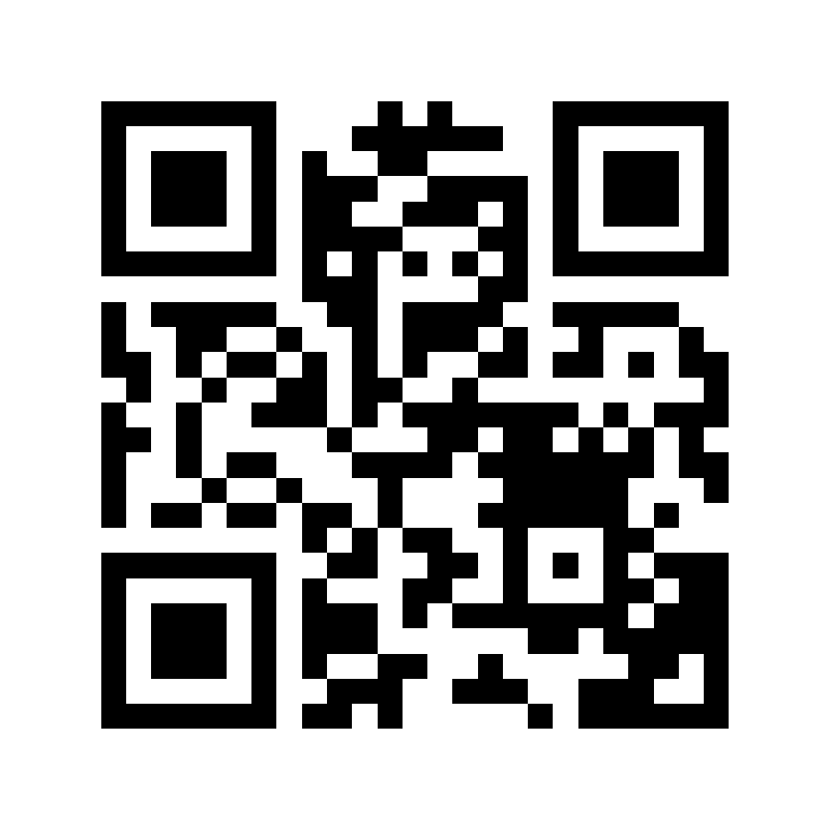
IMPACT · THE ASK · LIVE PROOF
সতর্ক থাকুন।
Stay alert. Tell the family.
WHAT CHANGES IF THIS WORKS
— Tk 30,000 stays with the person least able to lose it
— one filed report instead of one family argument
— trust in digital money stays with Grameenphone
WHAT WE ASK GP FOR
1. fraud-call audio and CDR patterns, anonymised
abukawser.xyz
no login · no install · works on a phone
2. one network announcement slot
3. one USSD gating test on *21
4. one pilot district · 90 days
On the site: Play the story runs the whole intervention in under a minute; নিজে যাচাই takes a scam line you were actually sent.
Reputations and radar records are demo data, and the page says so on every screen.
Shotorko · সতর্ক · GP FutureMakers 2026
10 / 10
Notes:
Three things change: the money stays with the person least able to lose it, a victim's spoken story becomes a filed record instead of a family argument, and trust in digital finance stays inside Grameenphone. To find out whether that is real I need four things — the fraud cell's recordings, one announcement slot, one USSD gating test, and a district for ninety days. Everything you saw screenshotted is live on this address right now. The on-device engine answers with no network at all, and flip to Live agent to watch the same sentence judged by a hosted model. Thank you.
— Scoring: Clarity & impact — the claim, the ask and the proof are all on one page the judges can open
— If asked: Q&A 23 — what would make us stop: if four weeks of real speech can't hold the false-positive rate, the pause is dropped and the network layer ships alone.

Slide 11
APPENDIX · SOURCES
Every number, and where it came from.
Tk 2.17T · Tk 182.7B · 258.7M
Bangladesh Bank, MFS statistics: transactions table 9, accounts table 8, July 2026 — bb.org.bd/econdata/fin_digitalfstat
191.09M · 87.20M
BTRC, mobile subscribers by operator, August 2026 — btrc.gov.bd/pages/static-pages/6922dda8933eb65569e15c3d
122.71M on 4G · 69.18% internet
BTRC, teledensity and penetration, August 2026 — btrc.gov.bd/pages/static-pages/teledensity-penetration-8ecc0e-6922e009933eb65569e2524c
4M+ subscribers · 0.75% conversion
Truecaller AB, 10 March 2026 — news.cision.com/truecaller-ab/r/truecaller-surpasses-4-million-premium-subscribers,c4318816
USD 3.99 a month
Verizon Call Filter Plus — verizon.com/support/call-filter-faqs
USD 3.5B lost to imposter scams
US Federal Trade Commission, 15 June 2026 — ftc.gov/news-events/news/press-releases/2026/06/ftc-data-show-people-reported-losing-3-point-5-billion-imposter-scams-2025
Tk 45.9B · 20.9B · 209M
calculated by us from the tables above; the Tk 20 price and 1% attach rate are our own assumptions
What we will not claim: there is no published Bangladeshi national fraud-loss figure, and we did not invent one
Shotorko · সতর্ক · GP FutureMakers 2026
A1 / A3
Notes:
[only if a number is challenged] Two primary sources carry every market number in this deck: Bangladesh Bank's MFS statistics for July 2026, and BTRC's subscriber and penetration tables for August 2026. The behavioural benchmarks are Truecaller's published subscriber count and conversion rate, and Verizon's published price. The FTC figure is there to show the category, not the market — it is American. Anything marked calculated is arithmetic on those tables, and the price and attach rate are ours, which is the first thing I would want tested in a pilot.
— Scoring: Credibility — every number traces to a named publication and date, and the gaps are stated out loud
— If asked: Any number a judge challenges — name the publication, the month, and what is calculated rather than published.

Slide 12
APPENDIX · UNIT ECONOMICS
Sensitivity, and what it costs to serve.
GP BASE OF 87.20M SUBSCRIBERS, AT Tk 20 A MONTH
0.5%
Tk 105M / yr
1%
Tk 209M / yr
base case
2%
Tk 419M / yr
3%
Tk 628M / yr
COST TO SERVE
WHY GP WOULD BUY IT
— the classifier runs on the handset — no inference per call
— retention: safety is a reason to stay on the network
— the cloud is used only to write the complaint letter
— Tk 182.7B of e-money float depends on trust
— no app-store royalty: the product is a network service
— fewer fraud tickets in the contact centre
— consumer-protection leadership with BTRC
Shotorko · সতর্ক · GP FutureMakers 2026
A2 / A3
Notes:
The revenue case is linear in attach rate, so the only assumption worth arguing about is that rate: half a percent is 105 million taka, three percent is 628 million. Cost does not scale with it, because the classifier is inference the handset already pays for; the cloud is only in the complaint letter, which the user starts. That is why the margin survives a hundredfold in volume — the thing that breaks at scale is trust in the alert, not the infrastructure.
— Scoring: Feasibility & business sense — the sensitivity of the revenue case, and the cost structure behind the margin
— If asked: Q&A 8, 16 and 17 — cost to serve, the price point, and why the on-device engine is a margin argument as well as a coverage one.

Slide 13
APPENDIX · Q&A PREPARATION
If the three minutes go to the market.
How big is it?
Tk 45.9B TAM · Tk 20.9B on GP's base · calculated
Who pays?
the subscriber, billed by Grameenphone as a Tk 20 pack
Will anyone pay?
Truecaller converts 0.75%; we assume 1% of an opt-in base
Why not just an app?
the phone at risk is a Tk 800 button phone — it needs the network
Why Grameenphone?
warn before the ring, and reputation without a cold start
Cost to serve?
on-device inference: a warning costs no cloud call
Past GP?
a shared report standard, then operators, MFS and BTRC
What would stop us?
if four weeks of real Bangla speech cannot hold the false-positive rate
The full bank of twenty-three questions, with the criterion each one scores, is in pitch/deck-and-qa.md and in the notes pane of every slide.
Shotorko · সতর্ক · GP FutureMakers 2026
A3 / A3
Notes:
[reference slide — not presented] This page is the answer sheet. The rule for the three minutes: the direct answer first, then the honest limit, then what would change the answer. Never quote the demo dashboard as if it were a field trial, and never quote the hosted battery while Google's free quota is throttling — the on-device numbers are the ones on the slide because they are the ones that re-run identically anywhere.
— Scoring: Q&A handling — the market questions taken in advance, answered in one line each
— If asked: This slide is the Q&A sheet itself; the full bank is in pitch/deck-and-qa.md.

