Slide 1
HEALTH CARE COST PREDICTION
TEAM MEMBERS:-
MAYANK KUMAR PANDEY
HARSHINI NARAMBATLA
PROFESSOR-TENGLONG Li

Slide 2
NTRODUCTION
The Primary aim of this analysis is to use patient data to estimate the average medical care expenses for population segments.
The estimates from the analysis are crucial to create actuarial tables that set the price of yearly premiums higher or lower, depending on the expected treatment cost because the most costly conditions are rare and seemingly random and some conditions are more prevalent for certain segments of the population

Slide 3

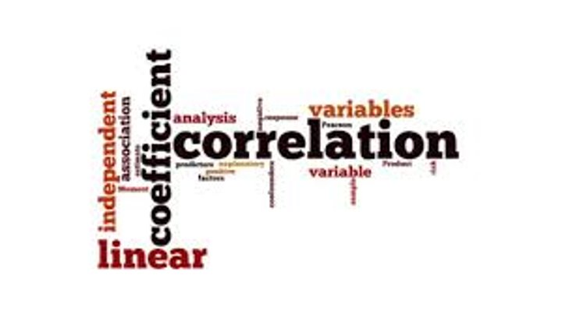
Business Questions
What is the BMI range description simplified combine with smoker people?
What is the Correlation analysis accordance to smoker people age?
What categorical variable in the data is most suitable for the prediction model?

Slide 4
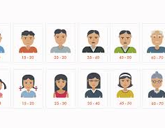

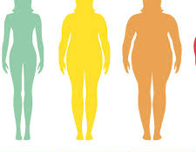
DATASET
Demographic data collected from US census bureau
Consists of 7 column types with 1338 entries
Provides patient listings with total medical expense charge.
Looking for correlation patters in regards with the success of prediction model

Slide 5
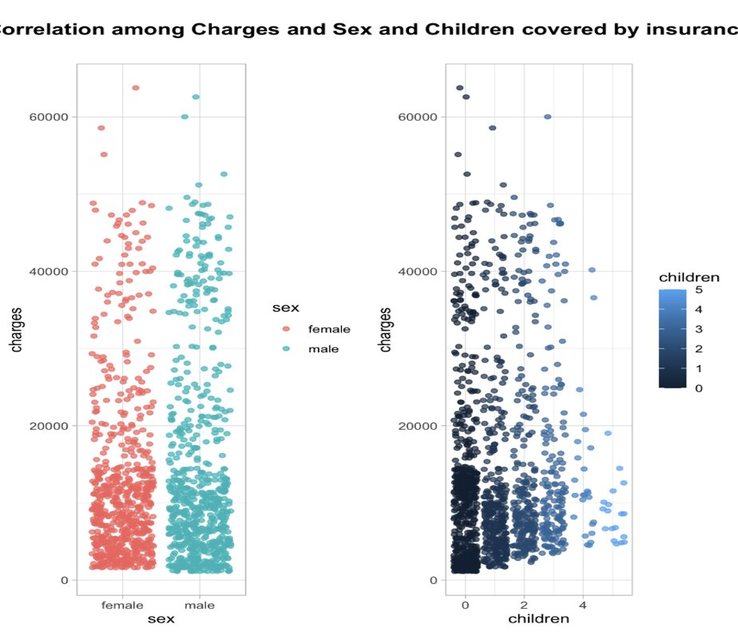
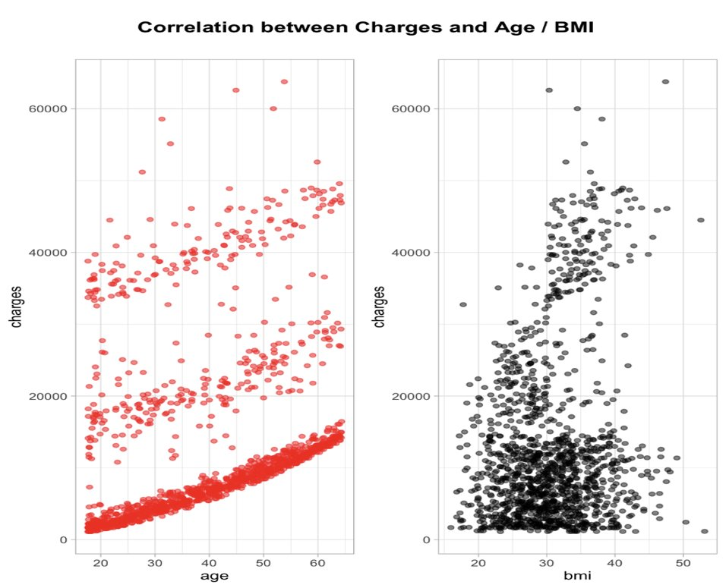
EXPLORATORY DATA ANALYSIS
The trends among Age and BMI as :- The Charges for health insurance increases simultaneously increasing the trend values
The trends among Charges vs sex and charges vs children as :-The Charges for health insurance with 4-5 children covered follows a decreasing pattern, and there is no overall pattern effect on the charge's vs sex

Slide 6
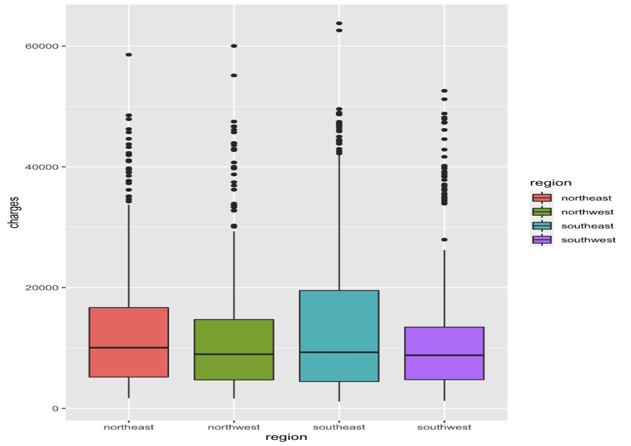
EXPLORATORY DATA ANALYSIS
The box plot describes the relation between the Charges vs region we can note the trends among as follows, as the Charges for health insurance has no effect by the regions

Slide 7
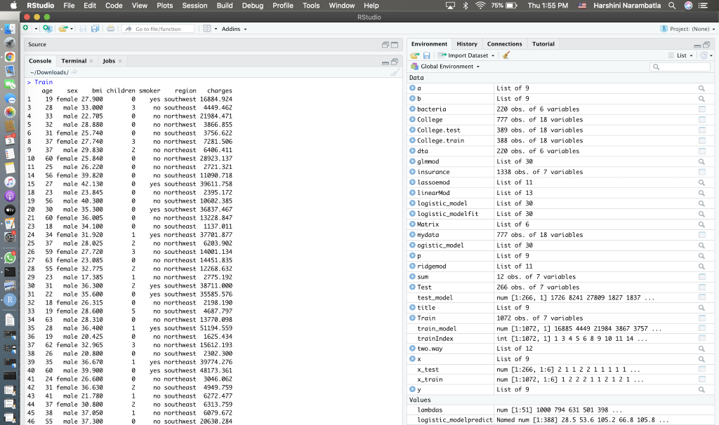
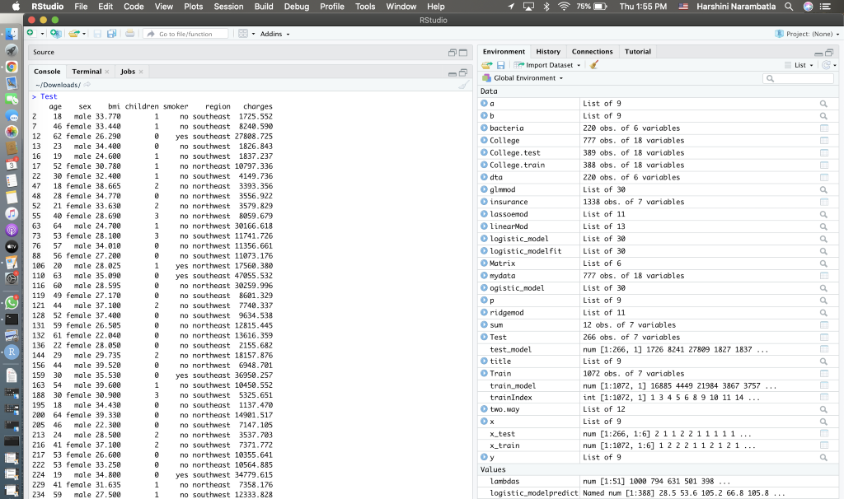
TESTING AND TRANING DATA
The training and testing data in regression models, are helpful in determining the strength of predictors and forecasting factors as to determine of the model performance of the Dataset.

Slide 8
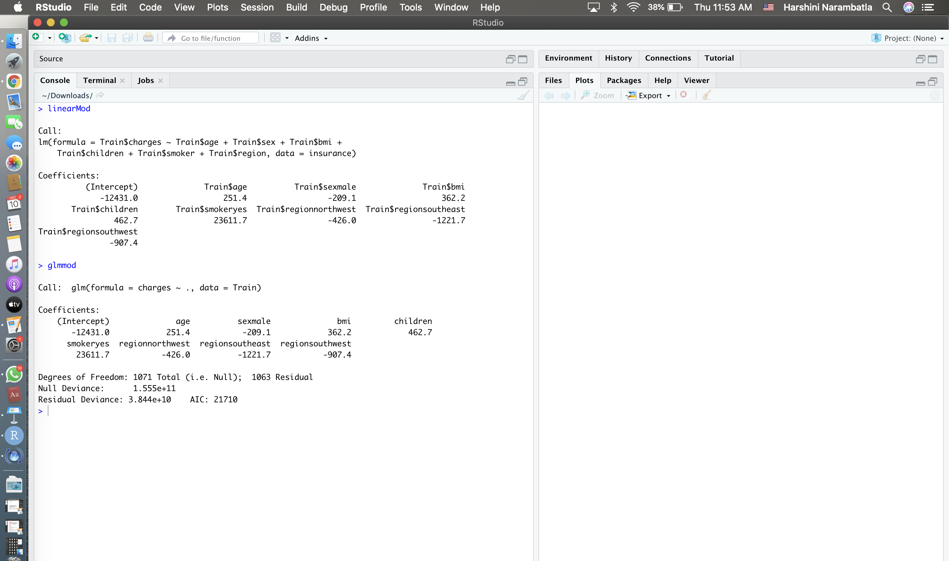
Model Evaluation
The linear model gives the linear prediction exploratory relationship and scalar variables.
The generalized linear model gives the flexible prediction explanation of the exploratory relationship and scalar variables.

Slide 9
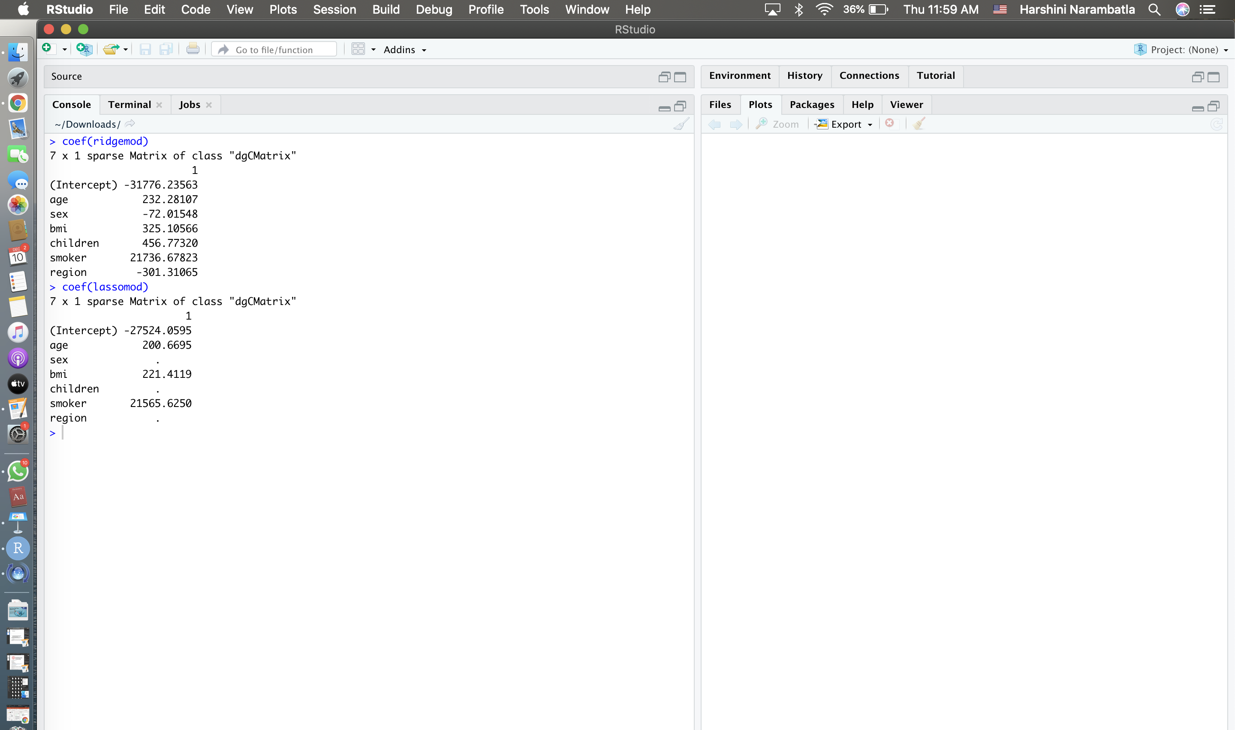
Model Evaluation
Ridge regression can term to be an extension to by adding the loss function as to reduce the model complexity
Lasso egression can term to be an extension to linear regression by adding the Shrinkage function as to reduce the model complexity

Slide 10
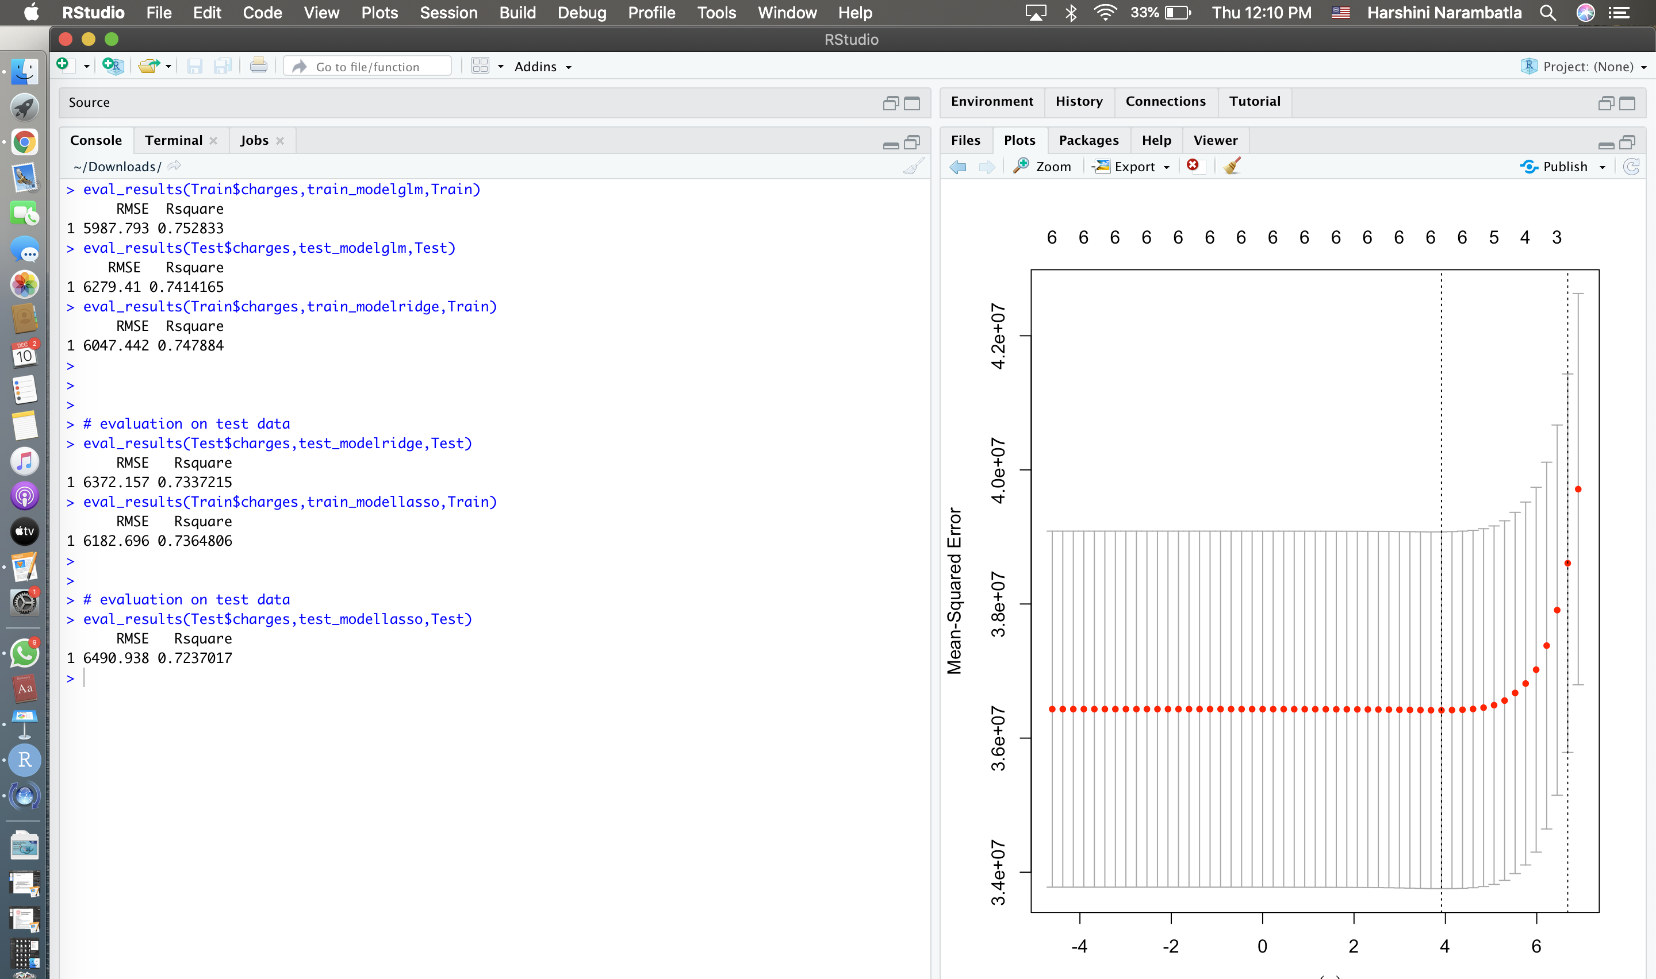
Best Model
Model Type | Comment
Linear | Not Situatable
GLM | Overfitting needs regularization
Ridge | One of the choices for best model
Lasso | Best suitable Model based on RMSE

Slide 11
Conclusion
The lasso regression unlike the ridge regression features the exploratory variables towards each towards zero only indicating the most potential feature to determine predictive accuracy
From detailed model predictions, we can interpret that the performance of the Lasso model is more accurate and is best suitable model with more accuracy and least RMSE and R-square.

