Slide 1
PROGRESS REVIEW
Presented by
Failure-Aware Fast Rerouting in Software-Defined Networks
S. No. | Name of the Student | Roll Number
1. | Mayank Bansal | 23BEC026
2. | Anas Khan | 23BCS083
3. | Shardendu Mishra | 23BCS122
4. | Himanshu Kumar | 23BCS055
5. | Divyanshu | 23BEC017
Interim progress: plan, emulator, failure detection and first results
Under the guidance of
_______________________________________
(Name and designation of the guide)
Department of ______________________
Institute ____________________________
Academic Year: ______________ Date: ______________

Slide 2
INTRODUCTION
Problem and motivation
• In SDN, a failure is repaired by the controller: report → recompute → reprogram
• That takes tens to hundreds of milliseconds, and grows with controller distance
• OpenFlow fast-failover groups let a switch switch to a pre-installed backup locally
• But classic fast reroute treats every link as equally reliable and plans each backup independently
• Links in the same conduit fail together: a backup can die with its primary
Failure-Aware Fast Rerouting in SDN
2

Slide 3
BACKGROUND
Literature review
Work | Finding
Sharma et al. (2013) | only protection meets 50 ms recovery in OpenFlow networks
van Adrichem et al. (2014) | with fast-failover + BFD, detection dominates recovery time
IP LFA (RFC 5286), MPLS FRR (RFC 4090) | local link / node detours around the failure
Suurballe / Bhandari | disjoint path pairs for end-to-end protection
Gap | backups ignore failure likelihood and shared risk (SRLG)
Failure-Aware Fast Rerouting in SDN
3

Slide 4
PROBLEM STATEMENT
Objectives
• Build a deterministic OpenFlow emulator (flow and group tables, port liveness, control-channel delay)
• Implement baselines: no recovery, reactive restoration, local fast reroute
• Model failure detection (LOS, BFD, LLDP) and gray failures and switch crashes
• Measure outage, packet loss and switch state on Abilene and NSFNET
• Design a failure-aware fast reroute scheme: risk model, SRLG-aware backups
• Port it to a real controller (OS-Ken/Ryu) for Mininet and Open vSwitch
Failure-Aware Fast Rerouting in SDN
4

Slide 5
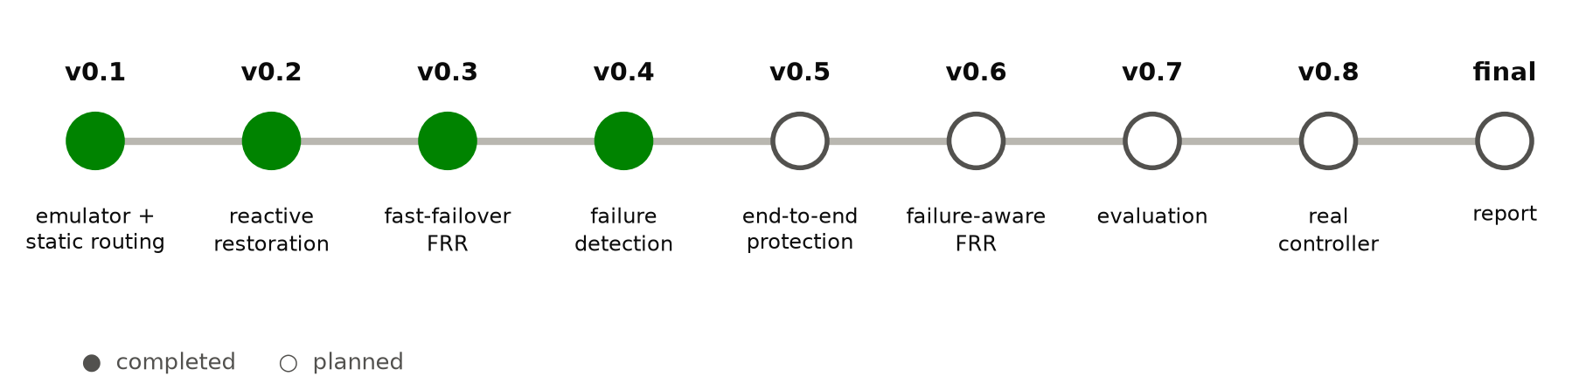
METHODOLOGY
Plan: built in versions
Done: v0.1 emulator + static routing, v0.2 reactive restoration, v0.3 fast reroute, v0.4 failure detection. Next: end-to-end protection, then the failure-aware scheme.
Failure-Aware Fast Rerouting in SDN
5

Slide 6
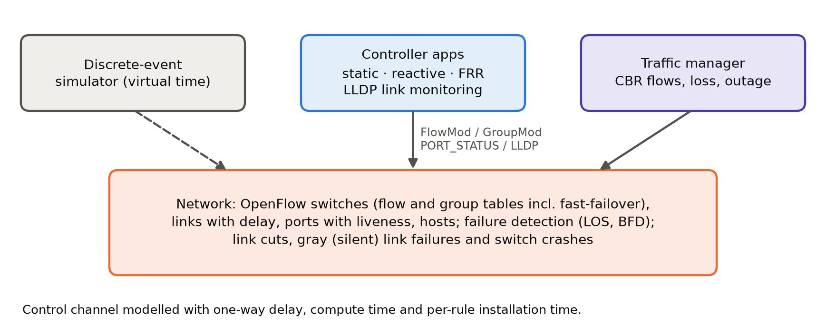
IMPLEMENTATION
Work completed: the emulator
• Python, ~2,100 lines
• 78 automated tests
• Flow + group tables, incl. fast-failover
• Controller delay, compute and rule-install time
• Every packet sequence-numbered
Failure-Aware Fast Rerouting in SDN
6

Slide 7
IMPLEMENTATION
Strategies implemented
Strategy | How it recovers
static | shortest paths, no recovery (baseline)
reactive | controller recomputes on PORT_STATUS and pushes changed rules
FRR (link) | fast-failover group: primary + VLAN-tagged detour around the link
FRR (node) | detour around the whole next switch (also covers switch failures)
Failure-Aware Fast Rerouting in SDN
7

Slide 8
IMPLEMENTATION
Work completed: failure detection
Mechanism | Detects | Time | Cost
Loss of signal (switch) | link cuts only | ~1 ms | free
BFD (switch) | cuts and gray failures | 3 × hello interval | hellos on every link
LLDP (controller) | cuts and gray failures | 3 × probe round + controller | probes via the controller
• Failure types: link cut, gray (silent) failure (signal up, traffic dropped), switch crash
• Every probe packet counted, so detection speed can be weighed against overhead
Failure-Aware Fast Rerouting in SDN
8

Slide 9
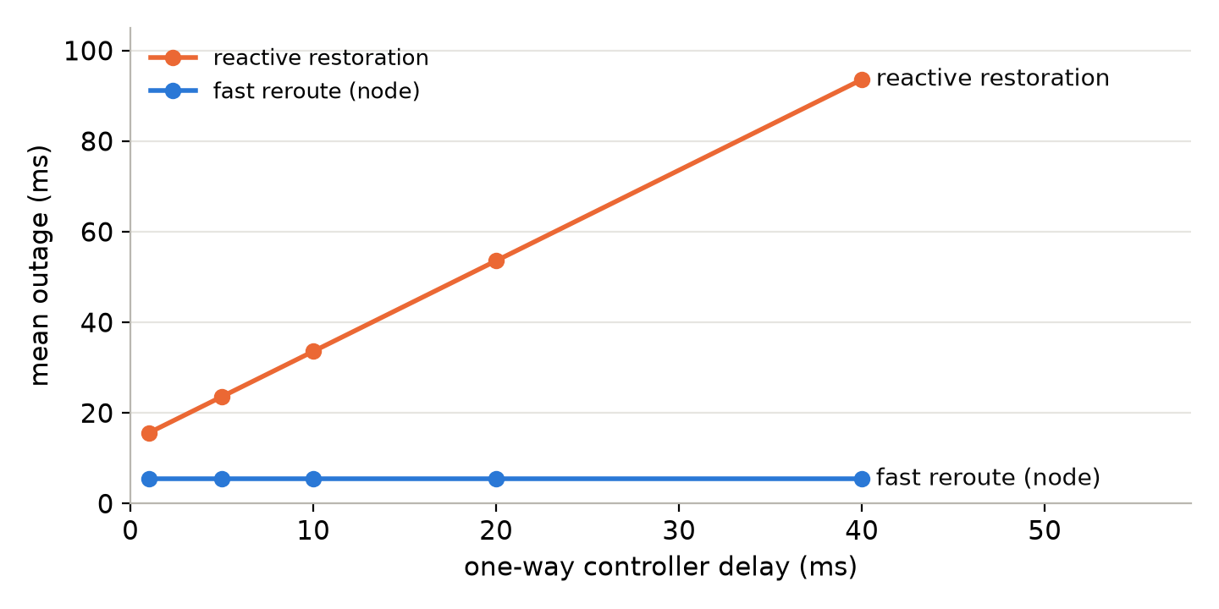
PRELIMINARY RESULTS
First results: single link failures
Strategy | Abilene | NSFNET | Flows / groups
static | never | never | 121 / 0
reactive | 23.3 ms | 20.6 ms | 121 / 0
FRR (link) | 5.8 ms | 3.0 ms | 440 / 110
FRR (node) | 5.8 ms | 3.0 ms | 404 / 110
Mean outage of affected flows, every link cut in turn
Fast reroute is ~4× faster and independent of controller distance, at ~3.5× the flow entries.
Failure-Aware Fast Rerouting in SDN
9

Slide 10
PRELIMINARY RESULTS
First results: gray failures and switch crashes
Gray failure (DEN–KSC) | Outage | Probes
FRR, LOS only | never | 0
FRR, BFD 3.3 ms | 12.3 ms | 5,937
FRR, BFD 10 ms | 31.1 ms | 1,960
FRR, BFD 50 ms | 144.3 ms | 392
reactive, LLDP 50 ms | 167.6 ms | 392
Crash of KSC | Never recovered | Outage
static | 62 / 62 | –
reactive | 20 / 62 | 27.3 ms
FRR (link) | 39 / 62 | 9.1 ms
FRR (node) | 20 / 62 | 9.1 ms
Without BFD a gray failure is never noticed. On a crash, the 20 flows of KSC itself are lost for everyone; node protection recovers all the others in ~9 ms, link protection leaves 19 down.
Failure-Aware Fast Rerouting in SDN
10

Slide 11
PRELIMINARY RESULTS
The open problem: correlated failures
Strategy | Never recovered | Lost packets
static | 50 / 50 | 10,549
reactive | 0 / 50 | 1,339
FRR (link) | 27 / 50 | 5,888
FRR (node) | 22 / 50 | 4,887
• DEN–KSC and SNV–DEN share a conduit and fail together
• Backups for one use the other
Reactive recovers everything, slowly. Fast reroute is fast but leaves 22–27 flows dead. A failure-aware scheme should be both fast and safe.
Failure-Aware Fast Rerouting in SDN
11

Slide 12
PLAN
Remaining work
Step | Content
v0.5 | end-to-end path protection (disjoint paths)
v0.6 | failure-aware FRR: risk model, SRLG-aware backups, re-optimisation
v0.7 | evaluation: single, correlated, sequential and flapping failures
v0.8 | OS-Ken/Ryu controller for Mininet and Open vSwitch
final | report and presentation
Failure-Aware Fast Rerouting in SDN
12

Slide 13
Thank you
Questions and feedback

