Slide 1

DST & Texas Instruments India Innovation Challenge Design
Contest 2018 Anchored by IIM Bangalore
Quarter Finals Business Proposal

Slide 2


Automated Guidance System for Motor Vehicles Team 390003
Team Members:
Mayank Baranwal
Utkarsh Jain
Nitin Chauhan
Srijan Sankrit
Prateek Manocha
Mentor:
Dr. Gaurav Trivedi
Assistant Professor,
IIT Guwahati
Indian Institute of Technology, Guwahati

Slide 3


Roadmap
1
Inspiration for Product

Slide 4

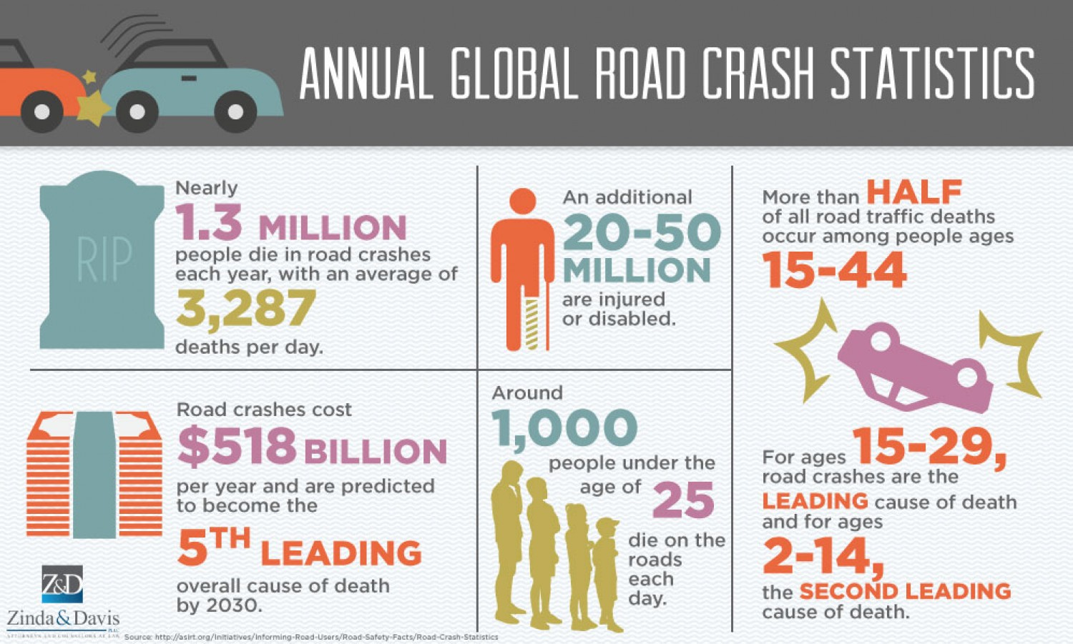
Product Inspiration
Road collisions is one of the leading causes of preventable death in India
Annually, 150,000 citizens of India lose their lives in motor vehicle accidents
55,000 crore (3% of Indian GDP) is lost through road accidents.
Immense social impact on families and corporations
Human error is the primary cause of motor vehicle accidents

Slide 5

Roadmap
2
Product
Pricing
1
Inspiration for Product

Slide 6
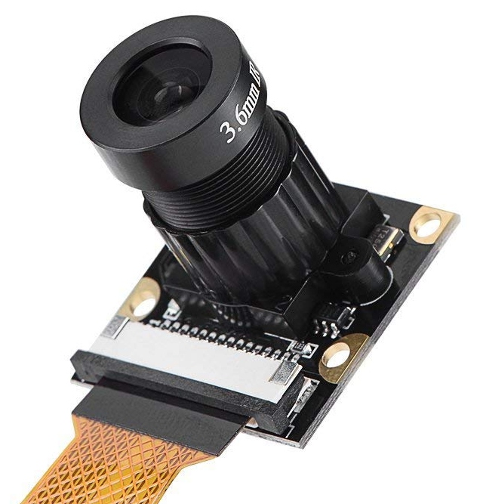
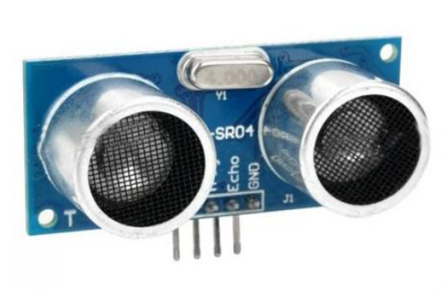
Product Pricing
Total Manufacturing Cost/Unit – ₹ 2700 - ₹ 4000
LIDAR Sensor (Max Range of 20m – 30m) - ₹ 1500 to ₹ 2300
Screen (Monochromatic: 2.5’’ × 2’’ to 3’’ × 2.5’’) - ₹ 400 to ₹ 600
Microprocessor (120 MHz) - ₹300
Camera (2 MP – 4MP) - ₹ 200 to ₹ 400
Ultrasonic Sensor (Max Range of 5m) – 2 × ₹100 = ₹200
Casing + Other Electronics - ₹100 - ₹200
Labour Costs – 30 people with total ₹ 6,00,000 /month
Other Overheads
Office HQ: ₹ 3,00,000 (Monthly bills inclusive)
Transportation Costs: 5 * (₹ 60,000/driver/month + ₹45,000/truck rental) + ₹ 5,00,000 (Fuel Costs) = ₹ 10,00,000/ month
Warehouse Rent: ₹ 50,000/month
Factory Running Cost: ₹ 50,00,000/month

Slide 7

Product Pricing
Marketing Costs
Salesman Cost – 15 people @ ₹ 20,000 /person/month
Online Advertisement Cost – ₹ 2,00,000 p.m. (Rs 4 CPC with 10% purchase rate)
Showcasing cost – ₹ 12,00,000 /year (Expo , travelling)
Sales Commission / Discount
Retailer’s commission – ₹ 1,500/ unit
Manufacturers bulk discount – ₹ 1,500/ unit
Online Retailer – ₹ 1,000/ unit
Number of Units Sold per Month
Sales through Car Vendors and Garages – 3000 (5% of new cars sold per month in a metro)
Sales through Manufacturers – 12000 (30% of 5 popular models)
Sales through Online Platform – 5000
Expected Selling Price (Without Taxes) : ₹ 5500 - ₹ 7000/ unit
Profit: ₹ 1000/unit

Slide 8

Roadmap
3
Product Differentiation
2
Product
Pricing
1
Inspiration for Product

Slide 9
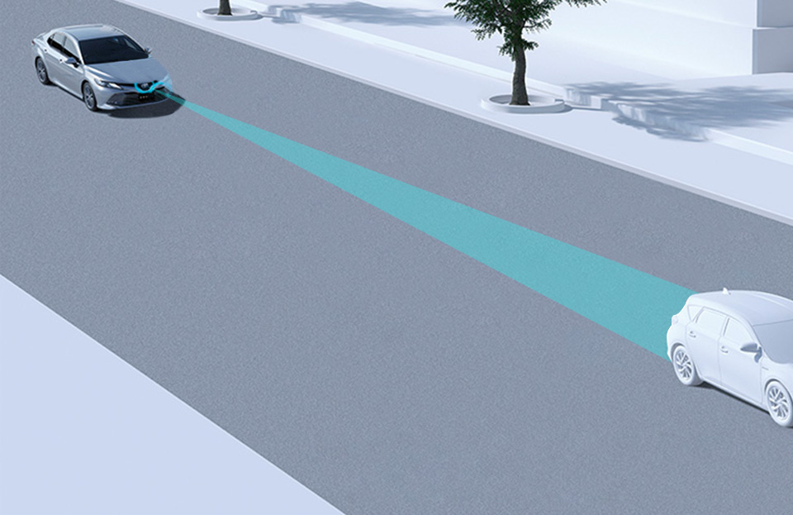

Product Differentiation and Innovativeness
Currently, no such product exists in the low to mid range market segment
Similar products in high end market have limited features → Unfair advantage
Customer Benefits:
Product can cause savings of up to ₹40,00,000 (based on cost of 1 accident)
Improved customer satisfaction for car manufacturers
Quality assessment of drivers for transport service providers
Design Innovation:
Entire product fits inside any existing car
Powered through a 5V USB cable
Able to give monitor all surroundings

Slide 10

Roadmap
4
Product Awareness
3
Product Differentiation
2
Product
Pricing
1
Inspiration for Product

Slide 11



Product Awareness Strategy
Different strategies for different distribution channels
Auto expos/ auto fairs to advertise product to auto manufacturers and dealerships
Live demonstrations for car dealerships and garages through sales personnel
Directly approaching transport service providers
Online advertisements (Google AdSense, Flipkart Ads, promoted ads)

Slide 12

Roadmap
4
Product Awareness
5
Distribution Strategy
3
Product Differentiation
2
Product
Pricing
1
Inspiration for Product

Slide 13






Product Distribution Channels
3 Major Customer Segments
Transport service providers (Truck companies, car hailing apps etc.)
Automobile manufacturers (as an add-on system)
Personal automobile owners
3 delivery channels to fulfill the needs of above segments :
Online Retail Stores ( Flipkart, Amazon etc.)
Offline Stores ( Garages and Car Vendors)
Direct tie-ups with Car manufacturers and transport service providers

Slide 14
SWOT Analysis
Strength
Product Drawbacks
Weaknesses
Multitude of Product Features
Need for scale to break even on product
Component quality is consumer, not industry grade
Certain scenarios not taken care of (e.g. no quantitative measure of attentiveness)
Low cost, low power solution to collision avoidance
Installable in existing as well as new cars
Availability of driver feedback to companies
S
W
O
T
Rise of the Indian Car Market
Unforeseen Dangers
Booming car maket → Car sales increasing 5% / year
Increasing conscious middle class investing in safety technology
Rising insurance premiums (that could be reduced by this product)
New, untried product, customer reaction is unknown
Advancements in self-driving cars may render product obsolete
Opportunities
Threats

Slide 15
Thank You!

