Slide 1
TI IICDC 2018 Quarterfinals interim business proposal
Team 39003: Automated Guidance System for Motor Vehicles

Slide 2






Product distribution channels
3 Major Customer Segments
Transport service providers (Truck companies, car hailing apps etc.)
Automobile manufacturers (as an add-on system)
Personal automobile owners
3 delivery channels to fulfill the needs of above segments :
Online Retail Stores ( Flipkart, Amazon etc.)
Offline Stores ( Garages and Car Vendors)
Direct tie-ups with Car manufacturers and transport service providers

Slide 3
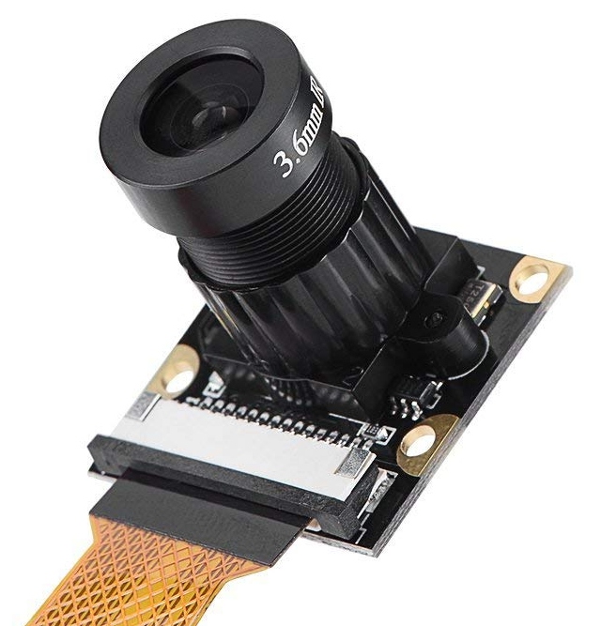
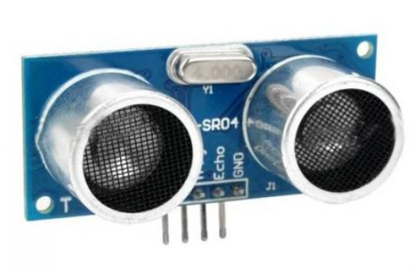
Product pricing
Total Manufacturing Cost/Unit – ₹ 2700 - ₹ 4000
LIDAR Sensor (Max Range of 20m – 30m) - ₹ 1500 to ₹ 2300
Screen (Monochromatic: 2.5’’ × 2’’ to 3’’ × 2.5’’) - ₹ 400 to ₹ 600
Microprocessor (120 MHz) - ₹300
Camera (2 MP – 4MP) - ₹ 200 to ₹ 400
Ultrasonic Sensor (Max Range of 5m) – 2 × ₹100 = ₹200
Casing + Other Electronics - ₹100 - ₹200
Labour Costs – 30 people with total ₹ 6,00,000 /month
Other Overheads
Office HQ: ₹ 3,00,000 (Monthly bills inclusive)
Transportation Costs: 5 * (₹ 60,000/driver/month + ₹45,000/truck rental) + ₹ 5,00,000 (Fuel Costs) = ₹ 10,00,000/ month
Warehouse Rent: ₹ 50,000/month
Factory Running Cost: ₹ 50,00,000/month

Slide 4

Product pricing
Marketing Costs
Salesman Cost – 15 people @ ₹ 20,000 /person/month
Online Advertisement Cost – ₹ 2,00,000 p.m. (Rs 4 CPC with 10% purchase rate)
Showcasing cost – ₹ 12,00,000 /year (Expo , travelling)
Sales Commission / Discount
Retailer’s commission – ₹ 1,500/ unit
Manufacturers bulk discount – ₹ 1,500/ unit
Online Retailer – ₹ 1,000/ unit
Number of Units Sold per Month
Sales through Car Vendors and Garages – 3000 (5% of new cars sold per month in a metro)
Sales through Manufacturers – 12000 (30% of 5 popular models)
Sales through Online Platform – 5000
Expected Selling Price (Without Taxes) : ₹ 5500 - ₹ 7000/ unit
Profit: ₹ 1000/unit

Slide 5
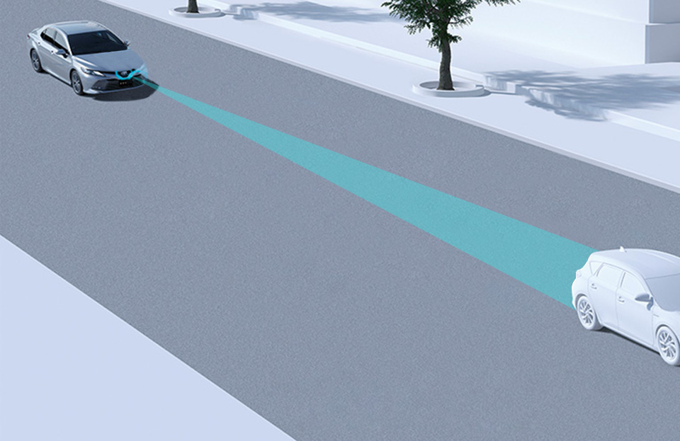

Product Differentiation
Currently, no such product exists in the low to mid range market segment
Similar products in high end market have limited features
Unfair Advantage
Unique product – Mover’s advantage
Customer Benefits:
Product can cause savings of up to ₹40,00,000 (based on cost of 1 accident)
Improved customer satisfaction for car manufacturers
Quality assessment of drivers for transport service providers

Slide 6



Product Awareness strategy
Different strategies for different distribution channels
Auto expos/ auto fairs to advertise product to auto manufacturers and dealerships
Live demonstrations for car dealerships and garages through sales personnel
Directly approaching transport service providers
Online advertisements (Google AdSense, Flipkart Ads, promoted ads)

