Slide 1


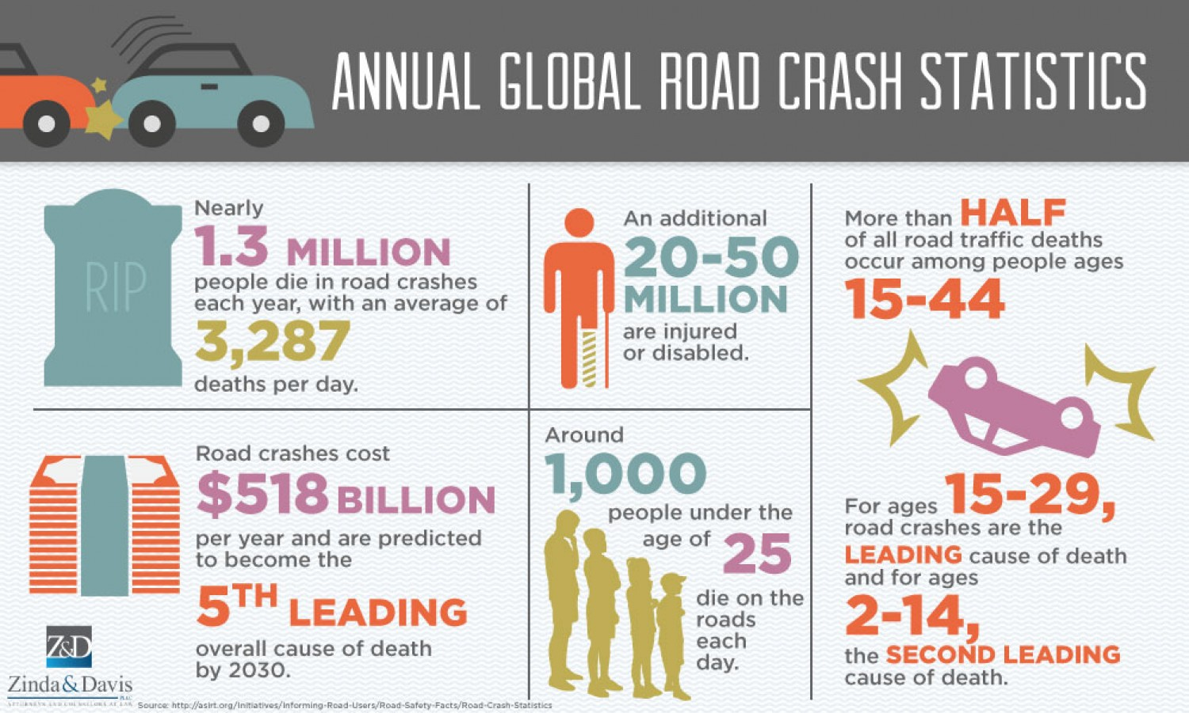
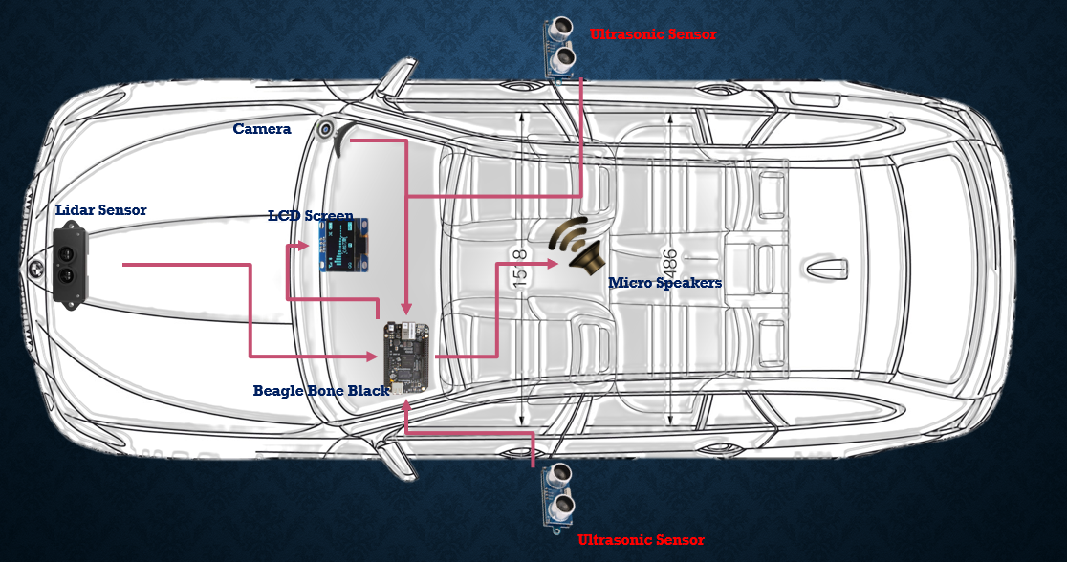
Automated Guidance System for Motor Vehicles
Mayank Baranwal, Utkarsh Jain, Srijan Sankrit, Nitin Chauhan, Prateek Manocha
Electronics Club
Abstract/Introduction
The “Automated Guidance System for Motor Vehicles” aims to curb the rising problem of motor vehicle accidents through the constant monitoring of the vehicles’ surroundings. Internal monitoring focuses on ensuring the driver is fit to drive at all times. Human error is the primary cause of accidents and thus it is of utmost importance that the driver is cognitively aware of his/her surroundings. Externally, we intend to provide 360 degree analysis by providing warnings of incoming traffic (including pedestrians) in the blind spots and suggesting minimum braking distance (depending on road conditions and speed). Furthermore, the system guides a vehicle steering off course back on the road. Thus, the system will help prevent accidents by acting as a personalized mentor and helping us make the best decisions while driving.
Results
Annually, around 150,000 citizens of India lose their lives in motor vehicle accidents, making it one of the largest causes of preventable deaths in India. The social impact on families and corporations is immense as accidents are life changing events. Our theoretical predictions indicate, that after thorough analysis of raw data using ML and other noise reduction algorithms, our system can sense and identify obstacles up to 100m and provide an 85% accuracy in recommending the next course of action. Thus, the automated guidance system can help improve the life of motorists all around the world. The product can cause user saving up to Rs 40,00,000 based on cost of one accident.
Methodology
Our system performs a 360 degree analysis of the user environment (both internal and external), assessing a variety of threats. We take in various inputs from the vehicle such as current velocity, current situation of tyres and from sensors like the distance to preceding vehicle, temperature, humidity, precipitation, ice build-up etc. To determine the minimum braking distance, we apply machine learning, training our model based on widely available data on braking distances.
Innovation
Key Achievements: Analyzing current speed and distance with car infront to determine the optimum minimum braking distance. Monitoring the alertness of the driver through eye tracking Alerting driver of incoming vehicles/pedestrians in blind spots Advantage over Competition: Currently no other product is available in the market which addresses such concerns. Only high –end luxury automotive have similar devices installed which are not only costly but also do not cover all variables. Our product is cost effective and is suitable for low end consumers Key Learnings: Applying Haar Cascade for eye tracking on the camera module Creation of a business and technical model surrounding a project
Internal User Environment
External Environmental Inputs
Array of digital and analog sensors (eg. humidity, temperature, internal camera etc)
References
https://en.wikipedia.org/wiki/Automated_driving_system https://en.wikipedia.org/wiki/Lidar https://docs.opencv.org/3.3.0/d7/d8b/tutorial_py_face_detection.html https://sites.ndtv.com/roadsafety/important-feature-to-you-in-your-car-5/ https://elinux.org/Beagleboard:BeagleBoneBlack
Central Processing with ML and Advanced Algorithms
Recommended Course of Action
User Interface using LED screen and voice interaction

