Slide 1
Javascript- Async and Fetch api

Slide 2
Synchronous
Asynchronous
Operations are performed one after the other, in sequence. Each line of code waits for the previous one to finish before proceeding to the next.
This approach enhances the user experience by keeping the application responsive and preventing the UI from freezing during delays.
A task can be initiated, and while waiting for it to complete, other tasks can proceed at the same time.
This approach enhances the user experience by keeping the application responsive and preventing the UI from freezing during delays.

Slide 3
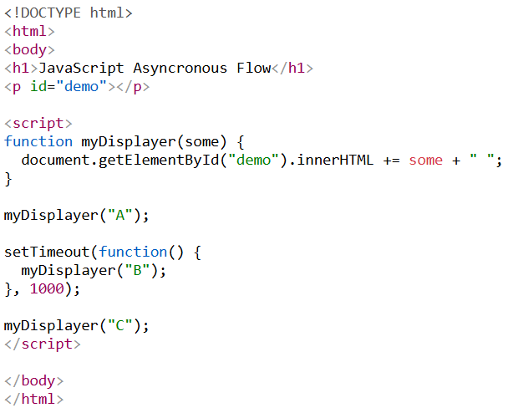
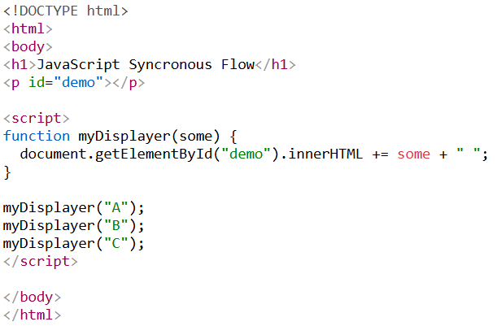
Synchronous Asynchronous

Slide 4
Why asynchronous?
Asynchronous programming is used in JavaScript to perform long-running tasks, such as fetching data over a network or reading files.
While the program is performing these tasks, if we use synchronous code to do so, it is non-sensical and highly inefficient to wait for the task to complete, to proceed further.
To fix this, asynchronous code is used.
Example- A button on a website, whose respective lines of codes need to be shown only after clicking on it

Slide 5

Timers
To understand asynchronous code better, let us look at how timers work in javascript.
1) Set timeout 2) Set interval

Slide 6
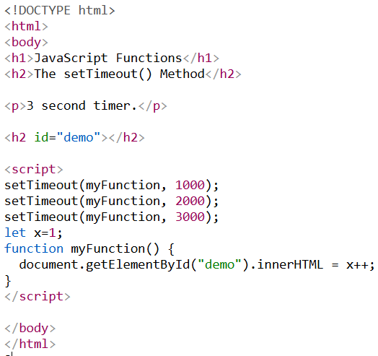
Timeout Demonstration
Timeout executes a function or a line of code after the specified interval. Note- 1000 means after 1 second.
Hence, 1 unit = 0.1 millisecond.

Slide 7
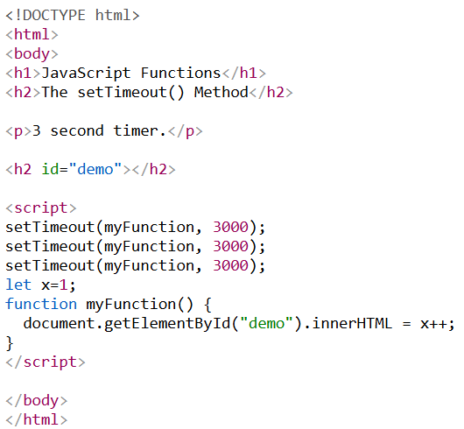
Q.What happens when all three calls are set to the same time?

Slide 8
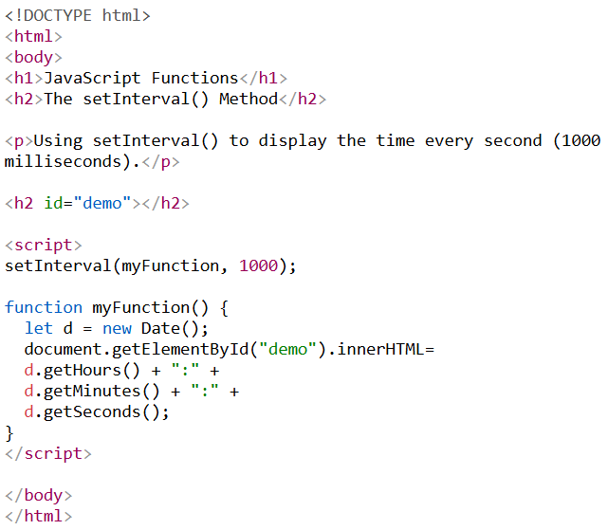
Interval demonstration
Interval is used to permanently set a line of code or function to execute after every given interval.
Here the Output is a live timer which updates itself every second.

Slide 9
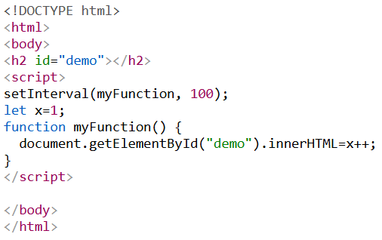
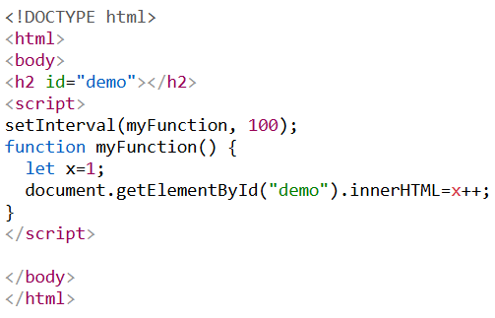
Trivia
Q. What’s the difference in these two codes? What will be their output?

Slide 10
How can I make asynchronous code?
There are many methods to achieve asynchronous code-
Callback method (“I must explicitly tell JS: after this finishes, run this function.”)
Promise method (“JS manages the states, I manage what to do with the states.“)
Async/Await method (“I write code as if it’s synchronous. JavaScript pauses and resumes automatically.”)
Callbacks < Promises < Async/Await

Slide 11
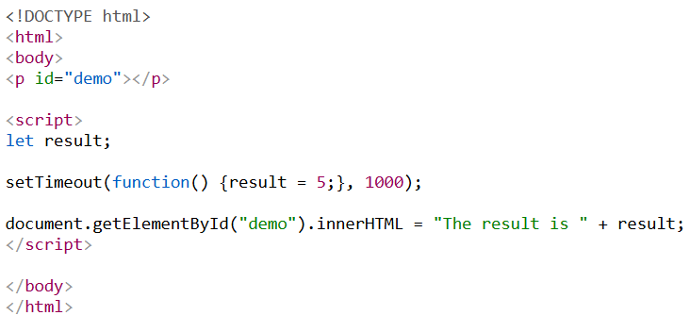
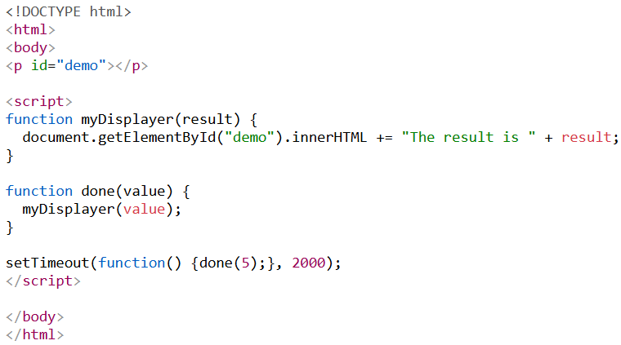


Callbacks
A function is passed as an argument to another function.
“Run this code when the asynchronous task finishes.”
Without callback With callback

Slide 12
Promises
Promises are a better way of executing callbacks. It helps in handling errors, if execution fails.
A promise can be in one of three exclusive states:
Pending: The initial state; the operation has started but is neither fulfilled nor rejected.
Fulfilled: The operation completed successfully, and a value is available.
Rejected: The operation failed, and a reason (error) is available.
A promise is considered settled if it is fulfilled or rejected (not pending).

Slide 13
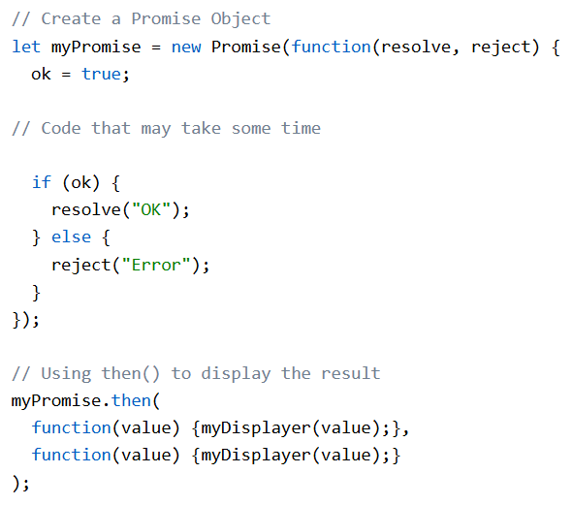
Promises
Syntax-

Slide 14
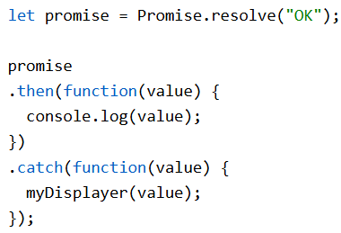
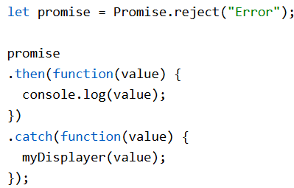
Promises
Using .then Using .then with .catch

Slide 15
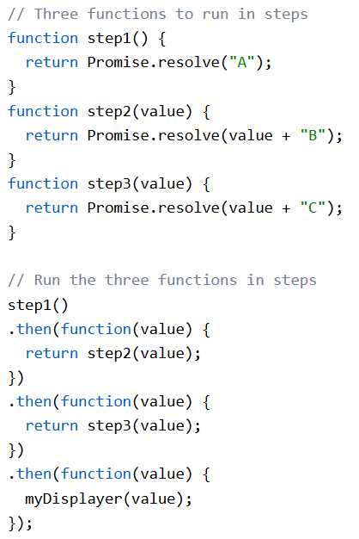
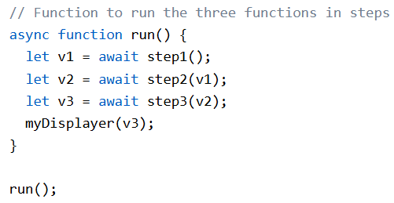
Async Await and Fetch
Promise chains can become long.
Async and await were created to reduce nesting and improve readability.
With Promise With Async Await

Slide 16
Async
Putting keyword async before your function makes it return a Promise.
async function myFunction() { return "Hello"; }
->is the same as
function myFunction() { return Promise.resolve("Hello"); }

Slide 17
Await
Await pauses the execution of the code until a resolved promise is returned.
Example-
async function step1() { return "A"; } async function run() { let value = await step1(); myDisplayer(value); } run();

Slide 18
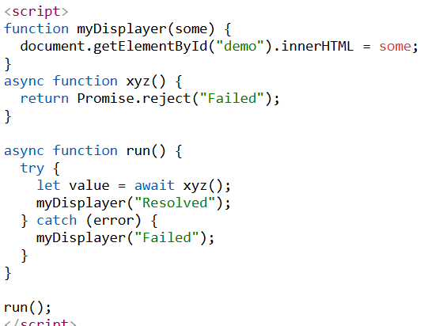
How rejects are handled with async
Here, the promise is hard coded to return a reject. Suppose xyz has some long lines of code and returns reject/resolve based on if it was successful. If resolved, the run() function is continued. If reject, it is treated as “throw” with the same value.
And the value is then passed onto catch and executes that lines of code.

Slide 19
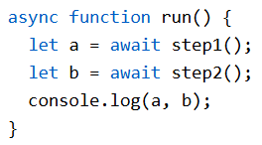
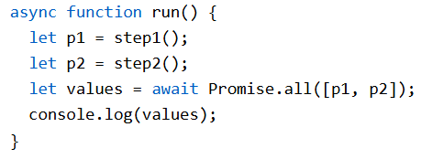
Sequential vs parallel
When dealing with multiple awaits, you must choose whether to handle them sequentially or parallely.
If the execution of the next step depends on the previous, use sequential (multiple await).
If they are independent of each other, use parallel (only one await at the last).

Slide 20
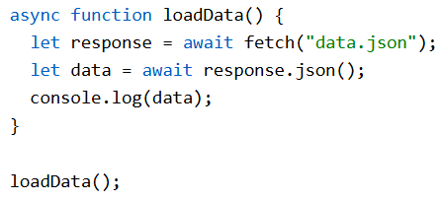
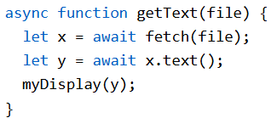
Fetch
Fetch is used to request data from a server. Return type is a Promise.
Requesting data from a server can be done with Callbacks as well, but Fetch is easier to use. Used in tandem with async and await for further ease of use.

Slide 21
Brief explanation on Servers, API, JSON.
Explanation in class

