Slide 1
NAME:MAYANK BHARTI
ROLL NO: 22CS3039
BRANCH:CSE

Slide 2
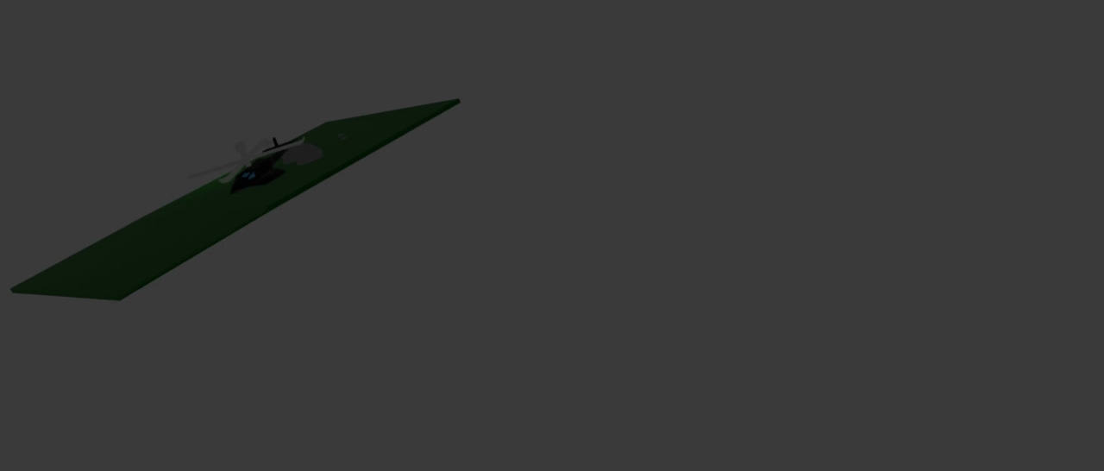
GVC PROJECT:
ANIMATED HELICOPTER IN BLENDER

Slide 3
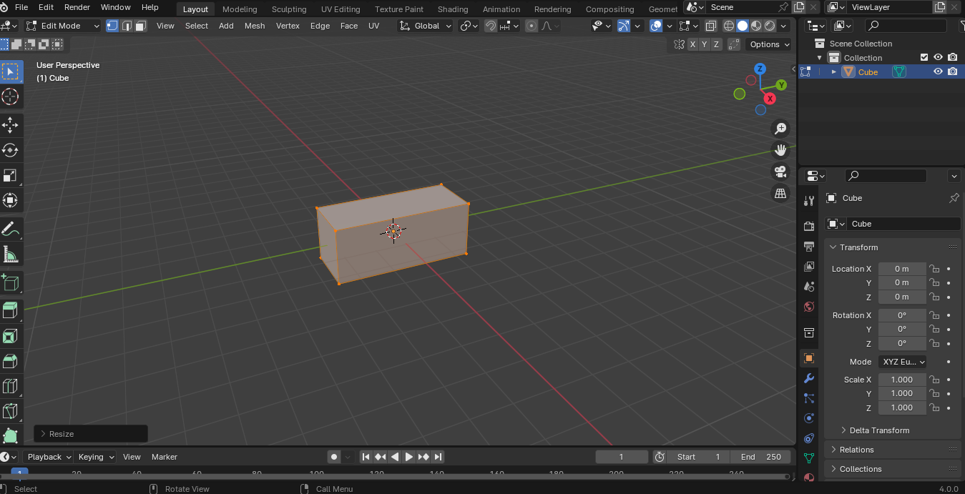
STEPS :1)Take one cube and scale y after going to the edit mode.

Slide 4
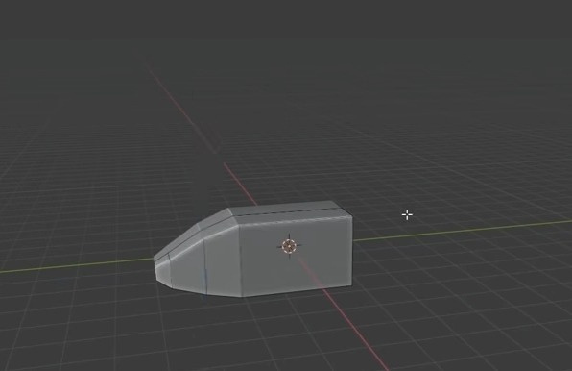
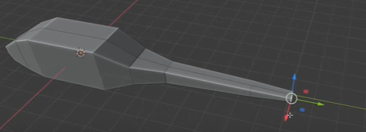
2)Extrude front part of helicopter and scale it down.
Again extrude and scale down.
3)Back of the helicopter, each extrude and scale down 4 times.

Slide 5
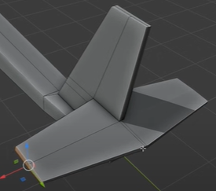
4)Cut the body parts of a helicopter in edit mode using ctrl+r and insert in the border of the helicopter at the last part using the i button and g twice, extrude it using the e command, and scale down using the s command twice. Also, ctrl+r to cut those parts horizontally. Extrude and scale that part which i had cut .

Slide 6
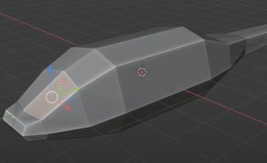

5)Now , i have to make helicopter an aerodynamics shape using g command to pull up and down the body of helicopter.
6) Now , i have made window by selecting front part of body simultaneously using shift and insert using i and extrude it using e command.
Add color to window and body of helicopter steps: i) go to the material tab in the properties panel.
ii) add a material and change base color and viewport display color.

Slide 7

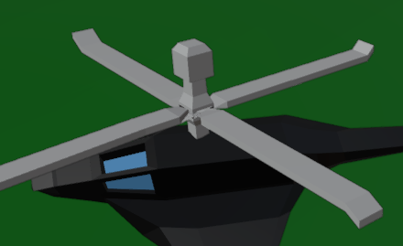
7) Make a wing of a helicopter by extruding and scaling down its body both sides.
8) Now i again took a cube for making helicopter fan.
steps for fan: i) scale down cube on the body of helicopter.
ii)extrude it and scale it up and again extrude and scale it down. Again repeat same process once. Lastly scale it down and select small parts of first rectangle and extrude for fan. So final helicopter fan is shown below.

Slide 8
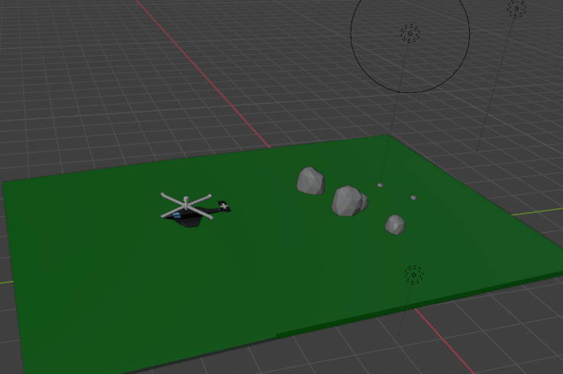
9) I have made plane and stone using command shift +a >>> mesh>>plane and circle and colored it using the material tab.
10) I have done lightening effect using shift+a >> light >> point in blender.
MY FINAL HELICOPTER after the lightening effect is:

Slide 9
Steps to animate my helicopter:
1) Taken 0 to 300 frames . 0 to 150 frames for landing the helicopter and 150 to 300 for flying.
2) For the revolving fan, I rotated the fan up to 300 frames in each interval of 5 frames.
3)Press command shift + A and focus it on the object using rotation and scaling and animate this camera as per the movement of object.
4) To view the camera, go to the view tab and click cameras and then active camera.
Steps to rendering:
1)Go to the rendering port and select a rendering animation after selecting the video file in object properties.

Slide 10
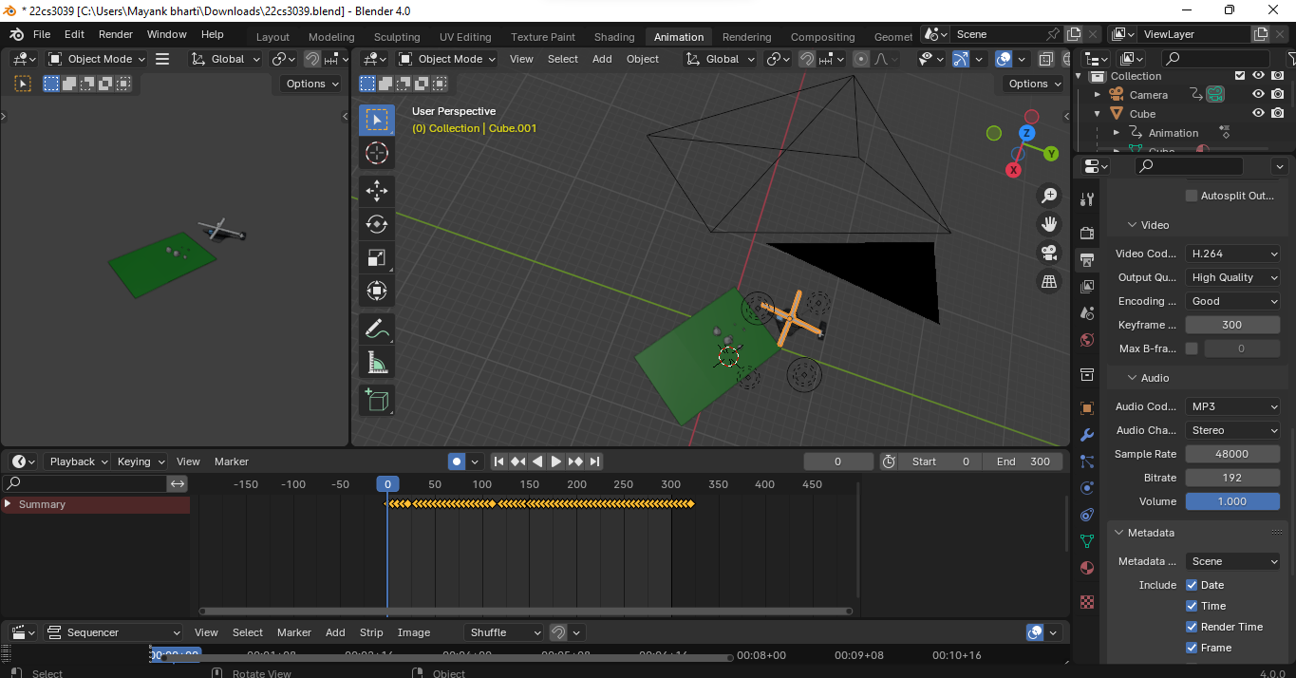
FINAL HELICOPTER :

