Slide 1

TABLET PRODUCTION ANALYSIS USING JMP
Presentation by:-
Mayank Chopra
Ajeet Kumar
Dheeraj Mahendra Bhardwaj
Mukesh Kumar
Indian Institute of Technology Ropar, Nagal Road
Rupnagar – 140001, Punjab

Slide 2
Introduction
Type of Product: Tablet
Manufacturing Process Type: Wet granulation, Dry granulation or Direct compression
Steps involved: Weighing, Milling, Mixing, Granulation, Drying, Compaction, (frequently) Coating and Packaging.
Regardless of the method used of the unit processes - Weighing, Milling and Mixing are the same. Subsequent steps may differ.

Slide 4
Objective
Selection of Atomizer pressure, Blend speed and Inlet temperature as critical parameters having significant impact on process outcome.
Maximize desirability of the Atomizer Pressure ( Minimum) and its effect
Maximize desirability of Blend Speed ( Minimum) and its effect
Maximize desirability of the Inlet Temperature ( Minimum) and its effect
Analysis of interaction of different parameters for maximum desirability using JMP

Slide 5
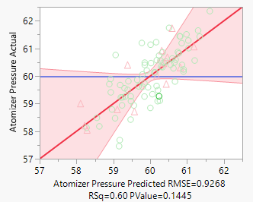
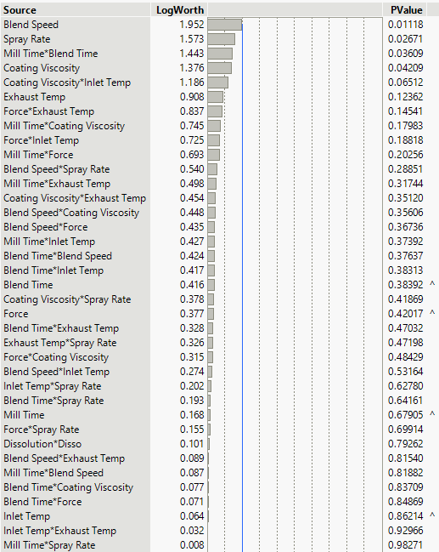
Results & Discussion
Based on below results, Atomizer pressure is highly dependent on Blend Speed. Higher the P value, lower the dependence on process outcome.

Slide 6
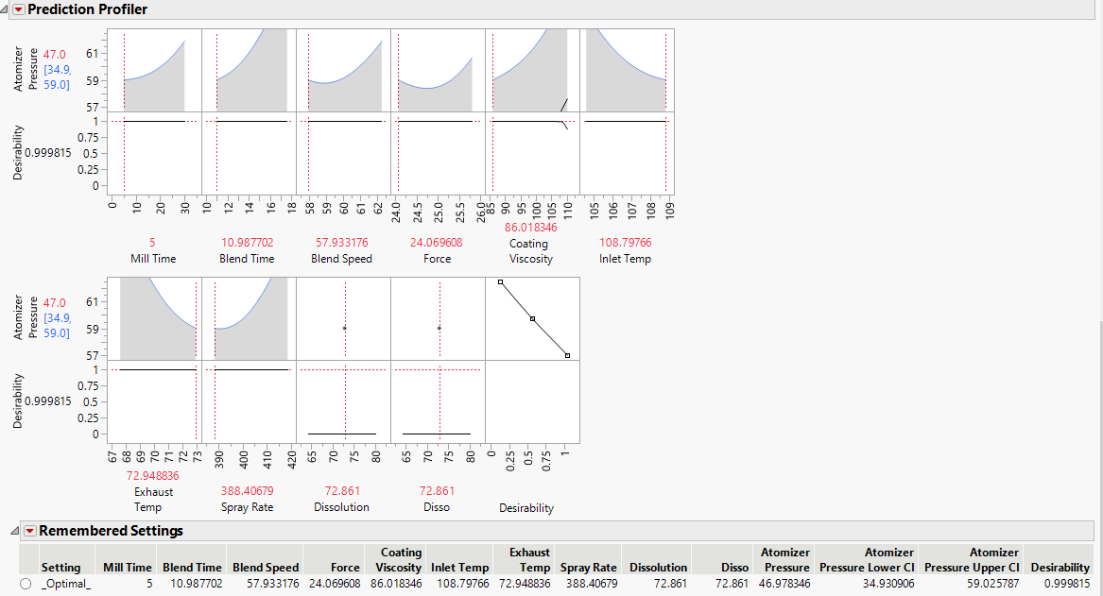
Interaction of Atomizer Pressure with Blend Time, Mill Time, Blend Speed, Force, Coating Viscosity, Exhaust Temp, Spray rate, Dissolution, Disso and subsequently finding out the optimum pressure by maximizing desirability

Slide 7
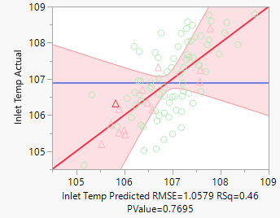
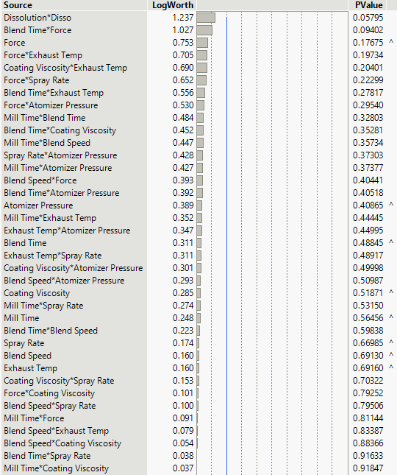
Based on the results, Inlet Temp is highly dependent on Dissolution*Disso.

Slide 8
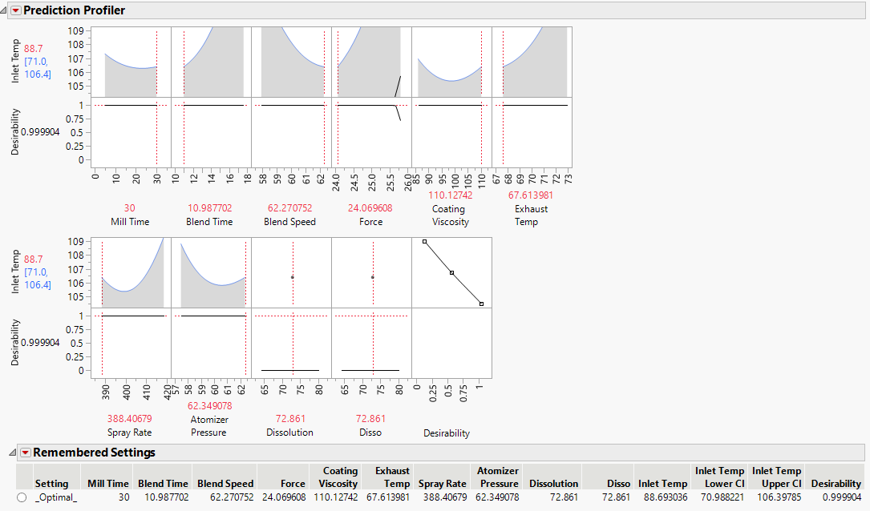
Interaction of Inlet Temp with Blend Time, Mill Time, Atomizer Pressure, Force, Coating Viscosity, Exhaust Temp, Spray rate, Dissolution, Disso and subsequently finding out the optimum inlet temp. by maximizing desirability

Slide 9
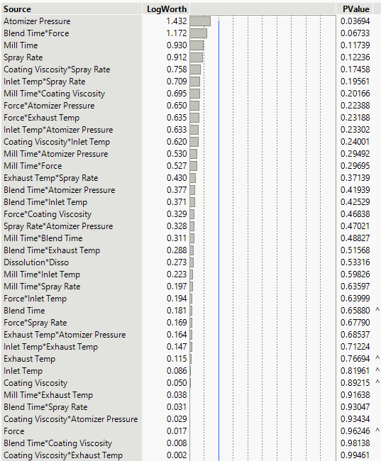
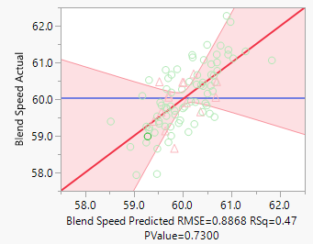
Based on below results, Blend Speed is highly dependent on Atomizer Pressure.

Slide 10
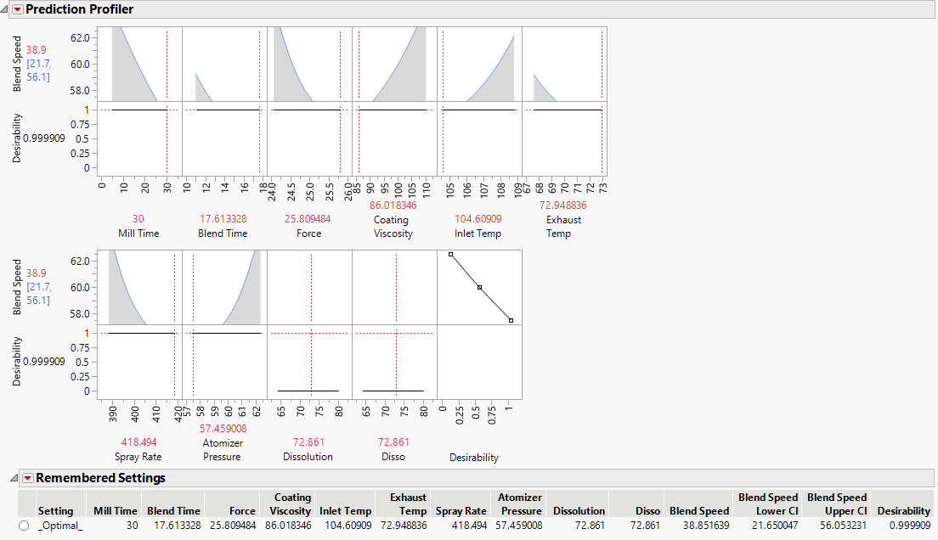
Interaction of Blend speed with Blend Time, Mill Time, Atomizer Pressure, Force, Coating Viscosity, Exhaust Temp, Spray rate, Dissolution, Disso and subsequently finding out the optimum blend speed by maximizing desirability

Slide 11
Conclusion
While optimizing for blend speed and atomizer pressure , we observe that we sacrifice on the third input parameter that we want to optimize i.e. inlet temperature.(Optimized inlet temperature is approx. 88 C while when optimizing the other two , inlet temperature value comes out to be 104 C and 108 C approx. respectively)
We observe that optimizing for inlet temperature sacrifices on the coating viscosity while optimizing for blending speed and atomizer pressure has no effect on the coating viscosity.

Slide 12
Contribution
Mayank Chopra – Data analysis ,observation and presentation
Ajeet Kumar – Data analysis and presentation
Dheeraj Bhardwaj – Presentation
Mukesh Kumar – Presentation

Slide 13
Thank You

