Slide 1
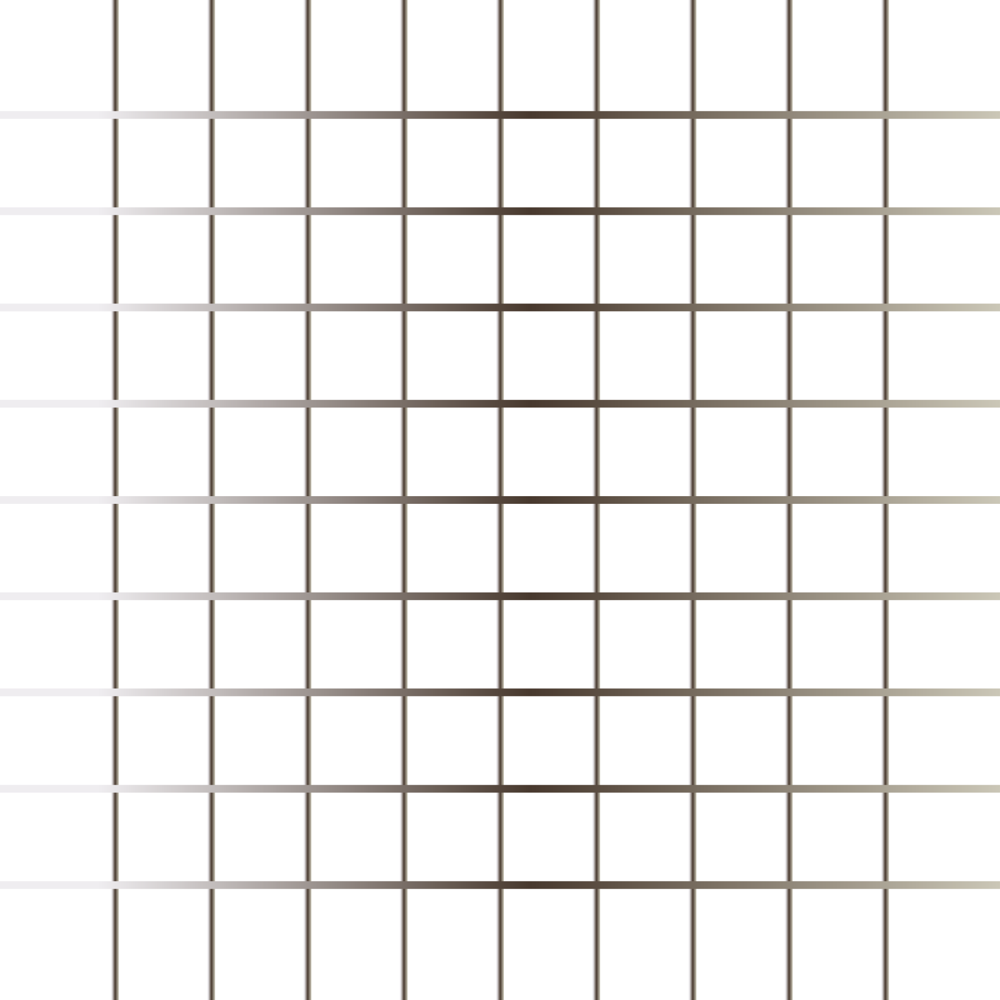
Today’s Agenda
Semantic & Non-Semantic
Links
Layout

Slide 2
Semantic & Non-Semantic
Semantic elements describe the meaning of the element and content. e.g.
<header>: Introductory content e.g. set of navigation links
<footer>: Define the footer section containing copyright, social media links, sitemap, etc.
<section>: Defines a section of a document.
<nav>: It define the navigation links.
Non-Semantic elements define nothing about the content. e.g.
div: tag is used to define division/section in an HTML document. It is used as a container for HTML elements. Any sort of content can be added in the div tag.
span: tag is an inline container to mark up a part of the text of document.

Slide 3
Links
HTML links are hyperlinks. You can click on a link and jump to another document.
When you move the mouse over a link, the mouse arrow will turn into a little hand. Links are found in nearly all web pages. Links allow users to click their way from page to page
Links are appear as follows in browser:
An unvisited link is underlined and blue
A visited link is underlined and purple
An active link is underlined and red

Slide 4
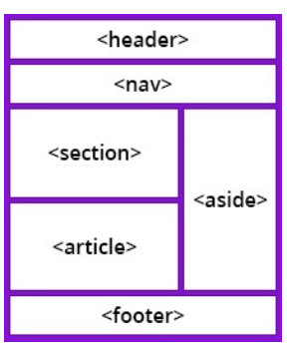
Layout
Websites often display content in multiple columns (like a magazine or a newspaper).
HTML has several semantic elements that define the different parts of a web page:
Header: Defines a header for a document or a section.
Nav: Defines a set of navigation links.
Section: Defines a section in a document.
Footer: Defines a footer for a document or a section.
Aside: Defines content aside from the content (like a sidebar).

