Slide 1

SEESAW: Set Enhanced Superpage Aware caching
Mayank Parasar∑, Abhishek Bhattacharjee^{Ω}, Tushar Krishna∑
http://synergy.ece.gatech.edu/
Associativity
∑School of Electrical and Computer Engineering
Georgia Institute of Technology
^{Ω}Department of Computer Science
Rutgers University
Set
mparasar3@gatech.edu

Slide 2
Outline
Motivation
SEESAW: Concept
SEESAW: Micro-architecture
Evaluation Methodology
Results
Conclusion

Slide 3

L1 Cache Characteristics
Ideal-Cache
VIPT-Cache
Fast lookup
High hit-rate
Energy
Efficiency

Slide 4

Virtually Indexed Physically Tagged [VIPT] Cache
VA
VPN
Page Offset
Set
index
block offset
v
tag
Data block
VIPT Caches necessitate:
(set-index + block-offset) <= Page-offset
Way-1
Way-1
TLB
Way-2
Way-2
set-1
Way-3
Way-3
Way-4
Way-4
PA
PPN
Page Offset
Way-1
Way-1
Way-2
Way-2
set-N
Way-3
Way-3
Way-4
Way-4
Cache
=
HIT/MISS

Slide 5
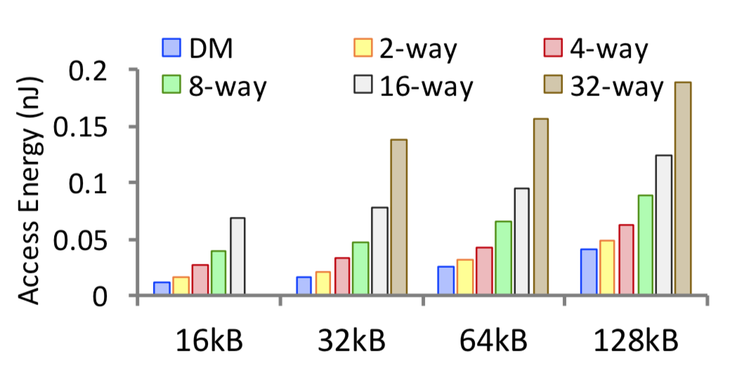
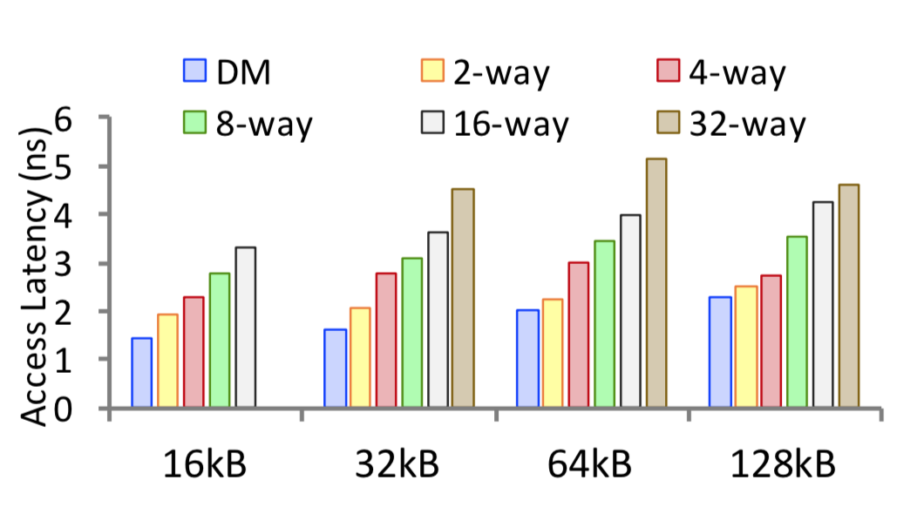
Impact of Associativity on Access Latency and Energy of cache
Cache Access Latency
Cache Access Energy

Slide 6
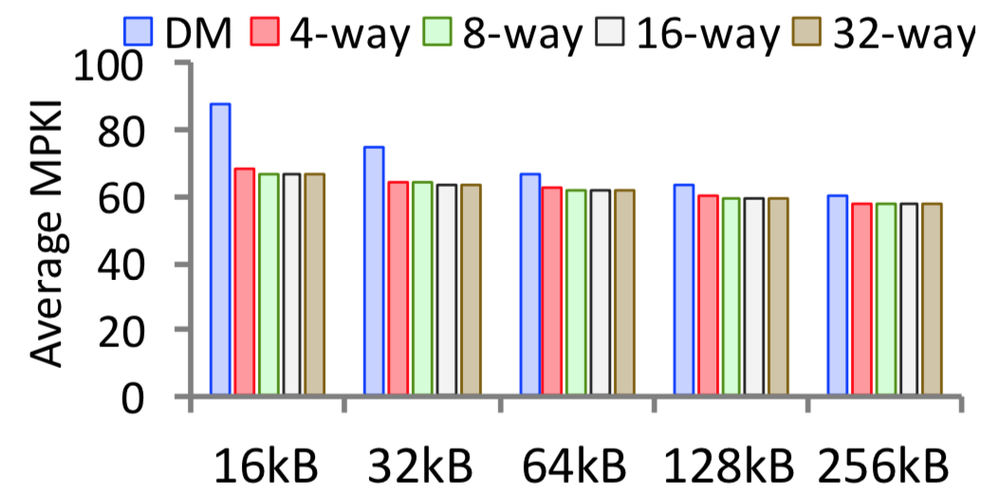
Effect of associativity on MPKI of cache
High Associativity hurts latency and energy without commensurately improving hit rate

Slide 7


Revisiting L1 Cache Characteristics for VIPT Cache
Ideal-Cache
VIPT-Cache
Virtual
memory!
Fast lookup
High hit-rate
Energy
Efficiency
Virtual
memory!

Slide 8
Opportunity: Superpage
Is it possible to relax constrains of
Traditional VIPT cache?
Yes
How ?
Offset-bits:
12
Offset-bits:
21
Offset-bits:
30
4-KB
2-MB
1-GB
More page-offset bits
for superpage!
Baseline Page
Super Page
HW and OS Support for Superpages in modern processors

Slide 9
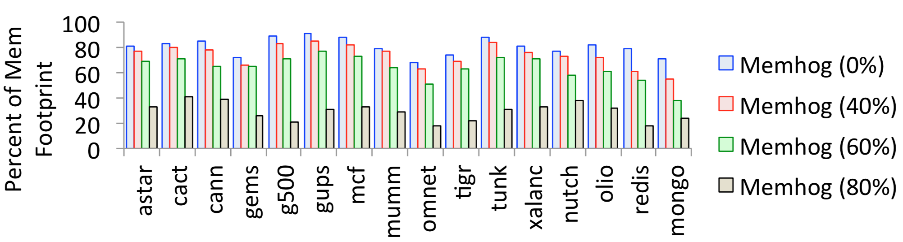
Prevalence of superpages in modern OSes under memory fragmentation
Ran on 32-core; Sandybridge; 32 GB RAM
Memhog causes memory fragmentation; higher %age indicates higher fragmentation

Slide 10
Outline
Motivation
SEESAW: Concept
SEESAW: Micro-architecture
Evaluation Methodology
Results
Conclusion

Slide 11
SEESAW: Concept
Faster
Energy-Efficient
v
tag
Data block
v
tag
Data block
Way-1
Way-1
Set:1
Way-1
Way-1
Set:1
Way-2
Way-2
super-page
Set:2
Way-1
Way-1
Way-3
Way-3
Set:3
Way-1
Way-1
Way-1
Way-1
Set:4
Way-1
Way-1
Set:2
Way-2
Way-2
Set:5
Way-1
Way-1
Way-3
Way-3
Set:6
Way-1
Way-1
Way-1
Way-1
Base-page
Set:7
Way-1
Way-1
Set:3
Way-2
Way-2
Set:8
Way-1
Way-1
Way-3
Way-3
Set:9
Way-1
Way-1
Less-sets
More-associativity
More-sets
Less-associativity

Slide 12
Outline
Motivation
SEESAW: Concept
SEESAW: Micro-architecture
Evaluation Methodology
Results
Conclusion

Slide 13
SEESAW: Micro-architecture
Superpage offset
VA
VPN
Basepage Offset
Decodes partition index from partition bit
Partition bit
Set index
block offset
Translation Filter Table
(TFT)
Partition
decoder
v
tag
Data block
v
tag
Data block
set-1
Way-1
Way-1
Way-3
Way-3
set-1
Way-2
Way-2
Way-4
Way-4
TLB
Predicts whether page is superpage
set-N
Way-1
Way-1
Way-3
Way-3
set-N
Way-2
Way-2
Way-4
Way-4
Partition-0
Partition-1
PA
PPN
Basepage Offset
Cache

Slide 14
SEESAW: Micro-architecture
Superpage offset
VA
VPN
Basepage Offset
Partition bit
Set index
block offset
Translation Filter Table
(TFT)
Partition
decoder
v
tag
Data block
v
tag
Data block
set-1
Way-1
Way-1
Way-3
Way-3
set-1
Way-2
Way-2
Way-4
Way-4
TLB
set-N
Way-1
Way-1
Way-3
Way-3
set-N
Way-2
Way-2
Way-4
Way-4
Partition-0
Partition-1
PA
PPN
Basepage Offset
Cache

Slide 15
SEESAW: Superpage access
Superpage offset
VA
VPN
Basepage Offset
Partition bit
Set index
block offset
Super Page
Partition
decoder
Translation Filter Table
(TFT)
v
tag
Data block
v
Data block
tag
set-1
Way-1
Way-1
Way-3
Way-3
set-1
Way-2
Way-2
Way-4
Way-4
TLB
set-N
Way-1
Way-1
Way-3
Way-3
set-N
Way-2
Way-2
Way-4
Way-4
Partition-0
Partition-1
PA
PPN
Basepage Offset
Cache
=
HIT/MISS

Slide 16
SEESAW: Basepage access
VA
VPN
Basepage Offset
Partition index
Set index
block offset
Not a Super Page
Translation Filter Table
(TFT)
Partition
decoder
v
tag
Data block
v
tag
Data block
set-1
Way-1
Way-1
Way-3
Way-3
set-1
Way-2
Way-2
Way-4
Way-4
TLB
set-N
Way-1
Way-1
Way-3
Way-3
set-N
Way-2
Way-2
Way-4
Way-4
Partition-0
Partition-1
PA
PPN
Basepage Offset
Cache
=
HIT/MISS

Slide 17
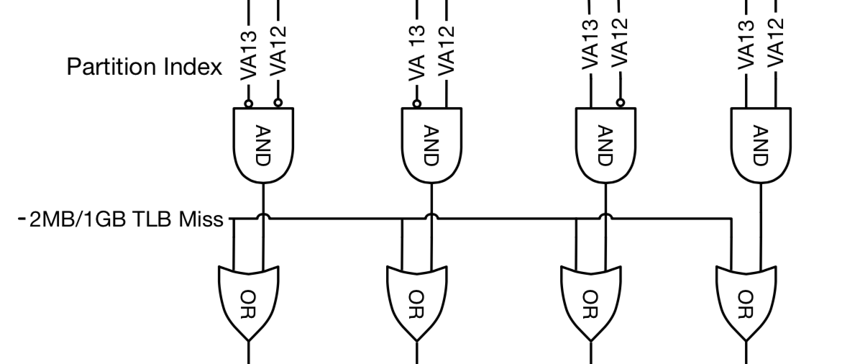
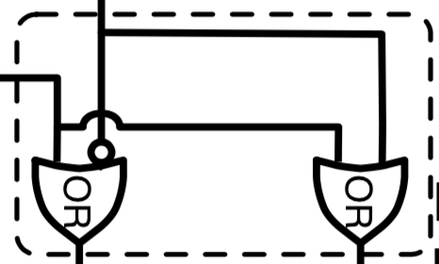
SEESAW: TFT and Partition Decoder
Translation Filter Table
(TFT)
Partition
decoder
Super
page?
Tag: VA[63:21]
Translation Filter Table
TFT Lookup
Direct mapped
False negative due to size
TFT Update
VA misprediction
2MB L1-TLB fill
2MB L1-TLB Invalidation
Partition Decoder
For 32kB Cache
For 64kB Cache

Slide 18
SEESAW: Cache line insertion policy
Which partition should cache-line be inserted?
VA
VPN
Baseline Page Offset
Partition bit
Set index
block offset
Translation Filter Table
(TFT)
Partition
decoder
v
tag
Data block
v
tag
Data block
set-1
Way-1
Way-1
Way-3
Way-3
set-1
Way-2
Way-2
Way-4
Way-4
TLB
set-N
Way-1
Way-1
Way-3
Way-3
set-N
Way-2
Way-2
Way-4
Way-4
Partition-0
Partition-1
PA
PPN
Baseline Page Offset
Cache

Slide 19
SEESAW: Cache line insertion policy
4way-8way
Superpage miss: victim within the partition
Basepage miss: victim within the set
4way
Uses LRU within the associated partition
Avoid installing the same line twice
Saves energy

Slide 20
SEESAW: System Level Optimization
Cache coherence
Cache coherence lookups use physical address
Snoopy provide higher energy benefits over Directory based coherence
Page table modifications
Superpage splintered into multiple basepages
Multiple basepages promoted to superpages

Slide 21
Outline
Motivation
SEESAW: Concept
SEESAW: Micro-architecture
Evaluation Methodology
Results
Conclusion

Slide 22
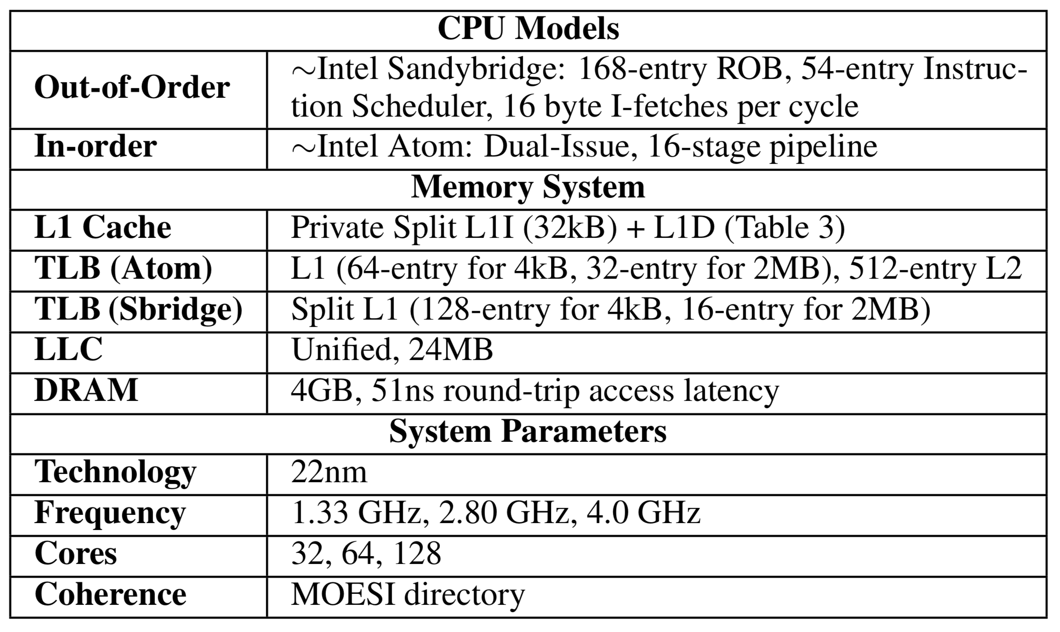
SEESAW: Simulated system

Slide 23
SEESAW: Workloads
Spec
Parsec
Cloudsuite
Tunkrank
Biobench
Mummer
Tiger
MongoDB
Server Workload
graph500
Nutch Hadoop
Social-event web service
Olia
Key value store
Redis

Slide 24
Outline
Motivation
SEESAW: Concept
SEESAW: Micro-architecture
Evaluation Methodology
Results
Conclusion

Slide 25
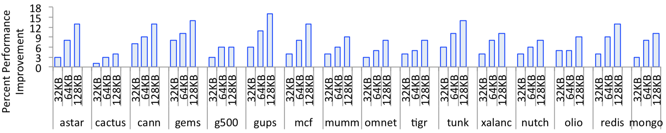
SEESAW: Performance improvement
SEESAW observes 3-10% better runtime over baseline

Slide 26
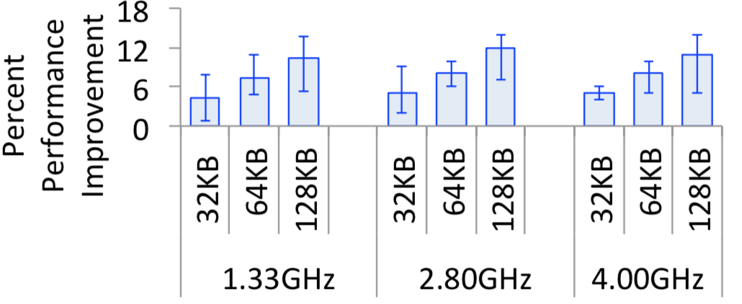
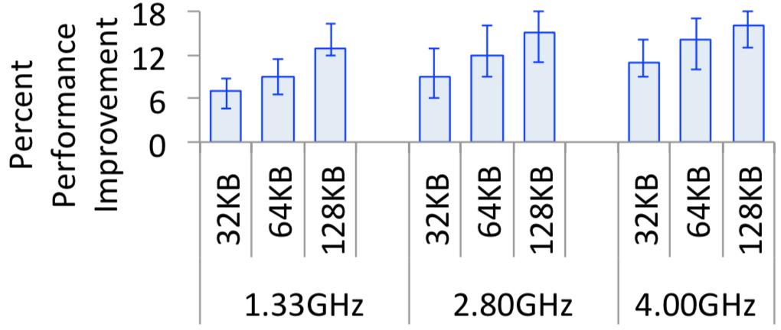
SEESAW: Performance improvement
Out-of-order
CPU
in-order
CPU
~10% performance improvement for 64kB cache in OoO CPUs

Slide 27
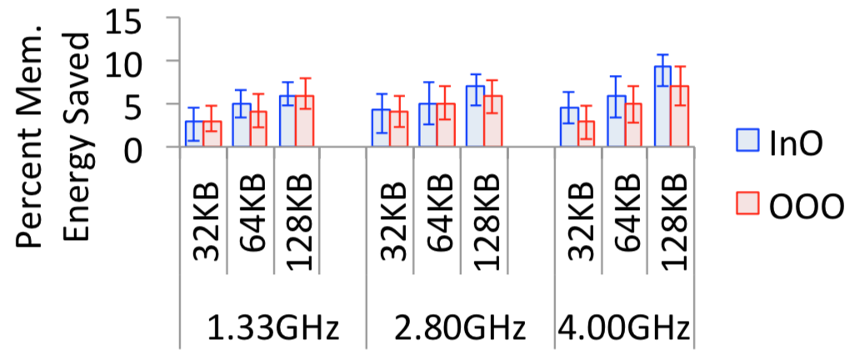
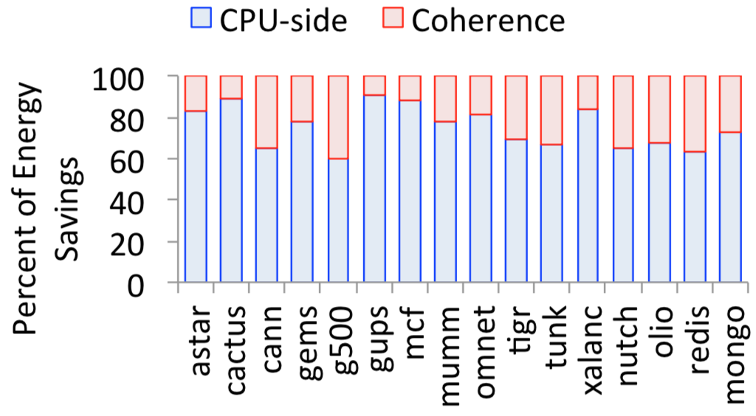
SEESAW: Energy savings
10-20% more energy savings over CPUs using baseline VIPT caches!
Approx. one-third of energy savings from coherence

Slide 28
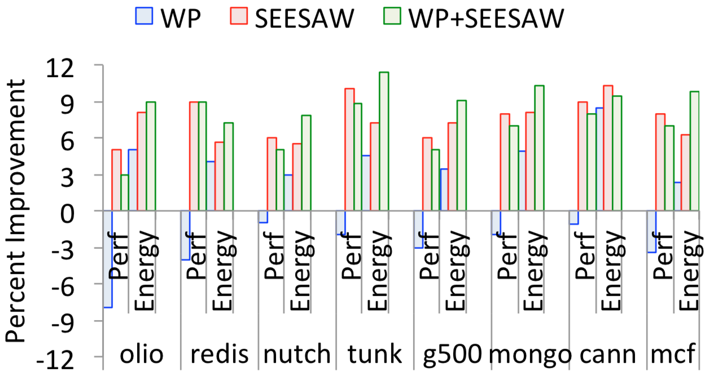
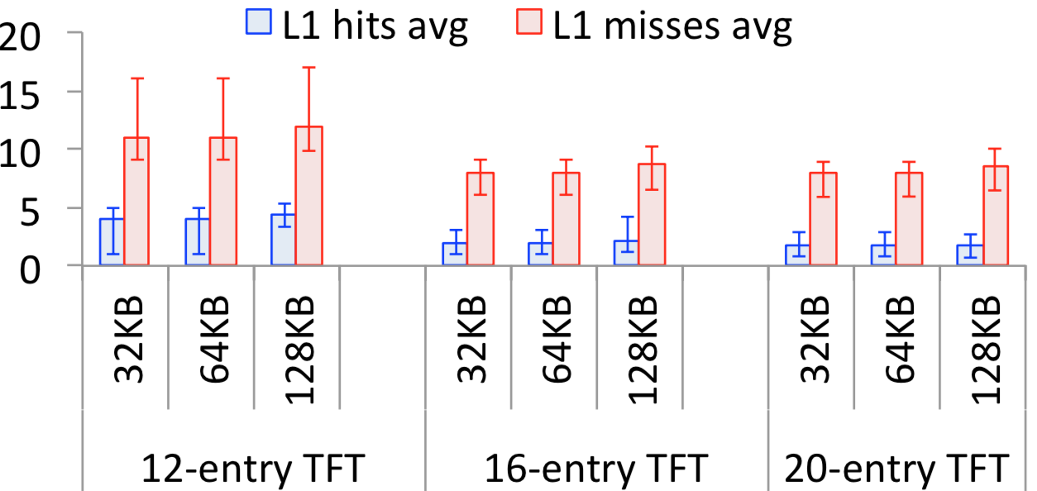
SEESAW: TFT analysis and Way-Prediction
TFT Analysis
SEESAW + Way-prediction
16-entry TFT drives miss-rate under 10%
SEESAW+WP shows symbiotic behavior

Slide 29
Outline
Motivation
SEESAW: Concept
SEESAW: Micro-architecture
Evaluation Methodology
Results
Conclusion

Slide 30
Revisiting L1 Cache Characteristic
SEESAW
Cache
Ideal-Cache
VIPT-Cache
Fast lookup
High hit-rate
Energy
Efficiency

Slide 31
SEESAW: Conclusion
L1 caches are optimized for latency
VIPT imposes indirect restriction on number of sets in a L1 cache, increasing associativity
There is non-linear relation between associativity and access latency/energy of the L1 cache
Superpages are often used in modern OSes
SEESAW provides low-associative access to superpages, providing both latency and energy benefits
Up to 10 % performance improvement and 20 % energy reduction in modern workloads
SEESAW has extremely low-overhead and is readily implementable
Associativity
Set
Thank you!

