Slide 1

Name – MAYANK RAI section – CST –SPL Roll no - 8 Project title – IMAGE DENOISING USING DEEP LEARNING
Mentor – Dr. VIDIT KUMAR (Assistant professor)

Slide 2
Introduction and problem statement In my mini project image denoising using deep learning I have used autoencoders in keras and python with tensorflow Keras Keras is an effective high-level neural network Application Programming Interface (API) written in Python. This open-source neural network library is designed to provide fast experimentation with deep neural networks, and it can run on top of CNTK, TensorFlow, and Theano. Tensorflow ->TensorFlow is the premier open-source deep learning framework developed and maintained by Google. Although using TensorFlow directly can be challenging, the modern tf.keras API brings Keras’s simplicity and ease of use to the TensorFlow . Autoencoders Encoder: Takes the input data and compresses it into a latent representation (a compressed code). Decoder: Takes the latent representation and tries to reconstruct the original input data from it.
Python
Readability and ease of use: Its simple syntax and vast libraries make it approachable for both beginners and experts.
Rich ecosystem of libraries:
NumPy: Efficient numerical computations and array manipulation.
Pandas: Data analysis and manipulation.
Matplotlib and Seaborn: Data visualization.
Scikit-learn: Traditional machine learning algorithms.
TensorFlow and PyTorch: Deep learning frameworks.

Slide 3
Why I choose this mini project "We were intrigued by the potential of deep learning, particularly autoencoders, to significantly improve image denoising, a challenging task with widespread applications.“ "Image denoising is crucial in various fields, such as medical imaging, astronomy, and autonomous vehicles. Our project aimed to contribute to developing better tools for these applications.“ "This project aligned with our individual interests in deep learning and its applications in computer vision, offering a challenging and rewarding learning experience.“ "The practical challenge of applying deep learning to a real-world problem like image denoising motivated us to push our limits and gain valuable knowledge in the field.“
“in this we get the knowledge about how neural networks work”

Slide 4
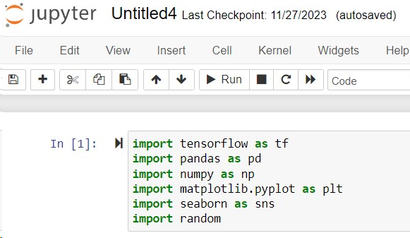
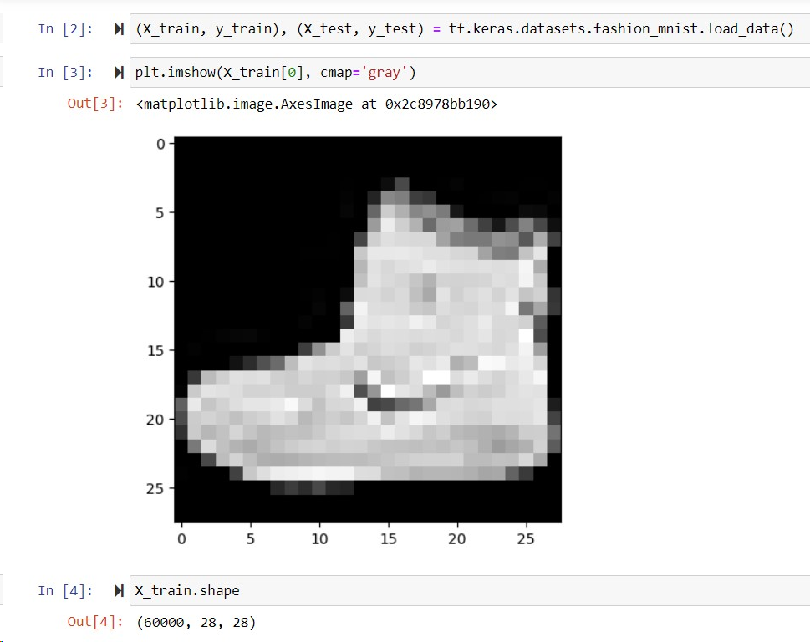
Methodology > In this project, we will use autoencoders to perform image denoising. > Autoencoders are a type of artificial neural networks that are used to perform a task of data encoding (representation learning). > We will feed in noisy images from the fashion dataset as input. > The output is a clean (denoised) image. Importing necessary library fuctions and dataset for image denoising -> ex – tensorflow , pandas , numpy , matplotlib.pyplot , seaborn , random -> I have taken the fashion-mnist datset from the inbuilt dataset in tesorflow and I have load the dataset using keras and python Perform data visualization in image denoising [] after that I performed data visualization by Showing a few examples of original images from the dataset using Matplotlib to showcase the image type and quality. I can display them as subplots or create a gallery view. [] Generate and visualize noisy versions of the original images using specific noise functions available in Python libraries.
Hvh mnnbmbjbjhvhjvhjvhvhv

Slide 5
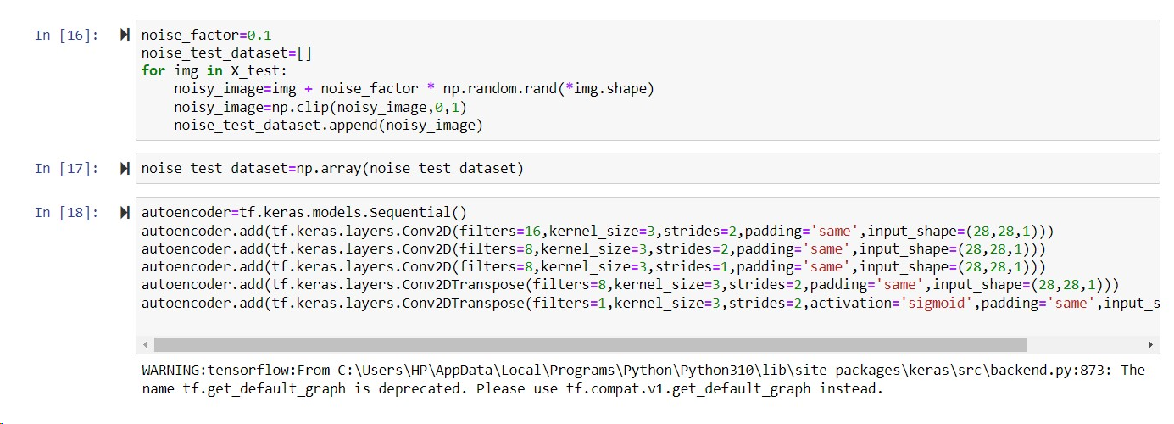
Performing Data Preprocessing in image denoising In this part of the methodology or we can say in data preprocessing I have normalize my dataset and them add some noise to it to make it noisy Understanding the theory and intuitions behind the autoencoders In this part I have understand the theory and process behind the working of autoencoders in includes the autoencoders inituitions , code layer , autoencoders functions , and mini misation of reconstruction error Build and train autoencoder In this portion I have trained the autoencoder using keras and python with tensorflow •Defining the model architecture: Construct the encoder and decoder layers using appropriate Keras layers. •Train the model: Fit the model to the noisy training data, monitoring performance on the validation set.

Slide 6
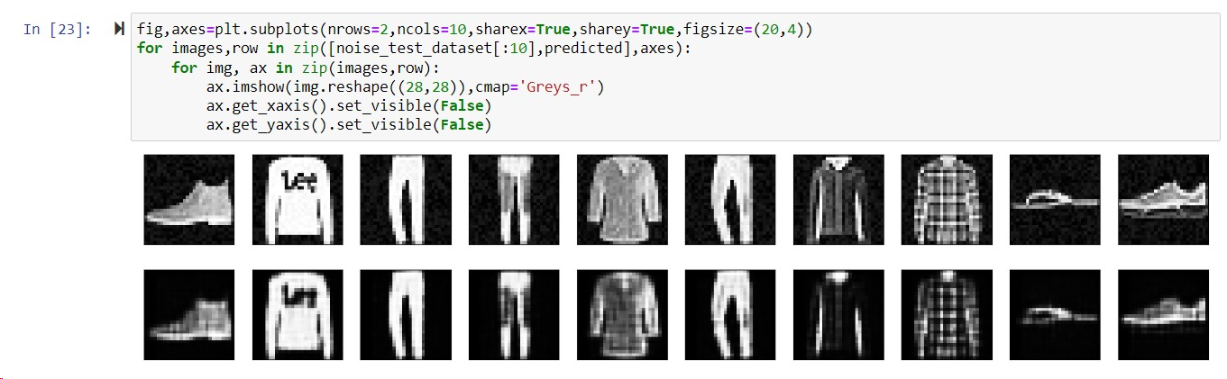
Access trained model performance In this part we access the trained model of autoencoder and try to minimise our reconstruction error less the error more is the accuracy Final Result Finally or image denoising using deep learning using autoencoders in keras and python with tesorflow shows the correct ouput and differentiate the noisy image and clear image

Slide 7
Results and Discussion on image denoising using deep learning Our project successfully demonstrated the effectiveness of applying deep learning with autoencoders for image denoising. The trained model achieved significant improvements in removing various types of noise (mention specific types encountered) from diverse images, showcasing its ability to enhance image quality and preserve vital details.
Successfully denoise the image using self trained autoencoders By applying certain logical algorithms and calculations I am able to make the trained autoencoder using the different keras and python with tensorflow

Slide 8
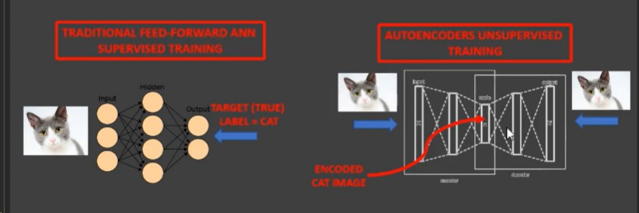
Problems faced during the image denoising using deep learning -> During the reconstruction of autoencoder we have to keep in mind that our reconstruction error will be minimum -> Finding appropriate datasets with various noise types and image qualities relevant to your project goals. -> Dealing with imbalanced datasets, corrupt data points, and the need for data augmentation. -> Choosing the appropriate autoencoder architecture for my specific noise types and image domain. Discuss the various techniques used in Autoencoders AUTOENCODERS INTUITION Auto encoders use the same input data for the input and output THE CODE LAYER OF AUTOENCODER Autoencoders work by adding a bottleneck in the network. This bottleneck forces the network to create a compressed (encoded) version of the original input ENCODER AND DECODER FUCTIONS ENCODER: h(x) = sigmoid (W * x + b) DECODER: x^= sigmoid(W* * h(x) + c) TIED WEIGHTS: Weights from input to hidden layer will be equal to the weights from hidden layer to output W* = WT

Slide 9
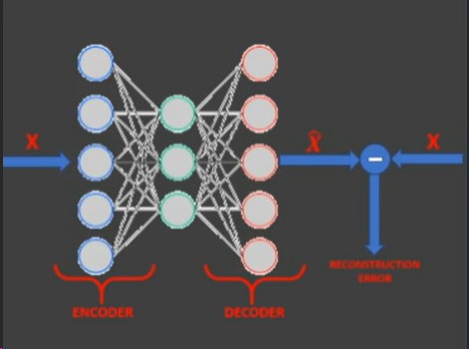
Reconstruction error of image denoising o Autoencoders objective is to minimize the reconstruction error which is the difference between the input X and the network output X o Autoencoders dimensionality reduction (latent space) is quite similar to PCA (Principal Component Analysis) if linear activation functions are used
OUTPUT Finally we successfully denoise the image using deep learning and we clearly see the difference between the noisy image and denoised image

Slide 10
Conclusion and future work Our mini project successfully leveraged deep learning with autoencoders to achieve significant image denoising. Using a Keras-based autoencoder model, we effectively removed various types of noise (mention specific types encountered) from diverse images, resulting in cleaner and clearer visual representations. The denoised images showcased noticeable improvements in terms of noise reduction, sharpness, and overall image quality. Future Work: Expanding upon these promising results, several exciting avenues for future research emerge: •Tackling challenging noise: Investigating customized architectures and loss functions to refine denoising performance for complex noise patterns like salt-and-pepper noise or motion blur. •Domain-specific adaptation: Tailoring the autoencoder for specific domains like medical imaging or satellite imagery by incorporating domain-specific knowledge into the model or training data. •Real-time denoising applications: Developing lightweight and efficient model architectures suitable for real-time denoising on resource-constrained platforms like mobile devices or embedded systems.
•Exploring hybrid approaches: Combining the strengths of autoencoders with other deep learning techniques like generative adversarial networks or residual connections to further enhance denoising capabilities.

