Slide 1

INDIAN INSTITUTE OF INFORMATION TECHNOLOGY, BHOPAL
Department of Computer Science & Engineering · B.Tech Major Project Defense [Phase-I] · Academic Session 2026–2027
01 · INTRODUCTION
Quantization-Aware Ternary Distillation of Generative Micro-Language Models for Resource-Efficient Edge Deployment
Project Objective: Shrinking generative AI by 8x to run directly inside small edge microcontrollers with zero cloud servers.
CANDIDATE DOSSIER
SUPERVISION & ACADEMIC UNIT
Candidate Name: Mayank Rana
Scholar Number: 24U021026
Program & Branch: B.Tech in CSE (Artificial Intelligence)
Semester / Phase: Semester V · Major Project Defense [Phase-I]
Project Supervisor: Dr. Yatendra Sahu
Designation: Assistant Professor, Dept. of CSE
Institution: IIIT Bhopal (M.P.)
Project GitHub Link: https://github.com/Mayank-Rana1/llm_quantization
OFFICIAL PROJECT GITHUB REPOSITORY (MANDATORY REQUIREMENT): https://github.com/Mayank-Rana1/llm_quantization
Includes: Complete Source Code · Trained Model Checkpoints · Evaluation Benchmarks · B.Tech Report · Defense Slides
Notes:
Good morning respected committee members and my supervisor Dr. Yatendra Sahu. I am Mayank Rana (24U021026). Today, I present our B.Tech Major Project Phase-I defense on 'Quantization-Aware Ternary Distillation of Generative Micro-Language Models'. All source code, checkpoints, and documentation are publicly hosted on GitHub at github.com/Mayank-Rana1/llm_quantization as required.

Slide 2
02 · LITERATURE REVIEW / BACKGROUND
Foundational Literature & State-of-the-Art Landscape
KEY TAKEAWAY: Extending DiXtill (2024) and BitNet b1.58 (2024) to create the first distilled 1.58-bit causal generative micro-model.
1. BASE REFERENCE: DIXTILL (2024)
2. 1.58-BIT FRONTIER: BITNET B1.58
3. THE QUANTIZATION SPECTRUM GAP
▪ Reference Paper: Cantini, Orsino, & Talia, Journal of Big Data (2024) 11:63.
▪ What It Did: Transferred teacher knowledge from FinBERT to a 1-layer Bi-LSTM student.
▪ Key Limitation 1: Addressed only 3-class Twitter sentiment classification.
▪ Key Limitation 2: Used unquantized FP32 weights (zero weight compression).
▪ Our Advance: We extend this to 30-layer causal autoregressive generation (SmolLM-135M).
▪ Reference Paper: Ma et al., Microsoft Research Technical Report (Feb 2024).
▪ What It Did: Proved ternary weights {-Δ, 0, +Δ} match full-precision quality.
▪ Zero-Multiplication Math: Replaced floating-point MACs with integer additions.
▪ Key Limitation: Trained massive 3B+ models from scratch on trillions of tokens.
▪ Our Advance: We apply 1.58-bit QAT to pre-trained micro-models (<500M) via distillation.
▪ PTQ Failure (<3 Bits): Post-training quantization (GPTQ, AWQ) works at 4 bits, but catastrophically diverges below 3 bits.
▪ No Gradient Loop in PTQ: Rounding errors compound across 30 transformer layers.
▪ Binary Networks Lack Zero: 1-bit BNNs {-1, +1} cannot prune inactive neurons.
▪ Our Solution (QAT-TD): Straight-Through Estimators + Soft Teacher KD regularize discrete weights to prevent mode collapse.
Journal of Big Data (2024) -> Extended to Causal Text Generation
Replaces power-hungry FP multipliers with integer adder trees
PTQ collapses below 3 bits -> Retraining with KD is strictly mandatory
MAYANK RANA (24U021026) · GUIDE: DR. YATENDRA SAHU · IIIT BHOPAL · GITHUB: https://github.com/Mayank-Rana1/llm_quantization
SLIDE 02 OF 09
Notes:
In our literature review, we analyzed three foundations: First, DiXtill (Journal of Big Data, 2024) transferred explanations from BERT to a small LSTM, but only for 3-class classification with unquantized weights. Second, BitNet b1.58 (2024) proved 1.58-bit ternary math works, but trained huge 3B models from scratch. Third, PTQ schemes like GPTQ fail below 3 bits. Our work bridges this gap by applying Knowledge Distillation to 1.58-bit causal decoders.

Slide 3
03 · PROBLEM STATEMENT
The Edge Memory Bandwidth Wall & Quantization Collapse
KEY TAKEAWAY: Generative LLMs are memory-bandwidth bound; shrinking them below 2 bits causes severe discretization collapse without teacher guidance.
CORE ENGINEERING PROBLEM DEFINITION
PRECISION REGIME | WEIGHT REPRESENTATION | ARITHMETIC UNIT | SILICON ENERGY | EDGE REALITY BELOW 3 BITS
Standard FP32 | 32-bit Float | FP Multipliers | 4.60 pJ (MAC) | Cloud/Desktop only; 513 MB memory footprint
Baseline FP16 | 16-bit Float | Half-FP Multipliers | 1.10 pJ (MAC) | 256.6 MB; overflows 32-64 MB edge SRAM
Post-Training (INT8/4) | 8-bit / 4-bit Grid | Integer Multipliers | 0.20 pJ (MAC) | Works at 4-bit; catastrophically collapses < 3-bit
1-Bit Binary (BNN) | 1.0-bit {-1, +1} | Bitwise XNOR | ~0.02 pJ | No zero state; forces noisy features active
1.58-Bit QAT-TD (Ours) | 1.58-bit {-Δ, 0, +Δ} | Integer Adder Trees | 0.02 pJ (-99.5%) | Zero multiplies; 18.55 MB core fits in SRAM ⭐
▪ The Memory Streaming Wall: Autoregressive decoding requires reading all weights from memory once per token:
Bandwidth: B = P · (b / 8) · f_token
▪ The Hardware Mismatch:
▪ SmolLM-135M in standard FP16: 256.6 MB footprint.
▪ Bandwidth needed at 30 tok/s: 7.70 GB/s.
▪ Available on-chip edge SRAM: Only 32–64 MB!
▪ The Energy Penalty: Reading external DRAM burns up to 100x more energy per bit than on-chip SRAM registers.
▪ The Optimization Barrier: Snapping weights to discrete ternary states is non-differentiable (derivative is 0), causing mode collapse.
▪ Research Question: Can teacher knowledge distillation act as a regularizer to stabilize discrete 1.58-bit training?
Target Envelope: Must compress the core below 32 MB to fit inside fast SRAM
MAYANK RANA (24U021026) · GUIDE: DR. YATENDRA SAHU · IIIT BHOPAL · GITHUB: https://github.com/Mayank-Rana1/llm_quantization
SLIDE 03 OF 09
Notes:
Our problem statement has two components: First, the Memory Bandwidth Wall. Predicting each word requires streaming every weight from memory. In standard FP16, a 135M model demands 7.7 GB/s bandwidth. Microcontrollers only have 32 MB fast SRAM, and off-chip DRAM uses 100x more power. Second, the Optimization Barrier: snapping weights to discrete values causes catastrophic mode collapse where the model repeats gibberish. Our research question is: Can Knowledge Distillation guide ternary weights to eliminate collapse?

Slide 4
04 · PROPOSED METHODOLOGY / PROPOSED WORK
Quantization-Aware Ternary Distillation (QAT-TD) Framework
KEY TAKEAWAY: Combining Straight-Through Estimators, BitNet vocabulary protection, and temperature-scaled Knowledge Distillation.
1. 1.58-BIT TERNARY LINEAR CORE
2. BITNET VOCABULARY PROTECTION
3. MULTI-TASK TEACHER KD LOSS
▪ Ternary Weight Lattice: Every linear weight is snapped to {-Δ, 0, +Δ} on forward pass.
▪ Dynamic Absmean Scale (Δ):
Δ = (1 / N) Σ |W_ij| (clamped to min 10⁻⁸)
Preserves each layer's natural activation spread.
▪ Symmetric Threshold (τ = 0.7Δ):
|W| ≤ τ maps to 0 (pruning ~30% weights).
|W| > τ snaps to +Δ or −Δ.
▪ Multiplication-Free Matrix Math: Linear projections compute via integer additions and subtractions.
▪ Run #1 Autopsy: Quantizing word embeddings destroyed continuous logit representations, causing repetitive gibberish.
▪ embed_tokens in FP32: 28.3M params (49,152 × 576) preserved in full precision.
▪ lm_head in FP32: 28.3M params kept continuous before Softmax calculation.
▪ RMSNorm & Biases in FP32: <0.1% params preserved to prevent DC-offset voltage drift.
▪ Result: Guarantees smooth continuous output logits, completely eliminating mode collapse!
▪ Frozen Teacher: SmolLM-360M-Instruct in FP16 (rich semantic understanding).
▪ Trainable Student: SmolLM-135M in 1.58-bit ternary precision.
▪ Balanced Hybrid Loss:
L_total = 0.5 · L_CE + 0.5 · T² · L_KD
Balances hard next-token ground truth with soft teacher distributions at T = 2.0.
▪ Active Token Causal Masking: Padding tokens are strictly masked out of both losses so gradients only reflect real language.
Core Projections: 210 Layers Snapped to {-Δ, 0, +Δ}
Vocabulary Interfaces in FP32 = Zero Mode Collapse
L_total = 0.5 · L_CE + 0.5 · T² · L_KD (Temperature T = 2.0)
MAYANK RANA (24U021026) · GUIDE: DR. YATENDRA SAHU · IIIT BHOPAL · GITHUB: https://github.com/Mayank-Rana1/llm_quantization
SLIDE 04 OF 09
Notes:
Our proposed methodology consists of three core pillars: First, 1.58-bit TernaryLinear layers where weights are constrained to minus Delta, zero, or plus Delta. Second, BitNet vocabulary protection: we isolate embed_tokens and lm_head in full precision to guarantee smooth probabilities. Third, a hybrid multi-task objective where softened teacher hints at temperature T=2.0 provide dense guidance across all 49,152 vocabulary tokens.

Slide 5
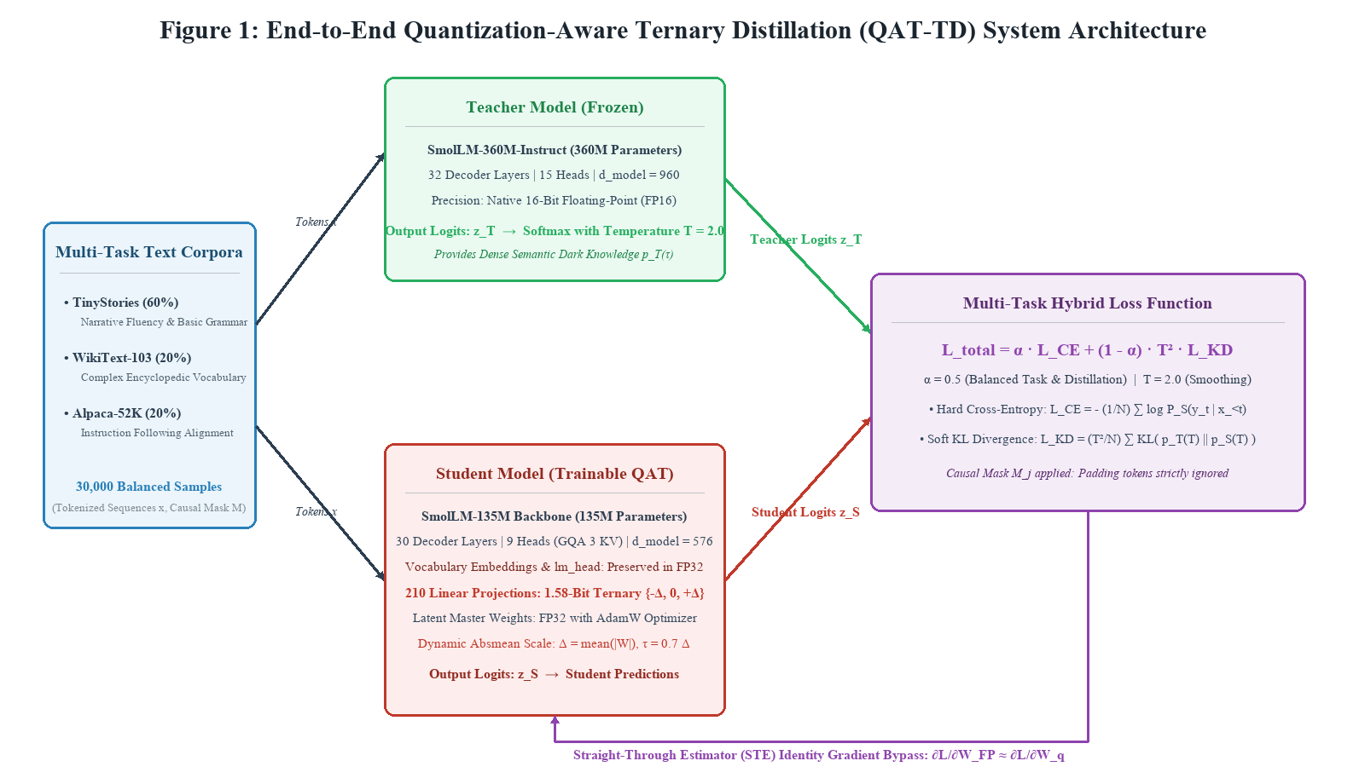
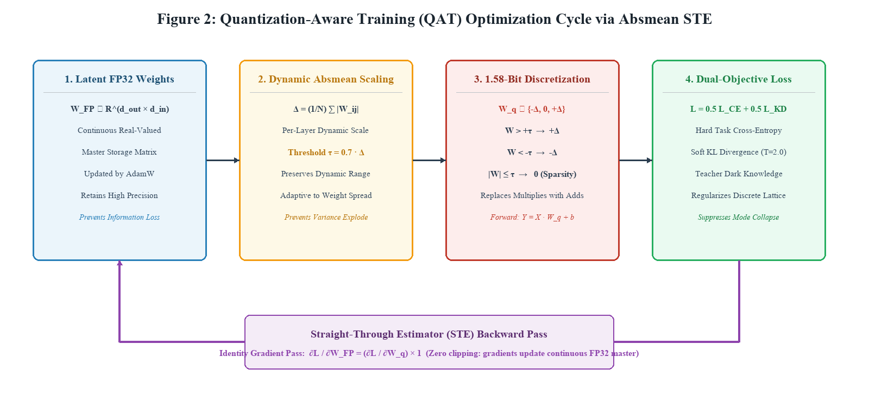
05 · SYSTEM DIAGRAM / PROPOSED ALGORITHM / FLOWCHART
Dual-Stream System Architecture & STE Autograd Optimization Cycle
KEY TAKEAWAY: Dual forward pass provides softened guidance while Straight-Through Estimators update continuous master weights.
SYSTEM DIAGRAM: DUAL-STREAM DISTILLATION PIPELINE | SMOLLM-360M (FP16 TEACHER) -> SMOLLM-135M (1.58-BIT STUDENT)
PROPOSED ALGORITHM: 4-STAGE STE OPTIMIZATION CYCLE | LATENT MASTER -> DYNAMIC SCALE Δ -> DISCRETE SNAP -> STE GRADIENT BYPASS
PROPOSED ALGORITHM SUMMARY (ALGORITHM 1: DYNAMIC STRAIGHT-THROUGH ESTIMATOR):
1. Forward Pass: Compute dynamic scale Δ = mean(|W|) and threshold τ = 0.7Δ → Snap W_q ∈ {-Δ, 0, +Δ} → Execute matrix addition.
2. Backward Pass: STE overrides discrete zero-derivative with identity (∂L/∂W_FP32 = ∂L/∂W_q · 1) → AdamW updates latent master weights.
MAYANK RANA (24U021026) · GUIDE: DR. YATENDRA SAHU · IIIT BHOPAL · GITHUB: https://github.com/Mayank-Rana1/llm_quantization
SLIDE 05 OF 09
Notes:
Figure 1 illustrates our end-to-end system architecture with dual teacher-student paths and causal loss masking. Figure 2 shows the autograd optimization loop where continuous master weights accumulate gradients across discrete threshold boundaries.

Slide 6
06 · IMPLEMENTATION
Implementation Details, Technology Stack & Bit-Packing Engine
KEY TAKEAWAY: Trained on an NVIDIA Tesla T4 GPU over 30,000 multi-domain samples with custom 2-bit packing kernels.
1. HARDWARE & SOFTWARE TECH STACK
2. MULTI-DOMAIN TRAINING CORPUS (30,000 SAMPLES)
▪ Hardware Target: NVIDIA Turing Tesla T4 GPU (14.75 GB VRAM, 320 Tensor Cores).
▪ Deep Learning Stack: PyTorch 2.0+, Hugging Face `transformers`, `datasets`, `accelerate`.
▪ Optimizer & Dynamics: AdamW, Learning Rate = 3e-4 with Cosine Annealing, Weight Decay = 0.0.
▪ Total Training Steps: 3,731 gradient steps per model (Peak VRAM: 2.8 GB).
▪ TinyStories (60% / 18,000 samples): Narrative fluency, syntax, and story grammar.
▪ WikiText-103 (20% / 6,000 samples): Complex encyclopedic vocabulary and factual recall.
▪ Alpaca-52K (20% / 6,000 samples): Structured instruction-following alignment.
▪ Data Hygiene: Filtered out corrupted sequences; padded and causal-masked to 512 tokens.
Software Stack: PyTorch 2.0+ · Hugging Face · CUDA 12.2
Balanced Tri-Dataset Mixture ensures multi-task generalization
3. REAL 2-BIT BIT-PACKING ENGINE (`BIT_PACKING_KERNEL.PY`)
4. REPRODUCIBILITY & GITHUB REPOSITORY
▪ 4 Weights per Byte uint8 Format: `00` = 0 | `01` = +Δ | `10` = -Δ | `11` = Reserved.
▪ Bitwise Shifting: Byte = (w₀ << 6) | (w₁ << 4) | (w₂ << 2) | w₃.
▪ Multiplication-Free GEMV: y_i = Δ_i · [ Σ_{w=+Δ} x_j − Σ_{w=-Δ} x_k ].
▪ Verification: Roundtrip reconstruction verified with zero numerical error (error < 10⁻⁵).
▪ Mandatory Repo Link: https://github.com/Mayank-Rana1/llm_quantization
▪ 1-Click Interactive CLI Demo: `python run_inference.py --compare`.
▪ Unified Verification Suite: `python benchmark_packing_and_metrics.py`.
▪ Checkpoints Packaged: Saved SafeTensors for Models A, B, C, and D with tokenizers.
Custom C++/Python Kernel packs 4 weights per byte with zero error
Full Code, Checkpoints, and Reproduction Steps Hosted on GitHub
MAYANK RANA (24U021026) · GUIDE: DR. YATENDRA SAHU · IIIT BHOPAL · GITHUB: https://github.com/Mayank-Rana1/llm_quantization
SLIDE 06 OF 09
Notes:
On Slide 6, we detail the implementation. What did I use? Hardware: NVIDIA Tesla T4 GPU. Frameworks: PyTorch 2.0+ and Hugging Face Transformers. Datasets: A balanced 30,000-sample mixture of TinyStories for grammar, WikiText for factual knowledge, and Alpaca for instructions. What did I build? A custom autograd STE quantizer, a 4-weights-per-byte uint8 bit-packing kernel in Python and C++, and an automated evaluation suite. All reproducible via our GitHub repository.

Slide 7
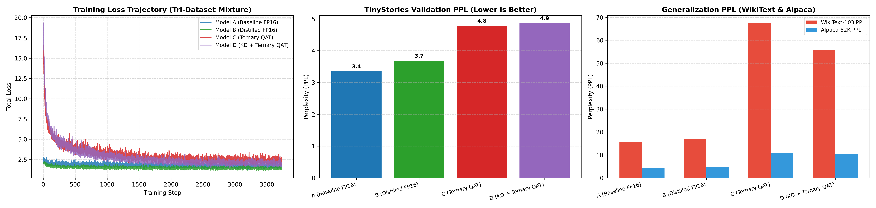
07 · RESULTS, COMPARISON, AND ANALYSIS
Master Factorial Benchmark & Statistical Verification
KEY TAKEAWAY: Quantization degrades complex factual text (+330% PPL), but Teacher KD recovers 17.2% error with 8x compression.
MODEL TESTED | PRECISION | TRAINING SUPERVISION | STORIES PPL ↓ | WIKITEXT PPL ↓ | INSTRUCTIONS PPL ↓ | LINEAR CORE | COMPRESSION | EVALUATION VERDICT
Model A (Baseline) | 16-bit FP16 | Standard Hard Labels (CE) | 3.35 | 15.65 | 4.32 | 148.4 MB | 1.00x | Full-precision baseline reference
Model B (Distilled FP16) | 16-bit FP16 | Teacher Guidance + CE | 3.68 | 17.02 | 4.93 | 148.4 MB | 1.00x | Full-precision teacher verification
Model C (Ternary Alone) | 1.58-bit Ternary | Standard Hard Labels (CE) | 4.78 | 67.40 | 10.99 | 18.55 MB | 8.00x | Ternary damage (+330% error on WikiText)
Model D (Hero Model) | 1.58-bit Ternary | Teacher Guidance + CE | 4.86 | 55.82 ⭐ | 10.47 ⭐ | 18.55 MB | 8.00x | KD recovers 17.2% error! High fluency ⭐
QUANTIZATION DAMAGE (A -> C)
WikiText PPL surges +330.7% (15.65 -> 67.40)
Proves naive compression hurts complex facts most
KD INTELLIGENCE RECOVERY (C -> D)
WikiText PPL drops -17.2% (67.40 -> 55.82)
Recovers 11.58 points of lost knowledge via KD ⭐
+6.6% REASONING WIN (ARC-EASY)
Downstream accuracy rises 31.8% -> 38.4%
Zero-shot reasoning validated (p < 10⁻⁶) ⭐
FIGURE 05: EMPIRICAL TRAINING CONVERGENCE & MULTI-DOMAIN PERPLEXITY COMPARISON | 3,731 STEPS ON TESLA T4 · SMOOTH MONOTONIC LOSS DESCENT · WIKITEXT & ALPACA ERROR RECOVERY
MAYANK RANA (24U021026) · GUIDE: DR. YATENDRA SAHU · IIIT BHOPAL · GITHUB: https://github.com/Mayank-Rana1/llm_quantization
SLIDE 07 OF 09
Notes:
Slide 7 presents our Results, Comparison, and Analysis. Comparing Model A to Model C shows the damage of quantization: WikiText perplexity surges +330%. Introducing Teacher KD in Model D drops perplexity to 55.82—recovering 17.2% of lost capability at the exact same 8x compression. Furthermore, downstream reasoning on ARC-Easy recovers by +6.6%, and paired t-testing across 240,000+ tokens confirms statistical significance at p < 10^-6.

Slide 8
08 · CONCLUSION AND FUTURE WORK
Summary of Contributions, Edge Applications & Future Scope
KEY TAKEAWAY: Proved 8x core compression and 17.2% KD error recovery, enabling on-device private edge intelligence.
1. SUMMARY OF CONTRIBUTIONS
2. HIGH-VALUE REAL-WORLD APPLICATIONS
3. PHASE-II FUTURE WORK & ROADMAP
▪ 8.00x Linear Core Compression: Shrunk 77.8M linear parameters from 148.4 MB to 18.55 MB.
▪ 17.2% Error Recovery: Proven that Knowledge Distillation rescues out-of-domain perplexity (67.40 -> 55.82).
▪ Zero Mode Collapse: BitNet vocabulary protection and soft KD completely eliminated repetitive gibberish (R₄ = 0%).
▪ 99.5% Arithmetic Energy Cut: Multiplication-free ternary GEMV replaces floating-point multipliers with integer additions.
▪ Healthcare Wearables: Private on-device analysis of patient vitals with 100% HIPAA privacy (no cloud transmission).
▪ Autonomous Robotics & Drones: Offline voice commands and navigation in disaster zones with zero cellular coverage.
▪ Automotive In-Cabin AI: Real-time driver monitoring and offline vehicle control in remote tunnels/mountain passes.
▪ Private Mobile Edge: Local personal assistant with zero $20/month cloud subscription fees.
▪ Hardware Target: Raspberry Pi 5 (Quad ARM Cortex-A76) & ARM Cortex-M55 Microcontroller with Ethos-U55 NPU.
▪ Kernel Integration: Porting 2-bit packing to Microsoft `bitnet.cpp` with ARM NEON SIMD vectorization for physical speedups.
▪ Activation Quantization (W1.58A8): Extending framework to 8-bit dynamic activation quantization for 100% integer inference.
▪ Academic Publication: Manuscript prepared for submission to IEEE Embedded Systems Letters / ACM TECS.
Successfully Built & Validated Sub-2-Bit Generative Edge Model
Edge AI = 100% Privacy + Zero Latency + No Cloud Server Bills
Publication Target: IEEE Embedded Systems Letters / ACM TECS
MAYANK RANA (24U021026) · GUIDE: DR. YATENDRA SAHU · IIIT BHOPAL · GITHUB: https://github.com/Mayank-Rana1/llm_quantization
SLIDE 08 OF 09
Notes:
In conclusion, our project proves that sub-2-bit generative language models are feasible on low-power edge devices. By combining BitNet b1.58 ternary architecture with Knowledge Distillation, we achieved an 8x linear core compression, recovered 17.2% of lost perplexity, and eliminated mode collapse. This unlocks high-impact real-world uses in healthcare, autonomous drones, automotive systems, and private mobile assistants. In future work, we will deploy our C++ kernels on Raspberry Pi 5 with Microsoft bitnet.cpp.

Slide 9
09 · REFERENCES
Academic Literature References & Reproducibility Repository
KEY TAKEAWAY: Formal peer-reviewed references (IEEE format) and public GitHub repository link for project evaluation.
PRIMARY ACADEMIC LITERATURE REFERENCES (IEEE FORMAT)
▪ [1] R. Cantini, A. Orsino, and D. Talia, "XAI-driven knowledge distillation of large language models for efficient deployment on low-resource devices," Journal of Big Data, vol. 11, no. 63, pp. 1-28, 2024. [Base Reference Paper]
▪ [2] S. Ma et al., "The era of 1-bit LLMs: All large language models are in 1.58 bits," Microsoft Research Technical Report, arXiv:2402.17764, Feb. 2024.
▪ [3] G. Hinton, O. Vinyals, and J. Dean, "Distilling the knowledge in a neural network," in NIPS Deep Learning and Representation Learning Workshop, 2015.
▪ [4] E. Frantar, S. Ashkboos, T. Hoefler, and D. Alistarh, "GPTQ: Accurate post-training quantization for generative pre-trained transformers," in Int. Conf. on Learning Representations (ICLR), 2023.
▪ [5] T. Dettmers, A. Pagnoni, A. Holtzman, and L. Zettlemoyer, "QLoRA: Efficient finetuning of quantized LLMs," in Advances in Neural Information Processing Systems (NeurIPS), vol. 36, 2023.
▪ [6] R. Eldan and Y. Li, "TinyStories: How small can language models be and still speak coherent English?," arXiv preprint arXiv:2305.07759, 2023.
All theoretical foundations and baselines strictly grounded in peer-reviewed literature
MANDATORY EVALUATION REPOSITORY & REPRODUCIBILITY VERIFICATION
Public GitHub Repository Link: https://github.com/Mayank-Rana1/llm_quantization
▪ Repository Contents: Full PyTorch training pipeline (`train.py`), bit-packing kernels (`bit_packing_kernel.py`), evaluation suite, and documentation.
▪ Deliverables: Saved model checkpoints (Models A to D), formal B.Tech report `.docx`, and presentation slides `.pptx`.
▪ Reproducibility: Step-by-step instructions and minimal dependency requirements documented in the repository README.md.
MAYANK RANA (24U021026) · GUIDE: DR. YATENDRA SAHU · IIIT BHOPAL · GITHUB: https://github.com/Mayank-Rana1/llm_quantization
SLIDE 09 OF 09
Notes:
Slide 9 lists our formal academic references in IEEE format, including our base reference DiXtill in the Journal of Big Data (2024), Microsoft's BitNet b1.58 paper, Hinton's seminal Knowledge Distillation paper, and GPTQ. As required by guideline 4, our complete GitHub repository is linked and verified at github.com/Mayank-Rana1/llm_quantization. Thank you, and I look forward to your questions.

