Slide 1
Retail Data Analysis Project
Mayank Bisht
Tools: Python, SQL, Excel

Slide 2
Objective
Analyze customer transaction data
Understand customer spending behavior
Identify high-value customers

Slide 3
Dataset
Retail_Data_Response (customer response)
Retail_Data_Transactions (transactions)

Slide 4
Tools Used
Python (pandas, matplotlib)
SQL (SQLite)
Excel (LibreOffice Calc)

Slide 5
Data Cleaning
Removed missing values
Converted date column
Cleaned inconsistent data

Slide 6
Data Preparation
Calculated total sales per customer
Counted transactions
Extracted month & year

Slide 7
Data Merging
Combined response and transaction data
Created final dataset

Slide 8
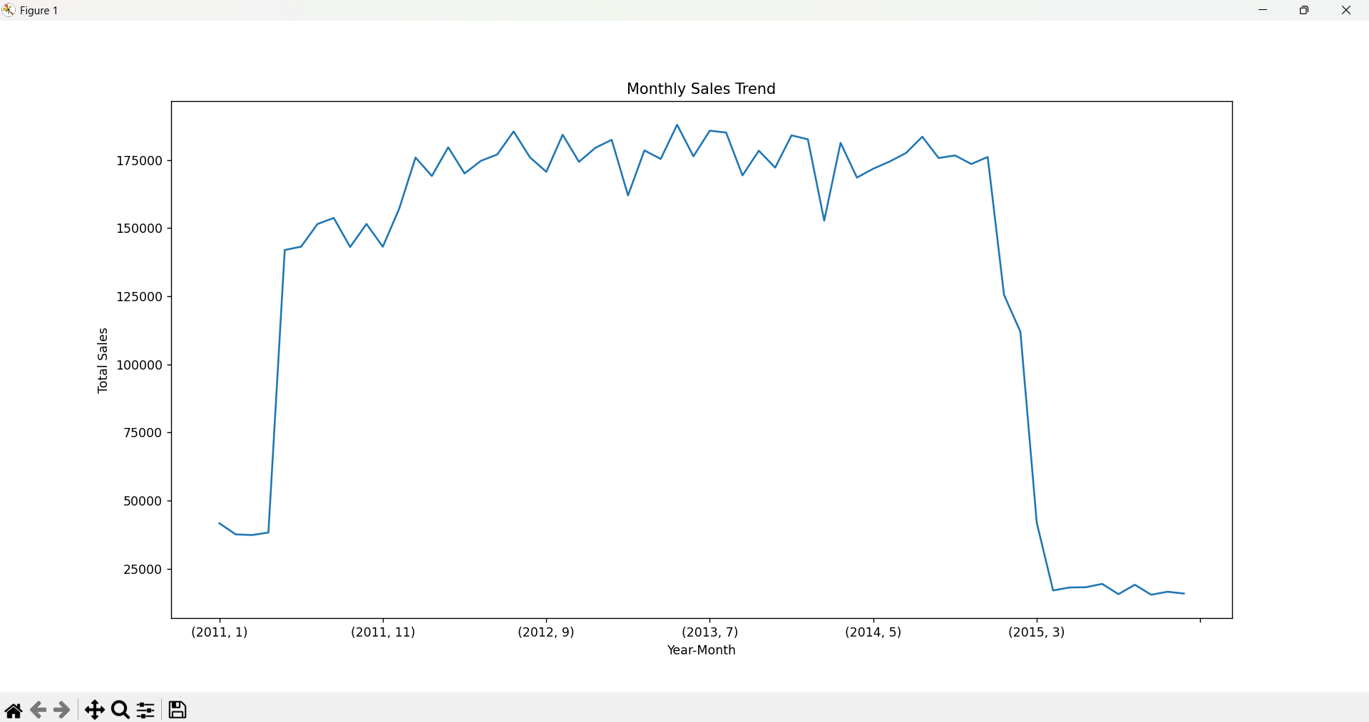
Visualization

Slide 9
Output
Final dataset (CSV)
Excel report
Python script
SQL queries

Slide 10
Conclusion
Identified high-value customers
Found customer behavior patterns
Data helps business decisions

Slide 11
Thank You

