Slide 1
The Platform
Consolidation Story
How Framingham State Students Chose Their IT Platform
and What the CIO Should Do About It
MISO Student Survey Analysis | 2018 · 2021 · 2024 | 815 Respondents
Team 5 | MISM 6213 | Northeastern University | April 2026

Slide 2
The Setting
Framingham State University has surveyed students about IT services three times over six years using the MISO (Measuring Information Service Outcomes) survey — a nationally recognized benchmarking tool used by over 100 institutions.
Pre-COVID
During-COVID
Post-COVID
2018
2021
2024
246 students
313 students
256 students
Scope: IT Services only | Student cohort | Likert-scale survey data
Team 5 | MISM 6213 | Northeastern University
2 / 12

Slide 3
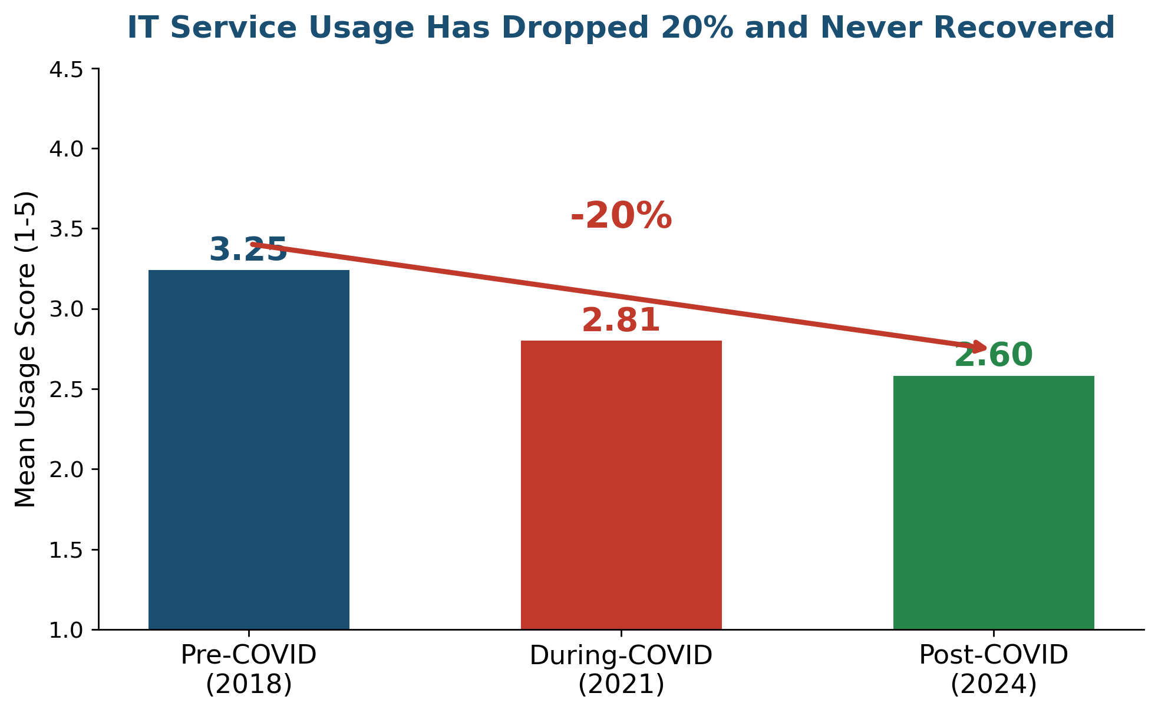
IT Usage Has Dropped 20%
...and it has never recovered.
Team 5 | MISM 6213 | Northeastern University
3 / 12

Slide 4
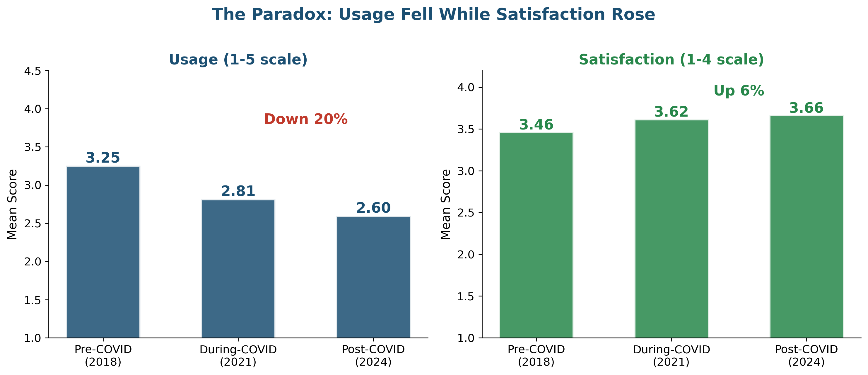
But Satisfaction Went Up
Students use services less, but are happier when they do.
Team 5 | MISM 6213 | Northeastern University
4 / 12

Slide 5
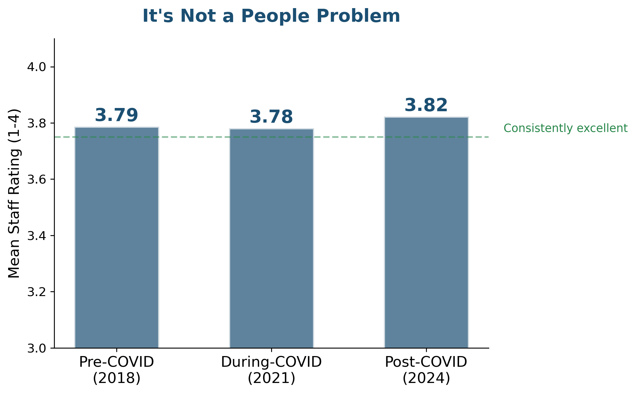
Is It a People Problem?
No. Helpdesk staff ratings are rock-solid across all three periods.
Team 5 | MISM 6213 | Northeastern University
5 / 12

Slide 6
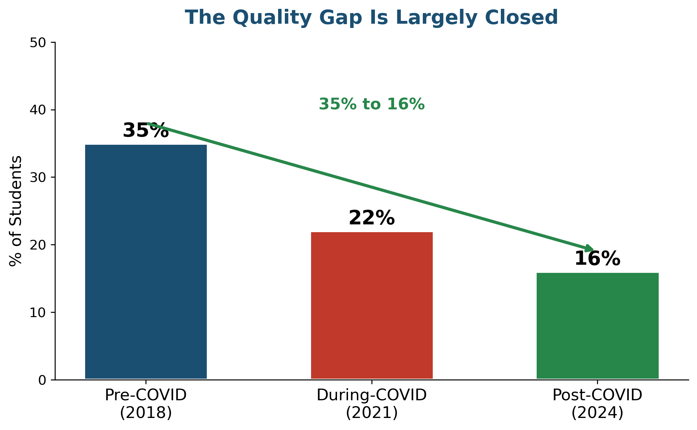
Is It a Quality Problem?
No. Students with unmet needs dropped from 35% to just 16%.
Team 5 | MISM 6213 | Northeastern University
6 / 12

Slide 7
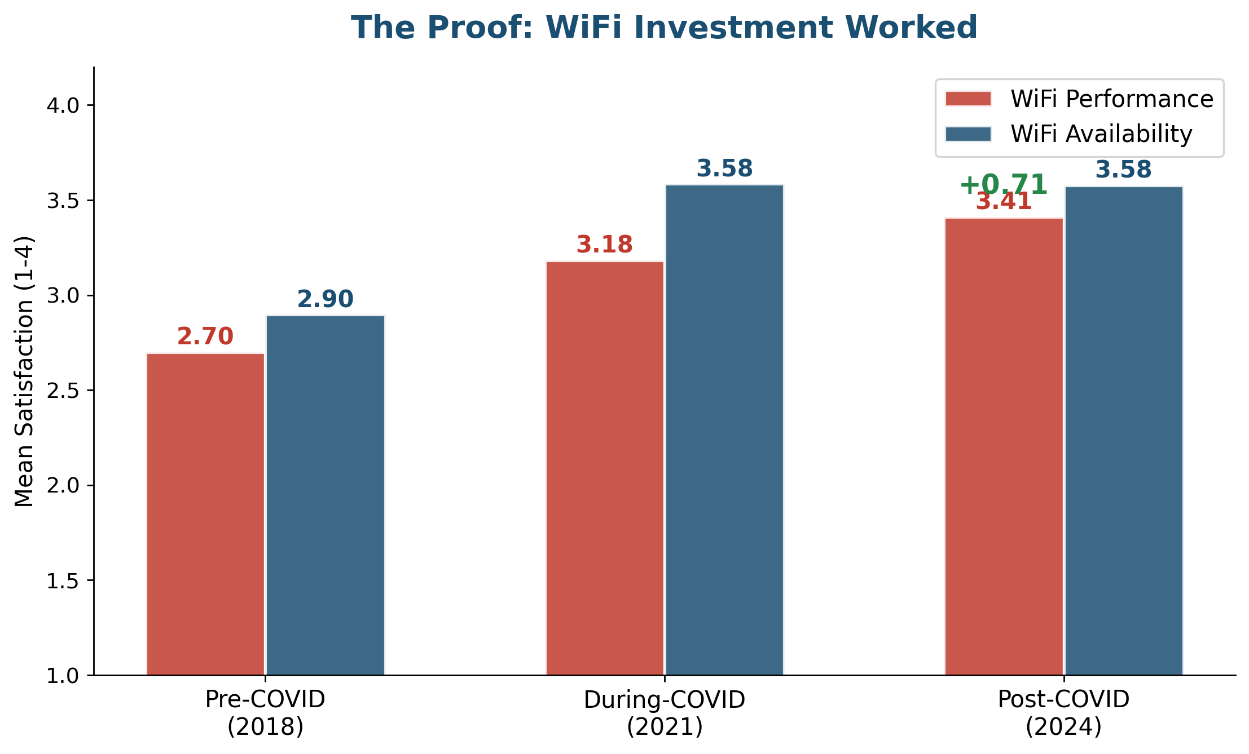
In Fact, Investment Has Worked
WiFi was the #1 pain point in 2018. Targeted investment closed the gap.
Team 5 | MISM 6213 | Northeastern University
7 / 12

Slide 8
If the quality is better,
the staff is great,
and investments are working...
Why is usage still falling?
8 / 12

Slide 9
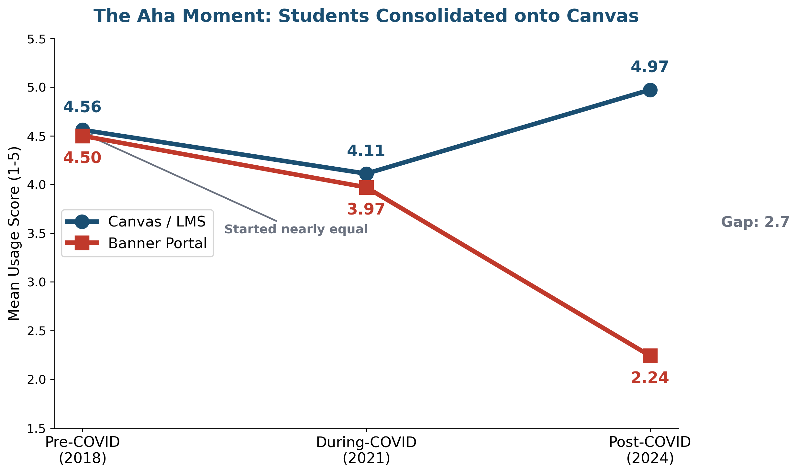
Students Didn't Leave IT. They Left Banner.
Team 5 | MISM 6213 | Northeastern University
9 / 12

Slide 10
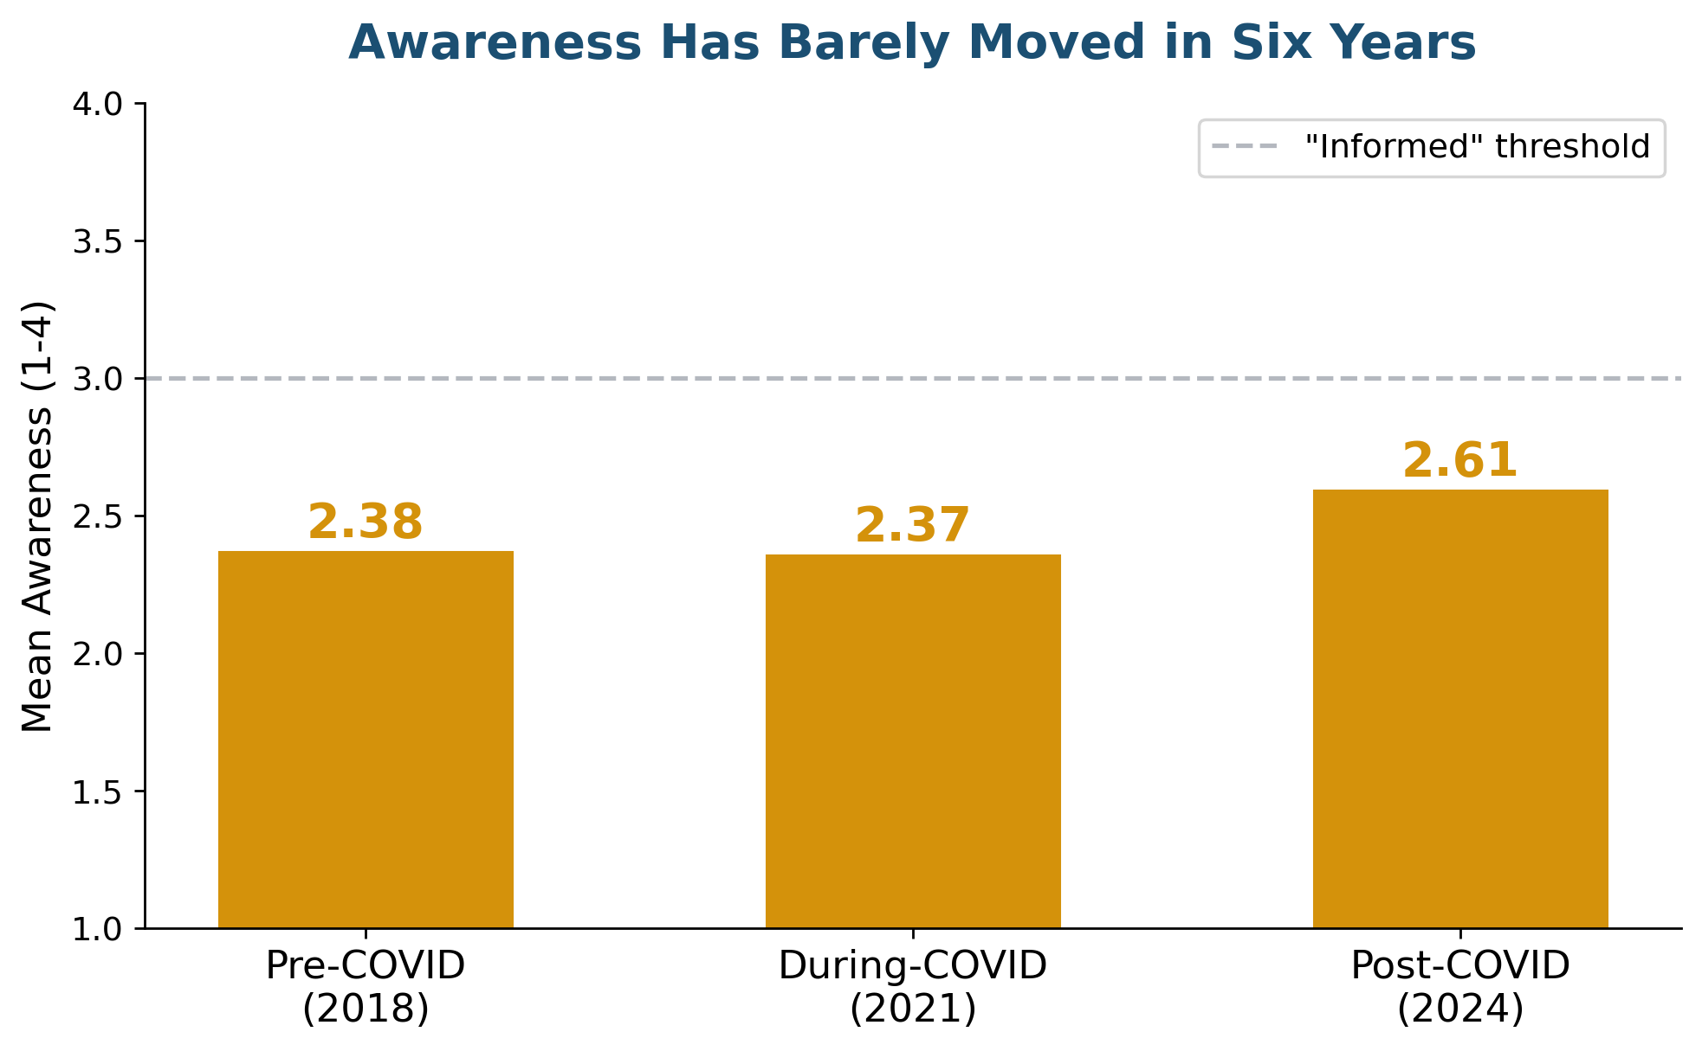
And Most Students Don't Know What Else Exists
IT awareness has barely moved in six years. Students consolidated onto Canvas partly because they never learned about alternatives.
Team 5 | MISM 6213 | Northeastern University
10 / 12

Slide 11
What This Means for the CIO
1
Follow the Students
Canvas is now the front door. Migrate Banner's most-used functions into Canvas integrations rather than maintaining a separate portal.
2
Audit Before You Build
Conduct a Banner usage audit to identify which functions students still need vs. which Canvas already replaced. Then retire or migrate.
3
Close the Awareness Gap
Invest in service discovery. Use the WiFi playbook: identify the gap, invest in communication, measure with the next MISO survey.
Measure: WiFi satisfaction (target 3.50+) | Awareness (target 65%+ Informed) | Banner usage (deliberate decline) | Canvas satisfaction (maintain 3.80+)
Team 5 | MISM 6213 | Northeastern University
11 / 12

Slide 12
The data shows students have
already chosen their platform.
Do we modernize Banner to
compete with Canvas, or do we
accelerate the consolidation
students are already demanding?
Team 5 | MISM 6213 | Data source: MISO Survey, Framingham State University

