Slide 1


AI-Based System to Predict Student Performance, Risk Level, and Weak Areas
Tech Team: Mayank Rajguru, Faraaz Kurawle & Yash Mhaparle
NEXTEDGE: Data Analytics & Cyber Security Showcase

Slide 2
The Unseen Struggle: Why Traditional Systems Fall Short
Academic Challenges are Complex
Reactive, Not Proactive
Students often face difficulties silently, leading to delayed support and missed opportunities.
Current systems rely on rigid, threshold-based alerts (e.g., attendance < 75%, failing an exam).
Missing the Bigger Picture
The Consequence
These rules often fail to detect subtle, underlying patterns in student data that indicate early signs of struggle.
Delayed interventions, increased dropout rates, and unfulfilled student potential.
As students, we've witnessed these challenges firsthand among our peers. We believe in leveraging advanced technology to empower both students and educators.

Slide 3



Our Solution: A Multi-Faceted AI for Student Success
Our "Student Success Predictor" is designed to empower proactive, personalized interventions for every student, directly aligning with the National Education Policy (NEP 2020) emphasis on holistic development and adaptive learning.
Predict Student SGPA
Assess Academic Risk Level
Identify Weak Course Type
Forecasting their future academic standing with precision.
Categorizing students into High, Medium, or Low risk of academic difficulty.
Pinpointing specific areas (e.g., Theory, Practical, Programming) where a student is likely to struggle.

Slide 4
Our Data: The Foundation of Accurate Predictions
Our Foundation:
Key Data Points (Features):
Source: Authenticated records from our college, spanning two semesters.
semester (1 or 2)
job_hours (hours/week a student works)
Dataset Size: Currently 360 student records (robust early-stage dataset, with plans for expansion!).
prev_sgpa (SGPA of the previous semester)
prev_course_score (Avg score in previous practical/theory/programming courses)
Accuracy: 100% real and accurate, meticulously collected and verified.
attendance_percentage (Current semester attendance)
course_type_score (Current semester's average per course type)

Slide 5





The Brains Behind the Predictions: Our Random Forest Models
Random Forest
Our algorithm of choice.
Handles Tabular Data
Excellently suited for structured student records.
Robust with Missing Values
Tolerant to initial gaps, like prev_sgpa for new students.
Strong Performance
Delivers reliable results even with 360 records – crucial for early-stage development.
Interpretability
Allows understanding of features driving predictions, aiding actionable insights.
Random Forest Regressor:
Random Forest Classifier (Risk):
Random Forest Classifier (Weak Areas):
Predicts SGPA: A precise numerical forecast of the student's academic standing.
Predicts Academic Risk Level:
Predicts Weak Course Type: Identifies specific areas for intervention:
High Risk (Predicted SGPA < 6)
Medium Risk (6 ≤ Predicted SGPA < 7.5)
Theory-focused courses
Low Risk (Predicted SGPA ≥ 7.5)
Programming-focused courses
Practical-focused courses

Slide 6



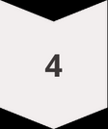




Our Seamless Pipeline: Data to Intervention
Data Collection
Gathering raw student data.
Preprocessing
Cleaning data, handling missing values, encoding.
Feature Engineering
Creating new, insightful features.
Train-Test Split
Preparing data for model training and validation.
Random Forest Model
The core prediction engine.
Predict
SGPA, Risk, Weak Type.
Output & Dashboard
Presenting predictions in an actionable format.
Take Action
Alerting counselors, suggesting interventions, recommending support.

Slide 7
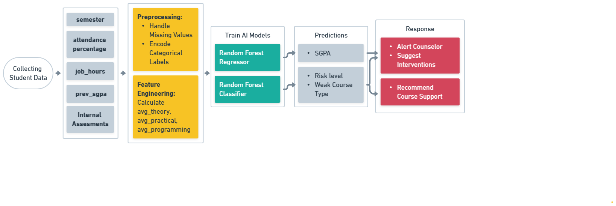
Model Workflow:

Slide 8
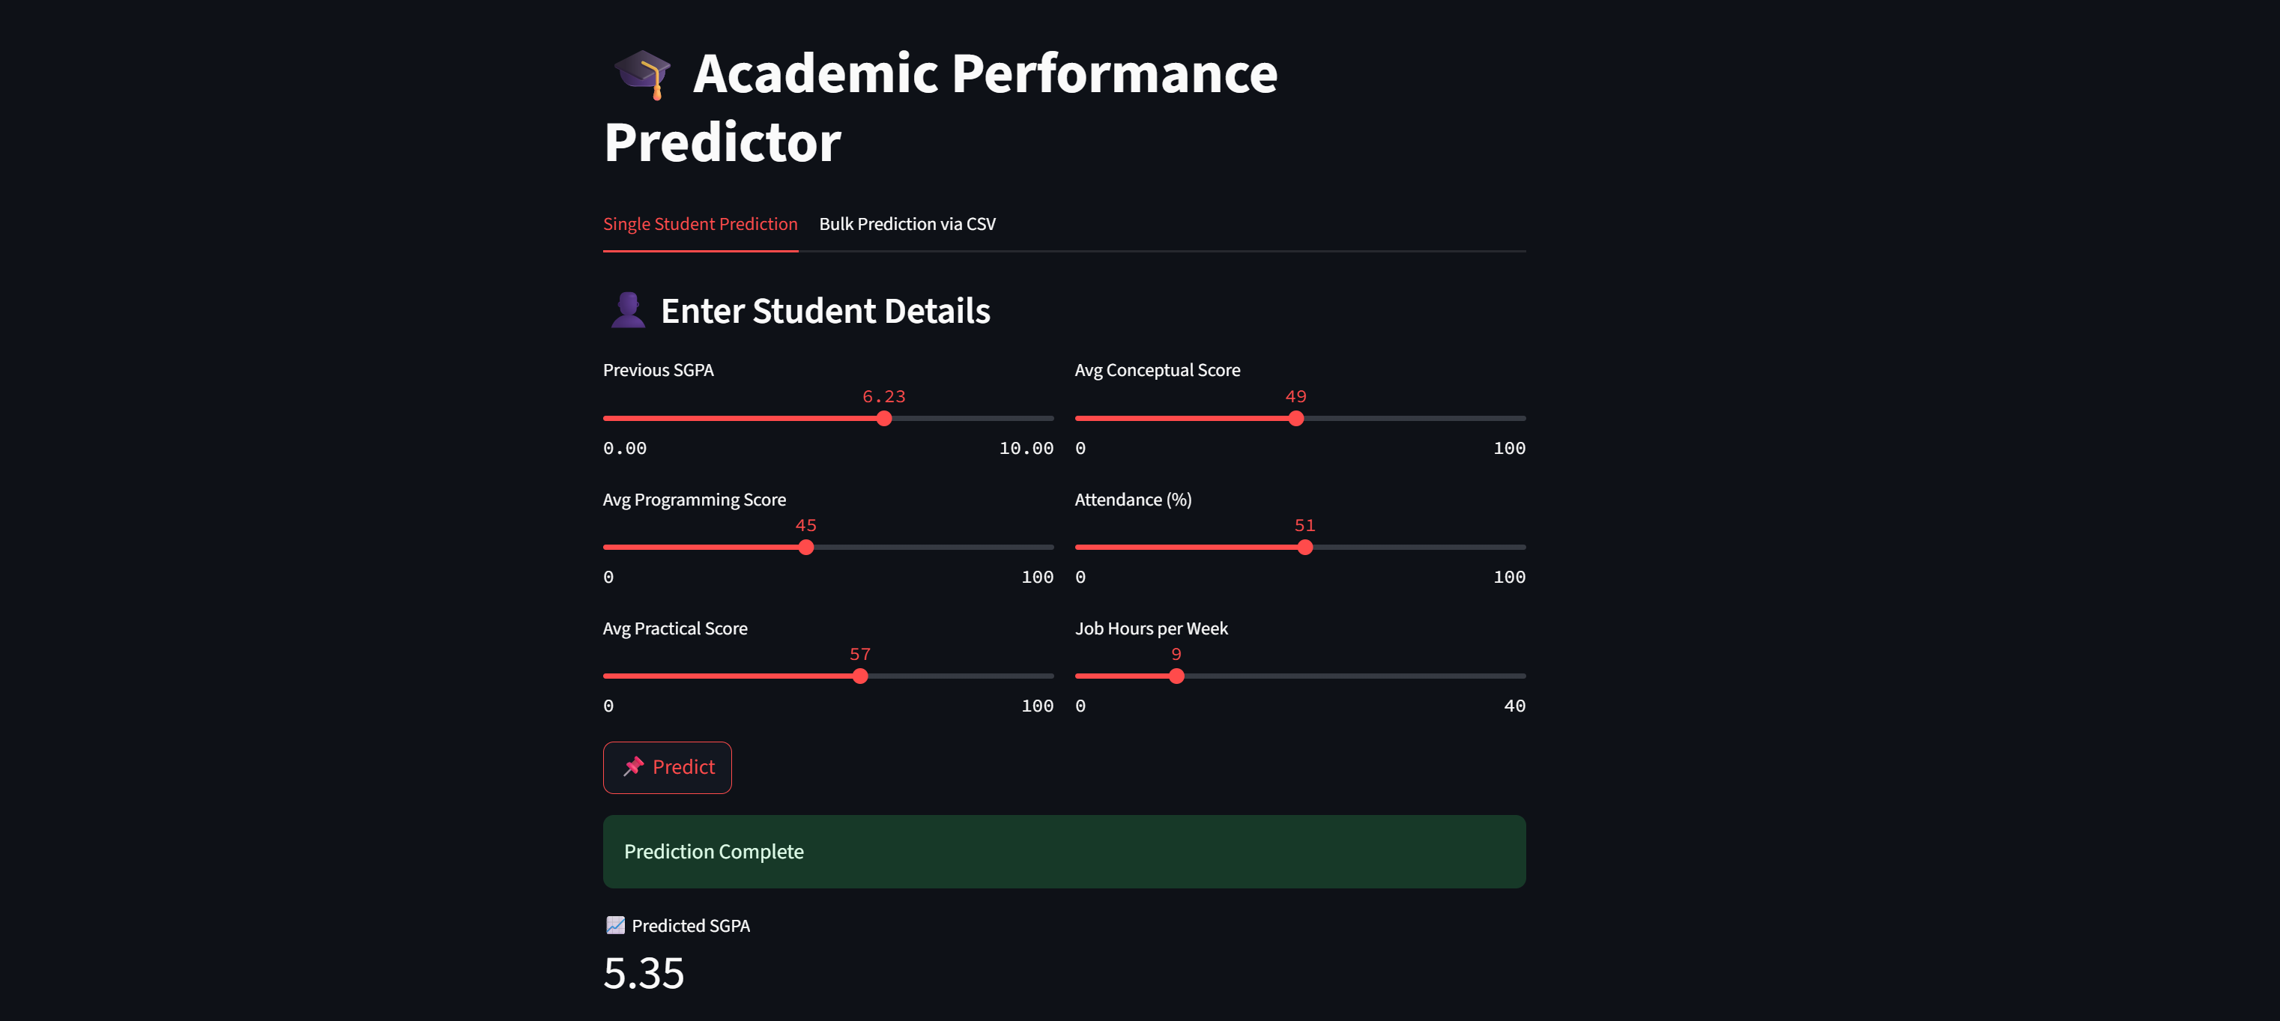

Slide 9
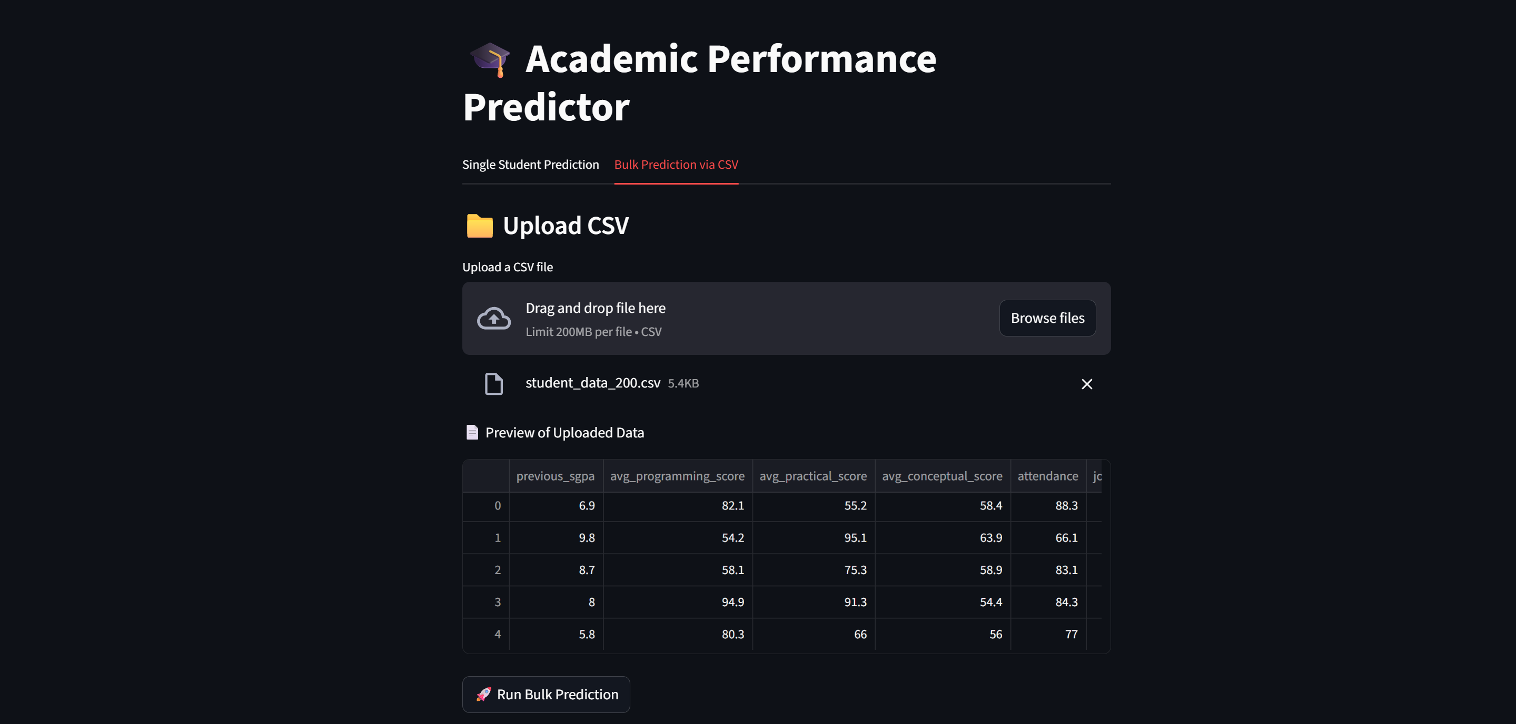

Slide 10


Slide 11
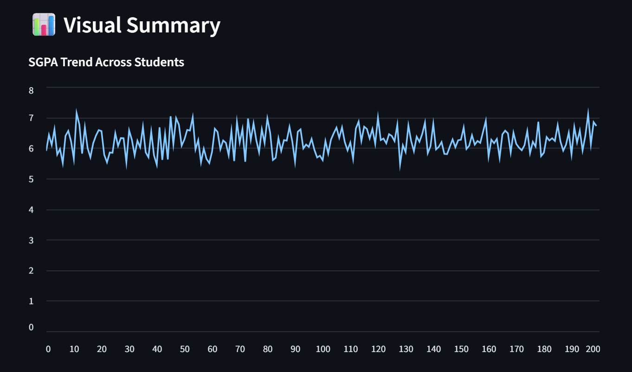
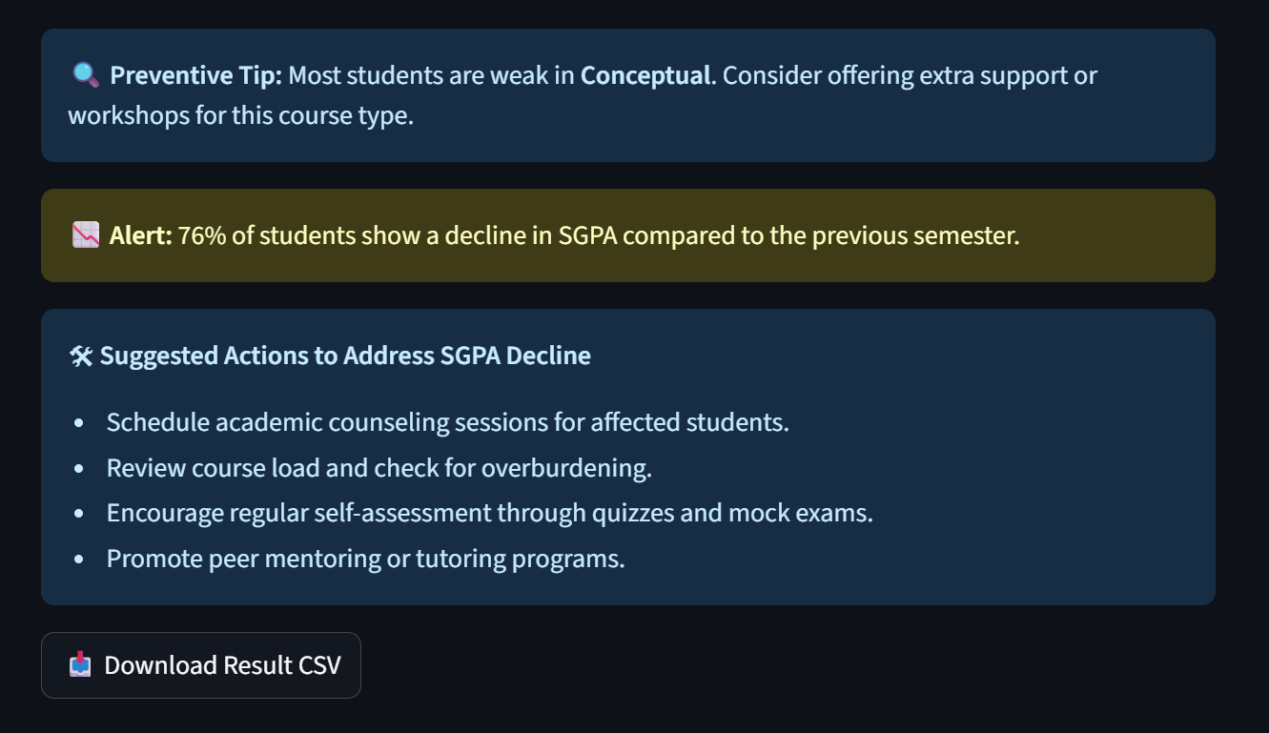
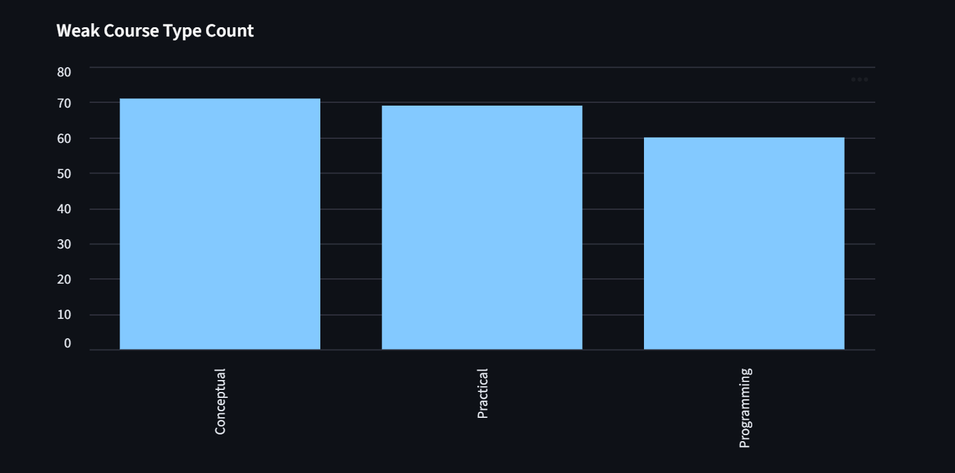
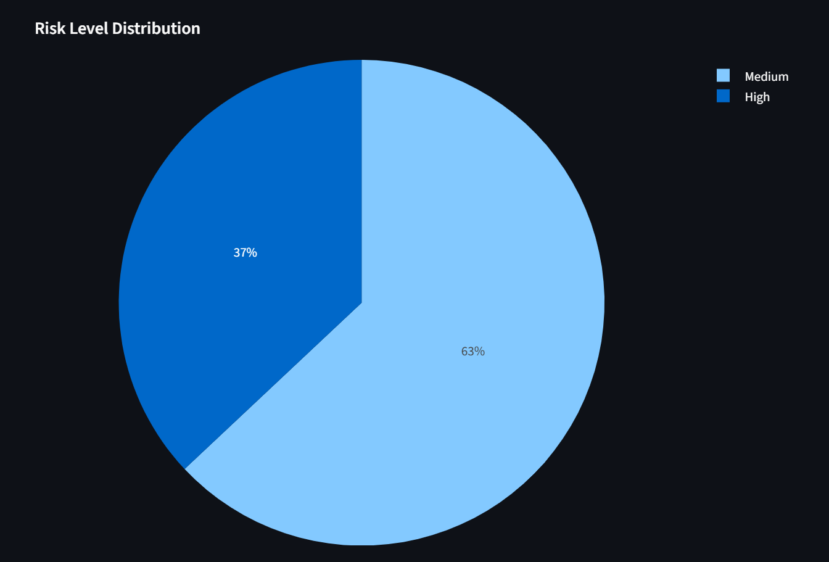

Slide 12
Ensuring Reliability & Driving Real Change
Rigorous Evaluation:
Robust Validation (Cross-Validation):
SGPA Prediction: Evaluated using RMSE (Root Mean Squared Error) to quantify prediction accuracy.
Helps us:
Assess how well models generalize to unseen data.
Risk Level & Weak Course Type: Evaluated using Accuracy (with future plans for Precision, Recall, F1-score to handle class imbalances more rigorously).
Reduce risk of overfitting, especially with early-stage dataset.
Provide reliable estimate of model performance across data subsets.
Why Our System is Unique & Impactful:
Localized & Relevant
Proactive & Actionable
Trained on our college's data, ensuring immediate applicability and trust. Clear vision for broader adoption.
Moves beyond reactive flags to predictive insights, enabling timely interventions.
Customized for India & NEP 2020
More Adaptive
Directly supports personalized learning and outcome-based education.
Outperforms rigid, threshold-based rules by learning from complex data patterns.

Slide 13
Overcoming Hurdles & Charting the Future
Challenge
Mitigation Strategy (Current & Future)
Data Availability & Scale
Expanding data collection to include more semesters and student cohorts. Exploring partnerships with other institutions for broader datasets.
Data Privacy & Security
Implementing robust anonymization techniques. Adhering to strict data protection regulations (e.g., GDPR, local equivalents). Encrypted storage and access controls.
Model Explainability
Using SHAP/LIME for clearer insights into model decisions. Developing user-friendly dashboards for educators to understand predictions.
Intervention Effectiveness
Longitudinal studies to track student outcomes based on interventions. A/B testing different intervention strategies. Feedback loops with counselors and students.
Integration with Existing Systems
Developing APIs for seamless integration with university management systems (e.g., SIS, LMS). User-friendly interface design.
Bias in Data & Model
Regular audits of data for bias. Implementing fairness metrics in model evaluation. Exploring debiasing techniques in training data and algorithms.

Slide 14
Future Enhancements
We envision improving the capabilities to provide even more comprehensive and integrated solutions.
Dataset Expansion
Automated Alerts
Train on larger, multi-semester data to boost accuracy and scalability.
Send proactive SMS/email notifications for at-risk students.
1
2
3
4
LMS Integration
Institutional Scalability
Seamlessly pull live data from learning management systems.
Expand to cover multiple departments and entire institutions.

