Slide 1

Senior Design Project
Mid-Term Evaluation Presentation
on
title of project here
Supervisor: Mrs. Sandhya Rani Sahoo
Dept. of CS&IT, ITER,
SoA Deemed to be University.
Presented by:
Mayank Kush (2141011185)
Sagarika Kumari (2141011188)
Aditi Raj (2141018143)
Shivaansh Shekhar (2141019447)
Department of Computer Science & Information Technology
Faculty of Engineering & Technology(ITER),
Siksha ‘O’ Anusandhan Deemed to be University, Bhubaneswar, Odisha

Slide 2
Presentation Outline
Introduction
Overview/Specifications
Motivations
Literature Review/Existing or Similar Product/Process/Algorithm
Existing System
Problem Identification
Dataset Description ( if applicable)
Proposed Design of product/ Process/Algorithm/Software
Implementation of product/process/algorithm/software
Results and its Analysis
Conclusion and Future Scope
Bibliography

Slide 3
Introduction
Overview/Specifications:
Agriculture is the backbone of the Indian economy, employing a significant portion of the population. However, the sector continues to face several challenges, including low productivity, small and fragmented landholdings, unpredictable weather, outdated farming practices, and lack of access to market pricing and government schemes.
Digital transformation in agriculture is necessary to bridge these gaps and improve crop yield, disease management, and economic sustainability. This project proposes a smart agricultural platform that uses AI and ML techniques to provide crop recommendations, detect plant diseases via image classification, and integrate support tools such as weather forecasting, warehouse locator, and access to training and government schemes.
The system leverages:
XGBoost for recommending the most suitable crop based on soil and weather parameters.
MobileNetV2 with attention for accurate plant disease detection.
External APIs for live weather data, nearest storage location detection, and curated government scheme information.

Slide 4
Motivation
Indian farmers continue to face key problems such as:
Heavy dependency on monsoons due to lack of irrigation.
Fragmented land and outdated methods limiting productivity.
Market fluctuations and middlemen causing unstable income.
Limited digital literacy and access to relevant government support schemes.
While platforms like PM-Kisan and eNAM exist, lack of awareness prevents full utilization. This project is motivated by the need to:
Provide crop and disease diagnosis tools using DL.
Offer educational content on sustainable farming practices.
Deliver localized support including weather insights and nearby storage options.
Improve access to government benefits by aggregating relevant scheme information.
By offering all these through a single unified platform, this system helps make farming more informed, profitable, and resilient to uncertainties.

Slide 5
Literature Review /Existing or Similar Product/Process/Algorithm
Title of the paper | Author and year | Dataset used | Findings | Limitations | Summary
A Decision Support System for Crop Recommendation Using ML Classification | MDPI Agriculture, 2024 | Custom CSV with SMOTE balancing; ~2,200 samples (augmented to ~4,000) | Logistic Regression accuracy improved post-SMOTE; XGBoost performed well; SVC recall dropped drastically from 100% to 29%. | SMOTE degraded performance of some models (e.g., SVC); inconsistent results across classifiers. | Showed the effect of class balancing with SMOTE on multiple classifiers in a crop recommendation setting
Crop Recommendation for Maximizing Crop Yield Using Random Forest | A. Kumar, 2023 (ResearchGate) | CSV with soil parameters; ~1,400 samples | Random Forest gave the best results; other models like NB, LR, and DT showed decent performance. | Did not account for weather, or external variables. | Focused on maximizing yield using soil-based input features.

Slide 6
Title of the paper | Author and year | Dataset used | Findings | Limitations | Summary
Intelligent Crop Recommendation Using Ensemble Learning | Patel & Singh, 2022 | Kaggle Crop Recommendation Dataset; ~2,200 samples | Ensemble voting improved consistency across models | Increased computational complexity; harder to interpret model behavior. | Demonstrated that combining models leads to improved overall reliability.
Field-Based Disease Classification Using CNNs | Pérez et al., 2019 | Digipathos | Robustness testing on natural field images | Limited crop variety, occlusion, noise, low number of classes complicate detection | Useful for testing robustness under real-world conditions
Attention-Based Soybean Disease Detection | Disease Detection Souza et al., 2020 | Embrapa | Use of attention models for disease detection | Class imbalance, low classes, domain-specific annotations limit general use | Valuable for soybean-specific detection but less generalizable.
Leaf Disease Classification with MobileNet & DenseNet | Zhang et al., 2018 | Mendeley Leaf Dataset | Effective prototyping on tomato, potato, and peppe | Suitable for prototyping; no major reported limitations | Good dataset for prototyping and academic research on key crops.

Slide 7
Problem Identification
Data Quality and Availability: Incomplete or inaccurate soil, weather, and crop data limit recommendation accuracy.
Limited Real-World Robustnes:Models trained on ideal datasets often fail to generalize under field conditions with variations in lighting, background clutter, leaf occlusions, and camera angles
Model Limitations: Simplified models often fail to capture complex agricultural interactions.
Farmer Adoption and Usability: Limited tech access and trust hinder system usage by farmers.
Lack of Real-Time Feedback Systems :Many models operate offline or post-capture; integrating real-time feedback systems for farmers remains a challenge in mobile deployment.

Slide 8
Dataset Description
Crop disease detection
The dataset contains approximately 112k images of crop leaves.
It includes 33 classes, covering both healthy and diseased plants.
Crops represented include [list of crops, e.g., Apple, Tomato, Potato, etc.].
Diseases covered include [list of common diseases, e.g., late blight, rust, leaf spot, etc.].
Images are standardized to a size of 224 x 224 pixels for uniform processing during model training.
Crop recommendation
This is a custom-made dataset compiled by integrating data from Mendeley and Kaggle repositories, tailored specifically for crop recommendation purposes.
Each sample includes soil parameters such as pH, nitrogen (N), phosphorus (P), potassium (K) levels and temperature.
Additionally, weather data such as rainfall, humidity, and average temperature for the region is included.
The dataset features multiple crop types that are commonly cultivated in the region, such as rice, wheat, maize, sugarcane, cotton, and pulses. etc

Slide 9
Proposed Design of Product
Crop Recommendation Module:Recommeneds crops on basis of soil and weather data
Plant Disease Detection Module:Detects diseases in plants by analyzing images of their leaves and highlights the affected areas.
Weather Dashboard: Delivers real-time, location-based weather forecasts to help plan irrigation, planting, and harvesting.
Warehouse Locator: Provides a map-based interface to discover nearby storage facilities and cold chains, reducing post-harvest losses.
Government Scheme Explorer: Offers an interactive card-based display of current agricultural schemes, subsidies, and loan programs, enabling farmers to discover and apply for support.
Training and Tutorial Portal: Hosts video tutorials and educational content to promote awareness of modern farming techniques, tool usage, and best practices.
Digital Marketplace: Allows farmers to showcase and sell their produce directly to buyers, minimizing reliance on middlemen and improving profits.

Slide 11
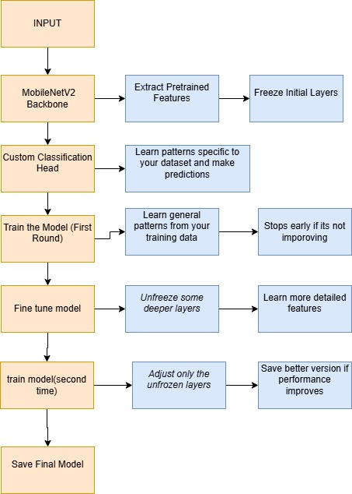

Slide 12
Algorithm & Technology,Frameworks and Tools used
Module | Algorithm & Technology | Frameworks | Tools
Crop Recommendation | XGBoost (Gradient Boosted Trees) SMOTE RandomizedSearchCV | Flask (API layer) React.js (Frontend interface) | Scikit-learn Pandas, NumPy
Plant Disease Detection | MobileNetV2 with ECA Custom CNN with ECA | TensorFlow & Keras (Model training) React.js (Frontend interface) | ImageDataGenerator (Augmentation) Matplotlib (Visualization)
Weather Dashboard | REST API integration (OpenMetro API) | React.js (Frontend display) | Geolocation API Axios/Fetch (API calls)
Warehouse Locator | Geospatial Mapping Geolocation API | OpenLayer (Map rendering) React.js (Interface) | JavaScript Map Services HTML5 Geolocation
Government Scheme | Hyperlinks | React.js (Card layout interface)
Training videos | Video embedding (YouTube, local sources) | React.js TailwindCSS | Media Player APIs YouTube iframe embeds
Digital Marketplace | JWT (Authentication) GraphQL (Data querying) | React.js (Frontend) Node.js + Express.js (Backend) MongoDB Atlas (Database) | Apollo Client/Server Mongoose (ODM) TailwindCSS (Styling)

Slide 13
Implementation of Proposed Design of Product
Crop Recommendation:
Built using the XGBoost classifier, suitable for structured/tabular data.
Preprocessing involves standard scaling and label encoding of target crop classes.
SMOTE (Synthetic Minority Over-sampling Technique) is used to handle class imbalance.
RandomizedSearchCV with Stratified K-Fold cross-validation is applied for hyperparameter tuning.
Crop Disease Detection:
Custom CNN:
Uses 160×160×3 input image size.
Consists of five convolutional blocks; each includes:
Conv2D → BatchNormalization → LeakyReLU → ECA → MaxPooling → Dropout.
Followed by Global Average Pooling, a dense layer, and a final Softmax output layer.
MobileNetV2 :
Uses MobileNetV2 as the base model (pretrained on ImageNet, include_top=False, initially frozen).
Adds a Conv2D → BatchNormalization → ReLU → ECA (Efficient Channel Attention) block.
Followed by Global Average Pooling, Dropout, Dense(256, ReLU), another Dropout, and Dense(Softmax) for classification.

Slide 14
Phase 1: Train with base model frozen (20 epochs, learning rate = 1e-4).
Phase 2: Unfreeze last 30 layers and fine-tune (10 epochs, learning rate = 1e-5).
Uses categorical crossentropy with label smoothing.
Weather Dashboard
Built using the OpenMetro API to fetch weather data.
Integrated with geolocation to retrieve user-specific forecasts.
Implemented with a responsive UI for dynamic, real-time updates.
Warehouse Locator
Developed using the OpenLayer Map API.
Utilizes browser geolocation to center the map.
Displays warehouse markers on an interactive map.
Government Scheme
Rendered in the frontend using card-based UI with search and filters
Training Videos
Content taken from YouTube
Integrated into a mobile-responsive dashboard with regional language support
Digital Marketplace
Backend built with GraphQL APIs and JWT authentication
Frontend built with a responsive product grid UI.
Includes seller portal for product uploads and inventory management.

Slide 15
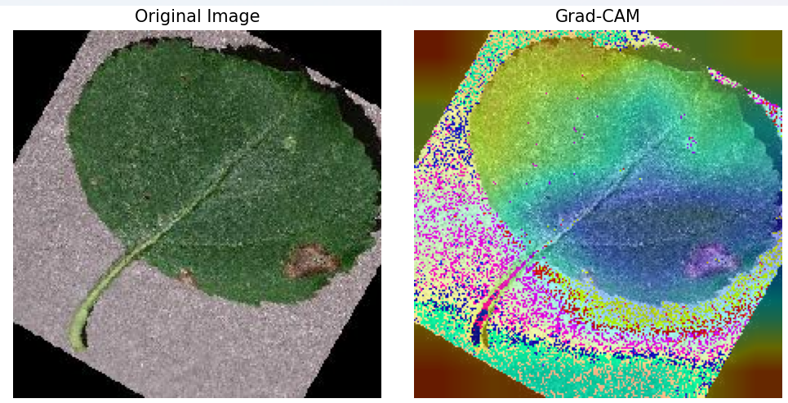
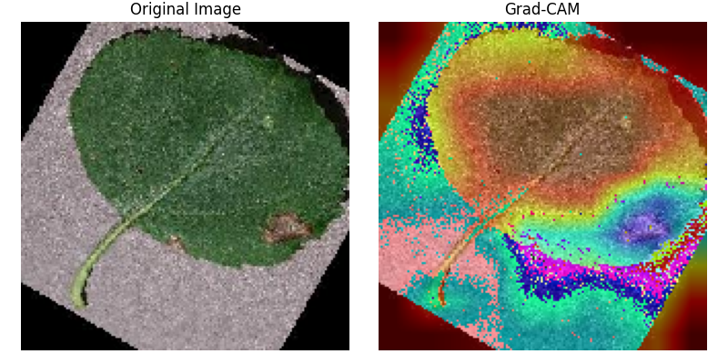
Result Analysis
MobileNetV2 with ECA Grad-CAM for apple black rot
Custom CNN with ECA Grad-CAM for Apple Black Rot

Slide 16
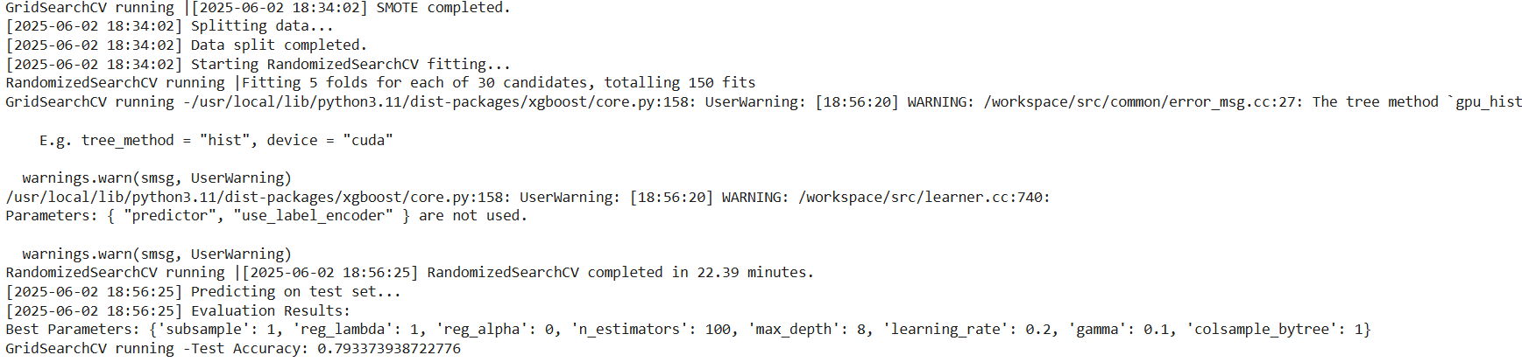
Result Analysis
Training log showing accuracy of 79% using xgboost for crop recommednation

Slide 17
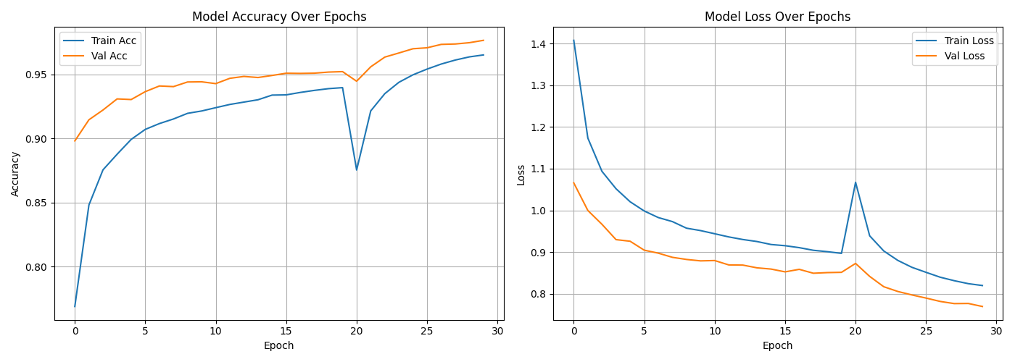
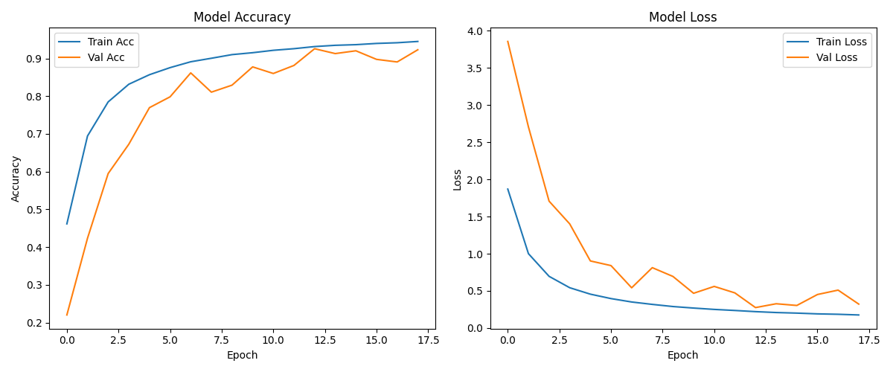
Model:MobileNetV2
epoch:30
accuracy:96.93
Model:Custom CNN
epochs:50
accuracy:80.63

Slide 18
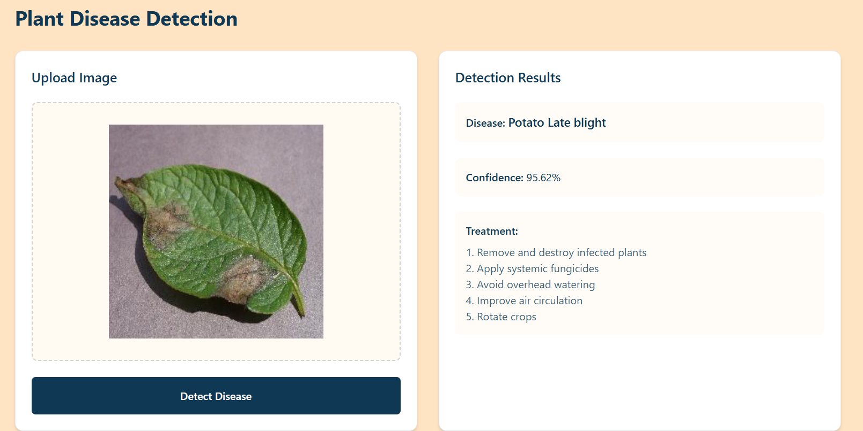
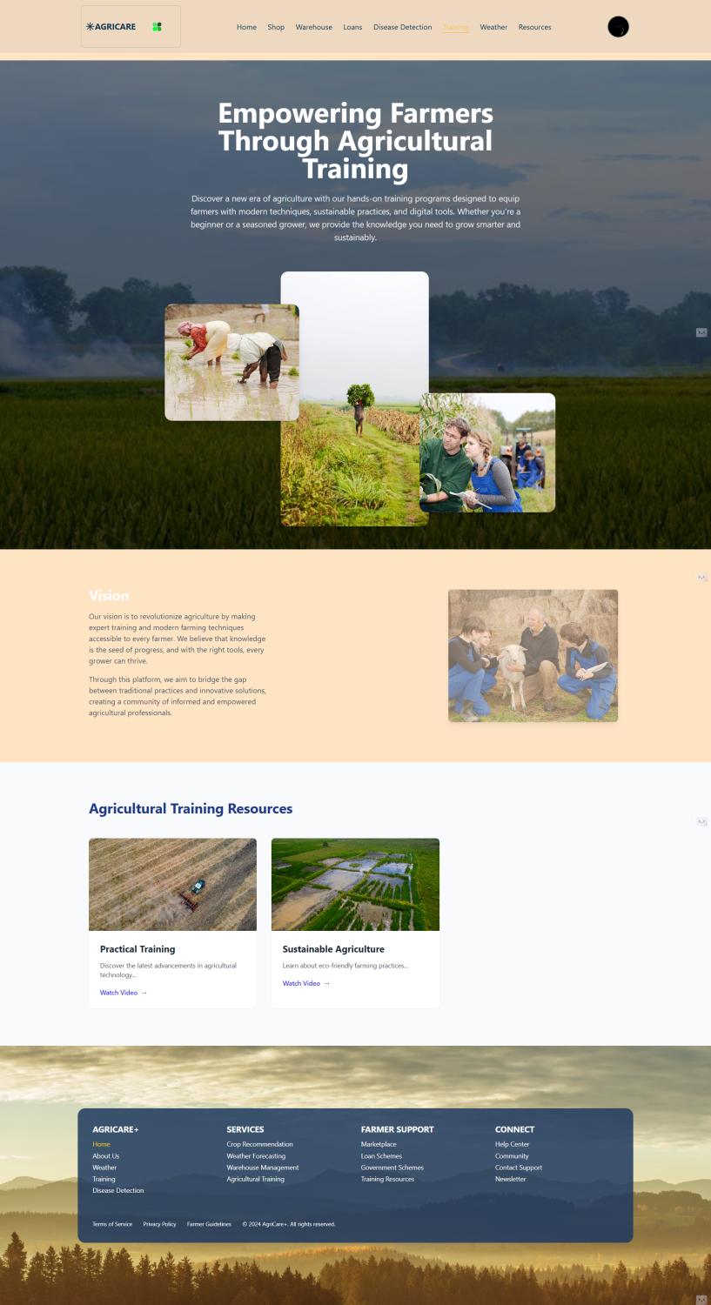
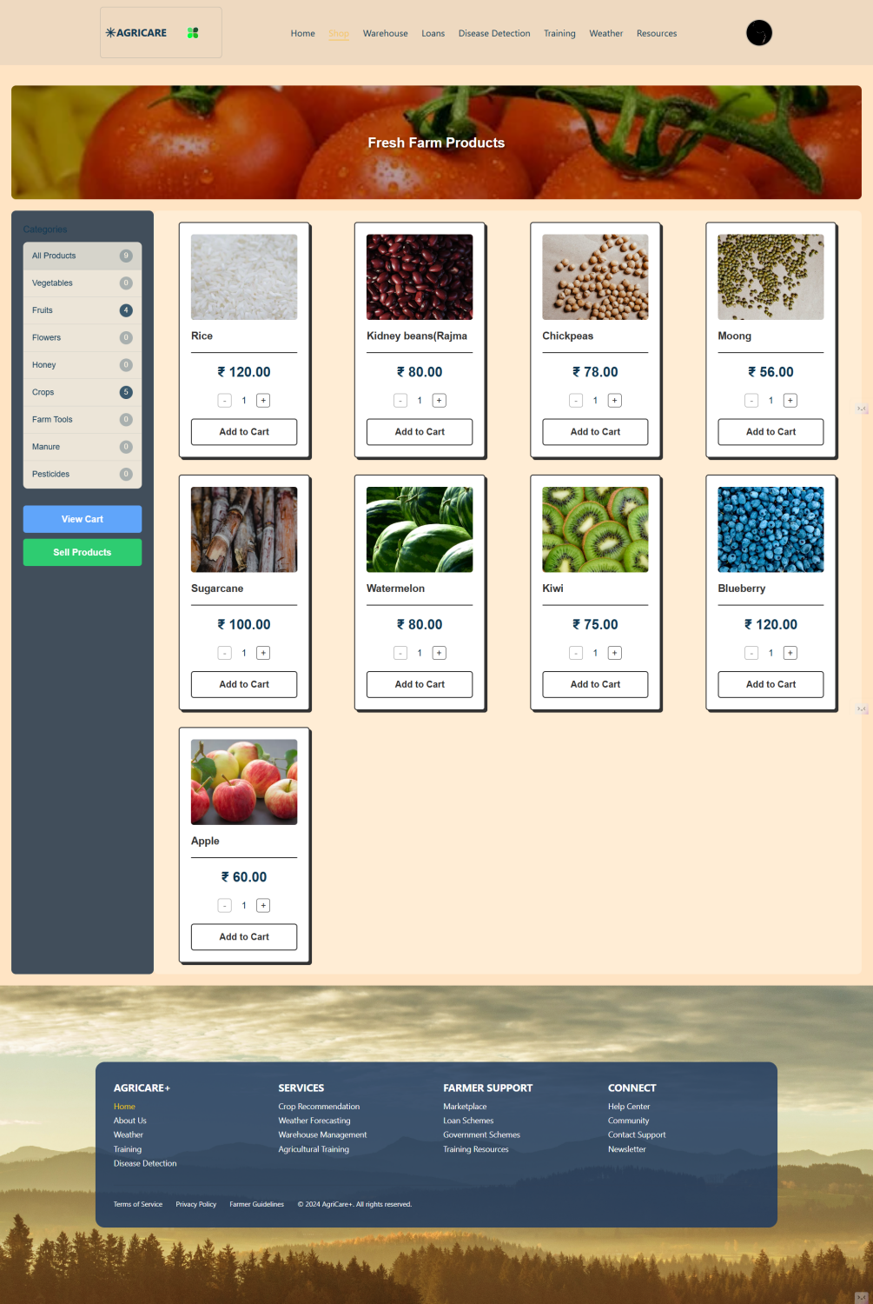
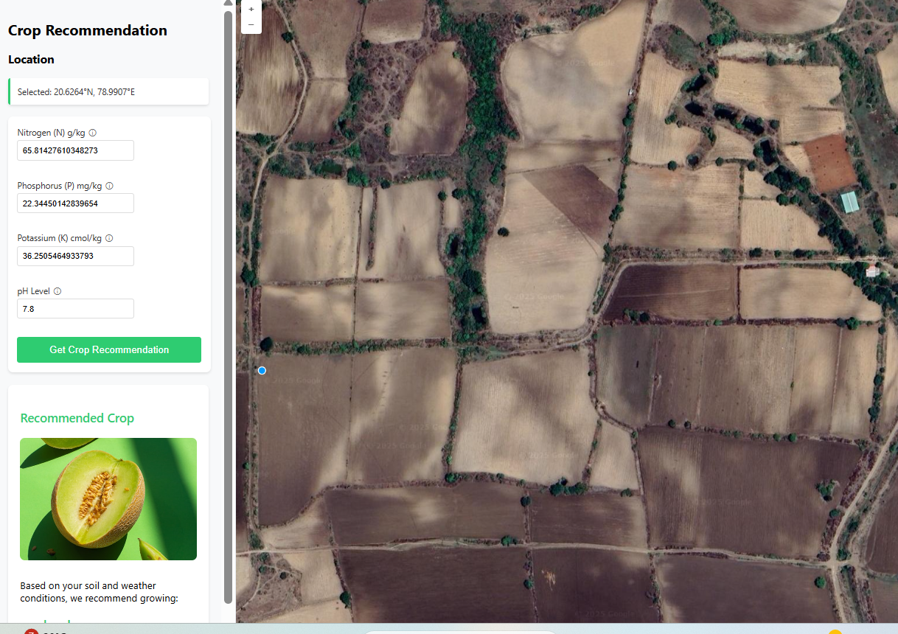
Plant disease detection page
Training page
Shop
Crop recommedantion page

Slide 19
Conclusions
Key Findings:
The MobileNetV2-based crop disease detection model, enhanced with CBAM attention modules, achieved strong classification accuracy while maintaining computational efficiency suitable for edge deployment.
Data augmentation and transfer learning improved the model’s robustness across multiple disease classes and varied environmental conditions.
Grad-CAM visualizations validated that the model’s predictions rely on disease-affected leaf regions, increasing interpretability
MobileNetV2, while efficient, may have limitations in capturing very subtle or complex disease symptoms compared to larger, more powerful architectures.
The model’s performance depends heavily on the quality and diversity of training data; rare diseases or unseen environmental conditions may reduce accuracy.

Slide 20
Future Scope
Support for More Crop Types and Diseases: Expand the dataset to include more crops and rare disease classes, improving generalizability across diverse agricultural zones.
Self-Supervised and Semi-Supervised Learning: Explore learning from unlabeled or partially labeled data to reduce dependency on expert-annotated datasets.
Explainability and Farmer-Friendly Interface: Enhance the system's usability with localized language support, visual cues (via Grad-CAM), and actionable recommendations.

Slide 21
Bibliography
Lavaman151. (2023). PlantifyDR Dataset. Kaggle. https://www.kaggle.com/datasets/lavaman151/plantifydr-dataset
Chollet,F.(2017).Xception:Deep Learning with Depthwise Separable Convolutions.arXiv preprint. https://arxiv.org/abs/1610.02357
Howard, A. G., et al. (2017). MobileNets: Efficient Convolutional Neural Networks for Mobile Vision Applications. arXiv. https://arxiv.org/abs/1704.04861
OpenWeatherMap. (n.d.). Weather API documentation. https://openweathermap.org/api
Google Maps API. (n.d.). Places & Geolocation API for Warehousing Locator. https://developers.google.com/maps/documentation
TensorFlow/Keras Framework Documentation. https://www.tensorflow.org/
“ImageDataGenerator and Data Augmentation in Keras”. https://keras.io/api/preprocessing/image/

Slide 22
Thank You!

