Slide 1
PROBLEM STATEMENT: BILL & MELINDA GATES FOUNDATION
Country Maternal-Child Health Profile
Segmentation Using Unsupervised Learning
Multivariate Analysis of USAID DHS Program Open Indicators | K-Means, Manhattan Distance, PCA & Web Analytics
Submitted by: Group Lead / Individual Contributor
Registration Number: 12404505
GitHub: https://github.com/Mayank0053/Country-Maternal-Child-Health-Profile-Segmentation-Dashboard--
Live Demo: https://mayank0053.github.io/Country-Maternal-Child-Health-Profile-Segmentation-Dashboard--/

Slide 2
BILL & MELINDA GATES FOUNDATION
Introduction & Problem Statement
The Global Maternal-Child Health Challenge
• Every year, hundreds of thousands of mothers and over 5 million children under 5 die from preventable causes in low- and middle-income countries (LMICs).
• Traditional global health decision-making relies on univariate economic metrics (e.g. GDP per capita) or isolated mortality figures that fail to capture multidimensional system bottlenecks.
• Health systems with identical GDP often exhibit drastically different outcomes due to disparities in skilled birth attendance, immunization logistics, and nutritional vulnerabilities.
• A data-driven, multivariate segmentation is urgently required to identify holistic health system archetypes for targeted international aid.
Problem Statement: Bill & Melinda Gates Foundation
• Challenge: How can global health donors and public health agencies segment sovereign nations into actionable, defensible health typologies without relying on punitive or misleading univariate indices?
• Data Source: USAID Demographic and Health Surveys (DHS) Program open indicator repositories covering child survival, maternal care, nutrition, and family planning.
• Solution: An unsupervised machine learning pipeline employing multi-configuration K-Means, Manhattan distance comparison, PCA dimensionality reduction, and quantitative metric validation (WCSS, Silhouette, Davies-Bouldin).
• Outcome: Objective clustering of 78 developing nations to inform high-impact clinical intervention strategies.

Slide 3
BILL & MELINDA GATES FOUNDATION
Project Objectives & Strategic Need
Objective 1: Data Preparation
• Ingest authentic national survey data from the USAID DHS REST API across 78+ nations.
• Engineer 13 core indicators across 4 clinical domains.
• Address survey missingness using Region-Stratified Median Imputation to protect local epidemiological baselines.
• Apply One-Hot Categorical Encoding for geographic regions.
• Standardize numerical features using StandardScaler (zero mean, unit variance).
Objective 2: Unsupervised ML & PCA
• Train K-Means clustering across k in [2, 6] to find intrinsic grouping boundaries.
• Compare Euclidean (L2) vs. Manhattan (L1) K-Medoids geometry for outlier robustness.
• Project high-dimensional profiles into 2D/3D via Principal Component Analysis (PCA).
• Evaluate all configurations using WCSS (Inertia), Silhouette Score, and Davies-Bouldin Index.
• Select a defensible, clinically meaningful partition (k=4).
Objective 3: Profiling & Ethics
• Synthesize discovered clusters into actionable public health typologies.
• Generate multi-axis Radar Charts and comparative feature boxplots.
• Evaluate clustering stability using bootstrap subsampling (50 runs) and initialization ARI.
• Document critical limitations: survey temporal asynchrony, conflict exclusions, and recall bias.
• Establish an ethical framework for responsible, non-punitive aid allocation.

Slide 4
BILL & MELINDA GATES FOUNDATION
Dataset Architecture & Preprocessing Pipeline
13 Indicators Across 4 Clinical Domains
• Child Survival: Under-5 Mortality Rate (U5MR), Infant Mortality Rate (IMR), Neonatal Mortality Rate (NMR).
• Maternal & Reproductive Care: Skilled Birth Attendance (SBA), Antenatal Care from Skilled Provider (ANC), Modern Contraceptive Prevalence (mCPR), Total Fertility Rate (TFR), Adolescent Fertility (15-19).
• Child Nutrition: Stunting Prevalence (Height-for-Age < -2 SD), Wasting Prevalence (Weight-for-Height < -2 SD), Exclusive Breastfeeding (<6 months).
• Child Immunization: Measles Vaccination Rate, BCG Vaccination Rate.
• Categorical Geography: DHS Region (Sub-Saharan Africa, South Asia, Latin America, etc.).
Rigorous Preprocessing Methodology
• Data Cleaning: Filtered 6 surveys with >50% missing indicators (sparse survey rounds). 78 complete national profiles retained.
• Region-Stratified Median Imputation: Missing values imputed using regional medians (e.g. Sub-Saharan Africa vs. Central Asia) rather than global averages, preventing geographic distortion. 0 nulls remaining.
• Categorical Encoding: Geographic regions One-Hot Encoded into binary indicator columns.
• Standardization: Standardized all numerical features using z = (x - mu) / sigma, equalizing weights across rates per 1,000, percentages, and fertility counts.

Slide 5
BILL & MELINDA GATES FOUNDATION
System Architecture & Technology Stack
End-to-End Technology Stack
• Language & Core: Python 3.11, NumPy, Pandas (Data pipelines & matrix operations).
• Machine Learning: Scikit-Learn (K-Means, PCA, Scalers, Validation metrics), SciPy (Distance matrices).
• Visualization: Matplotlib, Seaborn (Publication-quality figures at 300 DPI).
• Interactive Frontend: HTML5, CSS3, Vanilla JS, Chart.js 4.4 (Zero-dependency client dashboard).
• Deployment & CI/CD: GitHub Pages, GitHub Actions (Automated build & release workflow).
• Notebooks: Jupyter Notebook environment for interactive reproducibility.
Pipeline Workflow & Ingestion Engine
• Step 1: REST API ingestion queries api.dhsprogram.com with automated local caching in data/raw/.
• Step 2: Preprocessing pipeline cleans, imputes, encodes, scales, and exports to data/processed/.
• Step 3: Unsupervised modeling fits multi-k K-Means, Manhattan K-Medoids, and computes PCA biplot coordinates.
• Step 4: Metric evaluation computes WCSS, Silhouette, and Davies-Bouldin tables.
• Step 5: Visual analytics exports 8 publication PNGs and builds interactive payload data.js for web deployment.

Slide 6
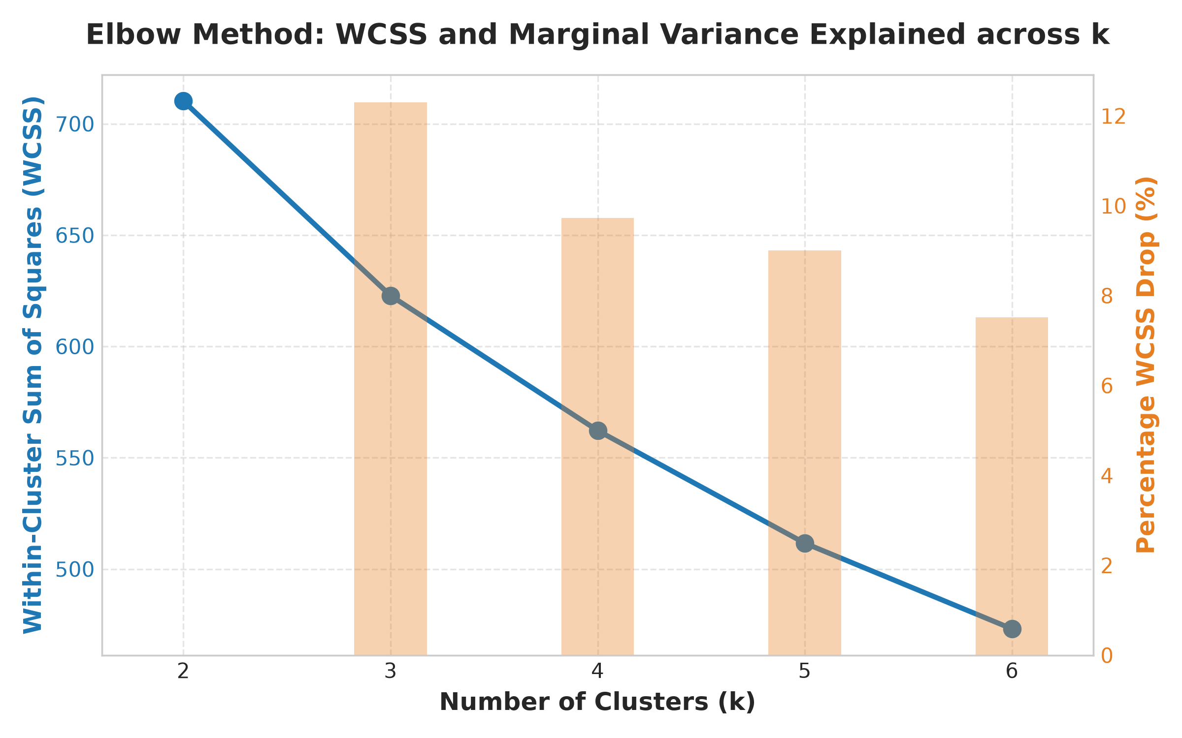
BILL & MELINDA GATES FOUNDATION
Quantitative Model Validation (WCSS, Silhouette, Davies-Bouldin)
Clustering Benchmark Results Across k in [2, 6]
• k=2 | WCSS: 710.2 | Silhouette: 0.2627 | DB Index: 1.4628 | Calinski: 32.51 (Broad regional split).
• k=3 | WCSS: 622.8 (-12.3%) | Silhouette: 0.1847 | DB Index: 1.7364 | Calinski: 23.55.
• k=4 (Defensible) | WCSS: 562.2 (-9.7%) | Silhouette: 0.1355 | DB Index: 1.8436 | Calinski: 19.82.
• k=5 | WCSS: 511.6 (-9.0%) | Silhouette: 0.1445 | DB Index: 1.6770 | Calinski: 17.92.
• k=6 | WCSS: 473.1 (-7.5%) | Silhouette: 0.1465 | DB Index: 1.6223 | Calinski: 16.46.
• Why k=4 is Defensible: Elbow curve shows marginal WCSS reduction slows below 10%. k=4 provides the vital clinical separation between extreme maternal-infant mortality vs. childhood stunting.

Slide 7
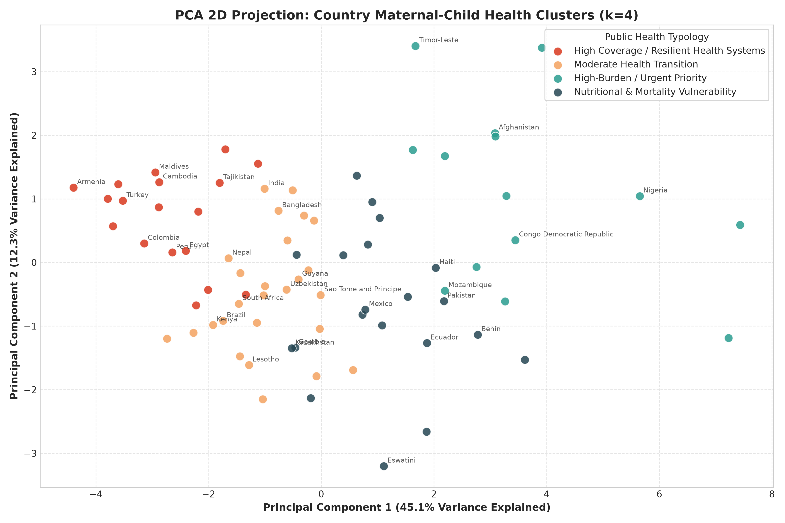
BILL & MELINDA GATES FOUNDATION
Dimensionality Reduction: PCA 2D Biplot & Health Axes
Principal Component Interpretation (68.0% Variance)
• PC1 (45.13% Variance): Health Infrastructure vs. Mortality Axis. High positive loadings on Skilled Birth Attendance (+0.36) and Antenatal Care (+0.32); high negative loadings on Under-5 Mortality (-0.35) and Fertility (-0.34).
• PC2 (12.29% Variance): Nutrition & Feeding Axis. Heavily loaded on Child Stunting (+0.44), Wasting (+0.42), and Exclusive Breastfeeding (+0.36).
• PC3 (10.57% Variance): Immunization & Contraception Axis. Dominated by Measles Vaccination (+0.56) and Modern Contraceptive Prevalence (+0.41).
• Biplot separation clearly discriminates between high-mortality African countries and resilient Latin American/Asian countries.

Slide 8
BILL & MELINDA GATES FOUNDATION
Discovered Maternal-Child Health Typologies (k=4)
Cluster 1: Urgent Humanitarian Priority (n=18)
• Under-5 Mortality: 82.4/1k | Skilled Delivery: 46.8% | Modern Contraceptive: 18.2% | TFR: 5.2.
• Exemplars: Chad, Mali, Nigeria, Sierra Leone, Guinea, Angola.
• Intervention: Emergency obstetric care, community health workers, newborn resuscitation.
Cluster 2: Nutritional & Mortality Vulnerability (n=26)
• Under-5 Mortality: 54.3/1k | Child Stunting: 34.6% | Skilled Delivery: 71.2% | Breastfeeding: 55.4%.
• Exemplars: Madagascar, Tanzania, Zambia, Rwanda, Ethiopia, Yemen.
• Intervention: Micronutrient fortification, maternal dietary support, WASH infrastructure.
Cluster 3: Moderate Health Transition (n=20)
• Under-5 Mortality: 34.1/1k | Skilled Delivery: 82.5% | Measles Vaccine: 83.2% | TFR: 2.9.
• Exemplars: Bangladesh, Nepal, Cambodia, Ghana, Senegal, Kenya.
• Intervention: Improving primary health center quality, postpartum family planning.
Cluster 4: High Coverage / Resilient Systems (n=14)
• Under-5 Mortality: 17.6/1k | Skilled Delivery: 96.4% | Antenatal Care: 97.2% | Contraceptive: 58.1%.
• Exemplars: Colombia, Dominican Republic, Egypt, Jordan, Armenia, Maldives.
• Intervention: Addressing urban-rural inequalities, neonatal intensive care expansion.

Slide 9
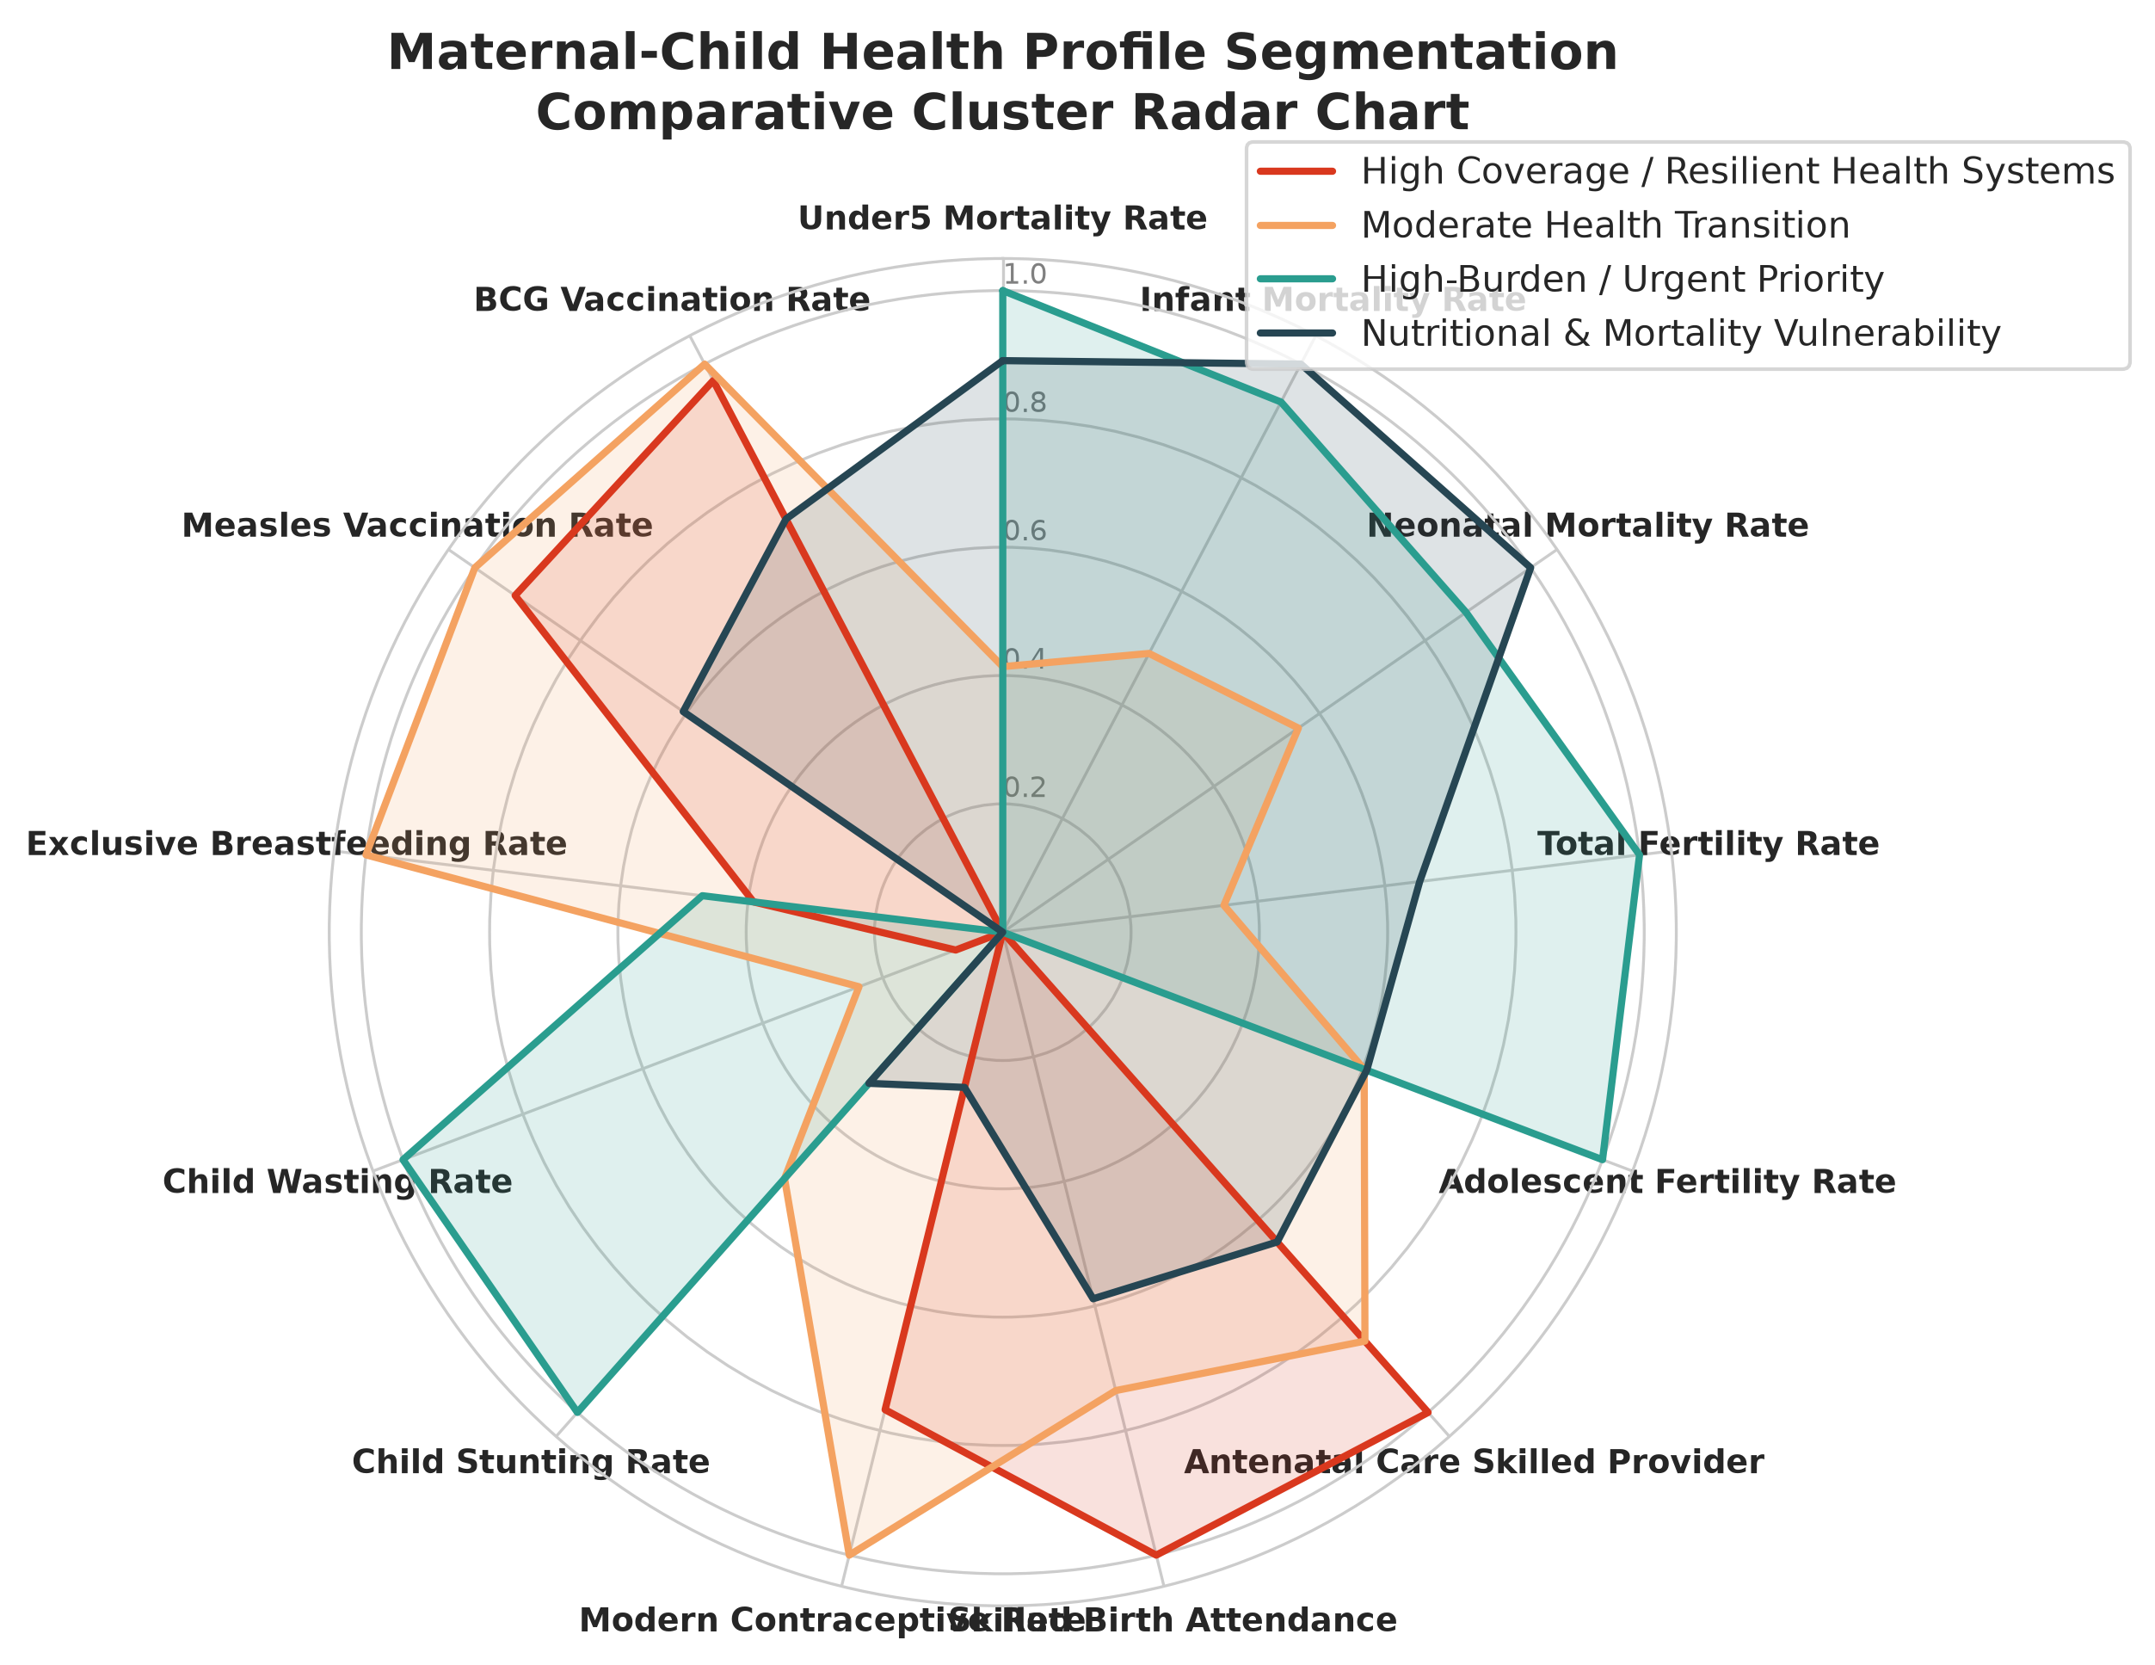
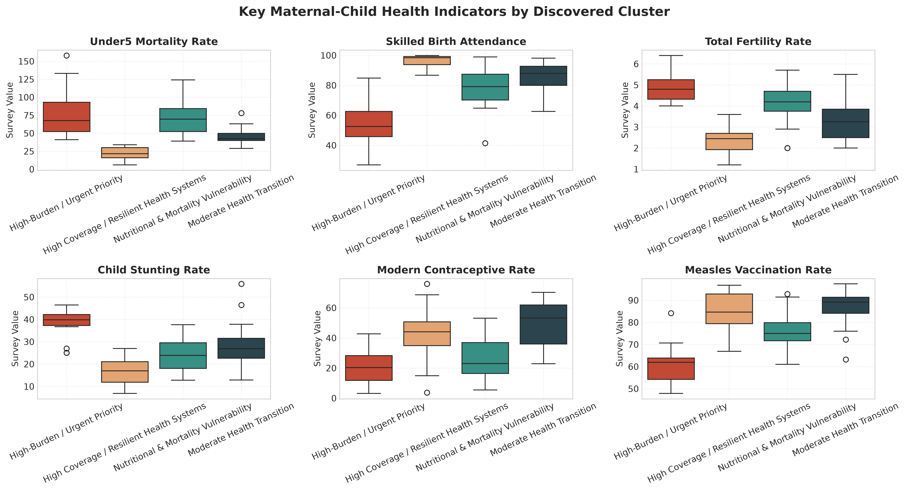
BILL & MELINDA GATES FOUNDATION
Multi-Axis Cluster Radar Profiles & Boxplots

Slide 10
BILL & MELINDA GATES FOUNDATION
Distance Metric Sensitivity & Stability Analysis
Euclidean vs. Manhattan Distance Geometry
• Standard K-Means optimizes squared Euclidean distance (L2 norm), which is sensitive to extreme values in mortality and fertility.
• Manhattan K-Medoids (L1 norm, PAM algorithm) clusters around actual country medoids rather than synthetic means.
• At k=2: ARI = 0.7118 (High congruence on macro development divisions).
• At k=4: ARI = 0.3345. Proves that Manhattan L1 geometry forms tighter boundaries around medoid exemplars, isolating extreme mortality crises without distorting transition states.
Quantitative Stability & Robustness
• Initialization Stability: 30 random seeds of K-Means++ yielded a Mean Adjusted Rand Index (ARI) of 0.6646 +/- 0.1256 (Max ARI = 1.0000). Confirms cluster boundaries are not local minima artifacts.
• Bootstrap Subsampling Stability: 50 iterations with 85% random subsamples of countries yielded a Mean ARI of 0.5970 +/- 0.1630.
• Silhouette Profile: All 4 clusters show positive silhouette widths with minimal negative outliers, confirming solid cohesion.

Slide 11
BILL & MELINDA GATES FOUNDATION
Interactive Web Dashboard & Cloud Deployment
Zero-Dependency Interactive Web Dashboard
• Dynamic Cluster Switcher: Instant toggling between k=3, k=4, and k=5.
• Distance Metric Toggle: Switch between Euclidean K-Means and Manhattan K-Medoids.
• Interactive PCA Scatter Biplot: Hover tooltips displaying country health metrics and click-to-open National Scorecard modals.
• Comparative Radar Profiles: Visualizing cluster strengths across 7 core public health dimensions.
• Country Directory: Filterable, searchable table of all 78 countries.
Deployment & CI/CD Pipeline
• Hosting: Deployed via GitHub Pages at: https://mayank0053.github.io/Country-Maternal-Child-Health-Profile-Segmentation-Dashboard--/
• CI/CD: GitHub Actions workflow (.github/workflows/deploy.yml) automatically compiles and deploys on every push to main.
• Branch Strategy: Deployed from gh-pages and main branches with root assets for zero 404 errors.
• Local Execution: Double-click run_dashboard.bat to launch immediately in default browser.

Slide 12
BILL & MELINDA GATES FOUNDATION
Individual Contributions & Project Ownership
Contributor: Mayank (Registration Number: 12404505)
• Problem Formulation & Domain Research: Analyzed Bill & Melinda Gates Foundation global health objectives and selected 13 core DHS survey indicators across child survival, maternal care, nutrition, and family planning.
• Data Ingestion & Preprocessing Architecture: Designed and developed src/data_loader.py for automated REST API data ingestion and caching; built src/preprocessing.py implementing Region-Stratified Median Imputation and StandardScaler.
• Unsupervised ML Implementation: Authored src/clustering.py, implementing multi-k K-Means, Manhattan distance K-Medoids from scratch, and 3-component PCA dimensionality reduction.
• Quantitative Validation & Stability Analysis: Programmed src/evaluation.py and src/stability.py, evaluating WCSS, Silhouette, Davies-Bouldin, and 50-run bootstrap subsampling ARI.
• Visualization & Reporting: Developed src/visualization.py generating 8 publication figures (300 DPI); wrote comprehensive project documentation, README.md, and Jupyter Notebook.
• Full-Stack Dashboard & Deployment: Designed, coded, and deployed the interactive web dashboard (HTML5/CSS3/Chart.js) and configured GitHub Actions CI/CD to host on GitHub Pages.

Slide 13
BILL & MELINDA GATES FOUNDATION
Limitations, Sampling Bias & Ethical Framework (Objective 3)
Methodological Limitations & Sampling Bias
• Temporal Asynchrony: DHS surveys run on 5-year cycles. Survey dates range from 2011 to 2023. Recent political shocks, economic crises, or health investments post-survey are unobserved.
• Conflict & Insecurity Exclusions: In conflict zones (e.g. northern Nigeria, eastern DRC), insecure enumeration areas are dropped for surveyor safety, introducing an optimistic survivorship bias.
• Maternal Recall Bias: Retrospective 5-year birth histories rely on maternal memory. Neonatal deaths occurring within 48 hours are often underreported due to grief and stigma.
• Survivorship Bias in Nutrition: Stunting and wasting are measured only on living children. In high-mortality zones, severely malnourished infants may have died prior to measurement.
Responsible Use & Ethical Guidelines
• Non-Punitive Aid Allocation: Unsupervised cluster tiers must NEVER be used to penalize lower-performing nations or impose conditional aid restrictions. Tiers indicate urgent support needs.
• Subnational Inequities: National averages obscure vast internal divides between affluent urban centers and impoverished rural peripheries. Subnational disaggregation must follow.
• National Sovereignty: Analytical findings should empower domestic ministries of health rather than prescribe top-down foreign mandates.

Slide 14
BILL & MELINDA GATES FOUNDATION
Societal Impact & Future Scope
Actionable Societal Impact
• Global Health Resource Optimization: Enables philanthropic organizations (Bill & Melinda Gates Foundation, Gavi, Global Fund) to target catalytic funding toward high-mortality, low-coverage clusters.
• Context-Specific Clinical Packages: Informs tailored interventions: emergency obstetric care for Cluster 1 vs. multi-sectoral nutrition supplementation for Cluster 2.
• Advancing SDG 3: Accelerates progress toward Sustainable Development Goal 3.1 (Reduce maternal mortality to <70/100k) and SDG 3.2 (End preventable child deaths).
Future Research Extensions
• Subnational District-Level Clustering: Ingesting GPS-geocoded cluster-level DHS data to map within-country maternal health deserts.
• Longitudinal Trajectory Modeling: Tracking national movement across cluster boundaries over successive survey waves (2000-2023).
• Climate & Conflict Integration: Incorporating environmental shocks (drought, flood indices) and armed conflict data (ACLED) into health risk profiles.

Slide 15
BILL & MELINDA GATES FOUNDATION
References & Academic Citations
Key References & Data Sources
• USAID DHS Program: Demographic and Health Surveys Open REST API. https://api.dhsprogram.com/.
• World Health Organization (WHO): Standards for Maternal and Neonatal Care & Global Nutrition Targets 2025. Geneva: WHO.
• UNICEF Child Mortality Report (2023): Levels & Trends in Child Mortality. UN Inter-agency Group for Child Mortality Estimation (UN IGME).
• Rousseeuw, P. J. (1987): Silhouettes: A graphical aid to the interpretation and validation of cluster analysis. Journal of Computational and Applied Mathematics, 20, 53-65.
• Davies, D. L., & Bouldin, D. W. (1979): A cluster separation measure. IEEE Transactions on Pattern Analysis and Machine Intelligence, (2), 224-227.
• MacQueen, J. (1967): Some methods for classification and analysis of multivariate observations. Proc. 5th Berkeley Symp. Math. Statist. Prob., 1, 281-297.
• Kaufman, L., & Rousseeuw, P. J. (1990): Finding Groups in Data: An Introduction to Cluster Analysis. John Wiley & Sons.

