Slide 1
Sentiment Analysis on IMDB movie review using SVM
Faculty-
Prof. Dr. P. Aparna
By-
Mayank Rajpurohit (202SP015)
Sameer Koleshwar (202SP010)

Slide 2
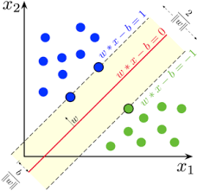
Introduction
What is Sentiment Analysis ?
IMDB’s movie review dataset
50,000 movie reviews.
25,000 Positive reviews
25,000 Negative reviews.
Support Vector Classifier

Slide 3
Pre-processing of dataset
Tokenization
Split the sentence into tokens(words).
Removal of stopwords
Stopwords such as (I, me, us, a, an, the, we, this, that, our)
Stemming
e.g. study, studying, studied → studi

Slide 4

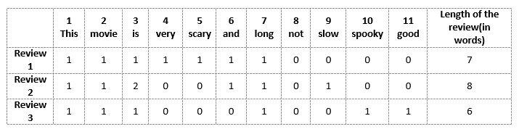
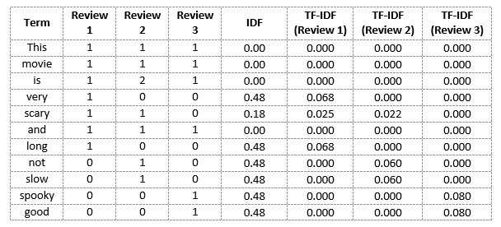
Transformation:
Bag of Words
Term Frequency - Inverse Document Frequency (TF - IDF)
TF = Frequency of word in sentence / Total no. of words in sentence
IDF = log( Total no. of sentences / No. of sentences contains that word)
n-gram
1-gram
2-gram
3-gram

Slide 5
Support Vector Classifier (SVC)
SVMs classify an input vector x ∈ R_{d} using:
y_{i} = argmax (w^{T} x)
Optimization problem:
Min 0.5 * ||w||²
Subject to ( x_{i} . w + b ) . y_{i} ≥ 1 for all i
Crammer - Singer formulation for optimization problem
minimize (0.5 * ∑ ||w_{m} ||² )+ C ( ∑ [1 + max (w_{m}^{T} .x_{i} - w_{yi}^{T} .x_{i} )])

Slide 6
Algorithm for solving Crammer-Singer equation
INPUT: X as train data, Y as train labels
X = hstack([X, ones((len(X), 1))])
N, d = X.shape
k = no. of classes
Initialize W matrix of size (k, d), penalty constant C = 1.0 , i=0
while i < iterations do
grad = gradient(W, X, Y, C)
W = W − α ∗ grad (Gradient Descent Approach)
i = i + 1
end

Slide 7
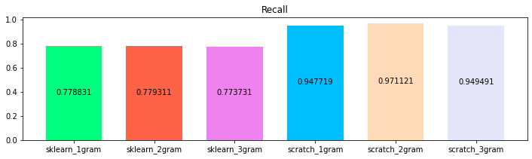
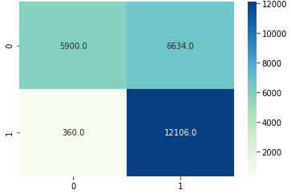
Results
Models | Precision | Recall | F1-Score | Accuracy
1-Gram Sklearn | 0.772 | 0.778 | 0.775 | 0.773
2-Gram Sklearn | 0.788 | 0.779 | 0.784 | 0.786
3-Gram Sklearn | 0.792 | 0.773 | 0.783 | 0.785
1-Gram Scratch | 0.681 | 0.948 | 0.792 | 0.753
2-Gram Scratch | 0.646 | 0.971 | 0.776 | 0.720
3-Gram Scratch | 0.683 | 0.945 | 0.795 | 0.756
Recall comparison
Confusion Matrix for 2-gram TF-IDF
Model build from scratch

Slide 8
References
[1] Aditi Sharan Sheeba Naz and Nidhi Malik. “ “sentiment classification on twitter data using support vector machine”. In: IEEE/WIC/ACM International Conference on Web Intelligence (WI) (2018).
[2] Casi Setianingsih Rimba Nuzulul Chory Muhammad Nasrun. “Sentiment analysis on user satisfaction level of monile data services using support vector machine (SVM) algorithm”. In: IEEE International Conference on Internet of Things and Intelligence System (2018).
[3] Andia Enggar Mayasari and Anggit Dwi Hartanto. “User Satisfaction Levels Sentiment Analysis Toward Goods Delivery Service On Twitter Using Support Vector Machine Algorithm (SVM)”. In: International Conference on Information Technology, Information system and Electrical Engineering (2019).
[4] Yoram Singer Koby Crammer. “On the Algorithmic Implementation of Multiclass Kernelbased Vector Machines”. In: Journal of Machine Learning Research (2001).

Slide 9
Thank you

