Slide 1


INTERNSHIP PRESENTATION
Mayank Kumar
Roll No.: 25SCS1003004705 Section: CSE 32
INTERNSHIP DETAILS
Domain: Artificial Intelligence
Organization: Codec Technologies

Slide 2
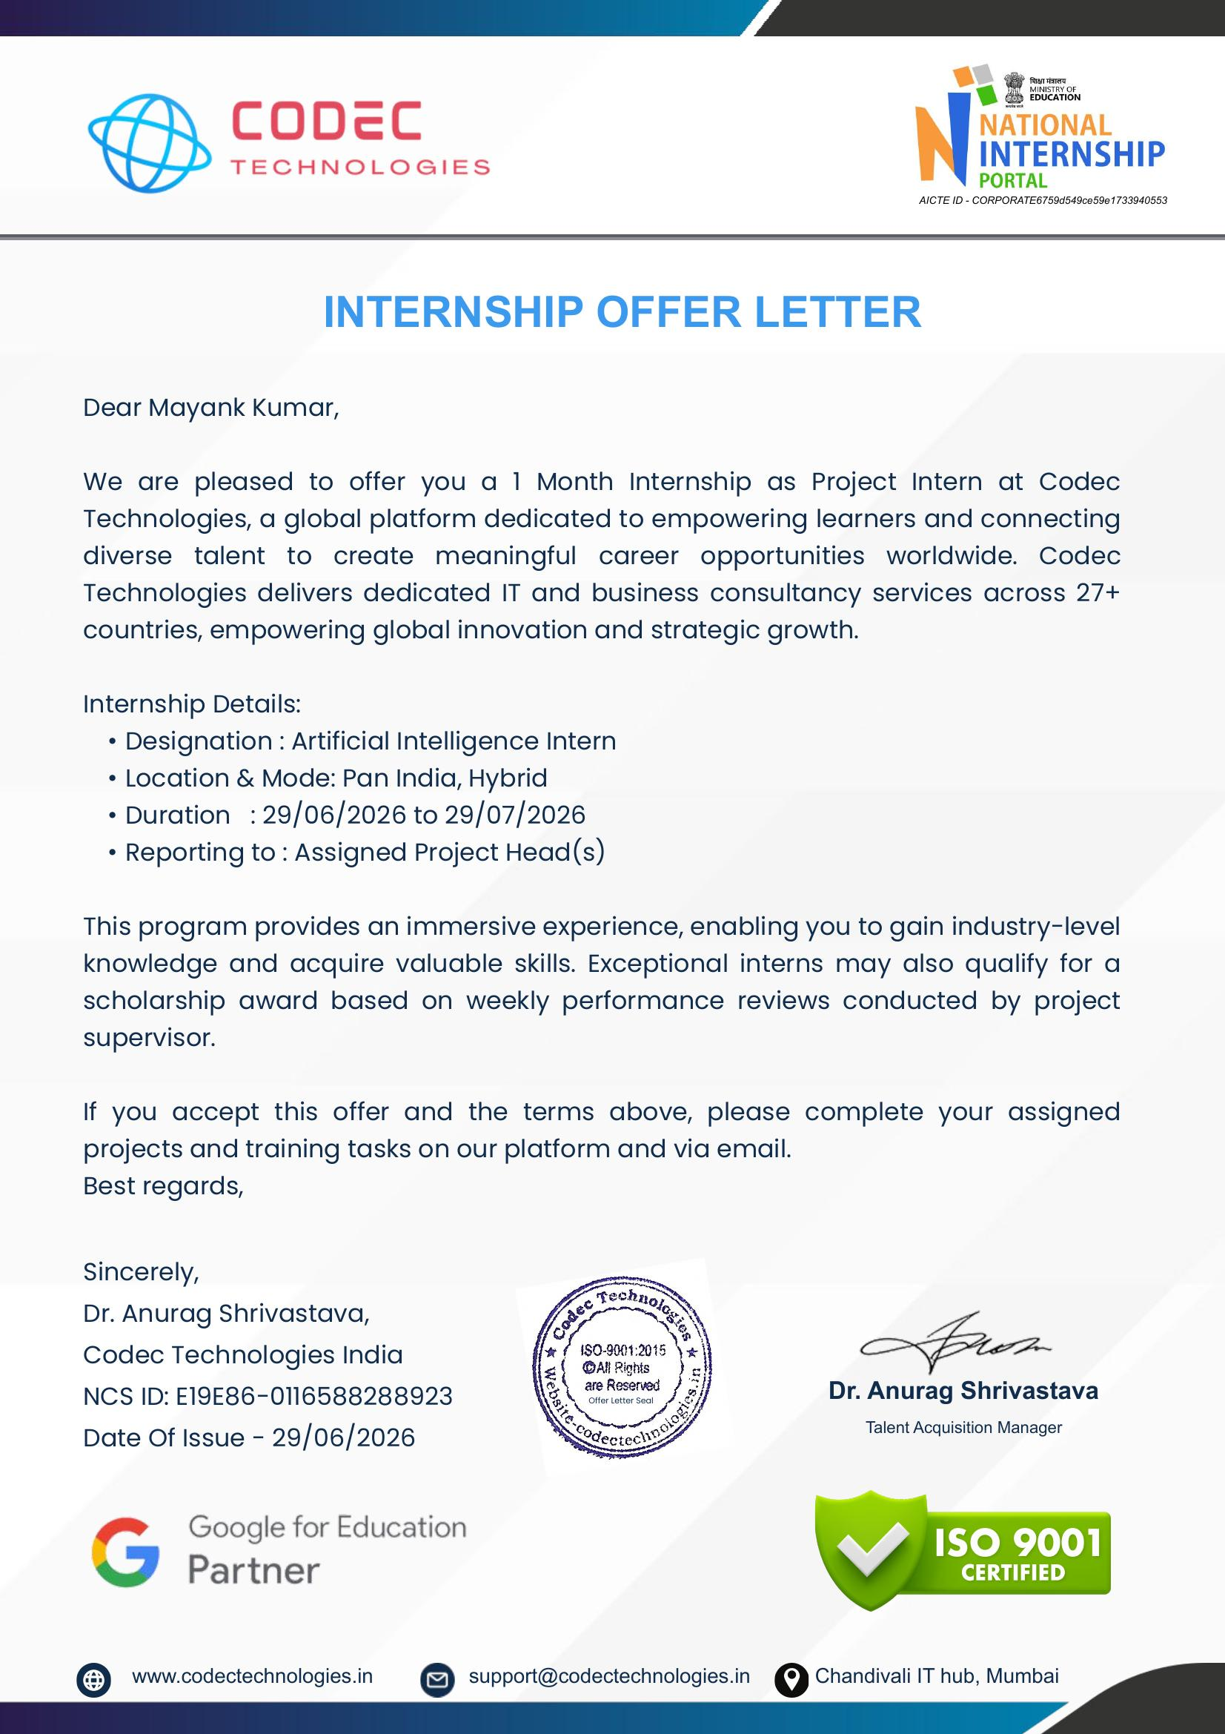
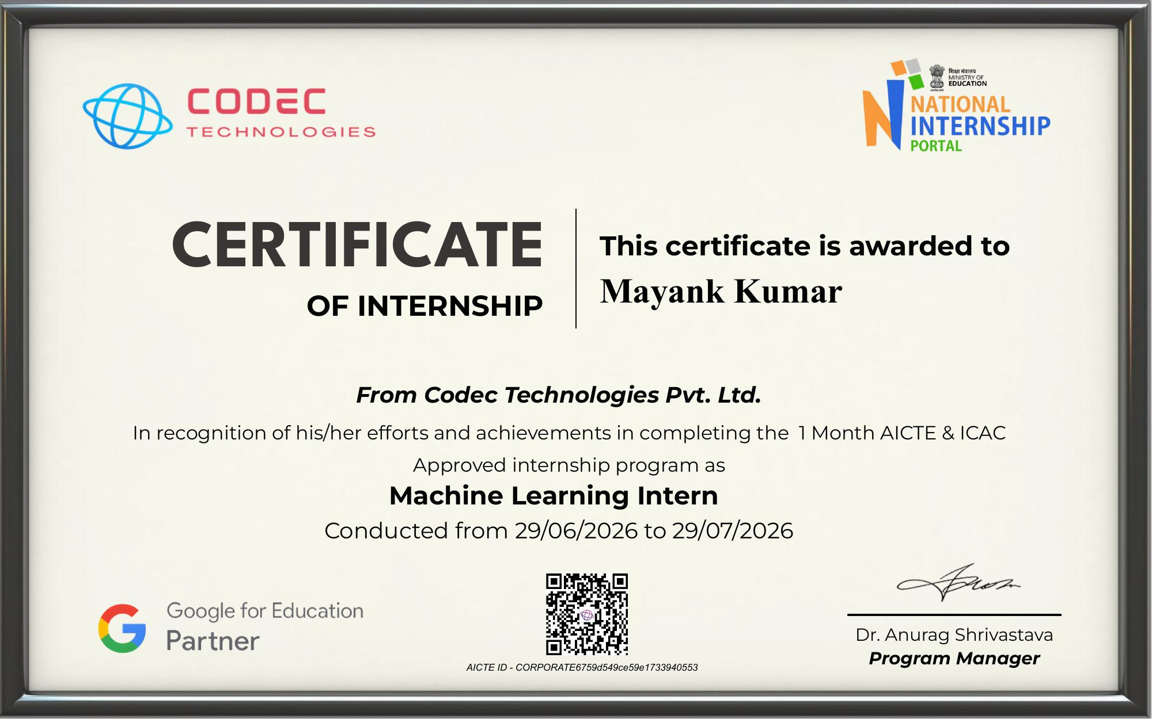
PROOF OF INTERNSHIP
Certificate & Offer Letter
Offer Letter — Codec Technologies
Certificate of Internship
10

Slide 3
MACHINE LEARNING INTERNSHIP
Building a Beginner-Friendly
Chatbot
A project built during my ML Internship at Codec Technologies Pvt. Ltd.
Mayank Kumar
Machine Learning Intern | 29 Jun 2026 – 29 Jul 2026

Slide 4
ABOUT THE INTERNSHIP
Where I Did This Project
Company
Codec Technologies Pvt. Ltd.
WHY THIS INTERNSHIP
Role
Machine Learning Intern
It gave me hands-on, practical exposure to how AI/ML projects are actually built — from picking a simple problem to shipping a working demo.
Duration
29 June 2026 – 29 July 2026 (1 Month)
Mode
Pan India, Hybrid
Google for Education Partner
ISO 9001 Certified
Program
AICTE & ICAC Approved Internship
National Internship Portal
02

Slide 5
THE PROJECT
Problem Statement
Most beginners find it hard to understand how conversational AI works. The goal was to design and build a simple chatbot that can understand basic user messages and reply automatically — without needing complex, heavy AI models.
No instant replies
Learning by building
Keep it simple
Users often need quick answers to common questions, but no one is always available to respond.
As a beginner, the best way to understand NLP and chat systems is to build one from scratch.
Focus on a lightweight, easy-to-explain chatbot rather than a complex, hard-to-debug system.
03

Slide 6
GOAL
Objective
1
Build a simple, rule-based chatbot using Python
2
Make it understand common greetings, questions & keywords
3
Generate relevant automatic replies in real time
4
Learn the basic building blocks of NLP & conversational AI
5
Deliver a working, demo-ready beginner project
04

Slide 7
TECH STACK
Tools & Technologies Used
Python
Keyword / Rule Matching
String Handling (NLP basics)
Core programming language used to write the chatbot logic.
Simple if-else and keyword-matching logic to understand user input.
Lowercasing, cleaning and matching text — the beginner-level NLP used.
Jupyter / VS Code
Command Line Interface
Google Colab / Local Setup
Environment used to write, run and test the chatbot step by step.
The chatbot runs and chats with the user directly in the terminal/console.
Used for quick testing during the internship's hybrid mode.
05

Slide 8
APPROACH
Methodology — How I Built It
01
02
03
04
05
Collect Sample Inputs
Clean the Text
Match Keywords
Pick a Response
Chat in a Loop
Listed common things users might type — greetings, questions, thank-yous, goodbyes.
→
Converted input to lowercase and removed extra spaces/punctuation so matching is reliable.
→
Checked the cleaned input against predefined keyword lists using simple if-else conditions.
→
For each matched keyword group, the bot picks a suitable reply from a small response set.
→
Wrapped everything in a while loop so the bot keeps chatting until the user types 'bye'.
06

Slide 9
HOW IT WORKS
Chatbot Flow
User Types
a Message
→
Text is
Cleaned
→
Keywords are
Matched
→
Best Reply
is Selected
→
Bot Displays
the Reply
Example: if the input contains “hello” or “hi” → the bot replies with a greeting. If it contains “bye” → the chat loop ends.
07

Slide 10
DEMO
Sample Conversation
Key Features
CHATBOT — CONSOLE
Hi there!
Understands greetings & basic questions
Hello! How can I help you today?
Instant, automated text replies
What is your name?
Runs continuously until user says 'bye'
I'm a simple chatbot built by Mayank.
Thank you
Lightweight — no heavy libraries needed
You're welcome! Happy to help.
Easy to extend with more keywords later
Bye
Goodbye! Have a great day.
08

Slide 11
TAKEAWAYS
Challenges & Learnings
CHALLENGES FACED
WHAT I LEARNED
– Handling different ways users phrase the same question
– Basics of how chatbots and NLP systems work
– Avoiding the bot giving no reply for unmatched input
– Writing clean, structured Python logic
– Keeping keyword lists organized as they grew
– Debugging and testing conversational flows
– Presenting a technical project simply
09

Slide 12
Thank You
Happy to answer any questions about the project or my internship experience.
Mayank Kumar | Machine Learning Intern | Codec Technologies Pvt. Ltd.

