Slide 1


Slide 2


TEAM pYSQUAD:
DEVELOPMENT
DEVELOPMENT
PPT
PPT
RESEARCH

Slide 3
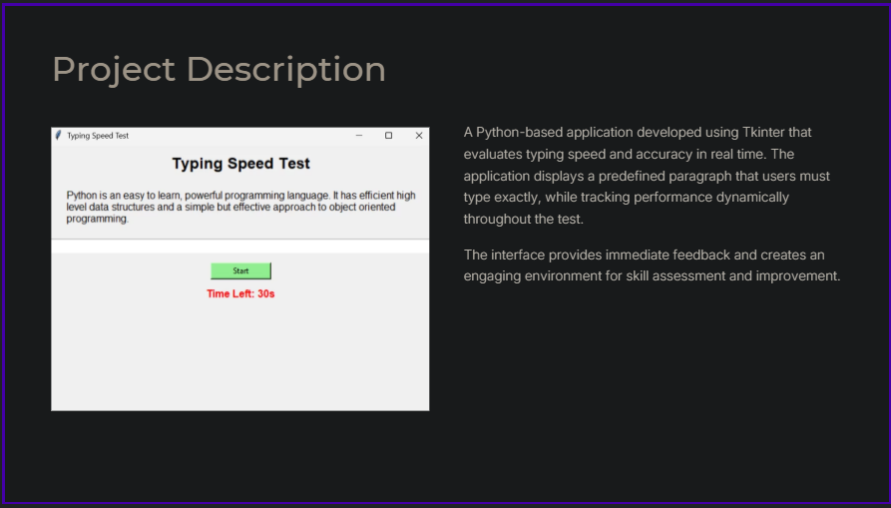

Slide 4
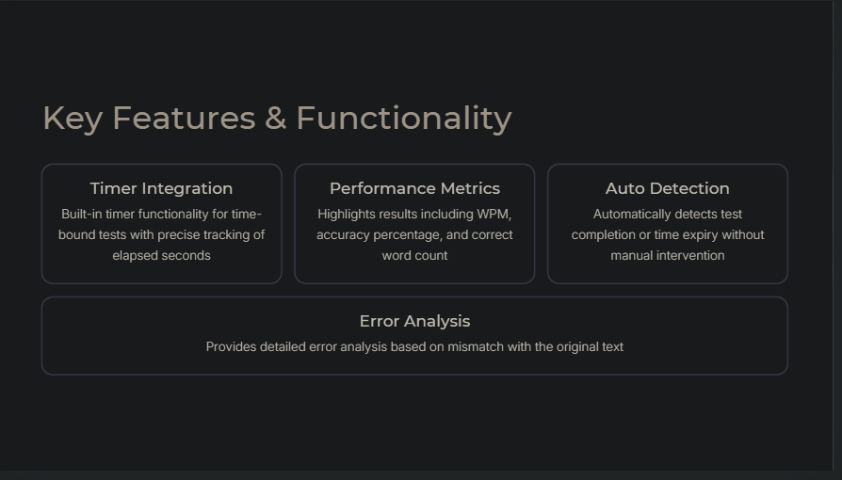

Slide 5


Slide 6
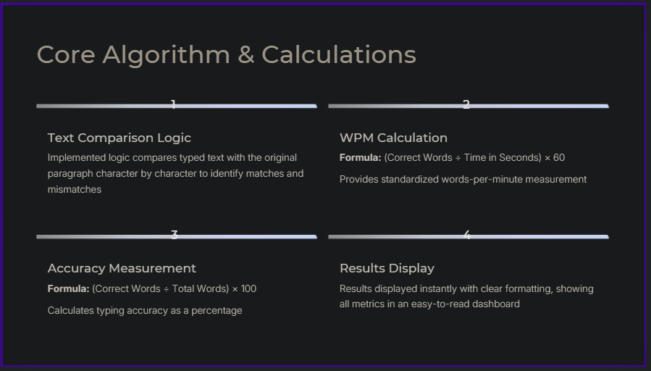

Slide 7


Slide 8



Slide 9


