Slide 1

Sentinel AML
5.14M
11
Agentic suspicious-activity detection with explainable, auditable decisions
Governed Analytical Rows
Selectively Invoked AML Tools
Ask the data. Trace every decision.
Human
The Problem
Static AML rules generate overwhelming alert volumes that bury real threats
Structuring, smurfing, layering, and rapid fund movement evade threshold-only detection
Investigators receive scores without evidence, context, or a defensible decision trail
Controlled Escalation Workflow
The Sentinel Approach
Key Capabilities
Ask
Plan
Query-aware dynamic planning
Analyst submits a natural-language investigation question
Sentinel extracts intent, entities, dates, amounts, countries, payment types, and AML typology — then builds the smallest defensible analytical toolchain
Hybrid AML detection
Grounded, evidence-checked explanations
Act
Governed dataset uploads
Ranked entities, risk level, evidence-based explanation, and a Monitor / Review / Report action surfaced to the human reviewer
Immutable investigation trace
Expected Impact: Faster triage · less unnecessary analysis · clearer reviewer decisions · stronger auditability

Slide 2
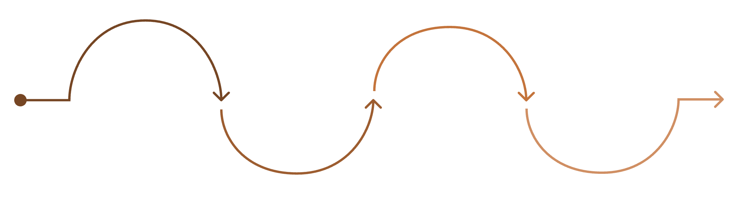
AGENTIC ARCHITECTURE
One query activates only the evidence path it needs
Intent & Entities
Query Input
BM25 Grounding
Plan & Tools
User enters their initial search request.
System analyzes the query's meaning.
An execution plan is created using tools.
Relevant data is retrieved from databases.
Selective Tool Registry
Adaptive Query Paths
Data Layer
Detection Layer
"10+ transactions under $10K"
"Is customer 4521 suspicious?"
"Detect circular layering"
DuckDB filtered loader
Direct aggregation
Selective EDA
On-demand feature engineering
AML rule engine
Z-score and IQR statistics
Isolation Forest
Conditional NetworkX graph analysis
→ Loader + Aggregation only
→ Entity lookup + targeted detectors
→ Filtered load + graph analysis
Technology Stack
Architecture Principles
React 19 · TypeScript 6 · Vite 8 · FastAPI · Python · DuckDB · Pandas · NumPy · scikit-learn · NetworkX · Groq · Plotly
Expensive tools run only when justified by the query
APIs & Database
EDA is skipped for targeted entity lookups
External: Groq API | Internal FastAPI REST: Query · Evidence · Datasets · Investigations · Review Queue · Governance · Audit & Export
DuckDB workspaces: Transactions · SAML-D knowledge · Dataset registry · Investigations · Alert queue · Append-only audit events
Every selected and skipped tool records its reason and execution time
Data is bounded before any model execution

Slide 3
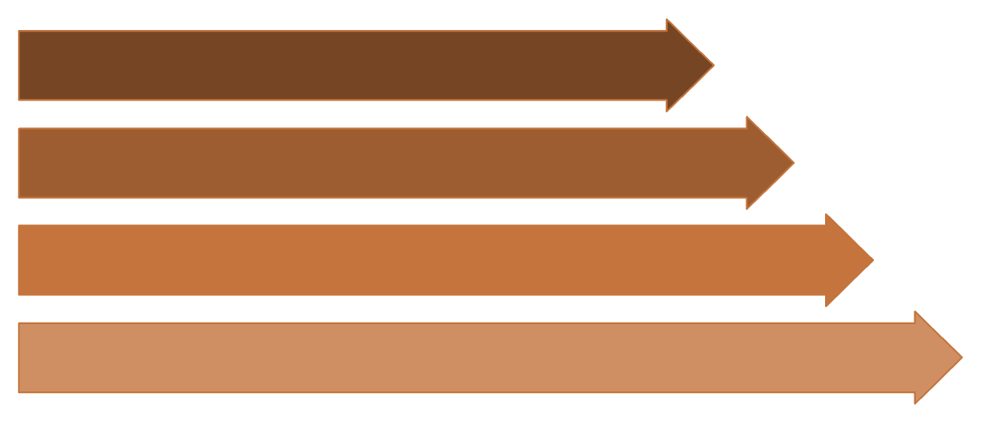
HYBRID INTELLIGENCE
Hybrid intelligence with evidence-level explainability
Detection & Scoring Workflow
Model & Dataset Governance
Query Transactions
Isolation Forest
HI-Small Dataset
Trained on 50,000 SAML-D normal-behavior rows · 200 estimators · 0.10% contamination · 6 versioned serving features · PSI feature-drift monitoring
5,078,345 operational transaction rows
Compute AML Features
Score & Evidence
SAML-D Dataset
59,873 compact knowledge and calibration rows · 17 laundering typologies in the governed knowledge catalogue · Operational evidence and calibration data remain isolated
Review & Report
On-Demand Feature Engineering
What Makes Sentinel Unique
7-day transaction frequency and rolling value
Adaptive agent, not a fixed pipeline
Near-threshold transaction count
Source labels are never presented as model predictions
Account amount deviation
Skipped detectors cannot dilute the final risk score
One-hour velocity
LLM explanations are evidence-checked, with deterministic fallbacks
Fan-in and fan-out behavior
Dataset, model, policy, tool execution, and analyst actions remain fully traceable
Rapid cash-out and counterparty-network indicators
Sentinel drafts evidence for reviewers but never autonomously files a SAR/STR
Detector Weight Allocation
Same transactions. Clearer risk. Every decision traceable.
40%
25%
Rule Engine
Statistical Detector
35%
Isolation Forest
Weights normalized only across detectors that actually ran · Optional high-risk-jurisdiction uplift · Explanations validated against computed numeric evidence

