Slide 1
CAUSAL RAG
for Business Conversations
Four independent retrieval architectures • evidence construction • benchmark-driven evaluation
19,621
686,764
Shared benchmark boundary
conversations
conversation turns
quality • retrieval • grounding
latency • token efficiency
4
independent RAG systems
Anonymous
01

Slide 2
INTER IIT 15.0
Why causal RAG is different
A causal rationale is rarely contained in one highly similar chunk.
• The customer's motivation can appear several turns before the agent response.
• The intervention, explanation, and outcome may occur later in the same conversation.
• Global top-k retrieval can mix multiple conversations with similar business vocabulary.
• Evidence must preserve transcript identity, turn order, speaker, and causal completeness.
PROJECT PRINCIPLE
RAG is treated as an
EVIDENCE-CONSTRUCTION
problem, not only a
similarity-search problem.
Task 1: causal rationale extraction
Task 2: causal synthesis
ANONYMOUS TECHNICAL PRESENTATION
02

Slide 3
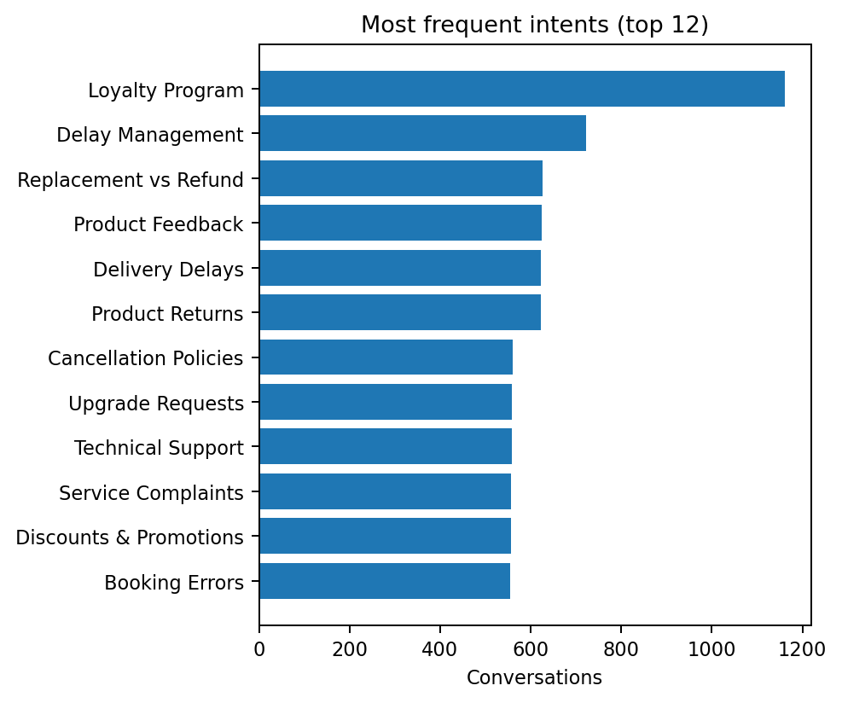
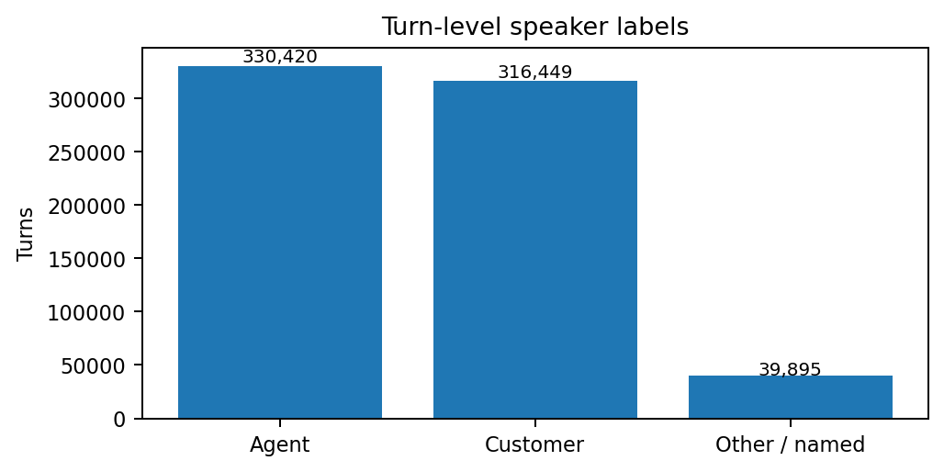
INTER IIT 15.0
Dataset and EDA
19,621
686,764
35
35
conversations
total turns
intents
median turns
EDA observations
• Real conversational noise and non-uniform speaker labels
• Shared intents create lexical overlap across transcripts
• Conversation identity is essential for reliable causal evidence
ANONYMOUS TECHNICAL PRESENTATION
03

Slide 4
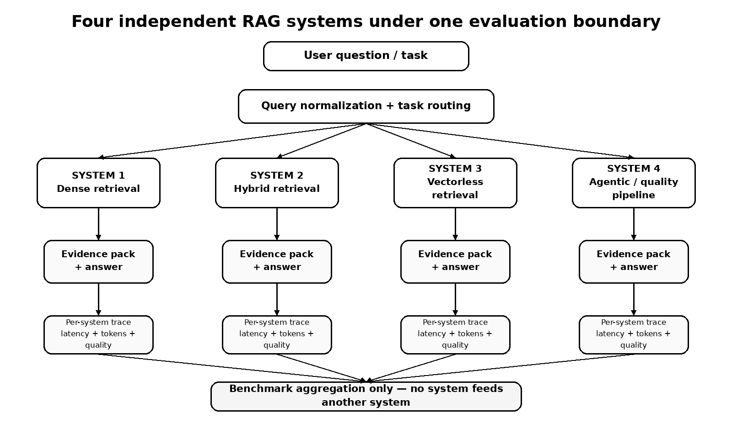
INTER IIT 15.0
Four independent systems
The systems share inputs and evaluation only; System 4 does NOT consume Systems 1–3 outputs.
ANONYMOUS TECHNICAL PRESENTATION
04

Slide 5
INTER IIT 15.0
What each system tests
SYSTEM 1
SYSTEM 2
SYSTEM 3
SYSTEM 4
Dense Vector RAG
Hybrid RAG
Vectorless RAG
Agentic / Quality RAG
• Embedding retrieval
• Conversation/chunk indexing
• Fast baseline for semantic matching
• Dense + BM25 retrieval
• Candidate fusion
• Tests semantic + lexical complementarity
• BM25 / lexical retrieval
• No embeddings / vector DB
• Fast, transparent, but ambiguity-sensitive
• Dense + lexical candidates
• Reranking + causal turn selection
• Laya gates + grounding validation
Laya is used as a lightweight decision/control layer — routing, evidence gates, and answer gates — not as a replacement for retrieval.
ANONYMOUS TECHNICAL PRESENTATION
05

Slide 6
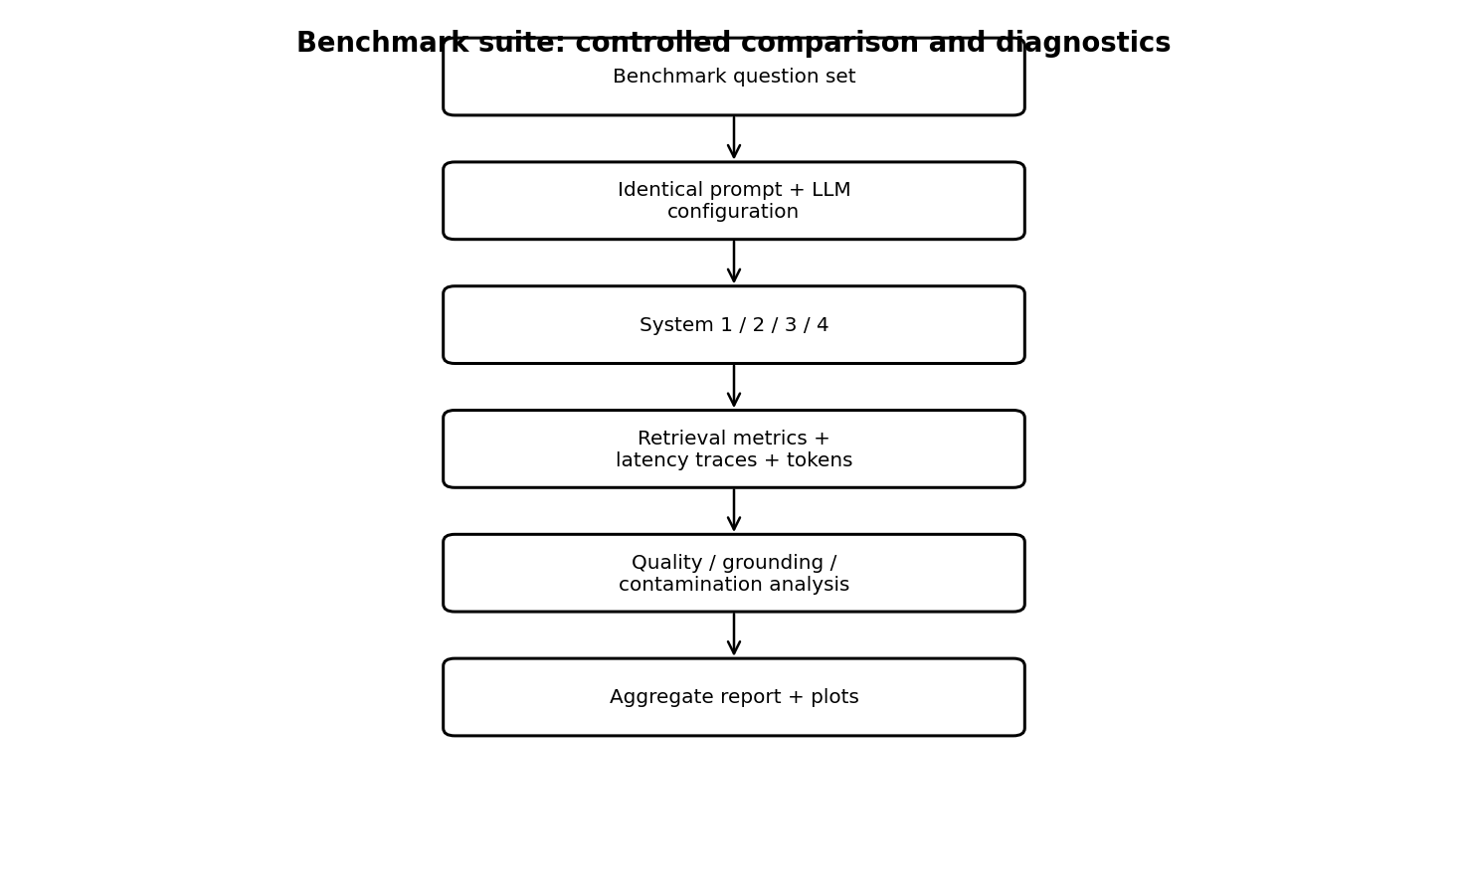
INTER IIT 15.0
Benchmark suite and evaluation boundary
Same evaluation contract
• Same benchmark questions and task definitions
• Structured JSON outputs with evidence identifiers
• Retrieval quality: conversation recall, evidence precision/recall
• Grounding and cross-conversation contamination
• Latency traces by pipeline stage
• Token / context efficiency
• Failure-mode and root-cause reporting
Latest benchmark: 13-query run. Task 2 quantitative coverage remained incomplete in the available benchmark archive.
ANONYMOUS TECHNICAL PRESENTATION
06

Slide 7
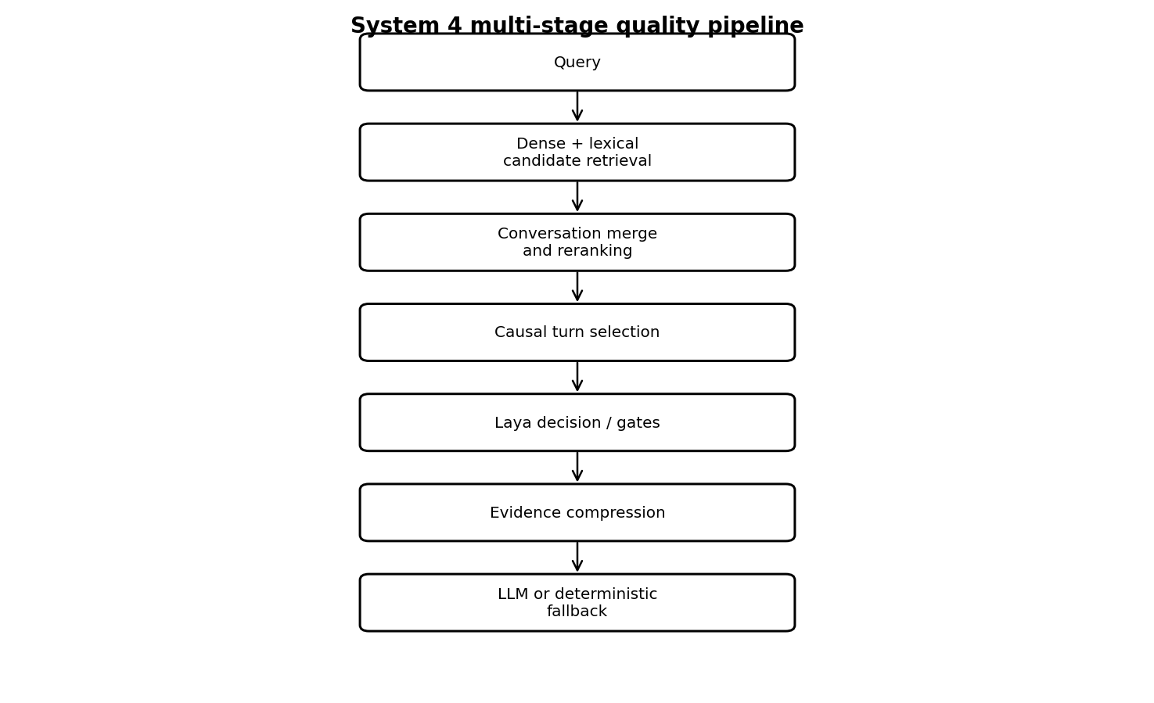
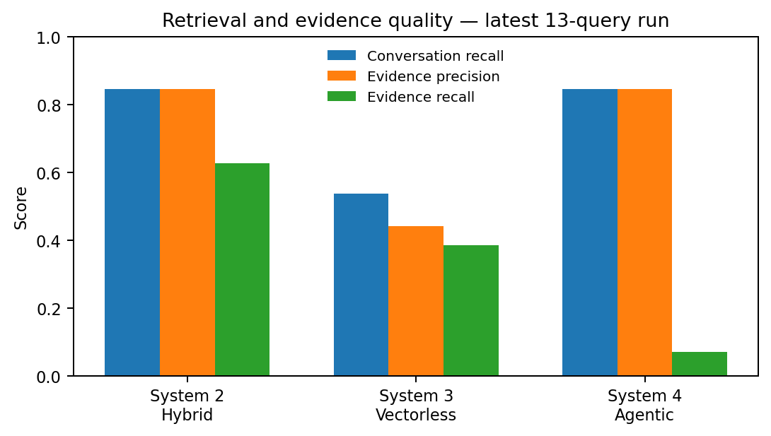
INTER IIT 15.0
System 4: multi-stage quality pipeline
LATEST 13-QUERY RUN
Conversation recall 0.85 • Evidence precision 0.85
Evidence recall 0.08
Interpretation: candidate selection became precise, but the pipeline still missed causal evidence coverage.
ANONYMOUS TECHNICAL PRESENTATION
07

Slide 8
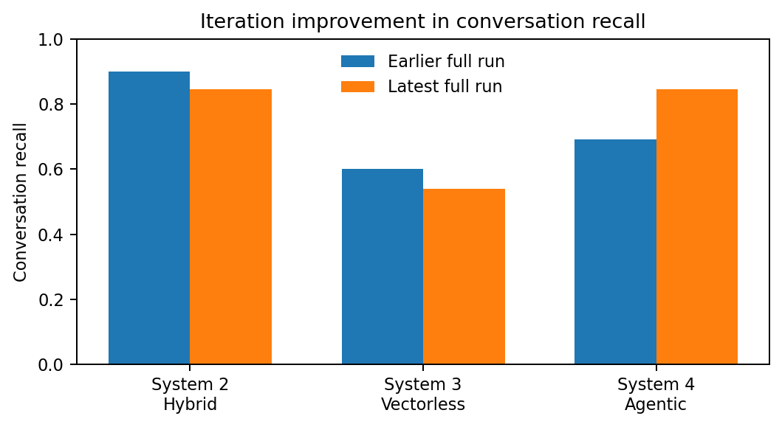
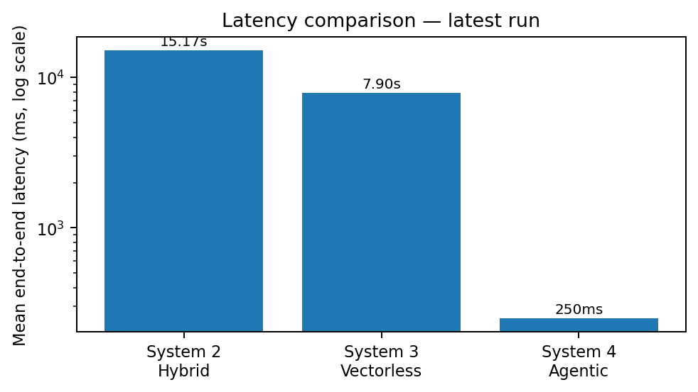
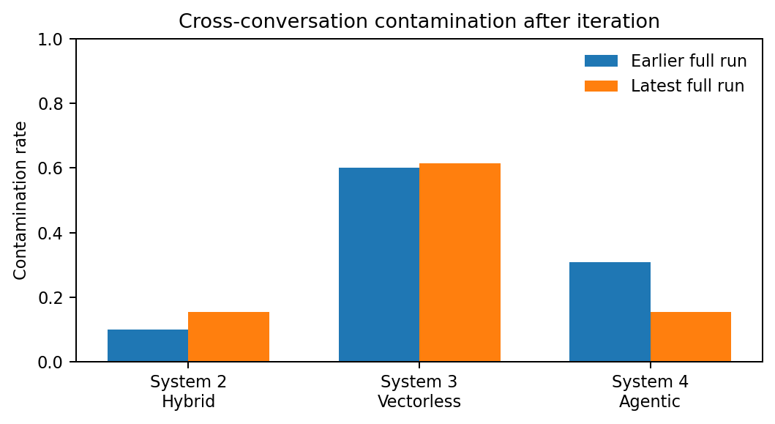
INTER IIT 15.0
What the latest results show
Recall improved for System 4 across iterations, while its evidence recall remains the main bottleneck.
ANONYMOUS TECHNICAL PRESENTATION
08

Slide 9
INTER IIT 15.0
Failure modes → likely causes → fixes
Observed difficulty
Likely reason
Next fix
Cross-conversation mixing
Shared business vocabulary; weak transcript grouping
Conversation-level retrieval + transcript identity
Weak causal evidence
Filler / isolated turns can rank highly
Neighbor expansion + causal turn selection
Vectorless ambiguity
Common terms have weak entity discrimination
Field-weighted BM25 + exact entity/phrase boosts
LLM latency
Generation dominates end-to-end time
Smaller local model / caching / shorter evidence
Task instability
Interactive prompts exposed contract edge cases
Stricter schema + task-specific evaluation
System 4 timing anomaly
Deterministic fallback bypassed LLM generation
Benchmark full generation separately
Core lesson
Retrieval quality is necessary, but causal completeness and transcript identity determine whether the final answer is trustworthy.
ANONYMOUS TECHNICAL PRESENTATION
09

Slide 10
INTER IIT 15.0
What remains to be tried
01
Improve System 3
Field-weighted BM25, phrase/entity boosts, metadata filters, speaker-aware scoring.
02
Fix evidence recall
Retrieve at conversation level, expand neighboring turns, then select causal evidence.
03
Benchmark the real LLM path
Do not compare System 4's deterministic fallback latency with full generation latency.
04
Complete Task 2 evaluation
Add a stable quantitative benchmark set and compare synthesis quality + latency.
05
Optimize local generation
Test smaller Ollama / local models, caching, context compression, and constrained JSON.
Time-constrained experiments were kept explicit rather than presented as completed results.
ANONYMOUS TECHNICAL PRESENTATION
10

Slide 11
KEY TAKEAWAYS
Causal RAG is primarily
a problem of evidence
management.
• Dense retrieval provides semantic recall but can lose conversation identity.
• Hybrid retrieval combines complementary signals but increases pipeline complexity.
• Vectorless RAG is efficient and transparent, but lexical ambiguity is a major risk.
• System 4 improved candidate precision and reduced contamination, yet evidence recall remains the key gap.
• A common benchmark boundary makes the four architectures comparable and experimentally independent.
The next iteration should optimize evidence completeness first, then generation efficiency.
ANONYMOUS • END
11

