Slide 1
Addition

Slide 2

Introduction
The addition of two whole numbers results in the total amount or sum of those values combined
Addition belongs to arithmetic, a branch of mathematics
Performing addition is one of the simplest numerical tasks to do
3 + 2 = 5 with apples, a popular choice in textbooks[1]

Slide 3

Notation and terminology
Addition is written using the plus sign "+" between the terms; that is, in infix notation
The result is expressed with an equals sign
There are also situations where addition is "understood", even though no symbol appears
The plus sign

Slide 4
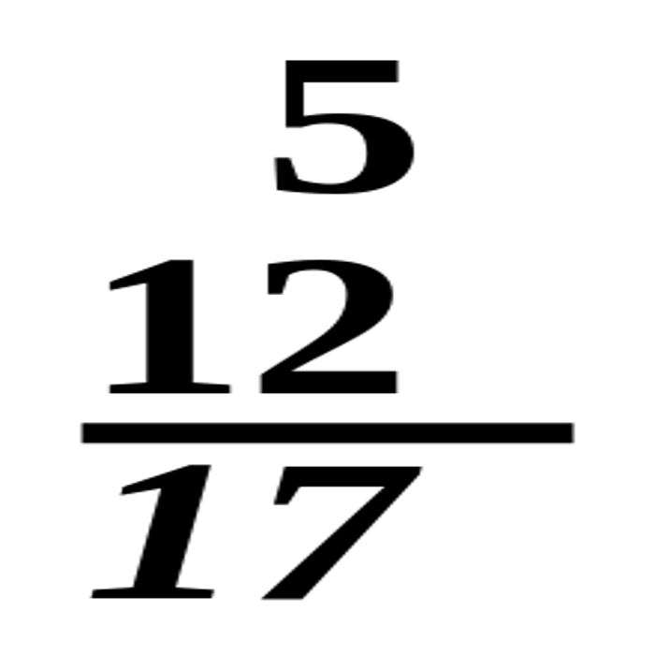
Interpretations
Addition is used to model many physical processes
Even for the simple case of adding natural numbers, there are many possible interpretations and even more visual representations
Possibly the most fundamental interpretation of addition lies in combining sets
Columnar addition – the numbers in the column are to be added, with the sum written below the underlined number.

Slide 5
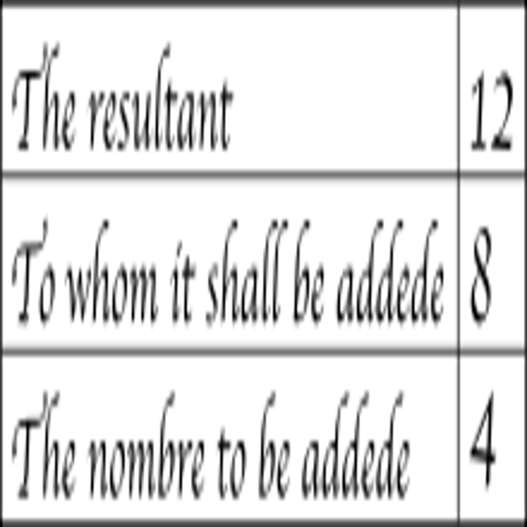
Properties
Addition is commutative, meaning that one can change the order of the terms in a sum, but still get the same result
For any three numbers a, b, and c, it is true that (a + b) + c = a + (b + c) In symbols, for every a, one has
This law was first identified in Brahmagupta's Brahmasphutasiddhanta in 628 AD
Redrawn illustration from The Art of Nombryng, one of the first English arithmetic texts, in the 15th century.[12]

Slide 6
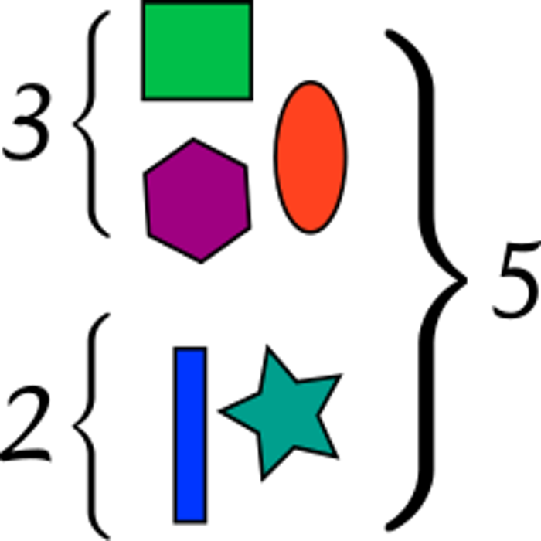
Performing addition
Studies on mathematical development starting around the 1980s have exploited the phenomenon of habituation: infants look longer at situations that are unexpected
Even some nonhuman animals show a limited ability to add, particularly primates
Different nations introduce whole numbers and arithmetic at different ages, with many countries teaching addition in pre-school
One set has 3 polygons while the other set has 2. The total amount of polygons are 5, which is a consequence of the addition of the objects from the two sets (3 + 2 = 5).

Slide 7
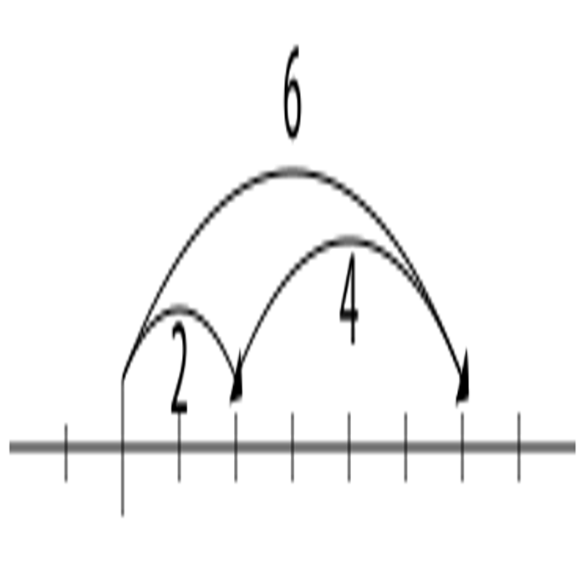
Addition of numbers
Addition is first defined on the natural numbers
In set theory, addition is then extended to progressively larger sets that include the integers, the rational numbers, and the real numbers
There are two popular ways to define the sum of two natural numbers a and b
A number-line visualization of the algebraic addition 2 + 4 = 6. A translation by 2 followed by a translation by 4 is the same as a translation by 6.

Slide 8
Sources
https://en.wikipedia.org/wiki/Addition

