Slide 1
MAJOR PROJECT CS1050 SENTIMENT ANALYSIS OF TWITTER DATA Guide: Members: Dr. Saad Yunus Ujjwal Jain(646) Sait Mayank Bansal(694)

Slide 2
Objective
To implement an algorithm for automatic classification of the text into positive, negative or neutral.
To determine the attitude of the mass is positive, negative or neutral towards the subject of interest.
Graphical representation of the user’s sentiments in the form of graph like pie chart, etc.
To express whether the expressed opinion in a document, a sentence or an entity feature/aspect is positive, negative or neutral.

Slide 3
Abstract
Sentiment analysis (also known as opinion mining) refers to the use of natural language processing, text analysis and computational linguistics.
Used to identify and extract subjective information in source materials.
In this project, we are performing sentiment analysis on the twitter data.
Assessment and analysis of sentiment of twitter data, we get a very good approach to screen the public’s sentiments towards any business, product, service, etc.
In this project, we discuss the different approaches of sentiment analysis on twitter data.

Slide 4
Introduction
Twitter is a micro-blogging website where people share their messages in the form of tweets. It is an online social networking website.
Properties of a tweet : The properties of a tweet determine the structure of a tweet.
twitter.com is a popular micro-blogging website.
Each tweet is 140 characters in length.
Tweets are frequently used to express a tweeter's emotion on a particular subject.
There are firms which poll twitter for analyzing sentiment on a particular topic.
The challenge is to gather all such relevant data, detect and summarize the overall sentiment on a topic.

Slide 5
Sentiment Analysis
Sentiment analysis is a method of computationally analyzing and predicting sentiments, opinion from text, image and any form of data.
It is a process of identifying and categorizing sentiments and opinions from a written piece of text.
Sentiment Analysis tries to determine the writer’s attitude towards a particular topic whether it is positive, negative or neutral.
Sentiment Analysis is generally a binary classification of opinions like for/against, like/dislike, good/bad, etc.
Sentiment Analysis has a wide range of applications. It helps businesses to understand the social sentiment of their brand, product or service. For example in social media, hospital data, product reviews, etc.

Slide 6
Applications of Sentiment Analysis
Applications to Review-Related Websites-Movie Reviews, Product Reviews etc.
Applications as a Sub-Component Technology-spam detection, context sensitive information detection etc.
Applications in Business and Government Intelligence-Knowing Consumer attitudes and trends.
Applications across Different Domains-Knowing public opinions for political leaders or their notions about rules and regulations in place etc.
Applications in social media-judging the opinion of the user towards a particular topic.

Slide 7
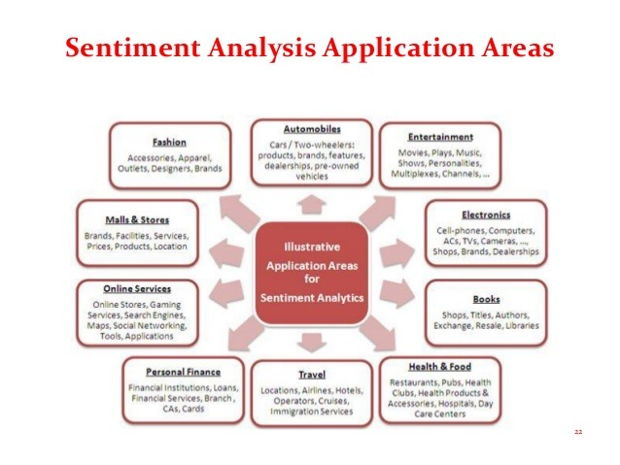

Slide 8
Literature Survey
Harsh Thakkar, Dhiren Patel, Department of Computer Engineering, National Institute of Technology, Surat, India in a paper on Approaches for Sentiment Analysis on Twitter: A State-of-Art study, have shown the utility of lexicon based approach to detect the sentiment of twitter messages.
Alexander Pak and Patric Paroubek, university of Paris, France in a paper on Twitter as a corpus for sentiment Analysis and opinion mining, have presented a method for an automatic collection of corpus that can be used to train a sentiment classifier.

Slide 9
Problem Statement
The problem in sentiment analysis is classifying the polarity of a given text at the document, sentence, or feature/aspect level .
whether the expressed opinion in a document, a sentence or an entity feature/aspect is positive, negative, or neutral .

Slide 10
Challenges
Tweets are highly unstructured and also non-grammatical.
Out of Vocabulary Words
Some of the words may be out of vocabulary or our dictionary.
Lexical Variation-People are of different regions and different areas. They use different languages in their tweets.
Extensive usage of acronyms like asap, lol, idk.
Extensive use of emoticons.

Slide 11
Sentiment analysis using knowledge based approach
Fetch the tweets
Pre-processing of the tweets
Tokenize the tweets.
Comparing the text with the dictionary to check the number of positive words, negative words.
Calculating the overall sentiment score of a tweet.
Predicting the sentiment of the tweet as positive, negative or neutral.
Plotting the graph

Slide 12
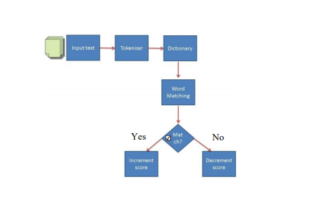
Architecture Diagram for knowledge based approach

Slide 13
Algorithm used for knowledge based approach
Positive-count = Number of positive words.
Negative-count = Number of negative words.
N-count = Number of positive words – Number of negative words
Prediction based upon the algorithm.
If N-count is positive the tweet is classified as positive.
If N-count is negative the tweet is classified as negative.
If the Ncount is zero, the tweet is classified as neutral.

Slide 14
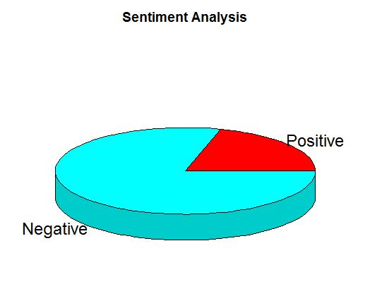
Result
The below PI-chart is the result for hashtag #JusitceForAsifa using knowledge based approach.

Slide 15
Drawbacks of the old approach
Sentence1 : I want a burger so bad.
Sentence2: I had a burger. It was so bad.
Sentence1 means the user wants a burger so badly.
Sentence2 means the user just had a burger and it was bad in taste.
If we perform sentiment analysis on both the sentences using approach1, it shows negative as both the sentences contain a negative word.
Both the sentences have different sentiment using the same word. Here our sentiment analysis fails as it is not able to display the correct sentiment.

Slide 16
Drawbacks
computes the number of positive and negative words in a document and makes a conclusion based on their difference.
when using a simple vocabularies approach for a phrase ‘not bad’ we will get a negative estimation.

Slide 17
Sentiment analysis using machine learning
Logistic regression model is used for classification of the data.
The dataset is used to train a model which predicts the probability of the positiveness for the input data.
Doc2vec package is used for text analysis.
The document term matrix is constructed.
The DTM is weighted using the term frequency-inverse document frequency.
The approach plots the graph and shows the probability of positiveness for the tweets.

Slide 18
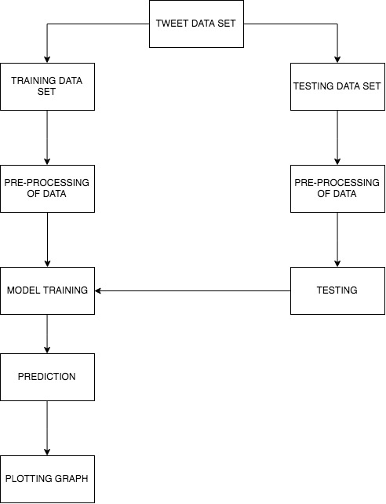
Architecture diagram

Slide 19
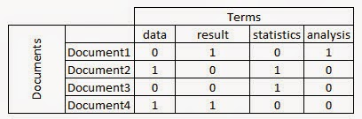
Document Term Matrix
a model to represent a list words in a document in a matrix form.
the frequency of occurrence of the words in a document.
value taken by the matrix is decided by the scheme - term frequency-inverse document frequency (tf-idf).

Slide 20
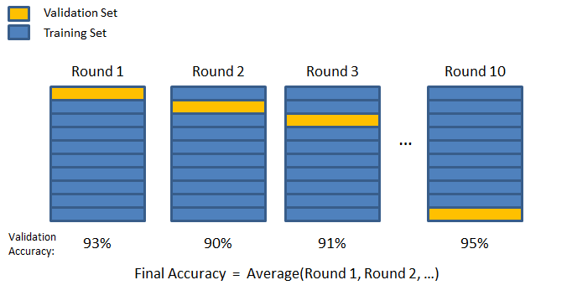
K-Fold Cross Validation
strategy for evaluating the execution of machine learning models.
how the machine learning model would sum up to a unknown data set.
to gauge how exact the forecasts our model will give in practice.

Slide 21
Regularization
machine learning algorithms face the problem of overfitting.
Overfitting of a model can cause the less accurate results.
model works well on training data-set and will not work accurate on unknown data-set.
Types of regularization:
L1 Regularization
L2 Regularization
A linear regression model is a function consisting of one dependent variable y and many independent variable x.
Lasso Regression-uses L1 method
Ridge Regression-uses L2 method

Slide 22
Term frequency-Inverse Document Frequency
numerical statistic used in information retrieval.
determines the importance of a word in a document in a collection or corpus.
weighting factor in text analysis, searches to gather information and user modeling.
dependable statistic to weigh the importance of a word in a document.
the term frequency is calculated by the frequency of the word in the document divided by the total number of words in the document.
Inverse Document Frequency which means logarithm of the number of total document in the collection divided by the number of document where the term appears.

Slide 23
Term Frequency
which measures how frequently a term occurs in a document.
the length of the documents is different, it may be possible that a term would appear more times in long documents than shorter ones.
the term frequency is divided by the document length as a way of normalization
TF(t) = (Number of times term t appears in a document) / (Total number of terms in the document)

Slide 24
Inverse Document Frequency
which measures the importance of a term.
We consider all terms equally important while computing the term frequency.
However it is known that terms, such as is, of, and that, appear a lot of times but have little importance.
Therefore we weigh down the frequent terms while scale up the rare ones, by computing the following:
Log (Total number of documents / Number of documents with term t in it).

Slide 25
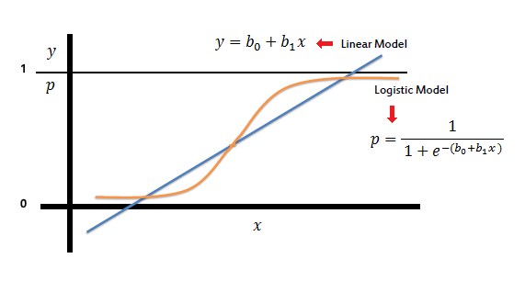
Logistic regression model
where the dependent variable is binary or categorized.
the output variable is binary dependent variable means the output will be binary.
like positive-negative, like-dislike, 0 or 1, good-bad, pass-fail, win-lose, alive-dead, etc.
can be binomial, multinomial or ordinal.

Slide 26
Sentiment analysis using machine learning[Training the model]
Load the dataset
data splitting on train and test
Pre-process and tokenization
Make a vocabulary and Document Term matrix
define tf-idf model
fit the model to the train data and transform
Used a tf-idf model for weight in Document Term Matrix
Train the model using glmnet function
Prediction on test data

Slide 27
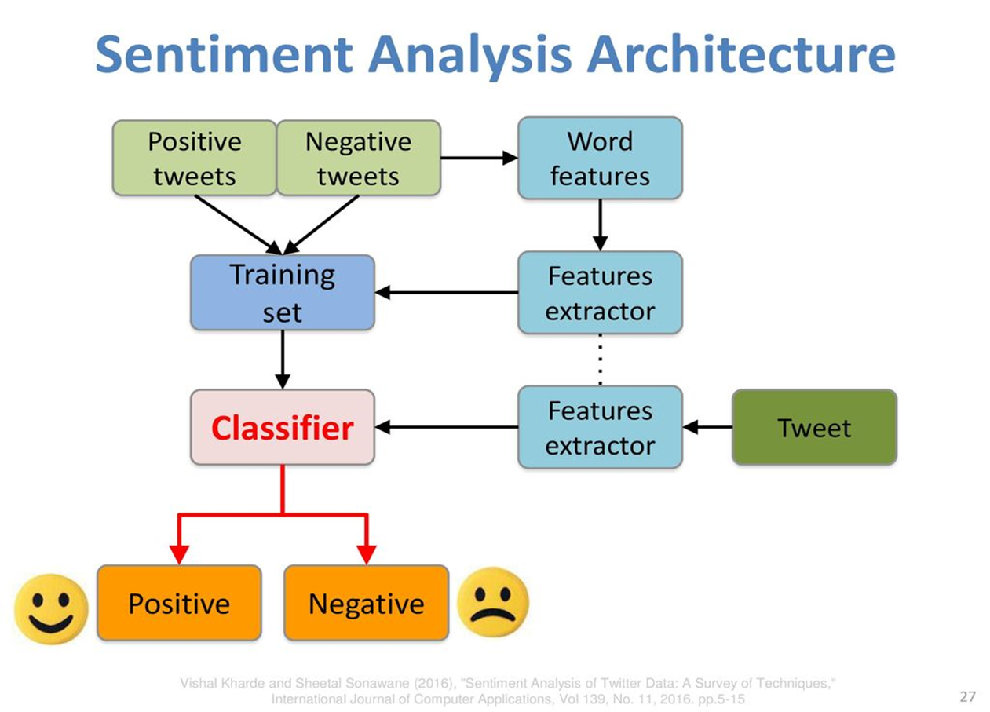

Slide 28
Sentiment analysis using machine learning [ Predicting the sentiment of tweets]
Fetch the tweets using twitter api
Pre-process the tweet
Creating vocabulary and Document term Matrix
Transform data with tf-idf
Predict probability of positiveness
Plot the graph

Slide 29
Experiments and Parameters
Parameters | Value
Data set | 1.6 million tweets
Training Data | 80%
Testing Data | 20%
K-fold cross validation | 5
Hashtag used for the experiment | #JusticeForAsifa

Slide 30
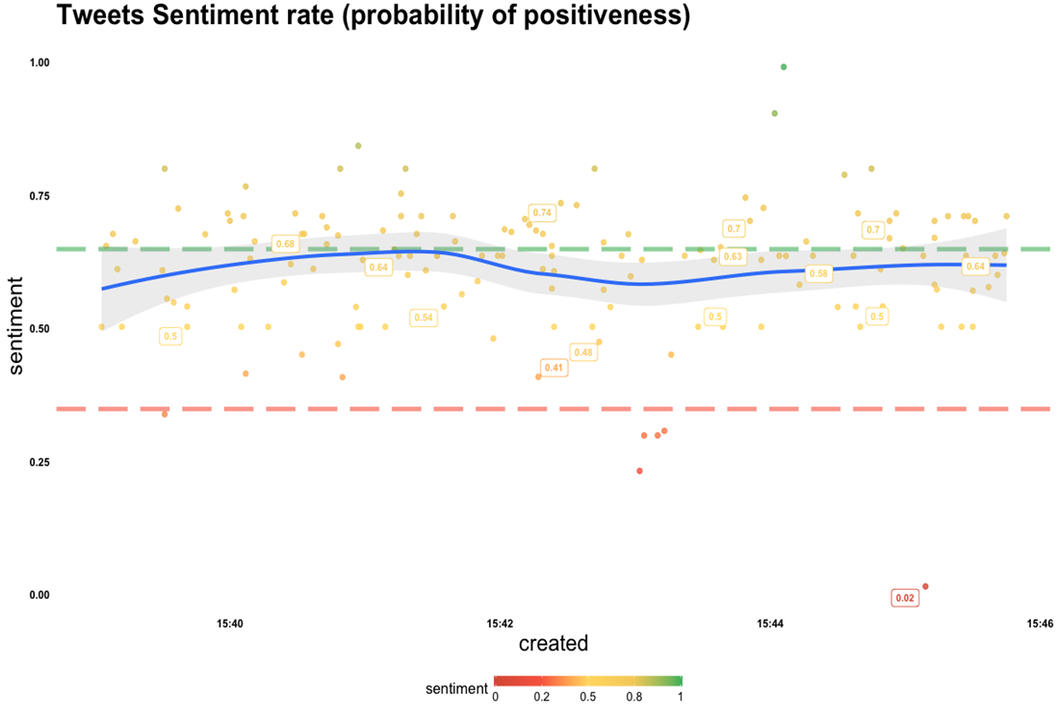
Result for #JusticeForAsifa

Slide 31
Conclusion and Future Enhancements
Sentiment analysis can be done on product reviews and hospital reviews.
Our classifier algorithm is 90% accurate.
express different sentiment with the same set of words, current model can not predict the exact emotion.
Pre-processing of tweets can be improves.
Regional languages can be included.
Combine application of sentiment analysis and machine learning can improve life.

Slide 32
Thank You for your patience hearing.

