Slide 1
Sentiment Analysis on Twitter Data
Presented By:
Mayank Bansal (RA1411003010694)
Ujjwal jain (RA1411003010646)

Slide 2
Abstract
What is Sentiment Analysis?.
It is classification of the polarity of a given text in the document, sentence or phrase . The goal is to determine whether the expressed opinion in the text is positive, negative or neutral.

Slide 3
Overview:
twitter.com is a popular microblogging website.
Each tweet is 140 characters in length
Tweets are frequently used to express a tweeter's emotion on a particular subject.
There are firms which poll twitter for analysing sentiment on a particular topic.
The challenge is to gather all such relevant data, detect and summarize the overall sentiment on a topic.

Slide 4
Classification Tasks and Tools:
Polarity classification – positive or negative sentiment
3-way classification – positive/negative/neutral
10,000 unigram features – baseline
100 twitter specific feature
A hand annotated dictionary for emoticons and acronyms

Slide 5
About twitter and structure of tweets:
140 charactes – spelling errors, acronyms, emoticons, etc.
@ symbol refers to a target twitter user
# hashtags can refer to topics
11,875 such manually annotated tweets
1709 positive/negative/neutral tweets – to balance the training data

Slide 6
Preprocessing of data
Emoticons are replaced with their labels
:) = positive :( = negative
170 such emoticons.
Acronyms are translated. 'lol' to laughing out loud.
5184 such acronyms
URLs are replaced with ||U|| tag and targets with ||T|| tag
All types of negations like no, n't, never are replaced by NOT
Replace repeated characters by 3 characters.

Slide 7
Problem Statement
The problem at hand consists of two subtasks:
• Phrase Level Sentiment Analysis in Twitter : Given a message containing a marked instance of a word or a phrase, determine whether that instance is positive, negative or neutral in that context.
• Emoticon Level Sentiment Analysis in Twitter : Given a message, consisting of phrase and emoticon decide whether the emoticon is of positive, negative, or neutral sentiment

Slide 8
Challenges
Tweets are highly unstructured and also non-grammatical
Out of Vocabulary Words
Lexical Variation
Extensive usage of acronyms like asap, lol, idk.
Extensive use of emoticons

Slide 9
Approach
Tokeniser Tweet Downloader
Download the tweets using Twitter API
Pre-processing to non-English Tweets
Replacing Emoticons by their polarity
Remove URL, Target Mentions, Hash tags, Numbers.
Replace Negative Mentions • Replace Sequence of Repeated Characters eg. ‘coooooooool’ by ‘coool’

Slide 10
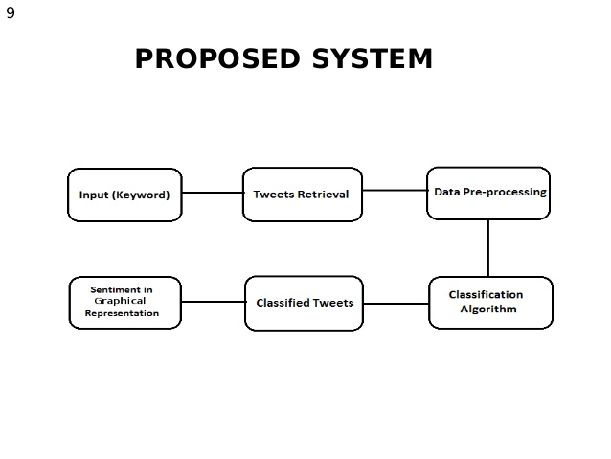
Architecture Diagram

Slide 11
Algorithm
Positive-count = number of positive words
Negative-count = Number of negative
Total Count = Positive-count – negative-count
If Total Count is positive then the tweet is positive
If total count is negative then tweet is negative

Slide 12
References
Techniques for Sentiment Analysis of Twitter Data: A Comprehensive Survey
Twitter as a corpus in sentiment analysis and opinion mining Pak, Patrick University of paris.

Slide 13
THANK YOU

