Slide 1
Sentiment Analysis on Twitter Data
Presented By:
Mayank Bansal (RA1411003010694)
Ujjwal jain (RA1411003010646)
Guide
Dr. Saad Yunus sait

Slide 2
Abstract
What is Sentiment Analysis?.
It is classification of the polarity of a given text in the document, sentence or phrase . The goal is to determine whether the expressed opinion in the text is positive, negative or neutral.

Slide 3
Overview:
twitter.com is a popular microblogging website.
Each tweet is 140 characters in length
Tweets are frequently used to express a tweeter's emotion on a particular subject.
There are firms which poll twitter for analysing sentiment on a particular topic.
The challenge is to gather all such relevant data, detect and summarize the overall sentiment on a topic.

Slide 4
Classification Tasks and Tools:
Polarity classification – positive or negative sentiment
3-way classification – positive/negative/neutral
10,000 unigram features – baseline
100 twitter specific feature
A hand annotated dictionary for emoticons and acronyms

Slide 5
About twitter and structure of tweets:
140 charactes – spelling errors, acronyms, emoticons, etc.
@ symbol refers to a target twitter user
# hashtags can refer to topics
11,875 such manually annotated tweets
1709 positive/negative/neutral tweets – to balance the training data

Slide 6
Preprocessing of data
Emoticons are replaced with their labels
:) = positive :( = negative
170 such emoticons.
Acronyms are translated. 'lol' to laughing out loud.
5184 such acronyms
URLs are replaced with ||U|| tag and targets with ||T|| tag
All types of negations like no, n't, never are replaced by NOT
Replace repeated characters by 3 characters.

Slide 7
Problem Statement
The problem at hand consists of two subtasks:
• Phrase Level Sentiment Analysis in Twitter : Given a message containing a marked instance of a word or a phrase, determine whether that instance is positive, negative or neutral in that context.
• Emoticon Level Sentiment Analysis in Twitter : Given a message, consisting of phrase and emoticon decide whether the emoticon is of positive, negative, or neutral sentiment

Slide 8
Challenges
Tweets are highly unstructured and also non-grammatical
Out of Vocabulary Words
Lexical Variation
Extensive usage of acronyms like asap, lol, idk.
Extensive use of emoticons

Slide 9
Approach
Tokeniser Tweet Downloader
Download the tweets using Twitter API
Pre-processing to non-English Tweets
Replacing Emoticons by their polarity
Remove URL, Target Mentions, Hash tags, Numbers.
Replace Negative Mentions • Replace Sequence of Repeated Characters eg. ‘coooooooool’ by ‘coool’

Slide 10
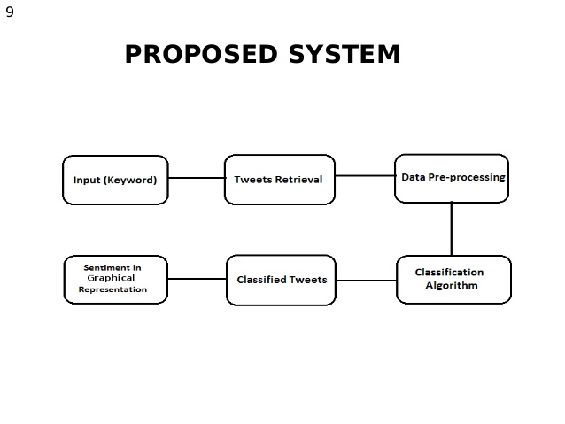
Architecture Diagram

Slide 11
Deep Learning
Model used-Logistic regression Model
R packages-text2vec and doc2vec
Train the model using 1.6million tweets
Tokenise the tweets into text using package
0=negative and 1=positive
Test the model to do cross validation

Slide 12
Problems in old approach
computes the number of positive and negative words and makes a conclusion based on their difference.
when using a simple vocabularies approach for a phrase “not bad” we’ll get a negative estimation.
results comparing to tweets analysis because they usually include lots of misspelling.

Slide 13
Technique used
training the model using Document-Term Matrix (DTM)
result of Vocabulary-based vectorization.
TF-IDF method for text preprocessing.
No need to train it every time you need to assess some tweets.

Slide 14
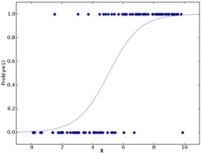
Logistic regression model

Slide 15
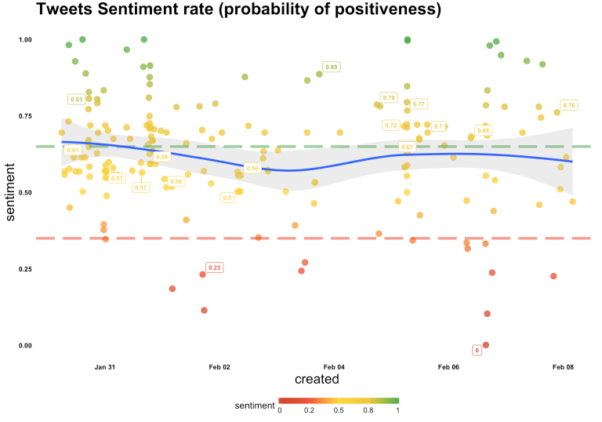
Probability of positiveness

Slide 16
References
International Conference on Computing, Communication and Automation (ICCCA2016)
Techniques for Sentiment Analysis of Twitter Data: A Comprehensive Survey

Slide 17
THANK YOU

