Slide 1
Independently Interpretable Lasso

Slide 2
INTRODUCTION
A common approach for high dimensional regression is Sparse Regularization as Lasso(least absolute shrinkage and selection operator).
It performs both parameter estimation and features selections simultaneously.
Advantages:
It offers interpretable results by identifying informative variables.
It can effectively avoid overfitting by discarding redundant variables.

Slide 3
INTRODUCTION
Disadvantages:
The performance of sparse regularization is guaranteed only under “small correlation” that is the features are not much correlated with each other.
Decomposability: When the features are highly correlated each coefficient cannot be seen as an independent variable contribution so that the model is no longer easy to interpret.

Slide 4
SOLUTION OF CORRELATION
Selecting several correlated variables results in worse generalization error because the redundant representation tends to give overfitting.
SOUTION
Either select all correlated variables or not select at all.
As Elastic Net, Pairwise Elastic Net and Trace Lasso
Advantage: Give better generalization error.
Disadvantage: This strategy makes it hard to interpret the model because many correlated variables are incorporated into the final model.

Slide 5
SOLUTION OF CORRELATION
Partially select correlated variables.
As Uncorrelated Lasso, Exclusive Group Lasso and Independently Interpretable Lasso
Uncorrelated Lasso: A model with uncorrelated variables to obtain decomposability but it tends to select “negatively” correlated variables.
Exclusive Group Lasso: Group variable whose correlation is beyond the threshold might produce unstable results.

Slide 6
Independently Interpretable Lasso
It does an efficient variable selection.
It does not select negatively correlated variables.
It is free from a specific preprocessing such as grouping.
More aggressively induce the sparsity of the active variables and reduce the correlations among them.
Hence, independently interpret the effects of active variables in the output model, and the generalization performance is also much improved.

Slide 7
ADVANTAGES
It achieves the sign consistency under a milder condition than Lasso.
Estimation error almost achieves minimax optimal rate and gives better performance than Lasso in some situations.
Every local optimal solution achieves the same statistical error rate as the global optimal solution.
It is almost minimax optimal though the objective function is not necessarily convex for the sake of better statistical properties.

Slide 8

FORMATION
Linear model y = Xβ + ϵ to predict y.
Where ϵ is noise and β is the regression coefficient.
Lasso solves:
Where λ > 0 is a regularization parameter.
Since the last penalty term induces the sparsity of estimated values, the output model contains few variables and hence is tractable.
Lasso can select correlated variables especially for a small λ resulting in worse interpretability and poor generalization error.

Slide 9


FORMATION
ULasso Regularization Formulation
New Regularization Formulation(IILasso)
Where α > 0 is a regularization parameter.
X is a monotonically increasing function of the absolute correlation.

Slide 10
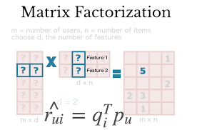
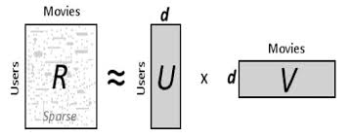


MODEL : Matrix Factorization
Regularization Formulation for Matrix Factorization.
Where:

Slide 11
MODEL
X is a monotonically increasing function of the absolute correlation.
In particular, when R_{j} and R_{k} are strongly correlated, the squared error does not change under the condition that p_{j} + p_{k} is constant, but the penalty X_{jk}|p_{j}||p_{k}| strongly induces either p_{j} = 0 or p_{k} = 0.
On the contrary, if R_{j} and R_{k} are uncorrelated, i.e., X_{jk} is small.
The penalty of selecting both pj and pk is negligible and the same applies for q.

Slide 12
SOLUTION
RATINGS BEFORE IILASSO
RATING | USER₁ | USER₂ | USER₃ | USER₄
MOVIE₁ | 5 | 3 | 0 | 1
MOVIE₂ | 4 | 0 | 0 | 1
MOVIE₃ | 1 | 1 | 0 | 5
MOVIE₄ | 1 | 0 | 0 | 4
MOVIE₅ | 0 | 1 | 5 | 4
RATINGS AFTER IILASSO
RATING | USER₁ | USER₂ | USER₃ | USER₄
MOVIE₁ | 5 (4.77) | 3 (3.18) | 1 (0.96) | 1 (1.12)
MOVIE₂ | 2 (2.24) | 2 (1.52) | 1 (0.64) | 1 (0.71)
MOVIE₃ | 1 (1.21) | 2 (1.54) | 5 (5.19) | 5 (5.16)
MOVIE₄ | 1 (0.88) | 1 (1.13) | 4 (3.90) | 4 (3.87)
MOVIE₅ | 0 (-0.04) | 1 (0.68) | 5 (4.78) | 5 (4.71)

Slide 13
RESULT
IILasso efficiency is better than all other efficiencies
Since we are considering correlation among variables in the regularization term.
RMS error for the taken example using
Lasso: 1.83
Ridge: 2.44
ULasso: 3.51
IILasso: 0.93
Increment of efficiency using IILasso is 41%.

Slide 14
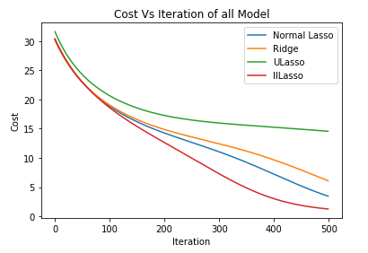
CONCLUSION
IILasso could construct accurate models with a few variables.
IILasso reduces correlations among the active variables.
The graph shows that on the same no. Of iterations, IILasso produces the least cost among all.

Slide 15
APPLICATION
Collaborative filtering
It is the task of making automatic predictions about the interests of a user by collecting taste information from many users.
System Identification
In control, one would like to fit a discrete-time linear time-invariant state-space model.
Netflix prize

Slide 16


