Slide 1
Independently Interpretable Lasso
Notes:
Introduction About Team.

Slide 2
INTRODUCTION
A common approach for high dimensional regression is Sparse Regularization as Lasso(least absolute shrinkage and selection operator).
It performs both parameter estimation and features selections simultaneously.
Advantages:
It offers interpretable results by identifying informative variables.
It can effectively avoid overfitting by discarding redundant variables.
Notes:
What is common approach in linear regression to do regulariztion. Add few point about regulariztion as reduction in overfitting.

Slide 3
INTRODUCTION
Disadvantages:
The performance of sparse regularization is guaranteed only under “small correlation” that is the features are not much correlated with each other.
Decomposability: The process of interpreting models. It represent the ability of how a model can be decomposed into several parts and its components can be interpreted separately.
Notes:
Disadvantage of previous method and decomsability. When the features are highly correlated each coefficient cannot be seen as an independent variable contribution so that the model is no longer easy to interpret.

Slide 4
SOLUTION OF CORRELATION
Selecting several correlated variables results in worse generalization error because the redundant representation tends to give overfitting.
SOLUTION
Either select all correlated variables or not select at all.
As Elastic Net, Pairwise Elastic Net and Trace Lasso
Advantage: Give better generalization error.
Disadvantage: This strategy makes it hard to interpret the model because many correlated variables are incorporated into the final model.
Notes:
Solutions of high correlation issue. Generaliztion error: measure of how accurately an algorithm is able to predict outcome values for previously unseen data as model inaccuracy, sampling error, and noise.

Slide 5
SOLUTION OF CORRELATION
Partially select correlated variables.
As Uncorrelated Lasso, Exclusive Group Lasso and Independently Interpretable Lasso
Uncorrelated Lasso: A model with uncorrelated variables to obtain decomposability but it tends to select “negatively” correlated variables.
Exclusive Group Lasso: Group variable whose correlation is beyond the threshold might produce unstable results.

Slide 6
Independently Interpretable Lasso
It does an efficient variable selection.
It does not select negatively correlated variables.
It is free from a specific preprocessing such as grouping.
More aggressively induce the sparsity of the active variables and reduce the correlations among them.
Hence, independently interpret the effects of active variables in the output model, and the generalization performance is also much improved.
Notes:
Comparision with other models.

Slide 7
ADVANTAGES
It achieves the sign consistency under a milder condition than Lasso.
Estimation error almost achieves minimax optimal rate and gives better performance than Lasso in some situations.
Every local optimal solution achieves the same statistical error rate as the global optimal solution.
It is almost minimax optimal though the objective function is not necessarily convex for the sake of better statistical properties.

Slide 8

FORMATION
Linear model y = Xβ + ϵ to predict y.
Where ϵ is noise and β is the regression coefficient.
Lasso solves:
Where λ > 0 is a regularization parameter.
Since the last penalty term induces the sparsity of estimated values, the output model contains few variables and hence is tractable.
Lasso can select correlated variables especially for a small λ resulting in worse interpretability and poor generalization error.
Notes:
Model with Lasso

Slide 9


FORMATION
ULasso Regularization Formulation
New Regularization Formulation(IILasso)
Where α > 0 is a regularization parameter.
X is a monotonically increasing function of the absolute correlation.
Notes:
With ULasso and IILasso

Slide 10
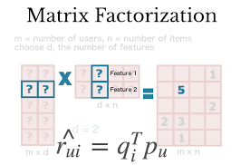
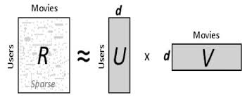
MODEL : Matrix Factorization
Basic model of matrix factorization Model of user ratings
Notes:
Our target model problem matrix factoriztion with rating of movie

Slide 11


MODEL : Matrix Factorization
Regularization Formulation for
Where:
R: model of user ratings.
p: Feature of movie.
q: Featurre of users.
α > 0 is a regularization parameter.
X₁ and X₂ are symmetry matrix.
Matrix Factorization.
We define X_{1jk} and X_{2jk} for j!=k as monotonically increasing function of the absolute correlation.
So correlated variables are hard to be selected simultaneously.
Notes:
Explaination of variables

Slide 12
MODEL
X_{1jk} and X_{2jk} are component of X₁ and X₂ respectively, represents the similarity between R_{j} and R_{k .}
When R_{j} and R_{k} are strongly correlated that is X_{jk} is high.
The squared error does not change under the condition that p_{j} + p_{k} is constant, but the penalty X_{jk}|p_{j}||p_{k}| strongly induces either p_{j} = 0 or p_{k} = 0.
On the contrary, if R_{j} and R_{k} are uncorrelated, i.e., X_{jk} is small.
The penalty of selecting both pj and pk is negligible and the same applies for q.

Slide 13
SOLUTION
RATINGS
RATING | USER₁ | USER₂ | USER₃ | USER₄
MOVIE₁ | 5 | 3 | - | 1
MOVIE₂ | 4 | - | - | 1
MOVIE₃ | 1 | 1 | - | 5
MOVIE₄ | 1 | - | - | 4
MOVIE₅ | - | 1 | 5 | 4
RATINGS AFTER IILASSO
RATING | USER₁ | USER₂ | USER₃ | USER₄
MOVIE₁ | 5 (4.77) | 3 (3.18) | 1 (0.96) | 1 (1.12)
MOVIE₂ | 2 (2.24) | 2 (1.52) | 1 (0.64) | 1 (0.71)
MOVIE₃ | 1 (1.21) | 2 (1.54) | 5 (5.19) | 5 (5.16)
MOVIE₄ | 1 (0.88) | 1 (1.13) | 4 (3.90) | 4 (3.87)
MOVIE₅ | 0 (-0.04) | 1 (0.68) | 5 (4.78) | 5 (4.71)
Notes:
Explaining Part of code

Slide 14
RESULT
IILasso efficiency is better than all other efficiencies
Since we are considering correlation among variables in the regularization term.
RMS error for the taken example using
Lasso: 1.83
Ridge: 2.44
ULasso: 3.51
IILasso: 0.93
Increment of efficiency using IILasso is 41%.
Notes:
Effieciency in terms of generalization error

Slide 15
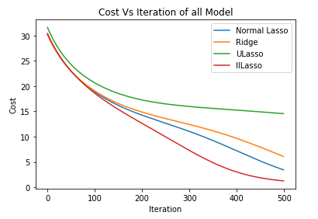
CONCLUSION
IILasso could construct accurate models with a few variables.
IILasso reduces correlations among the active variables.
The graph shows that on the same no. Of iterations, IILasso produces the least cost among all.
Notes:
Conclusion and comparision as per error

Slide 16
APPLICATION
Collaborative filtering
It is the task of making automatic predictions about the interests of a user by collecting taste information from many users.
Image background removal
SVD offers a neat way to separate the background and foreground from a video.
Eigen Faces
It is used in the computer vision problem of human face recognition.
Notes:
Split a video into frames (which are just a collection of images), make each image into a 1-D vector, and horizontally stack into a matrix those 1-D vectors corresponding to each image. Then we do SVD to separate the foreground or background.

Slide 17


