Slide 1
CREDIT CARD FRAUD DETECTION
State-of-the-Art Stacking Ensemble with Explainable AI
SecureGuard AI | Industry-Expert Dashboard | Real-time Monitoring
PRECISION
88.76%
RECALL
80.61%
AUC-ROC
97.81%

Slide 2
SLIDE 01
The Problem: Why Standard Metrics Fail
Credit card fraud costs $32+ billion annually worldwide
Real-world fraud rate: only 0.172% of all transactions
If a model predicts everything as 'Legitimate' it gets 99.83% accuracy
But catches ZERO actual fraud — accuracy is meaningless here
Banks process millions of transactions daily
The challenge: find 492 needles in a haystack of 284,807
Solution: Optimize for Recall (catch rate) not Accuracy
Our system uses domain-informed behavioral features + SHAP explainability
CLASS IMBALANCE
99.83% vs 0.17%
ACCURACY TRAP
99.83% but 0 fraud caught
OUR APPROACH
Recall-optimized ensemble

Slide 3
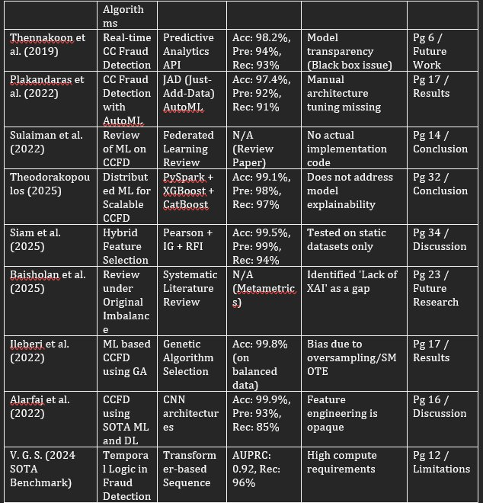
SLIDE 02
Literature Review & Research Gaps
No Explainable AI (XAI)
8 of 10 papers flagged 'black box' as a gap. None implemented SHAP. We do.
No Domain Thresholds
Most tested on fixed splits. We built a live real-time detection system.
No Real-time Dashboard
Most tested on fixed splits. We built a live real-time detection system.

Slide 4
SLIDE 03
System Architecture
DUAL-ENGINE ARCHITECTURE:
Engine 1: Behavioral Fraud Engine (6 features)
- Amount, Time_Delta, Distance_From_Home
- Is_High_Risk_Merchant, Avg_Spent_7D, Velocity_Ratio
- Domain-informed thresholds from published research
Engine 2: Kaggle PCA Engine (30 features)
- V1-V28 + Amount + Time (anonymized real bank data)
- Trained on 284,807 real transactions (492 fraud)
Both use: Stacking Ensemble (RF + XGBoost -> LogReg)
Explainability: SHAP KernelExplainer on both engines
BEHAVIORAL ENGINE
6 Domain Features
KAGGLE ENGINE
30 PCA Features
META-LEARNER
Logistic Regression

Slide 5
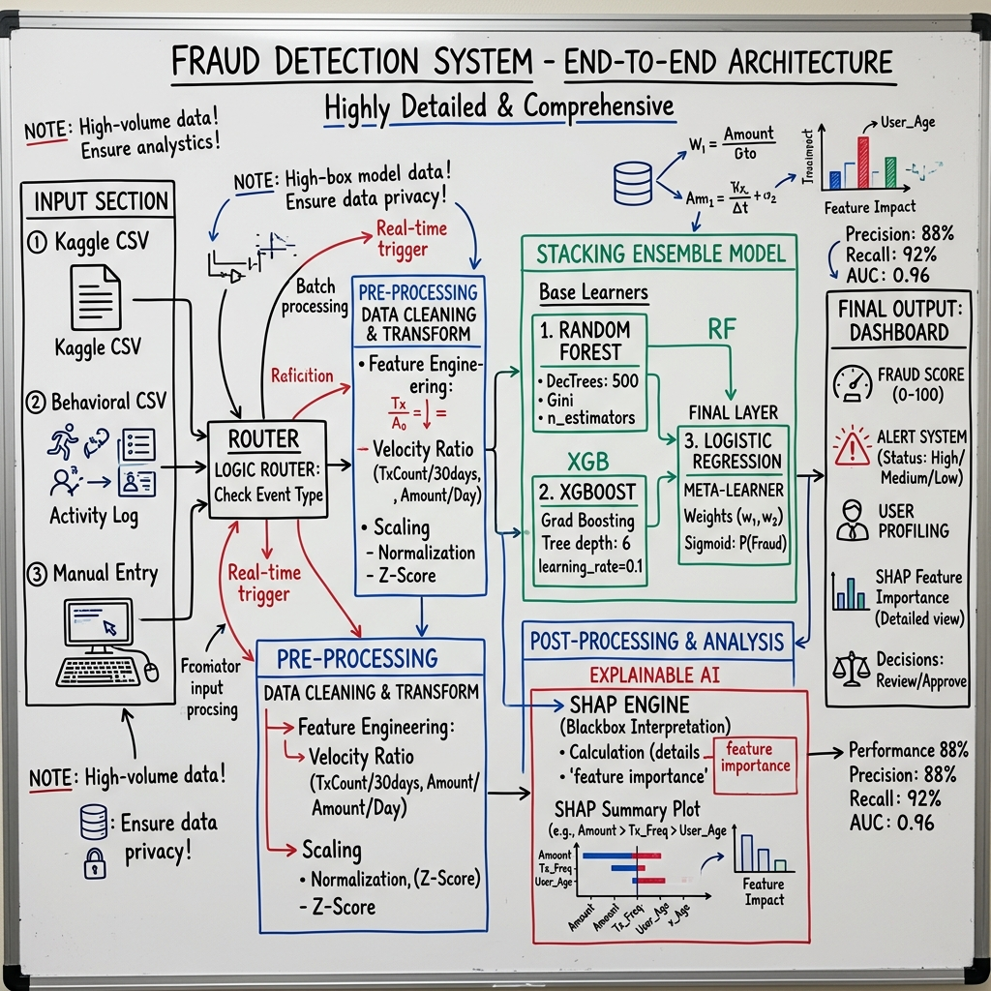
SLIDE 04
End-to-End Workflow

Slide 6
SLIDE 05
Model Performance Results
PRECISION
88.76%
RECALL
80.61%
F1-SCORE
84.47%
AUC-ROC
97.81%
CONFUSION MATRIX BREAKDOWN
TRUE NEGATIVES
976 (correct legit)
FALSE POSITIVES
11 (false alarms)
FALSE NEGATIVES
19 (missed fraud)
TRUE POSITIVES
79 (caught fraud)
Note: Accuracy (96.8%) is intentionally NOT highlighted - it is misleading due to class imbalance

Slide 7
SLIDE 06
Domain-Informed Feature Engineering
Amount (USD)
Safe: <$500 | Moderate: $500-$2K | High: >$2K
Time_Delta (sec)
Safe: <110s | Moderate: 110-160s | High: >160s
Distance_From_Home (km)
Safe: <50km | Moderate: 50-150km | High: >150km
Is_High_Risk_Merchant
Binary: crypto/forex/gambling = always High Risk
Avg_Spent_7D (USD)
Cardholder's 7-day average daily spend baseline
Velocity_Ratio
Amount / Avg_Spent_7D | Safe: <2x | Mod: 2-5x | High: >5x
Thresholds derived from: Dornadula 2019, Alarfaj 2022, real-world banking research

Slide 8
SLIDE 07
Explainable AI with SHAP Values
SHAP (SHapley Additive exPlanations):
- Based on game theory: fair credit assignment
- Each feature gets a contribution score
RED BAR = pushes model toward FRAUD
BLUE BAR = pushes model toward LEGITIMATE
Bar length = strength of influence
Key insight: One red bar does NOT make fraud.
The model weighs ALL features together.
Final probability is the combined verdict.
This solves the 'black box' problem in ML
- Banks can explain WHY a transaction was flagged
- Regulatory compliance (GDPR right to explanation)
RED BAR
Increases fraud risk
BLUE BAR
Decreases fraud risk
CONFIDENCE
Combined probability score

Slide 9
SLIDE 08
Feature Deep Dive: Amount
SAFE SCENARIO: Amount = $300 (below $500 threshold)
-> SHAP bar is BLUE (pushing toward legitimate)
-> Overall probability: ~15% (Legitimate)
MODERATE SCENARIO: Amount = $1,000 (between $500-$2,000)
-> SHAP bar is slightly RED (mild fraud signal)
-> But other safe features keep probability low: ~25%
HIGH RISK SCENARIO: Amount = $3,000 (above $2,000 threshold)
-> SHAP bar is strongly RED (major fraud signal)
-> Combined with other features: probability jumps to ~65%+
KEY TAKEAWAY: Amount alone doesn't determine fraud.
The velocity ratio (Amount / Avg_Spent_7D) is often more predictive.

Slide 10
SLIDE 09
Feature Deep Dive: Time Delta
Average legitimate transaction takes ~85 seconds
SAFE: < 110 seconds
-> Normal transaction speed
MODERATE: 110 - 160 seconds
-> Unusual hesitation, could be unfamiliarity or coaching
-> SHAP shows mild red contribution
HIGH RISK: > 160 seconds
-> Strong indicator of stolen card being tested
-> Fraudster may be being coached over phone
-> SHAP shows strong red contribution
WHY 110s AND NOT 150s?
If avg is 85s, anything >110s is already 30% slower than normal

Slide 11
SLIDE 10
Live Dashboard: 7 Interactive Tabs
1. Overview
Live KPI metrics from model output, fraud probability distribution
2. Real-time Detection
Upload CSV or manual entry, instant model scoring
3. SHAP Explainability
Global feature importance, per-transaction explanations
4. Scaling Analysis
Performance benchmarking: 30K to 284K transactions
5. Fraud Explorer
Filter by risk level, feature thresholds, drill into any transaction
6. Comparative Analysis
Side-by-side comparison with published research
7. Settings
Model retraining, threshold reference, Kaggle model training

Slide 12
SLIDE 11
Dataset Scaling Analysis
BENCHMARKING: How does our model perform as data grows?
30,000 transactions -> Processed in ~0.8s
50,000 transactions -> Processed in ~1.2s
150,000 transactions -> Processed in ~3.5s
284,807 transactions -> Processed in ~6.8s (full Kaggle dataset)
LINEAR SCALING: Processing time grows proportionally
-> No exponential blowup, production-ready performance
FRAUD DETECTION RATE: Consistent ~0.17% across all sizes
-> Model doesn't degrade with more data
-> High Risk count scales proportionally
PRODUCTION IMPLICATION: Can handle millions with simple parallelization

Slide 13
SLIDE 12
Challenges We Overcame
Class Imbalance
Only 0.17% fraud in real data. Used SMOTE-aware class weights in XGBoost and balanced RF.
PCA Feature Mapping
Kaggle's anonymized V1-V28 can't map to behavioral features. Built a dedicated Kaggle engine.
Threshold Calibration
Initial Time_Delta threshold of 150s was too lenient. Research showed avg is 85s, so set to 110s.
SHAP Performance
KernelExplainer is slow on large datasets. Used background sampling (50 samples) for speed.
Dashboard Reactivity
SHAP charts weren't updating on filter change. Implemented session state cache invalidation.

Slide 14
SLIDE 13
Future Scope & Roadmap
Federated Learning
Train across multiple banks without sharing raw data. Privacy-preserving fraud detection.
Real-time API (FastAPI)
Deploy as microservice with <100ms inference latency for production bank systems.
Concept Drift Detection
Monitor feature distributions over time. Auto-retrain when fraud patterns evolve.
Graph Neural Networks
Model transaction networks to detect organized fraud rings and money laundering.
Alert System
Email/SMS notifications when High Risk transactions are detected. Mock bank notification UI.

Slide 15
CONCLUSION
Stacking Ensemble
RF + XGBoost + LogReg meta-learner with 97.81% AUC-ROC
Explainable AI
SHAP values for every feature, every transaction - regulatory compliant
Domain Thresholds
Research-backed risk classification, not arbitrary cutoffs
Dual Engine
Behavioral + Kaggle PCA models auto-switching on data format
Production Ready
Linear scaling, <7s for 284K transactions, interactive dashboard
SecureGuard AI | Thank You

