Slide 1


Date : 15 August 2026

Slide 2

Daily Summary Sheet (15 August 2026)
Daily Activity Sheet Summary (15 Aug 2026)
 |  |  |  |  |  | Enquiry |  |  |  |  | Test Rides |  |  | Bookings |  | Retail |  |  |  |  |  | LMS |  |  | Retail
Sr.No | Dealer | Location | State | Zone | BG Team Member | Canopy /Mela | Planned | Actual | Per Canopy | Hot | Planned | Actual | Per Canopy | Today | In Hand | Today | MTD (Activity) | MTD | Retail Rate Per Canopy | Activity Day | Closing Stock | Leads | Punched | Gap | Conv %
1 | Shreeji Motors Private Limited | Vadodara | GJ | North | Soyeb | 2 | 70 | 65 | 33 | 2 | 60 | 55 | 28 | 3 | 9 | 2 | 15 | 15 | 0.5 | 15 | 24 | 1115 | 1100 | 15 | 1%
2 | Seth Brother | Ashoknagar | MP | West | Aditya | 1 | 35 | 70 | 70 | 2 | 30 | 55 | 55 | 1 | 9 | 0 | 15 | 15 | 1.0 | 15 | 24 | 1120 | 1105 | 15 | 1%
3 | D2 Galaxy | Nanded | MH | West | Om Kamble | 3 | 105 | 60 | 20 | 2 | 90 | 55 | 18 | 1 | 9 | 1 | 15 | 15 | 0.3 | 15 | 24 | 1110 | 1095 | 15 | 1%
 | Total (3) |  |  |  |  | 6 | 210 | 195 | 33 | 6 | 180 | 165 | 28 | 5 | 27 | 3 | 45 | 45 | 0.5 |  |  | 3345 | 3300 | 45

Slide 3
Lead Report (15 August 2026)
Statewise Planned leads vs Actual till 15 Aug 2026 EoD
State | Leads Month Targets | Leads MTD Target | Walkin |  |  | BTL |  |  | Referral |  |  | ATL |  |  | Digital |  |  | Total Leads Received | Leads Variance | Leads Achievement % | Leads Achievement % MTD | Aug 26 Retail Targets | MTD Retail Targets | MTD Retail Achieved | MTD Retail Achievement % | Retails/ Enquiries %
 |  |  | Target | MTD Target | MTD Ach. | Target | MTD Target | MTD Ach. | Target | MTD Target | MTD Ach. | Target | MTD Target | MTD Ach. | Target | MTD Target | MTD Ach.
Maharashtra | 3000 | 1440 | 300 | 144 | 120 | 1500 | 720 | 600 | 30 | 15 | 9 | 270 | 129 | 90 | 900 | 432 | 900 | 1719 | -1281 | 57% | 119% | 150 | 72 | 60 | 83% | 3%
Gujarat | 2000 | 960 | 200 | 96 | 80 | 1000 | 480 | 400 | 20 | 10 | 6 | 180 | 86 | 60 | 600 | 288 | 600 | 1146 | -854 | 57% | 119% | 100 | 48 | 40 | 83% | 3%
Tamil Nadu | 1000 | 480 | 100 | 48 | 40 | 500 | 240 | 200 | 10 | 5 | 3 | 90 | 43 | 30 | 300 | 144 | 300 | 573 | -427 | 57% | 119% | 50 | 24 | 20 | 83% | 3%
Grand Total | 6000 | 2880 | 600 | 288 | 240 | 3000 | 1440 | 1200 | 60 | 30 | 18 | 540 | 258 | 180 | 1800 | 864 | 1800 | 3438 | -2562 | 57% | 119% | 300 | 144 | 120 | 83% | 3%
MTD Ach % |  |  |  |  | 83% |  |  | 83% |  |  | 60% |  |  | 70% |  |  | 208%

Slide 4

Shreeji Motors Private Limited, Vadodara
Road Show
SHREEJI MOTORS PRIVATE LIMITED VADODARA (GJ) |  |  |  |  |  |  |  |  |  | BG - Soyeb
Date | Opening Stock | Enquiry |  |  |  |  |  |  |  | Test Drive |  | Booking |  | Retail | MTD Retail
 |  | Canopy | Planned | Actual | Walk in | In LMS | Gap | Hot | Revised Hot | Planned | Actual | Today | In hand
01-08-2026 | 39 | 2 | 70 | 65 | 1 | 64 | -1 | 2 | 1 | 60 | 41 | 1 | 1 | 0
02-08-2026 | 38 | 2 | 70 | 70 | 2 | 68 | -2 | 2 | 1 | 60 | 42 | 2 | 2 | 1 | 1
03-08-2026 | 37 | 2 | 70 | 75 | 0 | 75 | 0 | 2 | 1 | 60 | 43 | 3 | 3 | 2 | 3
04-08-2026 | 36 | 2 | 70 | 80 | 1 | 79 | -1 | 2 | 1 | 60 | 44 | 0 | 3 | 0 | 3
05-08-2026 | 35 | 2 | 70 | 85 | 2 | 83 | -2 | 2 | 1 | 60 | 45 | 1 | 3 | 1 | 4
06-08-2026 | 34 | 2 | 70 | 90 | 0 | 90 | 0 | 2 | 1 | 60 | 46 | 2 | 3 | 2 | 6
07-08-2026 | 33 | 2 | 70 | 60 | 1 | 59 | -1 | 2 | 1 | 60 | 47 | 3 | 6 | 0 | 6
08-08-2026 | 32 | 2 | 70 | 65 | 2 | 63 | -2 | 2 | 1 | 60 | 48 | 0 | 5 | 1 | 7
09-08-2026 | 31 | 2 | 70 | 70 | 0 | 70 | 0 | 2 | 1 | 60 | 49 | 1 | 4 | 2 | 9
10-08-2026 | 30 | 2 | 70 | 75 | 1 | 74 | -1 | 2 | 1 | 60 | 50 | 2 | 6 | 0 | 9
11-08-2026 | 29 | 2 | 70 | 80 | 2 | 78 | -2 | 2 | 1 | 60 | 51 | 3 | 8 | 1 | 10
12-08-2026 | 28 | 2 | 70 | 85 | 0 | 85 | 0 | 2 | 1 | 60 | 52 | 0 | 6 | 2 | 12
13-08-2026 | 27 | 2 | 70 | 90 | 1 | 89 | -1 | 2 | 1 | 60 | 53 | 1 | 7 | 0 | 12
14-08-2026 | 26 | 2 | 70 | 60 | 2 | 58 | -2 | 2 | 1 | 60 | 54 | 2 | 8 | 1 | 13
15-08-2026 | 25 | 2 | 70 | 65 | 0 | 65 | 0 | 2 | 1 | 60 | 55 | 3 | 9 | 2 | 15
16-08-2026 | 24 |  | 0 |  |  |  | 0 |  |  | 0
17-08-2026 | 23 |  | 0 |  |  |  | 0 |  |  | 0
18-08-2026 | 22 |  | 0 |  |  |  | 0 |  |  | 0
Total |  | 30 | 1050 | 1115 | 15 | 1100 | -15 | 30 | 15 | 900 | 720 | 24 | 9 | 15
Avg Per Canopy |  |  | 35 | 37 | 0.5 |  |  | 1 | 0.5 | 30 | 24 | 0.8 |  | 0.5

Slide 5
Seth Brother, Ashoknagar
Canopy
SETH BROTHER ASHOKNAGAR (MP) |  |  |  |  |  |  |  |  |  | BG - Aditya
Date | Opening Stock | Enquiry |  |  |  |  |  |  |  | Test Drive |  | Booking |  | Retail | MTD Retail
 |  | Canopy | Planned | Actual | Walk in | In LMS | Gap | Hot | Revised Hot | Planned | Actual | Today | In hand
01-08-2026 | 39 | 1 | 35 | 63 | 1 | 62 | -1 | 2 | 1 | 30 | 41 | 3 | 2 | 1 | 1
02-08-2026 | 38 | 1 | 35 | 66 | 2 | 64 | -2 | 2 | 1 | 30 | 42 | 2 | 2 | 2 | 3
03-08-2026 | 37 | 1 | 35 | 69 | 0 | 69 | 0 | 2 | 1 | 30 | 43 | 1 | 3 | 0 | 3
04-08-2026 | 36 | 1 | 35 | 72 | 1 | 71 | -1 | 2 | 1 | 30 | 44 | 0 | 2 | 1 | 4
05-08-2026 | 35 | 1 | 35 | 75 | 2 | 73 | -2 | 2 | 1 | 30 | 45 | 3 | 3 | 2 | 6
06-08-2026 | 34 | 1 | 35 | 78 | 0 | 78 | 0 | 2 | 1 | 30 | 46 | 2 | 5 | 0 | 6
07-08-2026 | 33 | 1 | 35 | 81 | 1 | 80 | -1 | 2 | 1 | 30 | 47 | 1 | 5 | 1 | 7
08-08-2026 | 32 | 1 | 35 | 84 | 2 | 82 | -2 | 2 | 1 | 30 | 48 | 0 | 3 | 2 | 9
09-08-2026 | 31 | 1 | 35 | 87 | 0 | 87 | 0 | 2 | 1 | 30 | 49 | 3 | 6 | 0 | 9
10-08-2026 | 30 | 1 | 35 | 90 | 1 | 89 | -1 | 2 | 1 | 30 | 50 | 2 | 7 | 1 | 10
11-08-2026 | 29 | 1 | 35 | 93 | 2 | 91 | -2 | 2 | 1 | 30 | 51 | 1 | 6 | 2 | 12
12-08-2026 | 28 | 1 | 35 | 61 | 0 | 61 | 0 | 2 | 1 | 30 | 52 | 0 | 6 | 0 | 12
13-08-2026 | 27 | 1 | 35 | 64 | 1 | 63 | -1 | 2 | 1 | 30 | 53 | 3 | 8 | 1 | 13
14-08-2026 | 26 | 1 | 35 | 67 | 2 | 65 | -2 | 2 | 1 | 30 | 54 | 2 | 8 | 2 | 15
15-08-2026 | 25 | 1 | 35 | 70 | 0 | 70 | 0 | 2 | 1 | 30 | 55 | 1 | 9 | 0 | 15
16-08-2026 | 24 |  | 0 |  |  |  | 0 |  |  | 0
17-08-2026 | 23 |  | 0 |  |  |  | 0 |  |  | 0
18-08-2026 | 22 |  | 0 |  |  |  | 0 |  |  | 0
Total |  | 15 | 525 | 1120 | 15 | 1105 | -15 | 30 | 15 | 450 | 720 | 24 | 9 | 15
Avg Per Canopy |  |  | 35 | 75 | 1 |  |  | 2 | 1 | 30 | 48 | 1.6 |  | 1

Slide 6
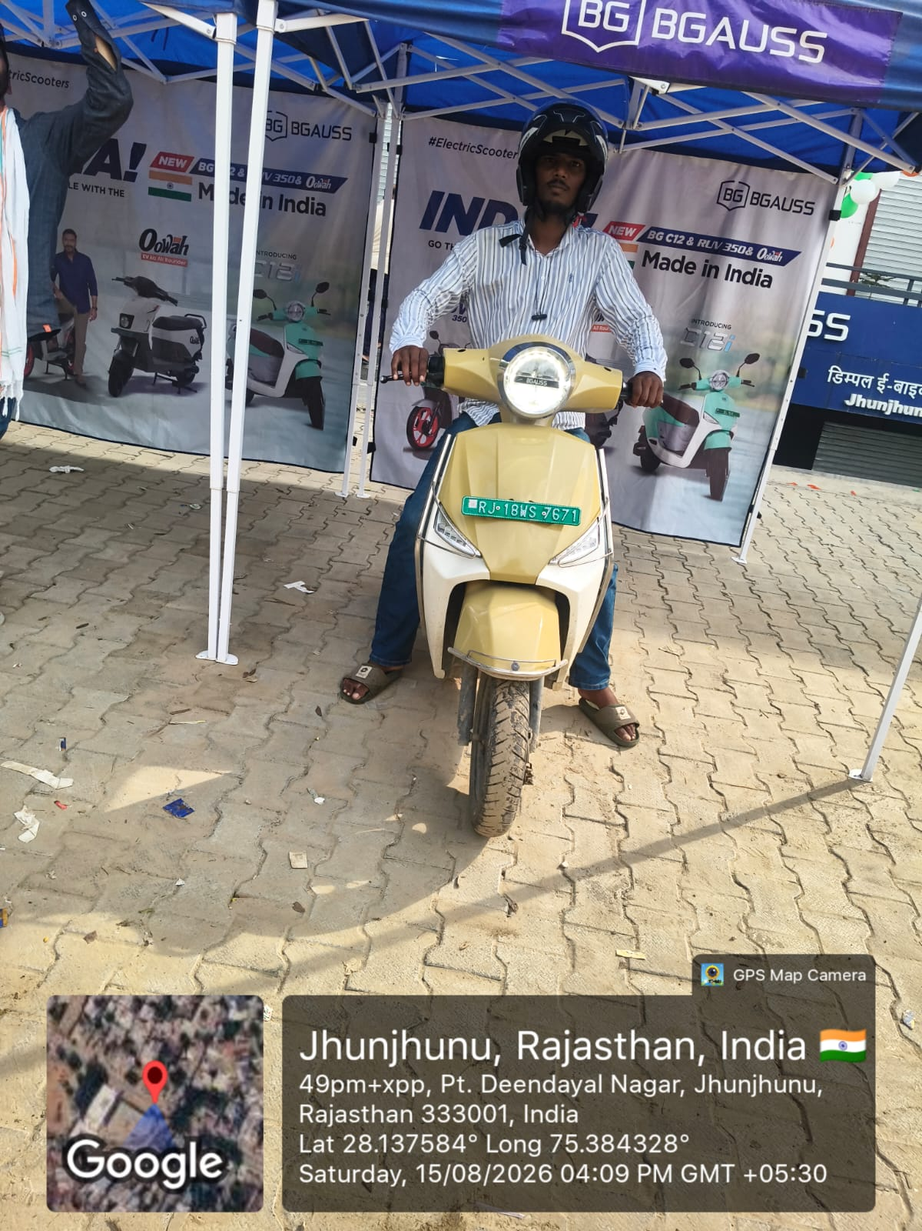
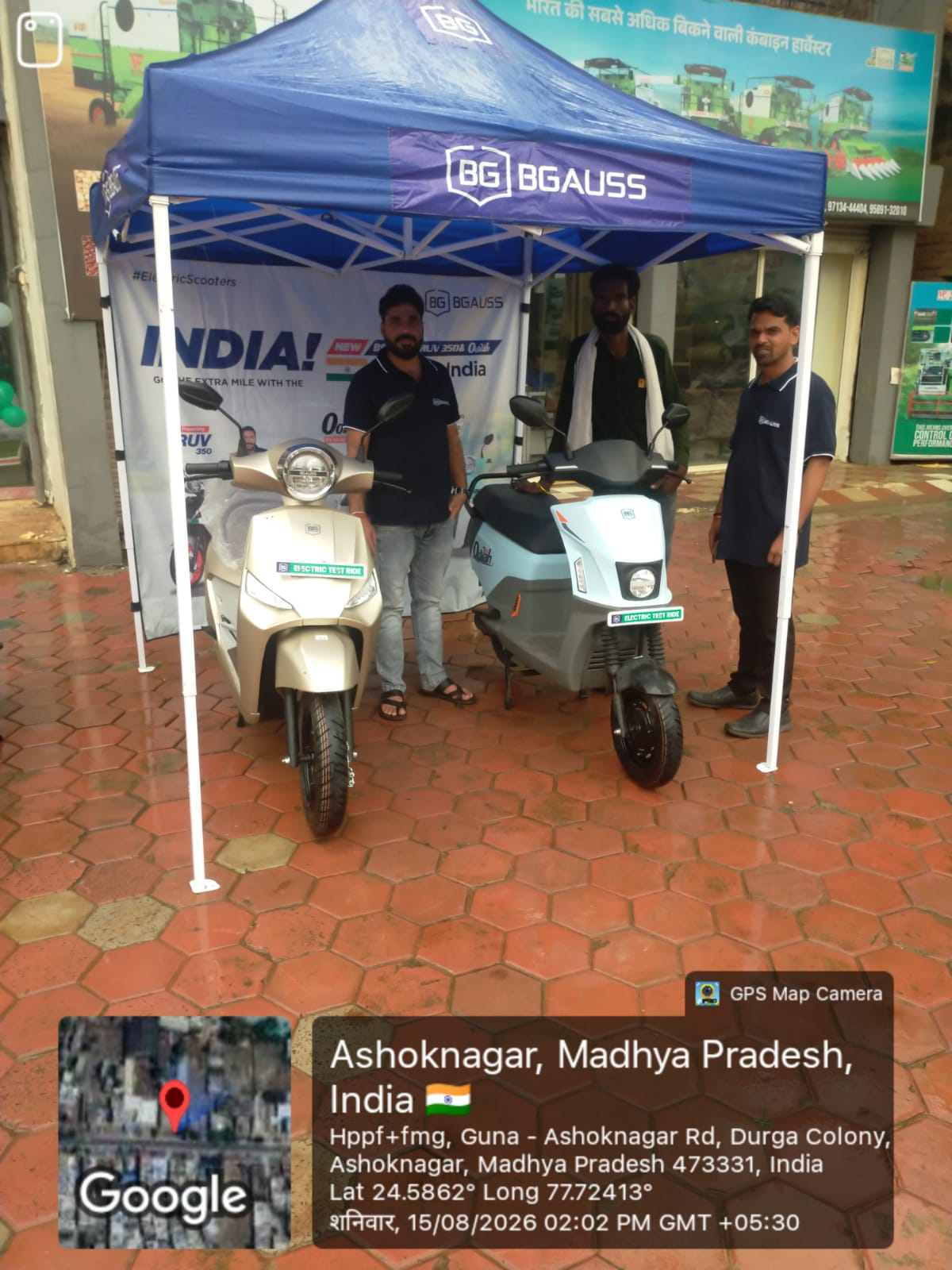
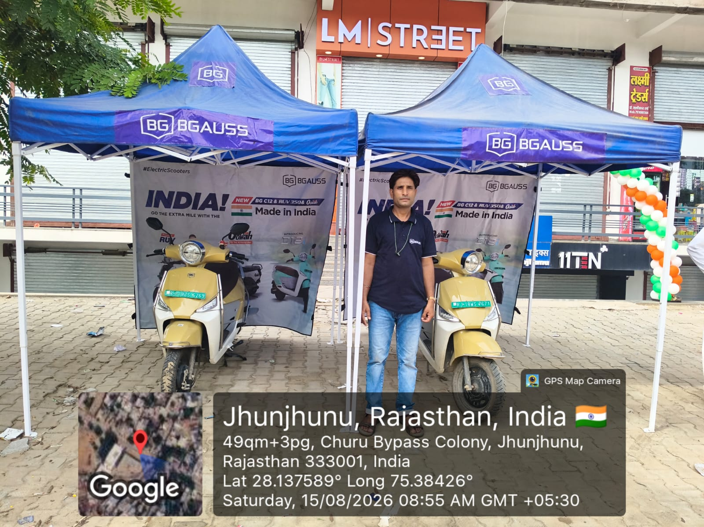
Seth Brother, Ashoknagar
15 Aug, 05:30 am · No GPS
15 Aug, 06:30 am · No GPS
15 Aug, 07:30 am · No GPS

Slide 7
D2 Galaxy, Nanded
Canopy
D2 GALAXY NANDED (MH) |  |  |  |  |  |  |  |  |  | BG - Om Kamble
Date | Opening Stock | Enquiry |  |  |  |  |  |  |  | Test Drive |  | Booking |  | Retail | MTD Retail
 |  | Canopy | Planned | Actual | Walk in | In LMS | Gap | Hot | Revised Hot | Planned | Actual | Today | In hand
01-08-2026 | 39 | 3 | 105 | 67 | 1 | 66 | -1 | 2 | 1 | 90 | 41 | 3 | 1 | 2 | 2
02-08-2026 | 38 | 3 | 105 | 74 | 2 | 72 | -2 | 2 | 1 | 90 | 42 | 2 | 3 | 0 | 2
03-08-2026 | 37 | 3 | 105 | 81 | 0 | 81 | 0 | 2 | 1 | 90 | 43 | 1 | 3 | 1 | 3
04-08-2026 | 36 | 3 | 105 | 88 | 1 | 87 | -1 | 2 | 1 | 90 | 44 | 0 | 1 | 2 | 5
05-08-2026 | 35 | 3 | 105 | 60 | 2 | 58 | -2 | 2 | 1 | 90 | 45 | 3 | 4 | 0 | 5
06-08-2026 | 34 | 3 | 105 | 67 | 0 | 67 | 0 | 2 | 1 | 90 | 46 | 2 | 5 | 1 | 6
07-08-2026 | 33 | 3 | 105 | 74 | 1 | 73 | -1 | 2 | 1 | 90 | 47 | 1 | 4 | 2 | 8
08-08-2026 | 32 | 3 | 105 | 81 | 2 | 79 | -2 | 2 | 1 | 90 | 48 | 0 | 4 | 0 | 8
09-08-2026 | 31 | 3 | 105 | 88 | 0 | 88 | 0 | 2 | 1 | 90 | 49 | 3 | 6 | 1 | 9
10-08-2026 | 30 | 3 | 105 | 60 | 1 | 59 | -1 | 2 | 1 | 90 | 50 | 2 | 6 | 2 | 11
11-08-2026 | 29 | 3 | 105 | 67 | 2 | 65 | -2 | 2 | 1 | 90 | 51 | 1 | 7 | 0 | 11
12-08-2026 | 28 | 3 | 105 | 74 | 0 | 74 | 0 | 2 | 1 | 90 | 52 | 0 | 6 | 1 | 12
13-08-2026 | 27 | 3 | 105 | 81 | 1 | 80 | -1 | 2 | 1 | 90 | 53 | 3 | 7 | 2 | 14
14-08-2026 | 26 | 3 | 105 | 88 | 2 | 86 | -2 | 2 | 1 | 90 | 54 | 2 | 9 | 0 | 14
15-08-2026 | 25 | 3 | 105 | 60 | 0 | 60 | 0 | 2 | 1 | 90 | 55 | 1 | 9 | 1 | 15
16-08-2026 | 24 |  | 0 |  |  |  | 0 |  |  | 0
17-08-2026 | 23 |  | 0 |  |  |  | 0 |  |  | 0
18-08-2026 | 22 |  | 0 |  |  |  | 0 |  |  | 0
Total |  | 45 | 1575 | 1110 | 15 | 1095 | -15 | 30 | 15 | 1350 | 720 | 24 | 9 | 15
Avg Per Canopy |  |  | 35 | 25 | 0.3 |  |  | 0.7 | 0.3 | 30 | 16 | 0.5 |  | 0.3

Slide 8
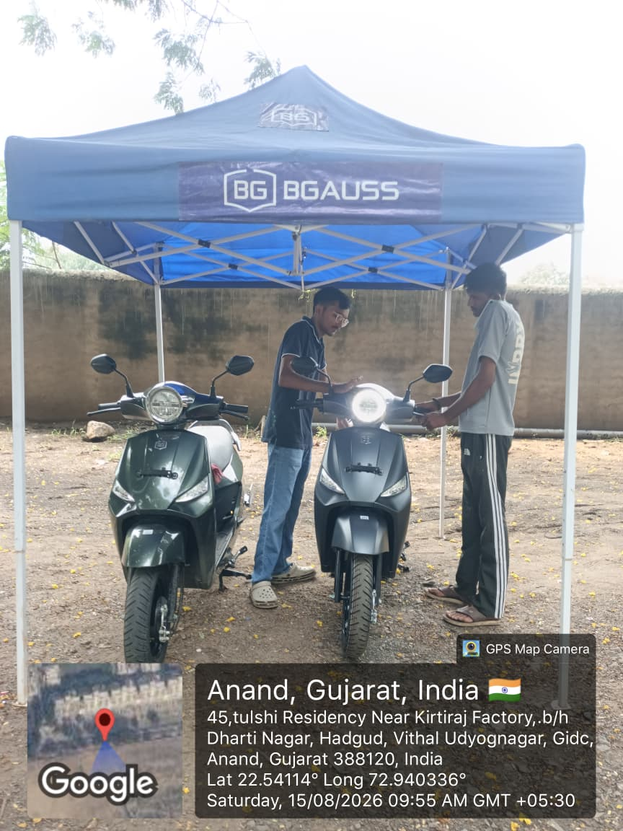
D2 Galaxy, Nanded
15 Aug, 05:30 am · GPS 19.18000, 77.30000
15 Aug, 06:30 am · GPS 19.19000, 77.30000
15 Aug, 07:30 am · GPS 19.20000, 77.30000
15 Aug, 08:30 am · GPS 19.21000, 77.30000

Slide 9
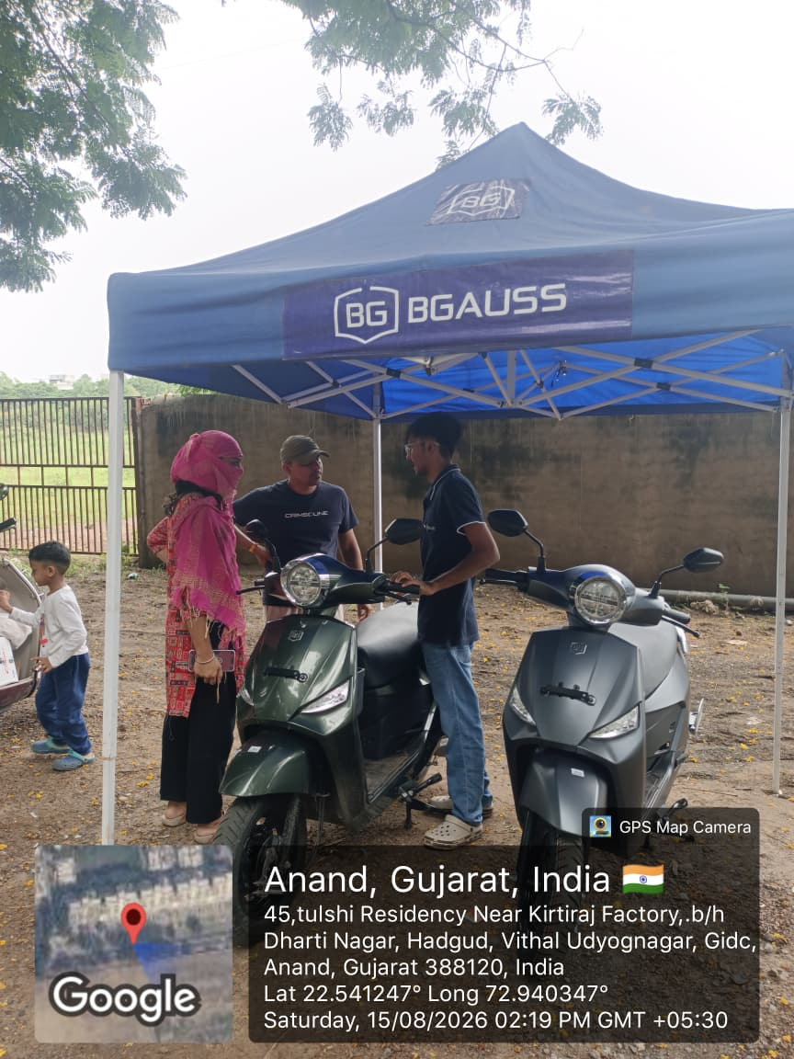
D2 Galaxy, Nanded
15 Aug, 09:30 am · GPS 19.22000, 77.30000

Slide 10

#Electricvehicles

