Slide 1
Theme: Environment
Data Visualization Lab
By:
Mayank Bansal
224161006

Slide 2
Why Do We Care?
India is still mostly an Agrarian Economy and relies heavily on the Rainfall for production in that sector.
As per the Article 21 of Indian Constitution, every person has the “Right To Live”, which includes access to Clean air and Water, so we need to ensure that people have that in plenty.
India has agreed to adopt UN’s 2030 Agenda for Sustainable Development, which includes 17 Sustainable Development Goals to develop India in a Sustainable Manner which means – “Fulfilling the needs of Today without Sacrificing the needs of tomorrow”.
Apart from all this, we as living beings are a part of the environment, taking all the resources we need to survive, so its our duty as the Superior Species to take care of the environment, as we our not the owners of the environment but the borrowers.

Slide 3
Data Sets
We have used a combination of given datasets as well as some additional datasets taken from authentic sources such as Government Websites and Surveys.
Following are the datasets that have been used:-
Given Datasets:
Rainfall Distribution (Yearly)
Rainfall Distribution (District wise)
Extra Data Sets Used:
Agriculture Production
Carbon Emissions
Climate Change

Slide 4
Role of Additional Datasets in the Overall Picture
Climate Change – We cannot talk about environment without talking about Global Warming and climate change. This has been the biggest concern and we will use this dataset to see its impact on India’s Environmental Picture.
Carbon Emissions - India has signed various International Treaties and Agreements to curb the carbon emissions which is the major contributor in deterioration of our Environment. We will use this data to see how sustainable is India’s Development Story has been and how are we handling that.
Agriculture – A country where more than half of the population still rely of Agriculture as primary income, we need to see how the changes in the environment impacts that.
Forest and Natural Vegetation – Our forests are our natural defense from various calamities along with being the lungs for our environment. We will the impact on and of this on overall Environmental Picture of India

Slide 5
What is the Story?
Environment is a complex combination of different aspects we have all around us and all them interact with each other and are affected by each other.
We have tried to give respect to each of these aspects to give as good a picture we can about the Environmental Story of our country
Rainfall and Agriculture are the two characters working together in one half of the story telling us the picture on the ground.
Climate Change and Carbon Emissions are other two characters which tells us the story of the future and big picture.

Slide 6
Rainfall
India has been very lucky in terms of rainfall. Our Monsoon is a unique phenomenon that happens only in India and this is why in almost parts of the country people are dependent on the rainfall directly or indirectly through Rain fed rivers.
Although rainfall distribution is not uniform and different regions receive different amounts of rain and most of the regions have adapted themselves to that.
But in recent years there has been a decrease in overall rainfall received and this has affected different regions in different ways.
Agriculture is the main character which is heavily affected by the rains. Although use of alternate sources of water have somehow led to decline in this dependency in some states which is “Not Good” in Environmentalist sense.
Let’s Look at some visuals!!

Slide 7
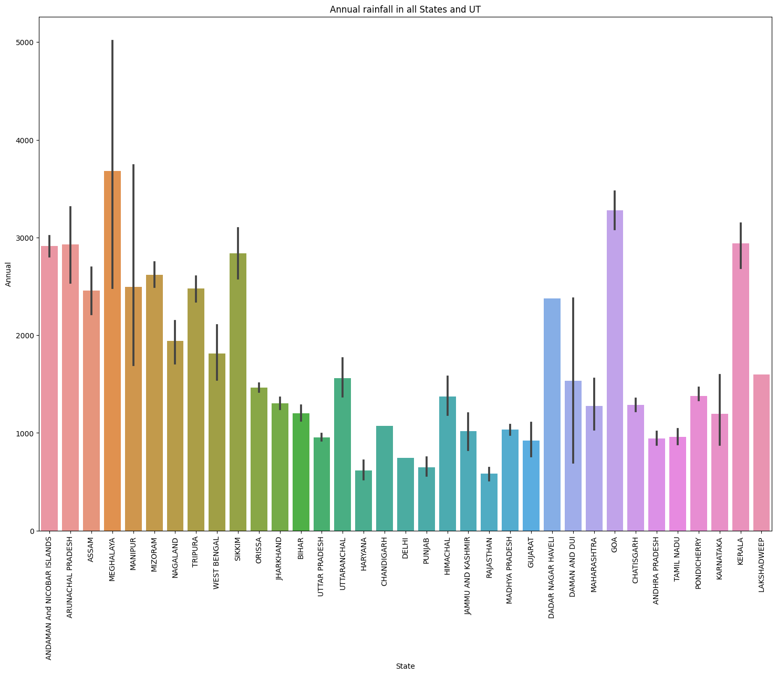
Rainfall Distribution

Slide 8
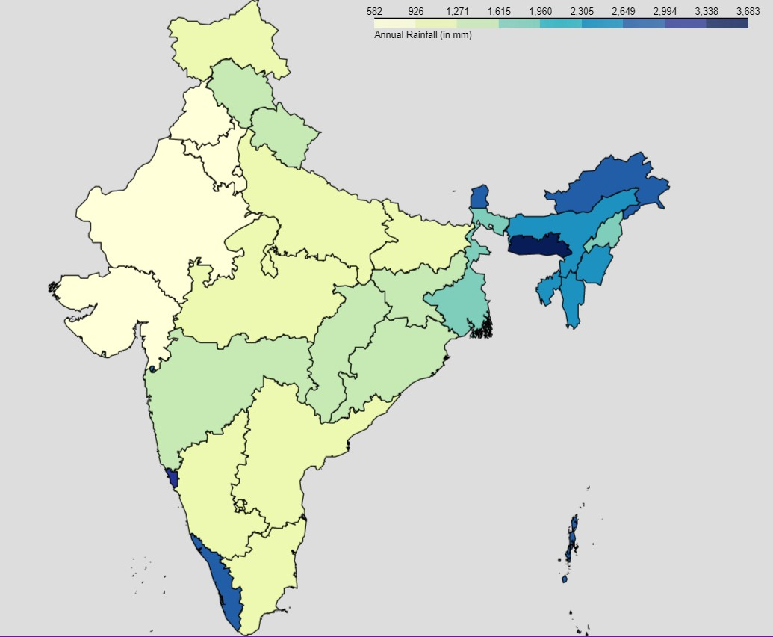
Rainfall Distribution
As expected the North Eastern States receive the maximum rainfall.
We also see Kerala, Bihar also getting a lot of rain and we know that these are flood prone areas because of the rivers flowing through these states
Gujarat, Rajasthan are on the lesser side of rain receiving spectrum.

Slide 9
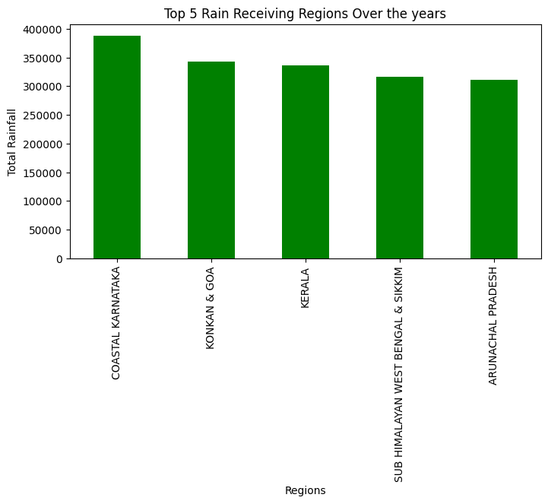
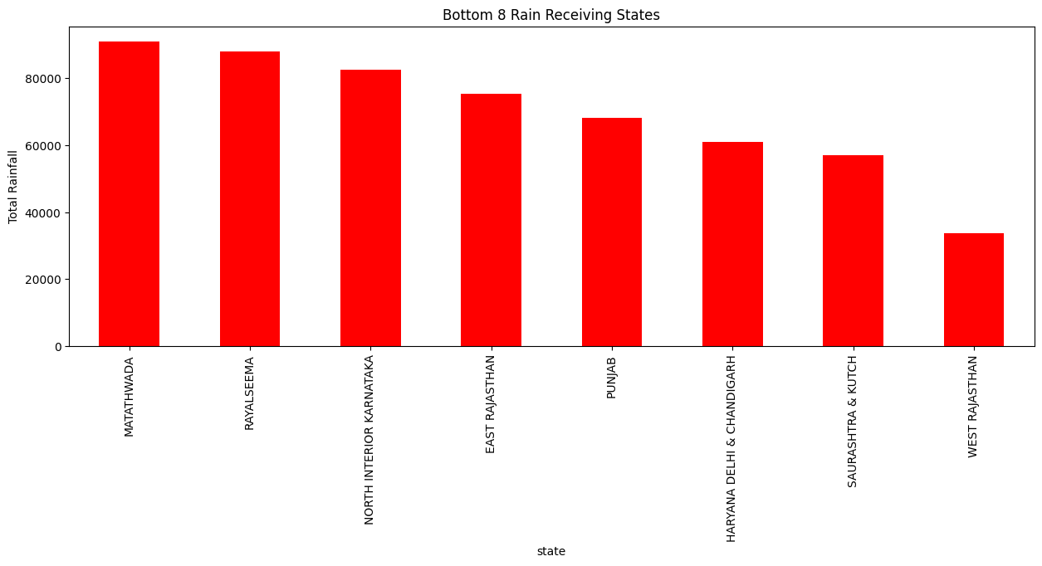
Cumulative Rainfall Data

Slide 10
Using the above plots, we get the insights on distribution of rainfall across the country. Using this we can draw out the plans for Water Management for Low rainfall receiving states and Flood Management in areas with heavier rainfall.
We can also see variation in the Vegetation, Soil Patterns, Agriculture Practices in different regions with varying rainfall.
Although this data is helpful in visualizing the current scenario of Rainfall and Monsoon in different regions of the country, it doesn’t really give any insight on the change in Rainfall Patterns over the years and the impact of Climate Change on it. For that we use time based visualization.

Slide 11
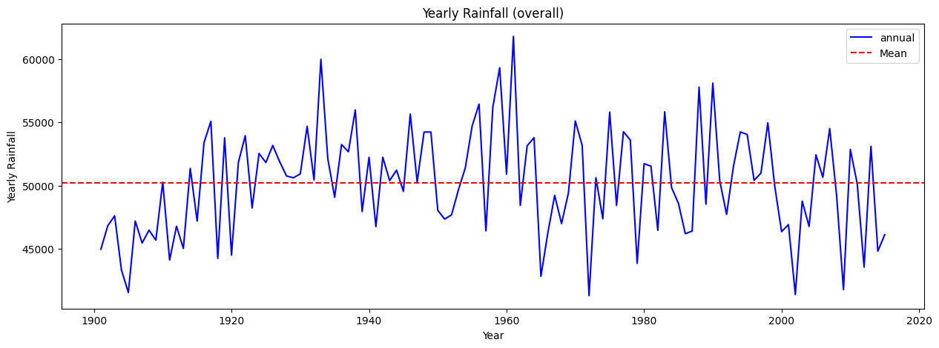
The above plot shows the Annual Rainfall variation over the years, we can draw some insights from this regarding the changes in rainfall in recent years. As we can see from the slides that Quantity of the rainfall has been decreasing recently which is a cause of concern.
Although we promised to relate it to climate change, but our exploration lead to the discovery that Climate Change although is an important factor but it is not the only factor and there are dozens of other factors including wind conditions, ocean currents etc which affect the rainfall in India. But because we couldn’t explore those other factors we cannot really say we know the reason for the effect on rainfall.

Slide 12
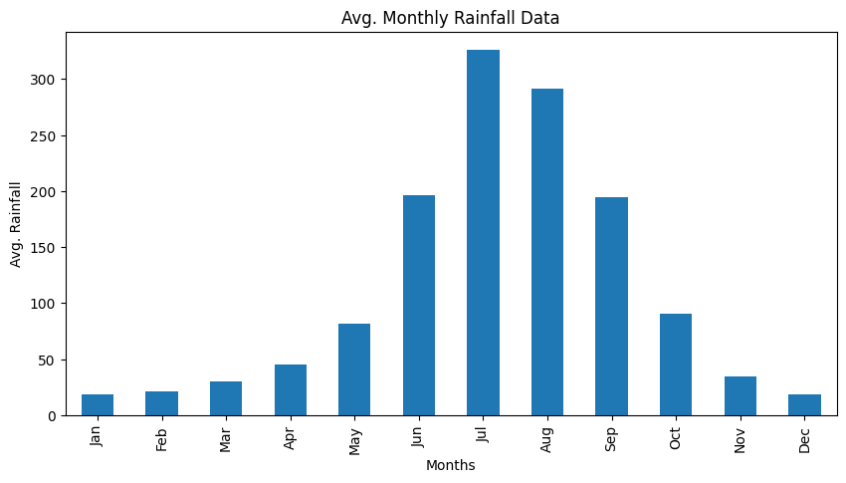
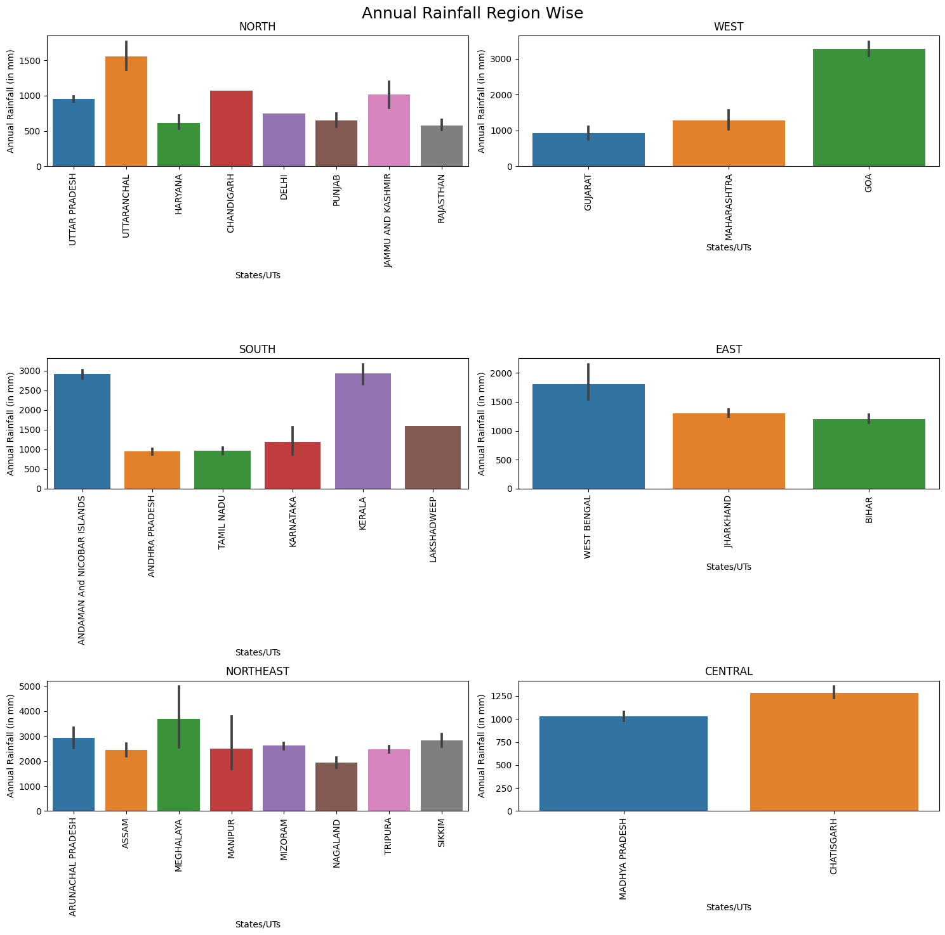
The monthly distribution of the rainfall and Rainfall distribution region wise can be related with Agricultural Practices in different regions in the country.

Slide 13
Impact of Rainfall on Agriculture
As we know that Indian Economy is still largely depends on Agriculture, and Rainfall Impacts Agriculture in India to a very large extent.
In general rainfall and rainfall for agriculture is very different. Timely arrival of Monsoon has always been considered a boon for Indian Farmers.
In recent years there has been a delay in monsoon due to various Ocean phenomena getting disturbed due to Global Warming that impacts the timely arrival of monsoon in India.
We have not been able to do that as rainfall is a complex phenomenon that we cannot predict. Thus, we have assumed rainfall to be a constant given and we will see how our agriculture goes around it.
We have consider “Paddy” as the crop of concern as it is a water intensive crop and is heavily reliant on rainfall.

Slide 14
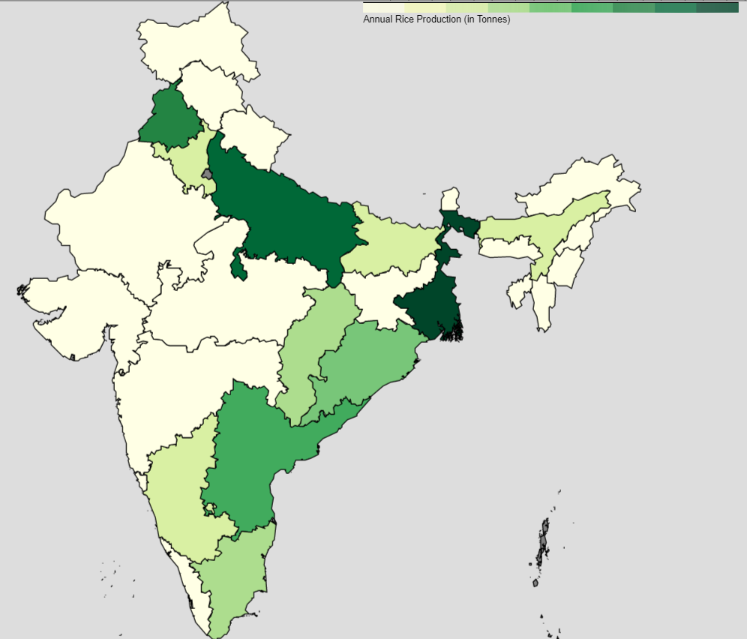
Rice Production in India
We can see from the map, Punjab, UP, West Bengal, Andhra Pradesh, Odisha, Tamil Nadu seem to be the highest producers of Rice
But not all of these states are high rainfall receiving states, thus are relying a lot on other water resources, mostly underwater reserves.
This is something of a concern as this is not a part of Sustainable Agriculture.
Let’s see some example as a Case Study.

Slide 15
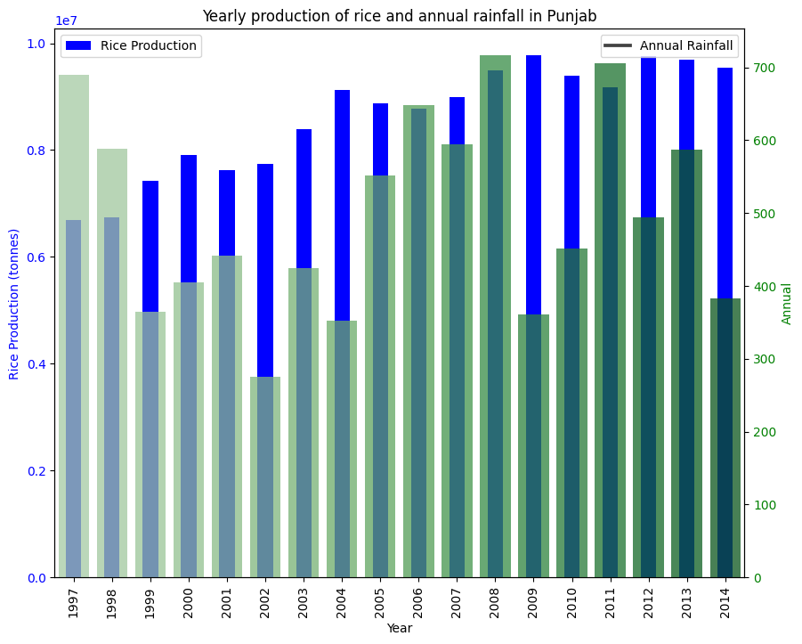
Case 1 : Punjab
Punjab is the bread bowl of India and it has been instrumental in providing the food security to India by leading the efforts of Green Revolution
But the times have changed and so has the needs of country, but Punjab is still living in the era of Green Revolution
As we can see that the rice production in Punjab is staying consistently high even though rainfall received is declining.
This means Punjab is using other water resources, which is not good and Policymakers should encourage low water intensive crops in this state.

Slide 16
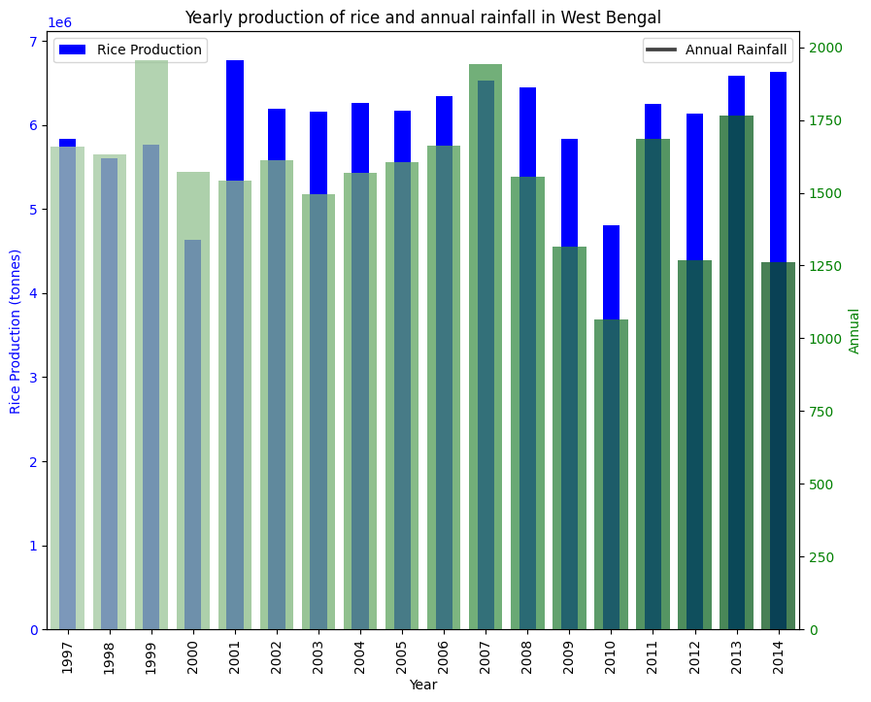
Case 2: West Bengal
This is a better case than Punjab.
Overall production is less than Punjab, but the rice production is somewhat following the rainfall.
This is much better way to implement the paddy farming, which might not be the best for economic gains but somewhat good for Ecological gains

Slide 17
Climate Change: The Big One
Climate Change is the big talk of today in every International Conference or any Multilateral Agreements among the countries.
As per Paris Agreement of 2015, we are supposed to keep this rise in Temperature to with 2 degrees of pre-industrialization era, but with recent trends and current scenario it seems we are going to overshoot that threshold.
We will study the Climate Change with Indian Perspective here.

Slide 18
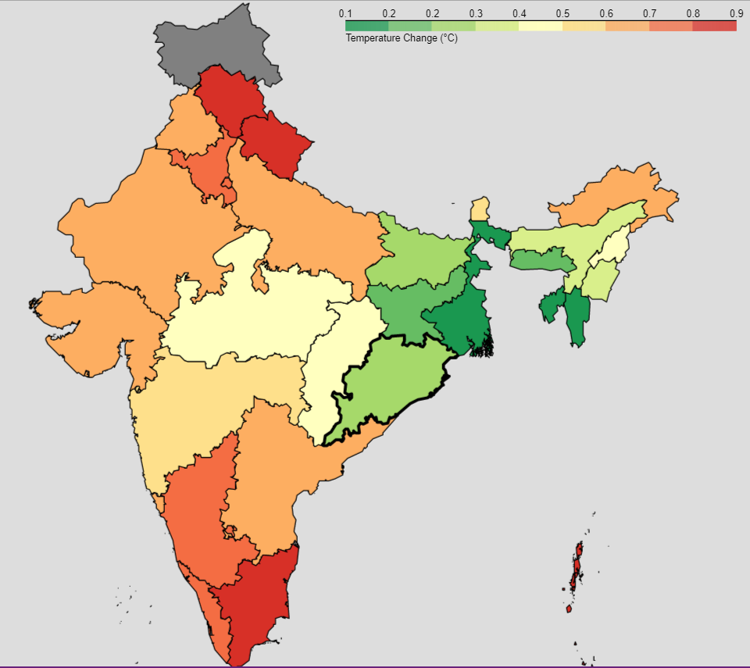
Climate Change’s Affect in Indian Subcontinent
The map shows the effect of Climate Change in different regions of the country.
The most affected parts are coastal regions and some Northern region of Himachal and Uttarakhand.
This plot has been using Mean Temperature Change in last 10 years.

Slide 19
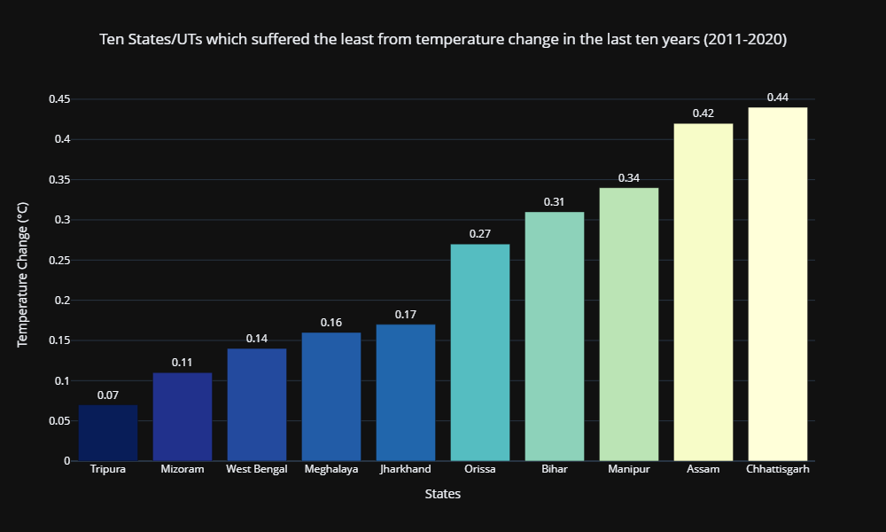
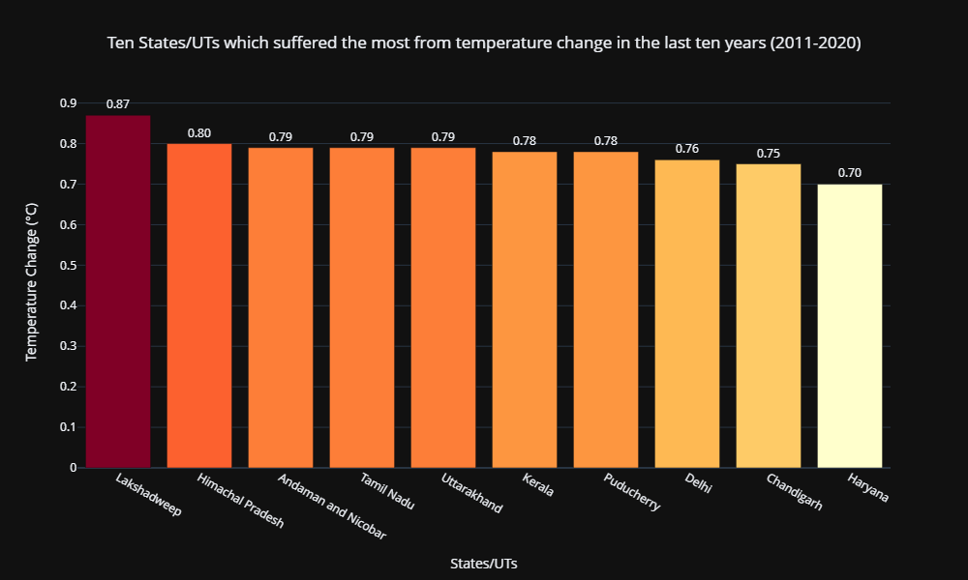
Effects of Temperature Change in different regions
Here we can see that Island regions and some of the mountain states of Himalayas are most affected by Climate Change

Slide 20
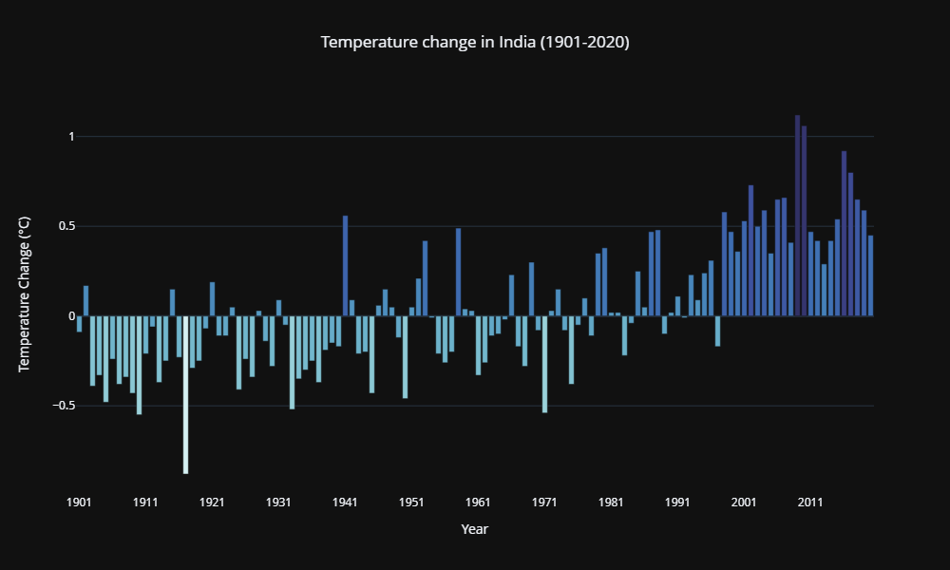
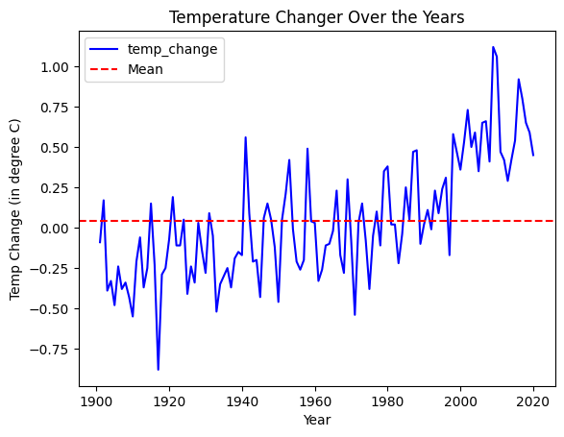
Climate Change Trends over the Years
We can see from these trends that, there has been a rising trend in Temperature Change in India in last few years, which is not a good outlook on Environment aspect of India.

Slide 21
Carbon Emissions: The Main Culprit
Carbon Emissions is the number one reason for Climate Change. This is why all the steps in curbing rising temperature include some sort of Carbon removal from the environment, either through Carbon Capture or through less emissions.
We compute the GHG (Green House Gases) in the unit of CO2 Equivalent, which is responsible for trapping heat and warming the environment.
Although we noticed that in State’s perspective, temperature change and Carbon Emissions were not always correlated. That might be because the emissions doesn’t affect “Temperature Change” in that particular region per say.

Slide 22
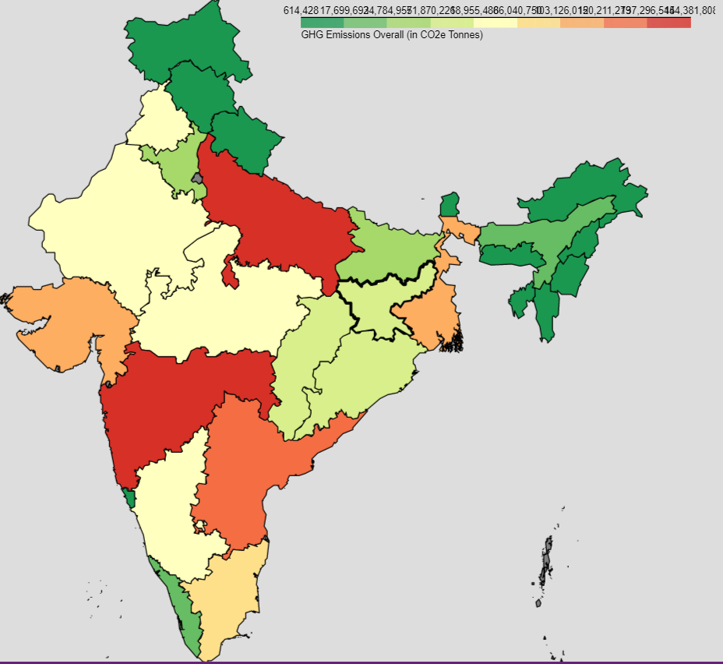
Carbon Emissions in India
As we can see from the map, that most of the culprit of high emissions are states with Industries powered by Coal and other non renewable sources.
But as we have seen from the above plot of temperature change, there are some mismatches
E.g. States Himachal and Uttarakhand have very less emissions but are highly affected by the temperature change.
This is how the general environment problems are, where cause is happening somewhere but its effect is seen in other places as well, in this case even more so.
These are the regions with high biodiversity and vegetation to capture some Carbon as well so we need to protect it.

Slide 23
Conclusion
We tried to come up with some interesting stories and insights based on the data given and collected data from various sources.
Although we are all aware of the problem of the environment, but we tried to bring the problem forward with the help of some visuals which might help in better understanding to a layman.
Further Exploration is possible in this theme, as this is a very dynamic field and there can be different perspective to see the problem, we tried to do that in our simplistic way.

Slide 24
Thank You

