Slide 1
Silent attrition is universal: win back the wallet with product fixes, not a target list
Synchrony Analytics Hackathon 2026 · HSIC × MetroMart co-branded card
28.9% → 19.5%
M
47%
M
4.8×
M
HSIC's share of MetroMart spend, FY25 → FY26. All of the fall comes from cards that stayed open
of HSIC's lost share went to Cash/UPI, which gained in every ticket size, while spend per card stayed flat
closure rate of cards under 6 months vs over 3 years (14.7% vs 3.0% in 6 months)
₹33.4M of HSIC spend lost in FY26. Net of the 1.40% HSIC pays in rewards, it carried only ₹0.03M–₹0.20M of margin (₹0.27M–₹0.43M if MetroMart co-funds half): the stake is retention and revolving balances.
A
1
Show the reward at the till: no incentive cost
2
Instant cashback and the card on UPI, to match Cash/UPI
3
Protect first-year cards, win back closed cards, pilot with 10% holdouts
Devansh Agarwal · Mayank Srivastava · Shreyash Tiwari · BITS Pilani · 24 October 2026
Notes:
HSIC's share of MetroMart spend fell by a third in a year, and it isn't a group of customers drifting away: it's everyone, at the same rate, while they keep shopping at MetroMart as much as before. That changes the answer. A target list of at-risk customers would be chosen at random, so the first fixes are product fixes that reach every basket. We price every offer net of the rewards HSIC already pays, because that margin is thin, and we pilot before scaling.

Slide 2
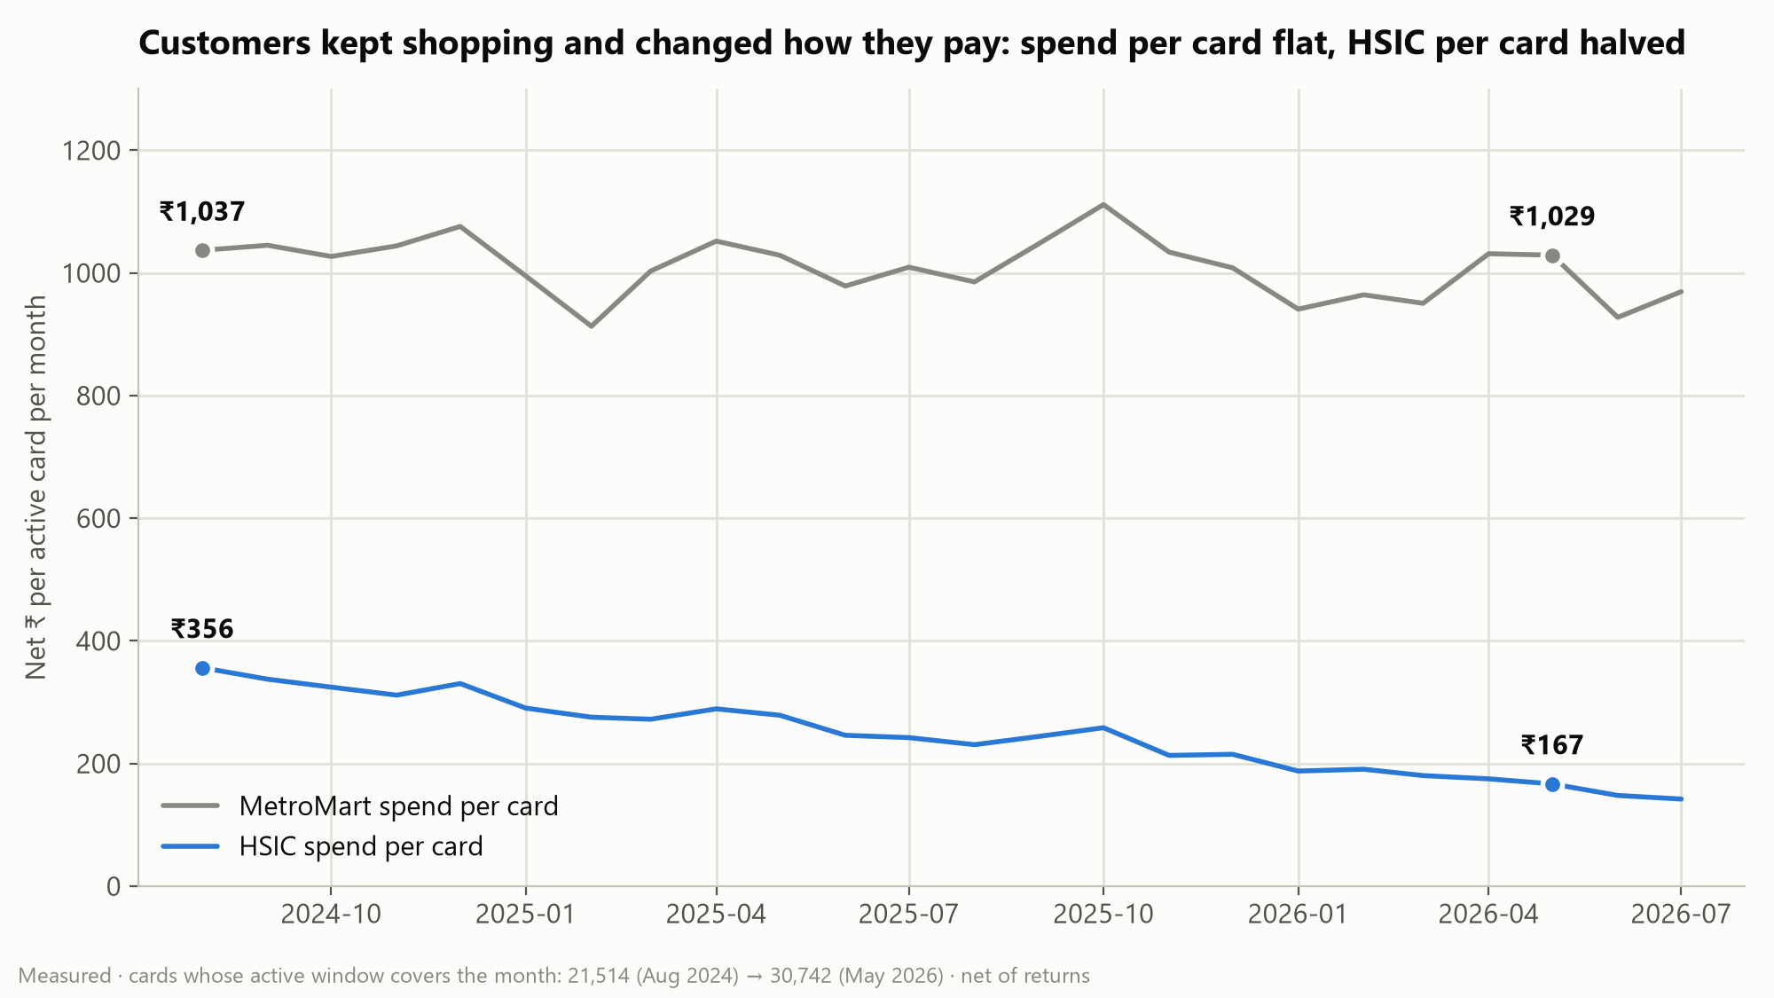
Customers kept shopping at MetroMart; they stopped paying with HSIC
−9.4 pts
M
SoW 28.9% → 19.5%. Cards open throughout explain −9.5 pts; closures and new cards net out (+0.3 pts, −0.1 pts)
47%
M
of the lost share went to Cash/UPI; Debit 21%, other cards 19%, MetroMart Wallet 14%
+4.5 pts vs +1.8 pts
M
Cash/UPI's gain among cardholders vs non-cardholders: much stronger for cardholders than for the market
H
Why Cash/UPI? Immediacy: settled at once, while the card's reward arrives on next month's statement. The pilot tests it.
SoW = HSIC net ÷ total net MetroMart spend, only while the card is open, net of returns (returns count as zero transactions). 38,164 cardholders, 444,118 transactions; 39 reproduction checks pass.
Notes:
The share fell from 28.9% to 19.5% in a straight line, and the bridge shows it isn't mix: cards that stayed open account for the whole fall. Spend per card at MetroMart was flat, while HSIC spend per card more than halved. Almost half of the lost share went to Cash/UPI, at every ticket size, and much more strongly for cardholders than for the market. Why customers pick Cash/UPI is a hypothesis, immediacy, which the instant-cashback pilot arm tests.

Slide 3
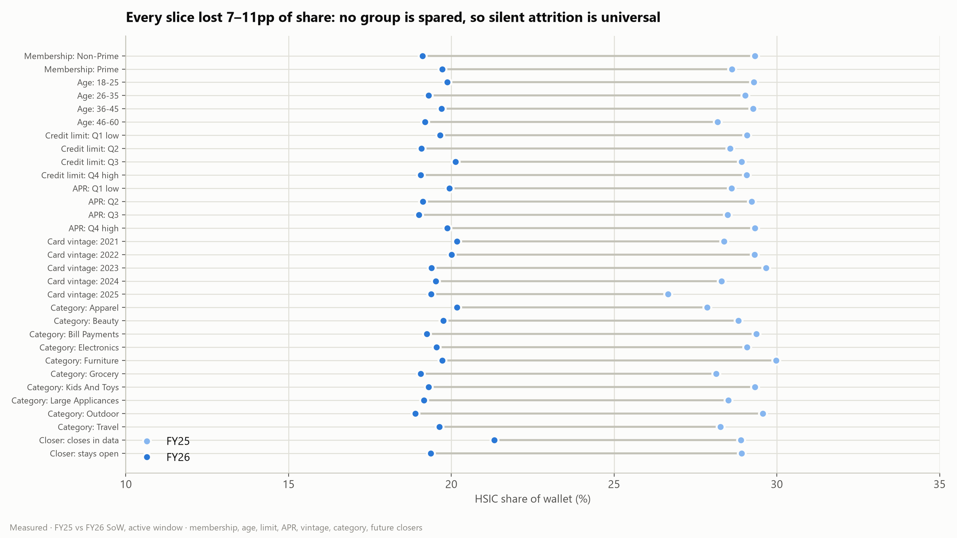
It's universal: no customer group behaves differently, so low SoW is the whole book
1.00
M
Variance ratio: customers differ in how often they use the card no more than coin flips would. This year's share predicts next year's at r = 0.00
+21.5 pts → −0.3 pts
M
"Silent attriters" by the usual count, and after allowing for the portfolio-wide trend: every open card is drifting, none faster
0.04%
M
of next year's SoW explained by K-means clusters built on SoW: clustering would target noise
We tested 17 common hypotheses, each against a simple baseline or a calendar-matched null.
Notes:
Every slice fell by 7 to 11 points: Prime and Non-Prime, every age, limit, APR band, vintage and category. Before segmenting, we tested whether customers differ at all: the spread in card use between customers is what coin flips produce, and this year's share doesn't predict next year's. The usual silent-attrition count flags about a fifth of cardholders; allow for the portfolio-wide trend and the excess is zero. Silent attrition is real, and it is universal.

Slide 4
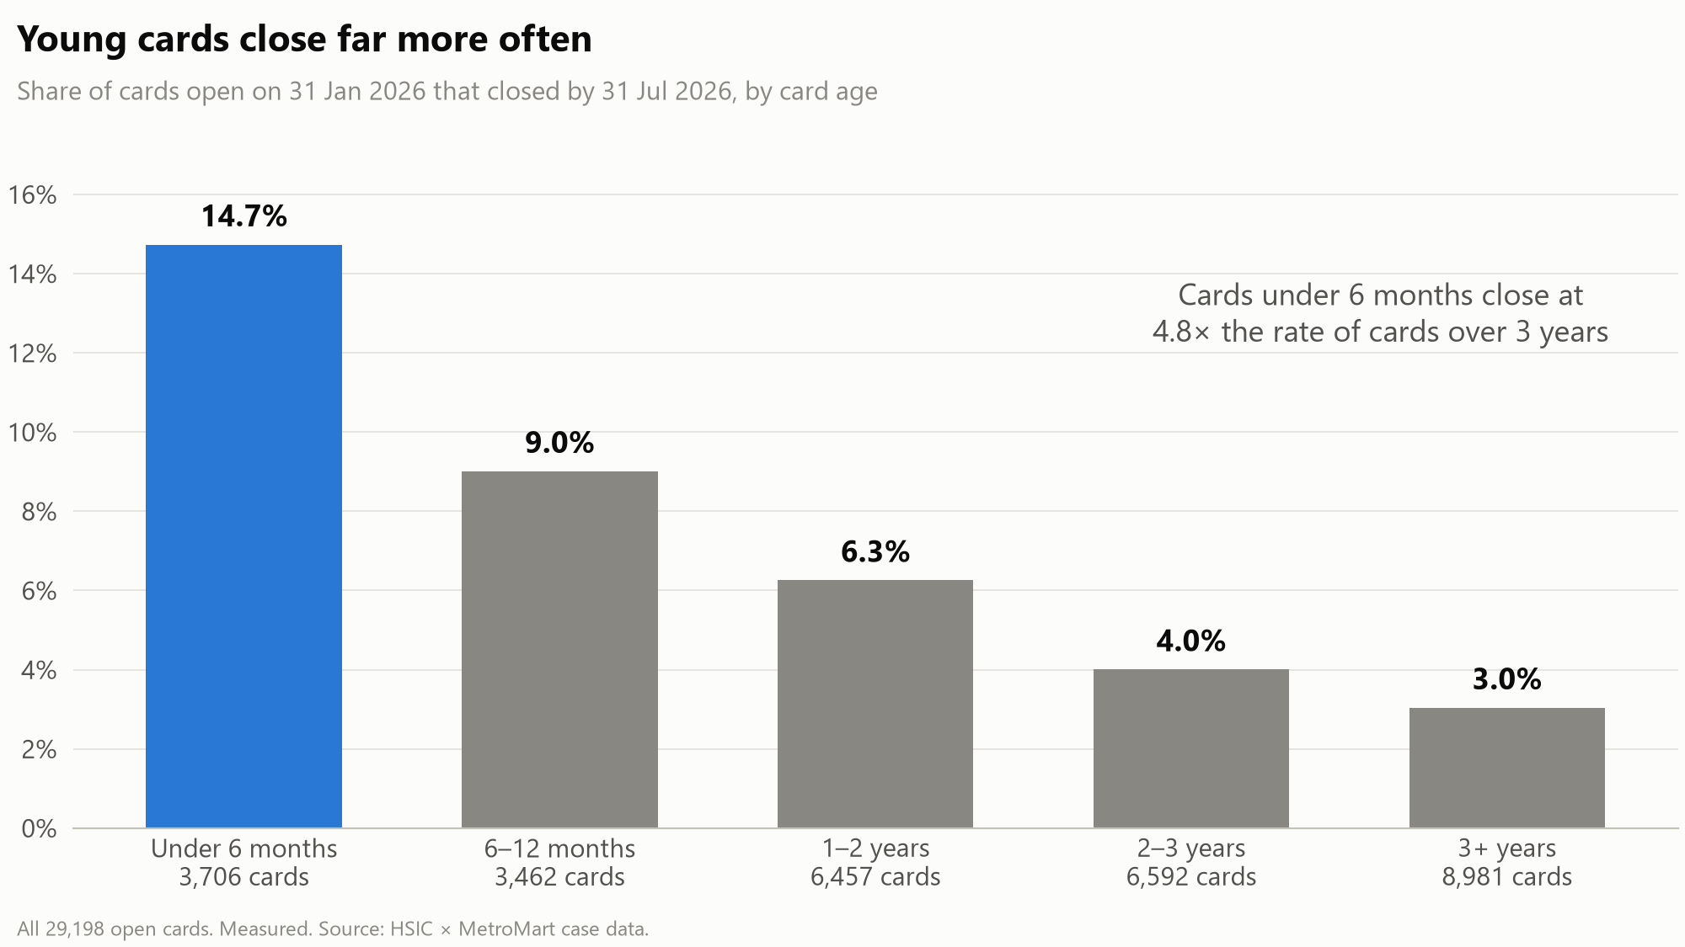
Closures doubled and sit in young cards: prioritise by risk × value, not by SoW
Young card (< 1 year)
Mature card
B. Protect first
D. Grow
High purchase frequency
1,961 cards
closes 11.6% in 6 months
₹6,235 off-card per customer
SoW 16.1%
7,486 cards
closes 4.2% in 6 months
₹6,393 off-card per customer
SoW 17.1%
C. Activate
E. Nudge
Low / mid frequency
4,352 cards
closes 12.1% in 6 months
₹3,976 off-card per customer
SoW 17.7%
16,720 cards
closes 4.3% in 6 months
₹4,139 off-card per customer
SoW 17.2%
1.7% → 3.4% of open cards closing per quarter. Card age alone predicts closure as well as any model we trained (ROC-AUC 0.672 vs 0.669)
M
SoW is within 1.7 pts in every box: risk and value separate customers, SoW doesn't. Outside the grid: 5,903 closed cardholders still spending at MetroMart (₹92.3M since closing): the win-back segment.
Notes:
Closures are the visible half and they are accelerating: the share of open cards closing each quarter doubled. Cards under six months close at 14.7% over the next six months, 4.8 times cards over three years, and no learned model beats card age alone, so the early warning is a rule: protect first-year cards. To answer the brief's segmentation question, we build a 2×2 on the two traits that do predict, card age for risk and purchase frequency for value. SoW is the same in every box; risk and value are not. Young, high-frequency cards come first.

Slide 5
Three product fixes first; paid offers only where they pay back
O3 Reward visibility (hero)
H
Is it awareness?
Paid and targeted offers: share of eligible spend that must move to pay back
A till and receipt line, "Pay with HSIC: earn ₹X on this basket", and a monthly "₹ you left on the table".
Offer | Who | Base | Conservative
O4 No-cost EMI, ₹3k+ baskets | All big baskets | 69% | never
O6 Win-back: 3% for 90 days | 5,903 closed, still shopping | from the first ₹ | never
O7 Prime trial, young cards | 6,313 cards < 1 year | keep 4.0% open | never
O8 Threshold bonus | 6,744 high-frequency mature | 8% | never
S
Prime members left ₹1.60M of cashback on the table in FY26. No incentive cost; pays back from the first rupee moved on 1% baskets in every scenario.
O1 Instant cashback at the till
H
Is it immediacy?
The same reward, credited at checkout instead of on next month's statement.
A
Goes after Cash/UPI's 47% of the loss; costs only a month of funding on the reward.
S
Break-even after the rewards HSIC funds; inputs are Assumed. O8 pays on noise: 91% of its segment's card spend would earn the bonus with no change in behaviour.
O2 HSIC card on UPI
Link the credit card to UPI, where the spend went.
M
Triggers must fit how rarely people shop: no one made 5 small HSIC purchases in a month (the most was 3), and 3 uses in 60 days reached 0.1% of new cards. So the small-basket bonus pays per visit, and the young-card milestone is the first use, which 15% of new cards reach in 60 days.
S
Cardholders' Cash/UPI spend in FY26: ₹82.8M. Each 1% of it moved is worth ₹17k a year (base).
Notes:
Lead with reward visibility because it is the cheapest lever: HSIC already pays the best Grocery and Electronics rates in the market, and Prime members still don't use the card more. Making the reward visible costs nothing extra; whether it works is exactly what the pilot tests. Instant cashback and the card on UPI go after the Cash/UPI habit. Paid offers come after, and only where they pay back: a blanket no-cost EMI needs most big-basket spend to move, and a threshold bonus mostly pays for spend that would have happened anyway.

Slide 6
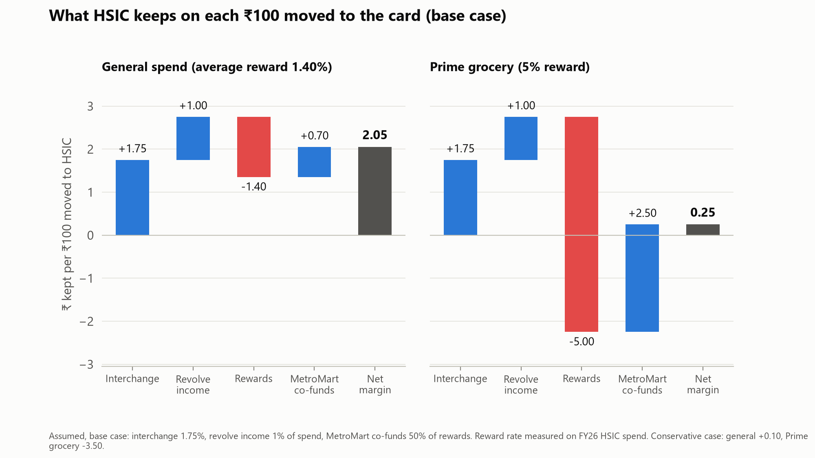
The margin on moved spend is thin: pilot the cheap fixes first and ask MetroMart to co-fund
Pilot
S
Randomised 10% holdout per offer and segment. Across the grid it detects a 1.8 pts change in HSIC share in 3 months; one box needs 2.6 pts to 6.1 pts, so read at grid level or run 6 months. Scale only if the lift's CI excludes 0 and net value > 0.
What the pilot tests
H
Reward visibility vs holdout: is it awareness? Instant cashback vs holdout: is it immediacy? A null result is reported as a refuted hypothesis.
Asks
HSIC: ship reward visibility, pilot instant cashback, start UPI linkage, protect first-year cards, offer win-back. MetroMart: co-fund Prime category rewards. Without it, reward visibility on those baskets needs revolve income of 1.6% of spend to pay back.
Per ₹100 moved to HSIC (base): +₹2.05 on general spend, +₹0.25 on Prime grocery. Conservative: +₹0.10 and −₹3.50.
Assumed: interchange 1.5–2%, revolve income 0–2% of spend, MetroMart co-funding 0–50%, cost of funds 8%, EMI subvention 3%. Measured: reward rate 1.40% on FY26 HSIC spend. Operating costs excluded, so break-evens are floors.
Notes:
Rewards eat most of the interchange, so a rupee moved to the card is worth about two paise in the base case and can lose money on Prime grocery. That is why reward visibility leads: it adds no cost. Every paid offer shows the shift it needs to pay back, and we say never where it can't. Nothing here is a forecast of recovery; the pilot turns these simulations into measured results, and it is sized honestly: effects under about two points need the whole grid.

