Slide 1
Project Presentation of CO-OP Project at Industry (Module-2) (22CS421)
On
Benchmarking LLMs for Code Generation Under Prompt Variability
Dharuv Singla(2210990268), Mayank Bansal(2210991904),
Dev Bhatia(2210991487)
Supervised By
Preeti Saini
Department of Computer Science and Engineering,
Chitkara University, Punjab

Slide 2
Introduction
The Gap in Current LLM Benchmarks
The Problem
Benchmark Disconnect
Current coding benchmarks test models on clean, perfectly structured prompts. Real-world developers often use messy, minimal, or semi-structured prompts.
The Objective
Evaluating Robustness
To evaluate how well AI coding assistants perform when "prompt discipline" drops.
The Scope: Rigorous East-West Comparison
Western Models
Claude 3.7 Sonnet
Gemini 2.0 Flash
GPT-4o
Eastern Models
GLM-4-Plus
MiniMax-M2
Kimi K2 Instruct

Slide 3

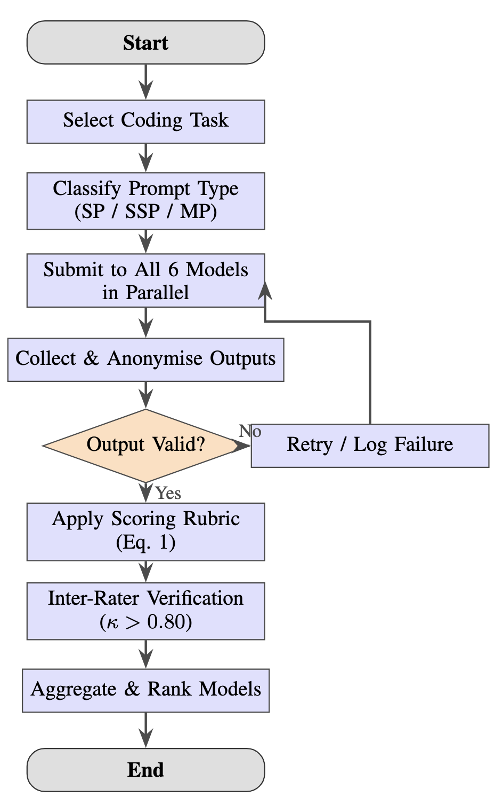
Methodology & Evaluation
Task Dataset
150 Diverse Coding Tasks
Algorithms, Debugging, Code Optimisation, and Documentation.
Prompt Formality Tiers
1. Structured (SP)
Explicit instructions, edge cases, complexity limits.
2. Semi-Structured (SSP)
Basic context without strict requirements.
3. Minimal (MP)
Raw keyword sequences (e.g., "merge sort python").
Scoring Rubric
40% Accuracy • 25% Syntax • 20% Optimisation • 15% Efficiency
Evaluation Workflow

Slide 4
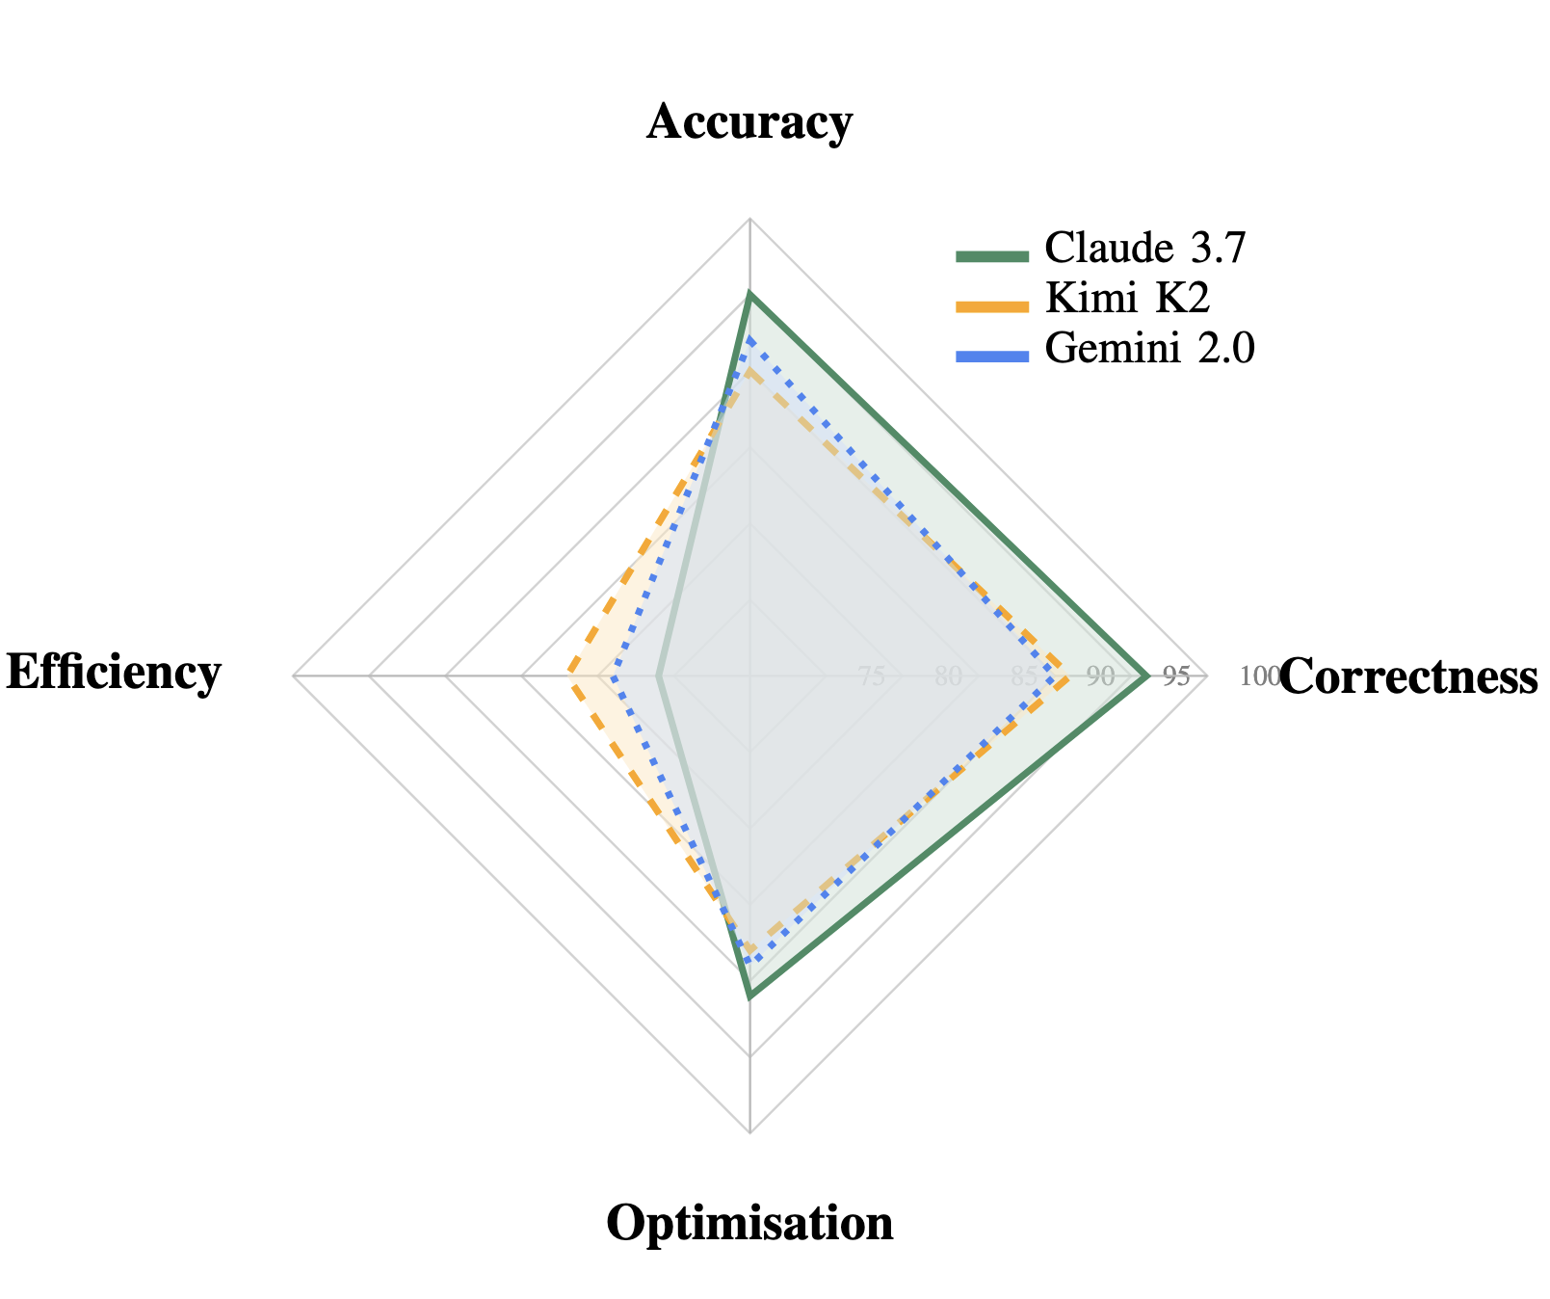
Overall Performance Rankings
1st Place • 91.3%
Claude 3.7 Sonnet
Dominates in structured prompts (96.1%), algorithms, and debugging. Best for precision-oriented tasks.
2nd Place • 88.6%
Kimi K2 Instruct
Surpassed top Western models like Gemini 2.0 and GPT-4o. Exceptionally balanced across all metrics.
3rd Place • 87.0%
Gemini 2.0 Flash
Strong optimizer, highly cost-efficient and fast.
Comparative Capability Analysis

Slide 5
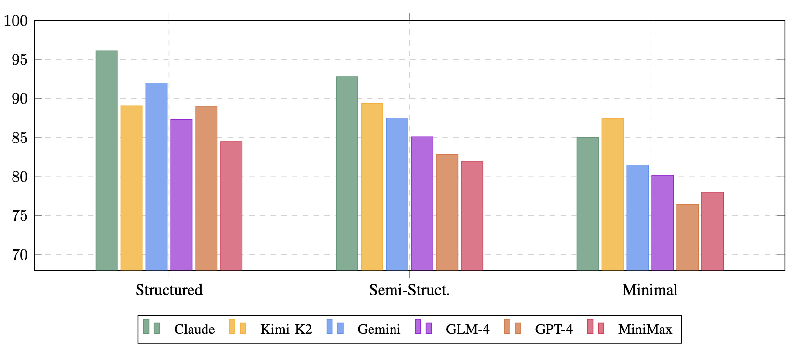
Prompt Sensitivity Analysis
Evaluating model robustness when user prompts transition from structured to minimal.
MOST ROBUST
Kimi K2 Instruct
Only a 1.7% drop. Incredible at detecting user intent with minimal context.
HIGHLY SENSITIVE
GPT-4o & Claude 3.7
Suffered massive drops (12.6% and 11.1%) when given minimal prompts.
Composite Score (%) across Structured, Semi-Structured, and Minimal Tiers
KEY TAKEAWAY
GPT-4o requires strict prompt engineering to be effective; Kimi K2 does not.

Slide 6
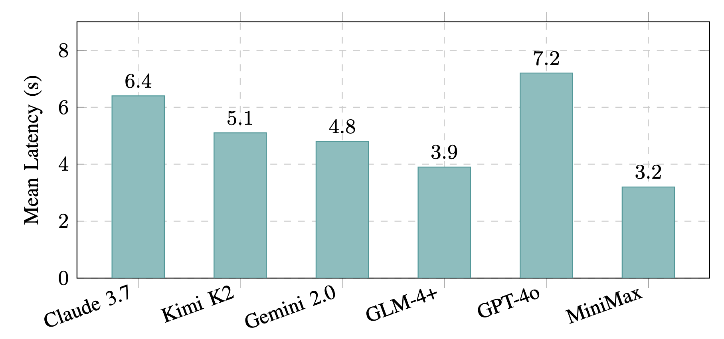
Task Specifics & Latency
SPEED VS. SPECIALIZATION
Algorithms & Debugging: Claude 3.7 Sonnet leads (94.2% & 95.0%).
Documentation: Kimi K2 Instruct takes the crown (91.2%).
FASTEST MODELS
3.2s – 3.9s
MiniMax-M2 & GLM-4-Plus. Ideal for interactive, low-latency loops.
SLOWEST PERFORMER
GPT-4o (7.2s). Generates the highest token count due to wordy explanations.

Slide 7
Conclusion & Deployment Recommendations
Which Model Should You Use?
COMPLEX DEBUGGING & ALGORITHMS
Claude 3.7 Sonnet
The premier choice for intricate logic and high-tier coding tasks.
ROBUSTNESS & LOW-CONTEXT
Kimi K2 Instruct
Best for teams with inconsistent prompting habits; highest statistical robustness.
AUTOMATED DOCUMENTATION
Kimi K2 Instruct
Optimized for structure and clarity in technical writing tasks.
BUDGET OPTIMIZATION
Gemini 2.0 Flash / GLM-4-Plus
High performance at a lower cost point for repetitive code tasks.
HIGH-SPEED INTERACTIVE DEV
MiniMax-M2
The ideal choice for ultra-low latency interactive development loops.

Slide 8
Thank You
‹#›

