Slide 1
Practice exercise: Creating Executive View
Feedback from Stakeholder meeting | Requester | Action Owner | Additional Hint
Create executive view | Nick Puri | You | Review mock up and reuse visuals from other pages as much as possible Add conditional formatting to show when there is a decline compared to Benchmark Do aesthetic enhancements and link the executive view to icons from all pages
We recommend you to achieve this solution without our support. If you want to verify your approach or need support please refer to the tutorial / worked out Power BI file in ‘Practice Exercise Solutions’ section of this course.

Slide 2
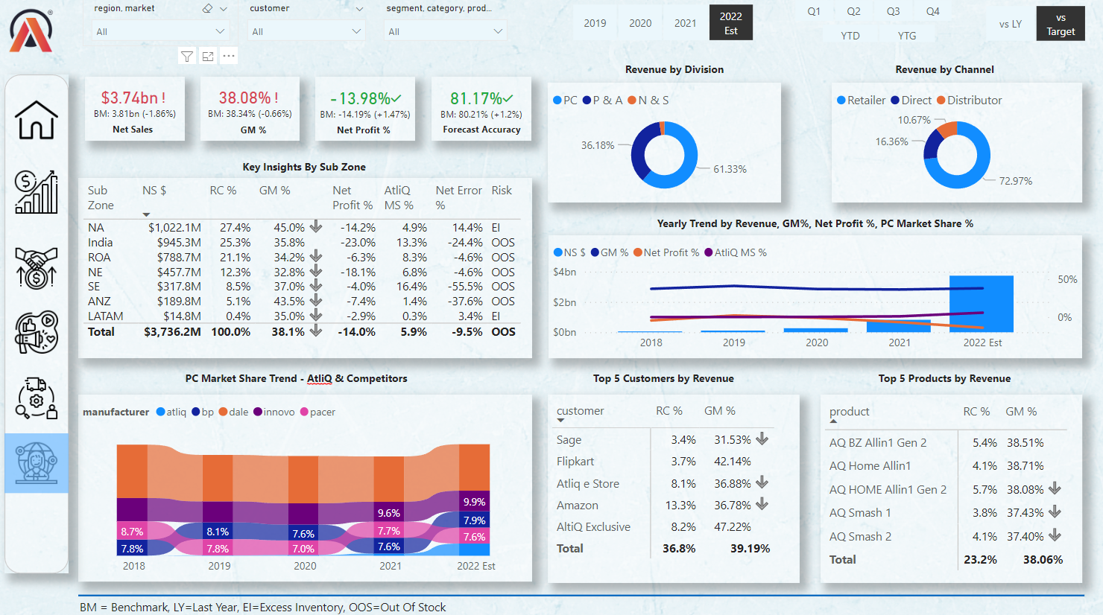
Executive View from solution for your inspiration
We recommend you to achieve this solution without our support. If you want to verify your approach or need support please refer to the tutorial / worked out Power BI file in ‘Practice Exercise Solutions’ section of this course.

