Slide 1
AI-Powered Food Discovery and Recommender App
-By Group Number 11

Slide 2
Outline
Problem Statement
Motivation
Literature review
Proposed solution
Novelty
Methodology
Results

Slide 3
Problem Statement
In today's culinary scene, there's a growing demand for cooking experiences that are both personalized and convenient.
Inefficiency in ingredient discovery and tailored recipe recommendations despite the abundance of recipes available.
Existing platforms struggle to provide tailored cooking guidance due to their limited ability to analyze real-world images of ingredients.
Technological gap in current recipe applications due to the lack of integration of advanced technologies like image recognition and natural language processing.

Slide 4
MOTIVATION
Growing demand for personalized and convenient cooking experiences in the contemporary culinary landscape.
Evolving lifestyles and dietary preferences are driving a shift towards personalized, health-conscious cooking, increasing the demand for tailored recipe recommendations.
Busy schedules require efficient ingredient discovery and recipe selection, enhancing convenience for users amidst limited time for meal preparation.

Slide 5
LITERATURE REVIEW
Cooking Recipe Analysis based on Sequences of Distributed Representations:
Introduction of a recipe graph data containing relational and multi-modal information.
Focus on learning recipe representations using multi-modal information from images, text, and relations.
Food Image Classification with Convolutional Neural Networks:
Utilization of Convolutional Neural Networks for food image classification.
Application of deep learning techniques for analyzing food images.
Potential for enhancing food-related applications through image analysis.

Slide 6
LITERATURE REVIEW
Additional Recipe Representation Multi Modal Network:
Integration of multi-modal information for recipe representation learning.
Consideration of both textual content and recipe images for learning representations.
Focus on relational information in recipe datasets.
Food Recipe Alternation and Generation with Natural Language Processing Techniques:
Application of natural language processing techniques for recipe alteration and generation.
Use of word embedding and N-gram models for ingredient and recipe analysis.
Exploration of alternative ingredients and recipes using NLP methods.
Contribution to the field of recipe generation and flavor authenticity.

Slide 7
PROPOSED SOLUTION
Food Image Classification:
Data Collection: Gather images of various food items.
Model Training: Train a deep learning model to recognize different food items.
Integration: Incorporate the trained model into our Android app for real-time image classification.
Feedback Loop: Collect user feedback on classification accuracy to improve the model over time.
Food Recommendations:
Recommendation Generation: Generate food recommendations using both content-based and collaborative-based filtering techniques.
Presentation: Display recommended food items within the app interface for users to explore.
Feedback Collection: Allow users to provide feedback on recommended items to enhance future recommendations.

Slide 8
PROPOSED SOLUTION
Continuous Improvement:
Learning from Feedback: Continuously learn from user feedback to refine and improve both image classification and recommendation algorithms.
Optimization: Optimize the app performance based on user interactions and feedback to provide a highly personalized experience

Slide 9
NOVELTY
Complimentary Food Pairing Suggestions:
Utilize machine learning to analyze recipes and user preferences.
Recommend side dishes, condiments, or beverages based on taste profiles, cultural cuisines, and nutritional balance.
Users input main food; app suggests complementary options considering taste preferences and dietary restrictions.
Food Clustering and Similarity Analysis:
Apply machine learning to cluster foods based on ingredients, cooking techniques, flavor profiles, and cultural cuisines.
Users explore clusters to find similar foods they enjoy.
Similarity analysis helps users discover variations of favorite dishes.
Feedback System:
Implement a feedback system for users to rate recommendations.
User ratings improve recommendation algorithms.
Understanding preferences enhances personalized recommendations for a satisfying user experience.

Slide 10
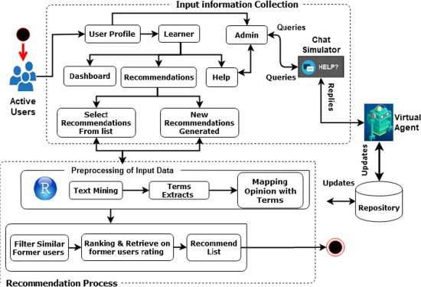
METHODOLOGY

Slide 11
METHODOLOGY
User Interface and Model Training:
Dataset Assembly and Preprocessing:
- Assemble dataset of 63 food classes, split into training, validation, and testing sets.
- Preprocess images for consistency and augmentation.
- Utilize transfer learning with VGG16 architecture.
- Add custom classification layers for food classification.
Model Deployment and Integration:
- Convert model to TensorFlow Lite format for mobile deployment.
- Integrate model into Android app, enabling seamless inference.
- Preprocess and post-process image data within app interface.
- Collect user feedback for model enhancement.

Slide 12
METHODOLOGY
Recommender System:
Content-Based Filtering:
- Infer user preferences from attributes and features of liked food items.
- Preprocess textual data for analysis using techniques like data cleaning and tokenization.
- Calculate cosine similarity to find similar food items.
- Rank and present top recommendations to users based on similarity scores.
Collaborative-Based Filtering:
- Analyze patterns of user preferences and behaviors.
- Identify food items closely resembling user preferences based on various attributes.
- Calculate similarity metrics using collaborative filtering algorithms.
- Present personalized recommendations to users for exploration.

Slide 13
METHODOLOGY
Model Design and Evaluation Metrics:
Cosine Similarity Metric:
- Measure similarity between vectors in multi-dimensional space.
- Utilize for item-item recommendations, capturing similarities between items.
- Consider cosine similarity's computational efficiency and intuitive interpretation for personalized recommendations.

Slide 14
METHODOLOGY
Model Architecture for Content and Collaborative Filtering:
Content-Based Filtering Design:
- Input food item to initiate recommendation process.
- Compare attributes to find similar foods.
- Rank and present top 5 recommendations to users based on similarity scores.
Collaborative-Based Filtering Design:
- Begin with user-provided food item as input.
- Compare attributes to identify similar foods.
- Calculate set of recommended items based on similarity metrics.
- Display recommendations for user consideration and feedback.

Slide 15
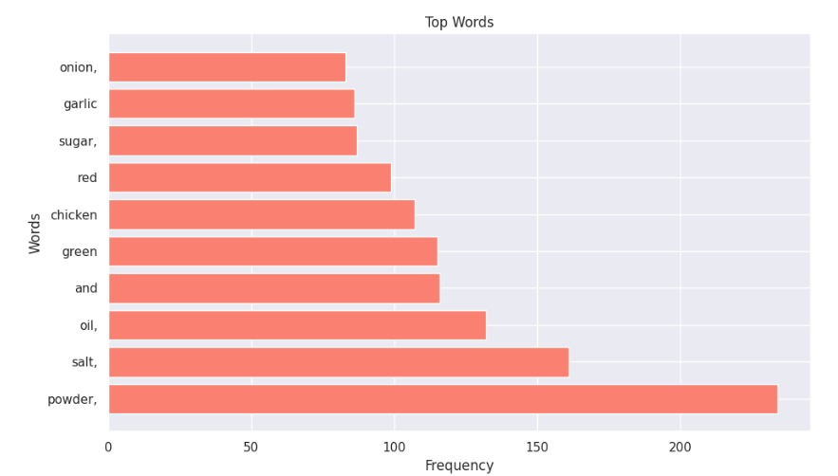
RESULT
Robust Performance: The food recommender system demonstrates high accuracy in both image classification and recommendation functionalities, providing users with real-time feedback within the Android app interface.
Culinary Trends and Preferences: Analysis of word frequency and ingredient pairs from user searches reveals prevalent culinary trends and preferences. Ingredients like "Powder," "Salt," and "Oil" emerge as commonly occurring, guiding content curation and recommendation strategies.

Slide 16
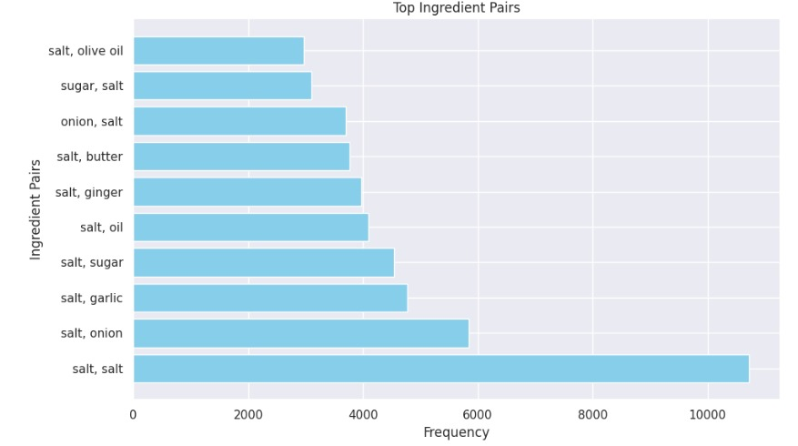
RESULT
Flavor Profiles and Ingredient Synergies: By analyzing ingredient pairs, the system gains insights into flavor profiles and ingredient synergies that resonate with users. This understanding aids in refining recommendation algorithms to suggest food items that complement each other well.

Slide 17
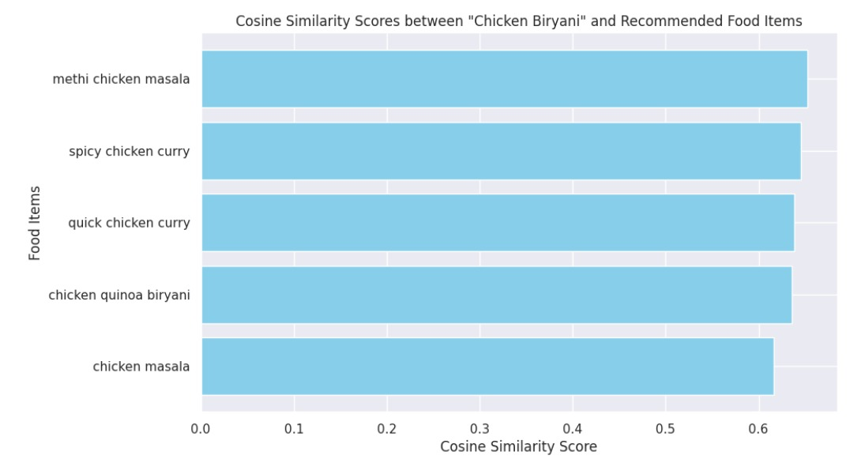
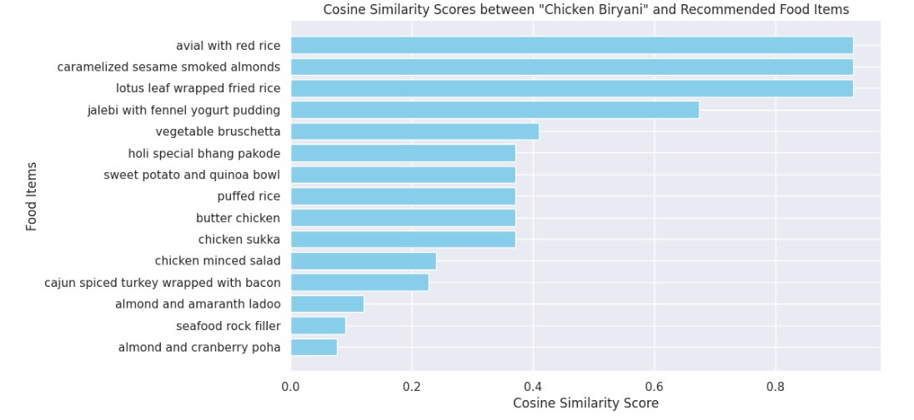
RESULT
Personalized Recommendations: Evaluation of cosine similarity scores from content-based and collaborative filtering approaches highlights the system's ability to generate personalized recommendations aligned with user preferences. Dishes like "Methi Chicken Masala" and "Avial with Red Rice" receive high similarity scores, indicating strong alignment with user tastes.

Slide 18
RESULT
Collaborative vs. Content-Based Filtering: Collaborative filtering captures user preferences based on collective behavior, suggesting popular items among similar user segments. In contrast, content-based filtering leverages item attributes to recommend items with shared characteristics, offering suggestions based on intrinsic qualities of the user-selected item.

Slide 19
CONCLUSIONS
Integration of Advanced Technologies:
Deep learning for image recognition.
Natural language processing for interactive communication.
Promotion of Healthier Eating Habits:
Tailored food suggestions based on individual preferences.
Emphasis on promoting healthier choices through personalized recommendations.
Continuous Algorithm Refinement:
User feedback mechanisms for continuous algorithm improvement.
Iterative learning process to enhance user experience over time.
Innovative Features and User-Centric Design:
Introduction of innovative features to enhance the dining journey.
Design focused on providing a user-friendly and enjoyable experience.

Slide 20
REFERENCES
Cooking Recipe Analysis based on Sequences of Distributed Representation on Procedure Texts and Associated Images [Akari Ninomiya; Tomonobu Ozaki: Nihon University Tokyo, Japan]
Food Recipe Alternation and Generation with Natural Language Processing Technique [Yuran Pan,Qiangwen Xu; Yanjun Li: Dept. of Computer and Information Sciences Fordham University New York, U.S.A.]
Food Image Classification with Convolutional Neural Networks [Malina Jiang Department of Computer Science Stanford University]
Recipe2Vec: Multi-modal Recipe Representation Learning with Graph Neural Networks [Yijun Tian, Chuxu Zhang, Zhichun Guo, Yihong Ma, Ronald Metoyer, Nitesh V. Chawla]

Slide 21
THANK YOU

