Slide 1


Selenium Web Automation & Testing
From browser control fundamentals to CI/CD integration — a complete teaching guide for B.Tech CSE students and DevOps practitioners.
B.TECH CSE · DEVOPS CASE STUDY

Slide 2

Why It Matters
The Case for Browser Automation
Modern web applications are complex, dynamic, and release rapidly. Manual UI testing cannot keep pace with continuous delivery pipelines.
Speed
Repeatability
CI/CD Integration
Automated suites run in minutes what testers take hours to verify manually.
Identical test execution every run — no human error, no fatigue.
Automated browser tests become quality gates in build pipelines, blocking regressions before they reach production.

Slide 3

Ecosystem Overview
What is Selenium?
Selenium is an umbrella project for tools and libraries that automate web browsers. It is not a single tool — it is a suite.
WebDriver
Selenium IDE
The core API. Drives browsers natively via the W3C WebDriver standard — locally or remotely. This is what your test code calls.
A browser extension for recording and playing back user actions. Great for quick prototyping and generating boilerplate scripts.
Selenium Grid
Selenium Manager
Enables distributed and parallel test execution across multiple browsers, operating systems, and remote machines.
The official driver/browser manager shipped with Selenium releases. Automatically resolves browser drivers — no manual setup required.
Selenium is not a test framework, CI server, or load-testing tool. It is a browser automation library.

Slide 4
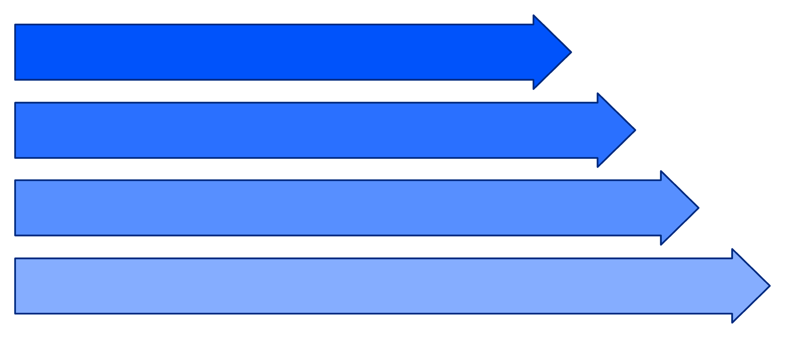
Architecture Deep Dive
How WebDriver Works
Test Code
WebDriver API
Browser Driver
Real Browser
W3C WebDriver Protocol
Selenium Manager & Drivers
WebDriver communicates over HTTP using a standardised W3C REST-like protocol. Every action — click, find element, navigate — is an HTTP request to the browser driver process.
When a browser driver is not found on the system PATH, Selenium Manager automatically downloads and caches the correct driver version. Newer versions can also manage browsers themselves.
Source: Selenium official documentation — selenium.dev/documentation/webdriver/

Slide 5

First Script · Locators · DOM
Finding & Interacting with Elements
Locator Strategies
Every Selenium test follows the same workflow:
ID / NAME
Fastest, most reliable when available
CSS Selector
Powerful and widely supported
XPath
Flexible; can traverse DOM tree axes
Locate
Interact
Verify
Link Text / Partial
Targets anchor tags by visible text
find_element() → first match · find_elements() → all matches (list)
from selenium import webdriver
from selenium.webdriver.common.by import By
driver = webdriver.Chrome()
driver.get("https://example.com")
# Locate → Interact → Verify
search_box = driver.find_element(By.ID, "search")
search_box.send_keys("Selenium")
search_box.clear()
print(search_box.get_attribute("placeholder"))
print(search_box.is_displayed()) # True / False
driver.quit()

Slide 6




Synchronisation & Waits
Why Timing is Everything
Modern JavaScript modifies the DOM after initial page load. Tests that run too fast will fail on elements that do not yet exist.
Implicit Wait
Global timeout; WebDriver polls the DOM for the set duration before raising NoSuchElementException. Simple but inflexible.
Explicit Wait + Expected Conditions
Waits for a specific condition on a specific element. Preferred approach — precise and readable.
Avoid time.sleep()
Fixed sleeps are brittle: too short → flaky failures; too long → slow suites. Never use in production test code.
from selenium.webdriver.support.ui import WebDriverWait
from selenium.webdriver.support import expected_conditions as EC
wait = WebDriverWait(driver, timeout=10)
btn = wait.until(EC.element_to_be_clickable((By.ID, "submit")))
btn.click()

Slide 7
Browser Contexts & Advanced Interactions
Alerts, iFrames, Windows & More
Additional Advanced Capabilities
Select API — Interact with standard HTML <select> dropdowns by value, index, or visible text.
Screenshots — driver.save_screenshot() for visual evidence on failure.
Cookies — Add, delete, and read browser cookies programmatically.
JavaScript Execution — driver.execute_script() for scrolling, visibility hacks, or JS-only interactions.
Shadow DOM — Selenium 4 supports expand_shadow_element() to pierce Shadow DOM boundaries.
Alerts
iFrames
driver.switch_to.alert — accept, dismiss, or read alert text.
switch_to.frame() to enter; switch_to.default_content() to exit.
Windows / Tabs
Actions API
Use driver.window_handles list and switch_to.window(handle).
Complex gestures: hover, drag-and-drop, right-click, key chords.

Slide 8
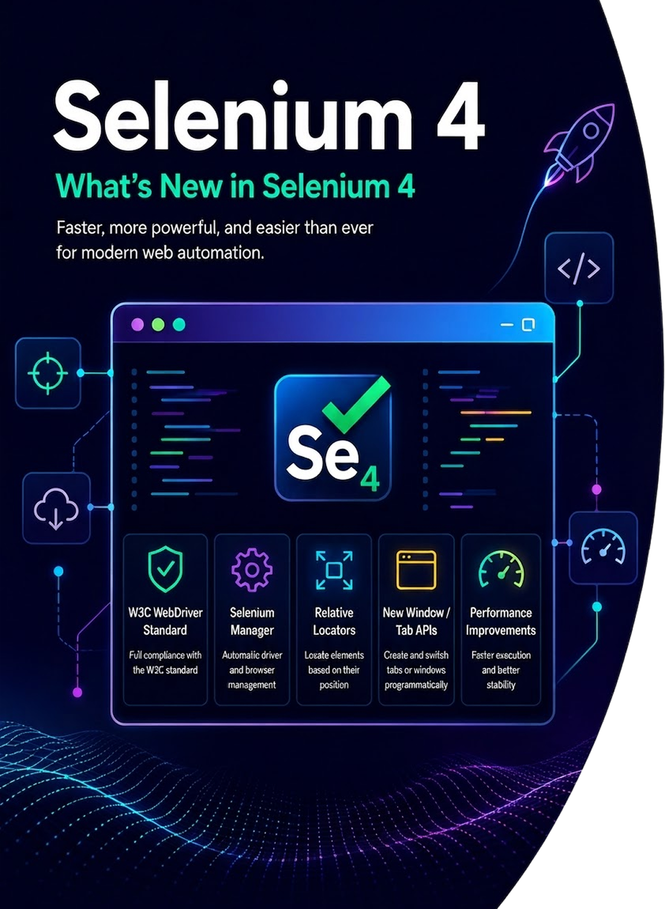

Selenium 4 Modernisation
What's New in Selenium 4
Full W3C Standard
All communication is now pure W3C WebDriver — no legacy JSON Wire Protocol. Better cross-browser consistency.
Selenium Manager
Zero-config driver management. Bundled with Selenium; automatically locates and downloads the right driver binary.
Relative Locators
Find elements relative to others: above(), below(), near(), to_left_of(), to_right_of().
New Window / Tab APIs
driver.switch_to.new_window('tab') and 'window' — clean programmatic control without JS hacks.
Source: selenium.dev/documentation/about/platforms/webdriver/ · selenium.dev/blog/2021/selenium-4-released/

Slide 9

Design Pattern & Frameworks
Page Object Model
# page_objects/login_page.py
from selenium.webdriver.common.by import By
class LoginPage:
def __init__(self, driver):
self.driver = driver
self._username = (By.ID, "username")
self._password = (By.ID, "password")
self._login_btn = (By.CSS_SELECTOR, "button[type='submit']")
def login(self, user, pwd):
self.driver.find_element(*self._username).send_keys(user)
self.driver.find_element(*self._password).send_keys(pwd)
self.driver.find_element(*self._login_btn).click()
# test_login.py
def test_valid_login(driver):
page = LoginPage(driver)
page.login("admin", "secret")
assert "Dashboard" in driver.title # assertion in test
The Problem Without POM
When locators are scattered across dozens of test files, a single UI change breaks every file. Maintenance becomes unmanageable.
POM Solution
Encapsulate page structure and actions in a dedicated class. Tests call page methods — they never know the raw locator. Assertions live in tests, not page objects.
POM is an architecture pattern, not a Selenium feature. Apply it in any language/framework.
Common test frameworks that complement Selenium: pytest (Python), JUnit / TestNG (Java), Mocha (JavaScript).

Slide 10
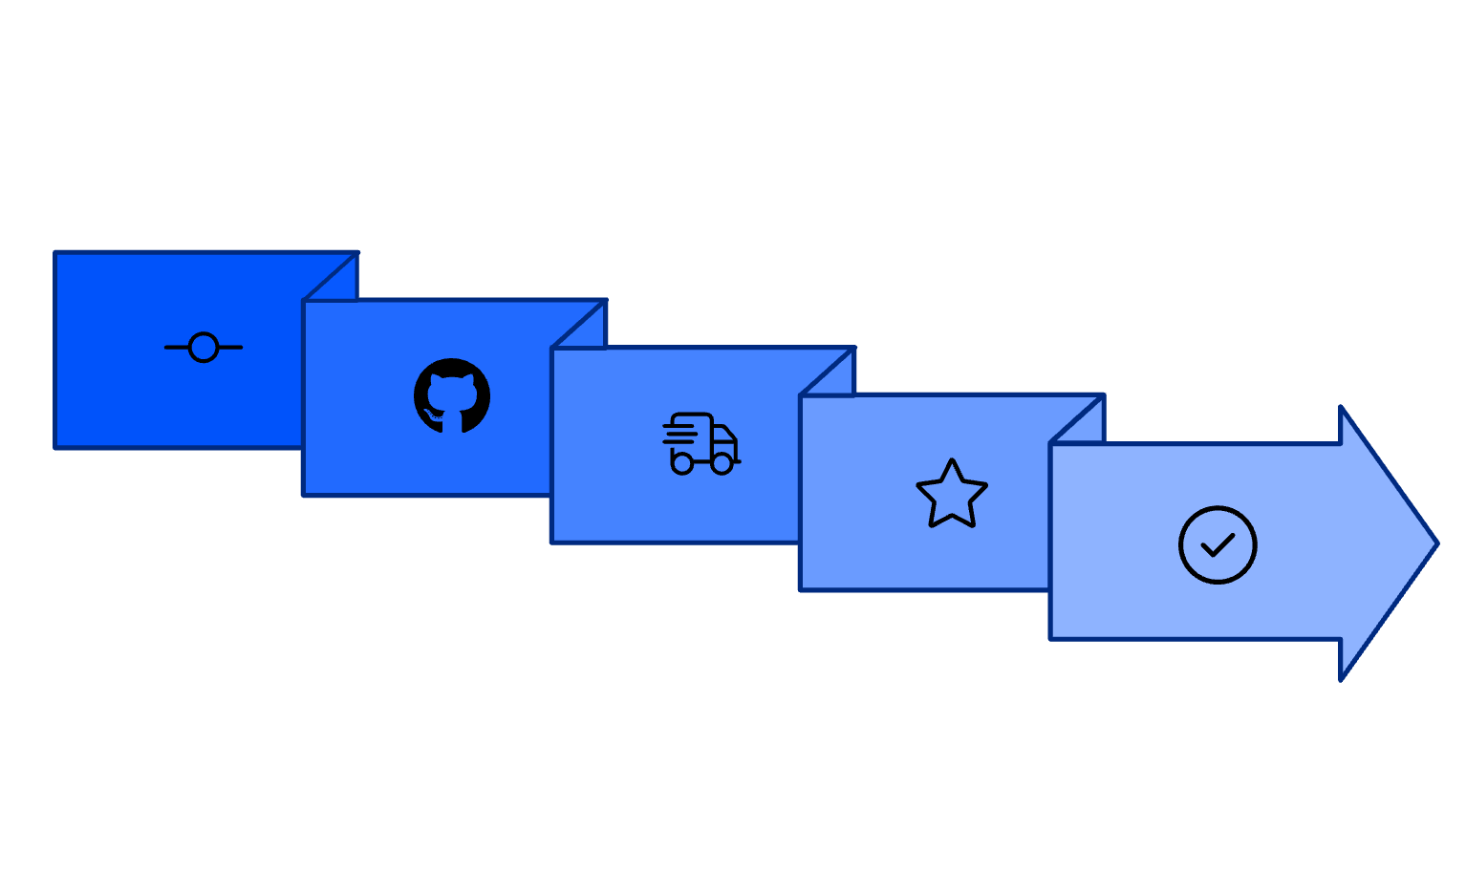
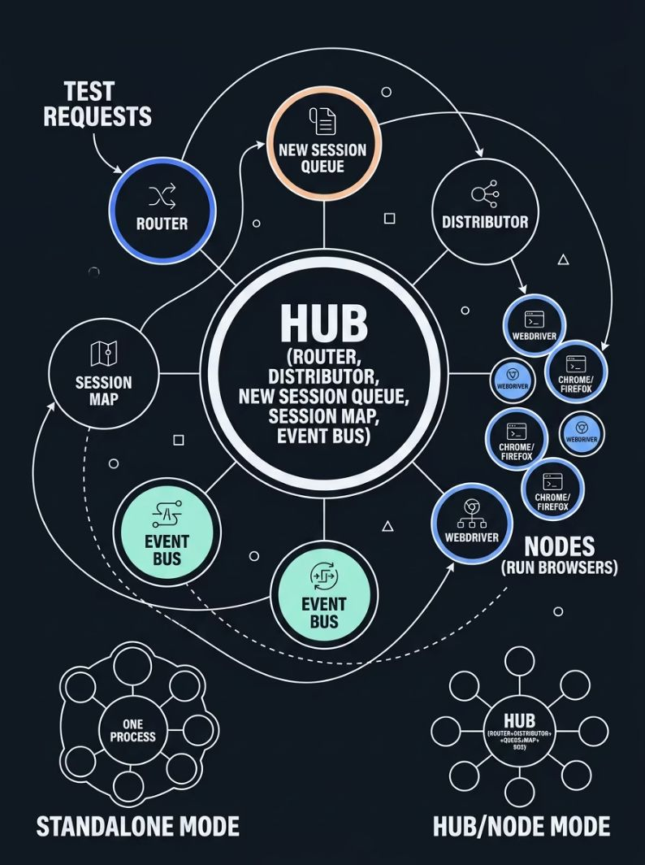
Infrastructure & DevOps
Selenium Grid 4 & CI/CD Integration
CI/CD Pipeline Flow
Grid 4 Architecture
Code Push
Build & Deploy
Pass/Fail Gate
CI Runner
UI Tests
Selenium vs JMeter
Selenium
JMeter
UI / browser behaviour validation
Performance & load testing
Real browser rendering
Protocol-level HTTP simulation
Functional correctness
Throughput, latency, scalability

