Slide 1
AiD-LExys
AN ANDROID APP TO AID DYSLEXIC KIDS

Slide 2

PROBLEM STATEMENT

Slide 3
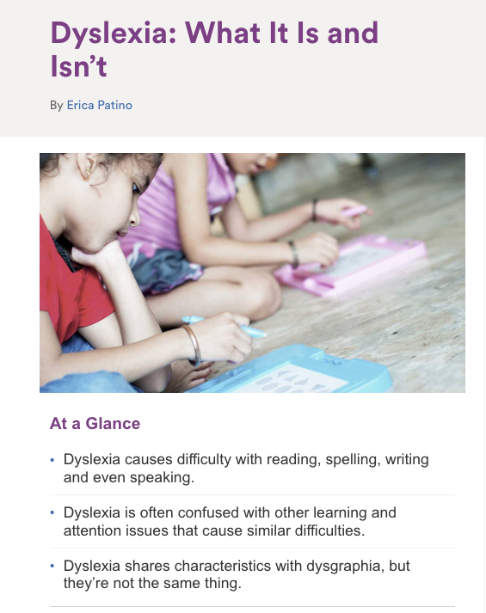

Slide 4


Slide 5


Slide 6
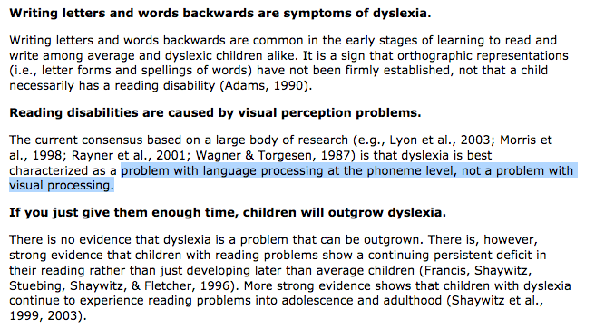

Slide 7


Slide 8
