Slide 1
Artificial Intelligence
The theory and development of computer systems able to perform tasks normally requiring human intelligence, such as visual perception, speech recognition, decision-making, and translation between languages.

Slide 2
Agenda
Introduction
Merits of Artificial Intelligence
Demerits of Artificial Intelligence
Innovations through Artificial Intelligence
Conclusion

Slide 3
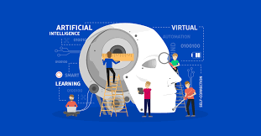
Introduction

Slide 4
What Is Artificial Intelligence?
Artificial intelligence is computer science technology that emphasizes creating intelligent machine that can mimic human behavior
Examples that describe it better:
Using computers to solve problems
Make automated designs for cars
For making smart assistants

Slide 5
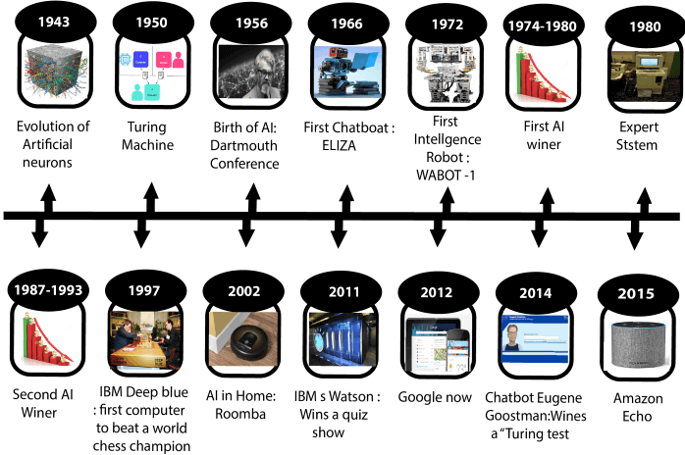
History of AI
The birth of Artificial Intelligence (1952-1956)
Year 1955: An Allen Newell and Herbert A. Simon created the "first artificial intelligence program" Which was named as "Logic Theorist". This program had proved 38 of 52 Mathematics theorems, and find new and more elegant proofs for some theorems.
Year 1956: The word "Artificial Intelligence" first adopted by American Computer scientist John McCarthy at the Dartmouth Conference. For the first time, AI coined as an academic field.
At that time high-level computer languages such as FORTRAN, LISP, or COBOL were invented. And the enthusiasm for AI was very high at that time.

Slide 6
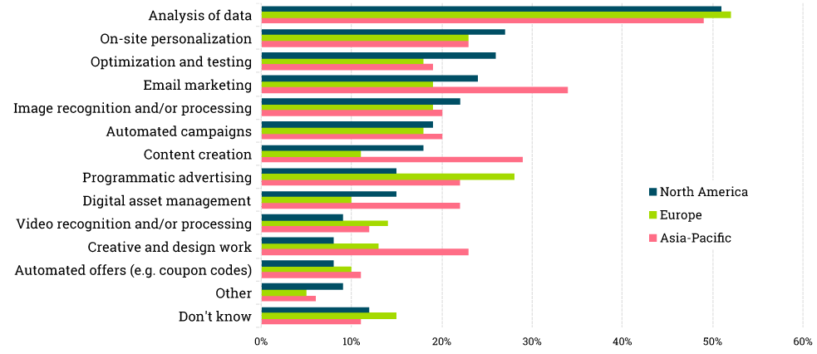
How Companies are currently using AI

Slide 7
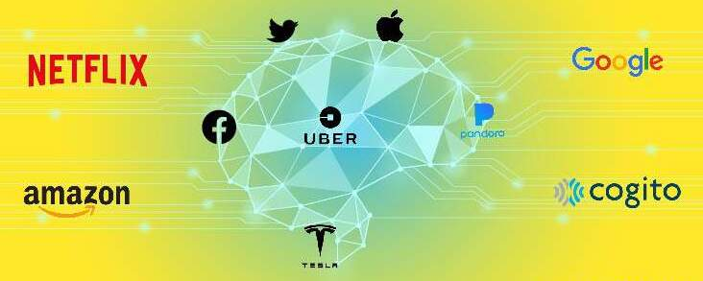
Companies using AI

Slide 8
Merits of Artificial Intelligence

Slide 9
Reduction of Human Error
The phrase “human error” was born because humans make mistakes from time to time.
Computers, however, do not make these mistakes if they are programmed properly. With Artificial intelligence, the decisions are taken from the previously gathered information applying a certain set of algorithms. So errors are reduced and the chance of reaching accuracy with a greater degree of precision is a possibility.
Example: In Weather Forecasting using AI they have reduced the majority of human error.

Slide 10
Takes risks instead of Humans
This is one of the biggest advantages of Artificial intelligence. We can overcome many risky limitations of humans by developing an AI Robot which in turn can do the risky things for us. Let it be going to mars, defuse a bomb, explore the deepest parts of oceans, mining for coal and oil, it can be used effectively in any kind of natural or man-made disasters.
Example: Have you heard about the Chernobyl nuclear power plant explosion in Ukraine? At that time there were no AI-powered robots that can help us to minimize the effect of radiation by controlling the fire in early stages, as any human went close to the core was dead in a matter of minutes. They eventually poured sand and boron from helicopters from a mere distance.

Slide 11
Available 24x7
An Average human will work for 4–6 hours a day excluding the breaks. Humans are built in such a way to get some time out for refreshing themselves and get ready for a new day of work and they even have weekly offed to stay intact with their work-life and personal life. But using AI we can make machines work 24x7 without any breaks and they don’t even get bored, unlike humans.
Example: Educational Institutes and Helpline centers are getting many queries and issues which can be handled effectively using AI.

Slide 12
Helping in Repetitive Jobs
In our day-to-day work, we will be performing many repetitive works like sending a thanking mail, verifying certain documents for errors and many more things. Using artificial intelligence we can productively automate these mundane tasks and can even remove “boring” tasks for humans and free them up to be increasingly creative.
Example: In banks, we often see many verifications of documents to get a loan which is a repetitive task for the owner of the bank. Using AI Cognitive Automation the owner can speed up the process of verifying the documents by which both the customers and the owner will be benefited.

Slide 13
Daily Applications
Daily applications such as Apple’s Siri, Window’s Cortana, Google’s OK Google are frequently used in our daily routine whether it is for searching a location, taking a selfie, making a phone call, replying to a mail and many more.
Example: Around 20 years ago, when we are planning to go somewhere we used to ask a person who already went there for the directions. But now all we have to do is say “OK Google where is Visakhapatnam”. It will show you Visakhapatnam’s location on google map and the best path between you and Visakhapatnam.

Slide 14
Demerits of Artificial Intelligence

Slide 15
High Costs of Creation
As AI is updating every day the hardware and software need to get updated with time to meet the latest requirements. Machines need repairing and maintenance which need plenty of costs. It’ s creation requires huge costs as they are very complex machines.

Slide 16
Making Humans Lazy
AI is making humans lazy with its applications automating the majority of the work. Humans tend to get addicted to these inventions which can cause a problem to future generations.

Slide 17
Unemployment
As AI is replacing the majority of the repetitive tasks and other works with robots, human interference is becoming less which will cause a major problem in the employment standards. Every organization is looking to replace the minimum qualified individuals with AI robots which can do similar work with more efficiency.

Slide 18
No Emotions
There is no doubt that machines are much better when it comes to working efficiently but they cannot replace the human connection that makes the team. Machines cannot develop a bond with humans which is an essential attribute when comes to Team Management.

Slide 19
Lacking Out of Box Thinking
Machines can perform only those tasks which they are designed or programmed to do, anything out of that they tend to crash or give irrelevant outputs which could be a major backdrop.

Slide 20
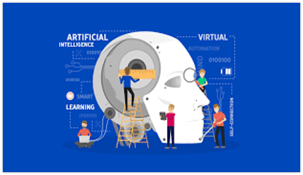
Innovations through Artificial Intelligence

Slide 21
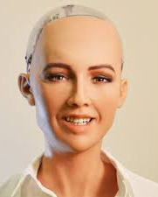
Sofia – The Robot
Sophia was first activated on February 14, 2016. The robot, modeled after the ancient Egyptian Queen Nefertiti, Audrey Hepburn, and her inventor's wife, Amanda Hanson, is known for human-like appearance and behavior compared to previous robotic variants. As of 2018, Sophia's architecture includes scripting software, a chat system, and OpenCog, an AI system designed for general reasoning. Sophia imitates human gestures and facial expressions and is able to answer certain questions and to make simple conversations on predefined topics (e.g. on the weather). Sophia uses speech recognition technology from Alphabet Inc. (parent company of Google) and is "designed to get smarter over time". Her speech synthesis ability is provided by Cereproc's Text-to-Speech engine and also allows her to sing. Sophia's intelligence software is designed by Hanson Robotics. The AI program analyses conversations and extracts data that allows it to improve responses in the future.

Slide 22
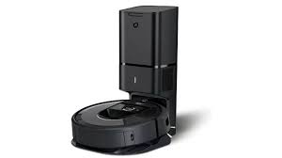
iRobot Roomba
IRobot Roomba is a cleaning robot embedded with a speech recognition AI engine to enable tasks such as reporting the current status of the robot through a combination of blinking lights and spoken messages. For example, when a user gives a voice command to the robot to “Clean,” the RX-V100 uses AI speech to reply, “All right,” and “waggles” to acknowledge the command. It then begins cleaning in Automatic Mode. In addition to this, the product comes with a set of predefined messages and responses to simulate simple conversations, such as “Good Morning” or “How’s it going?”

Slide 23

Alexa
Amazon Alexa, also known simply as Alexa, is a virtual assistant AI technology developed by Amazon, first used in the Amazon Echo smart speaker and the Echo Dot, Echo Studio and Amazon Tap speakers developed by Amazon Lab126. It is capable of voice interaction, music playback, making to-do lists, setting alarms, streaming podcasts, playing audiobooks, and providing weather, traffic, sports, and other real-time information, such as news. Alexa can also control several smart devices using itself as a home automation system. Users are able to extend the Alexa capabilities by installing "skills" (additional functionality developed by third-party vendors, in other settings more commonly called apps) such as weather programs and audio features.

Slide 24
Conclusion
These are some advantages and disadvantages of Artificial Intelligence. Every new invention or breakthrough will have both, but we as humans need to take care of that and use the positive sides of the invention to create a better world. Artificial intelligence has massive potential advantages. The key for humans will ensure the “rise of the robots” doesn’t get out of hand. Some people also say that Artificial intelligence can destroy human civilization if it goes into the wrong hands. But still, none of the AI applications made at that scale that can destroy or enslave humanity.

Slide 25

Thank You

